Slide 1

PROPOSED SELECTIONS
SANITARYWARE |
July 02, 2025
PP-YR25-0313
MA Villa - Master Bathroom

Slide 2


Slide 3
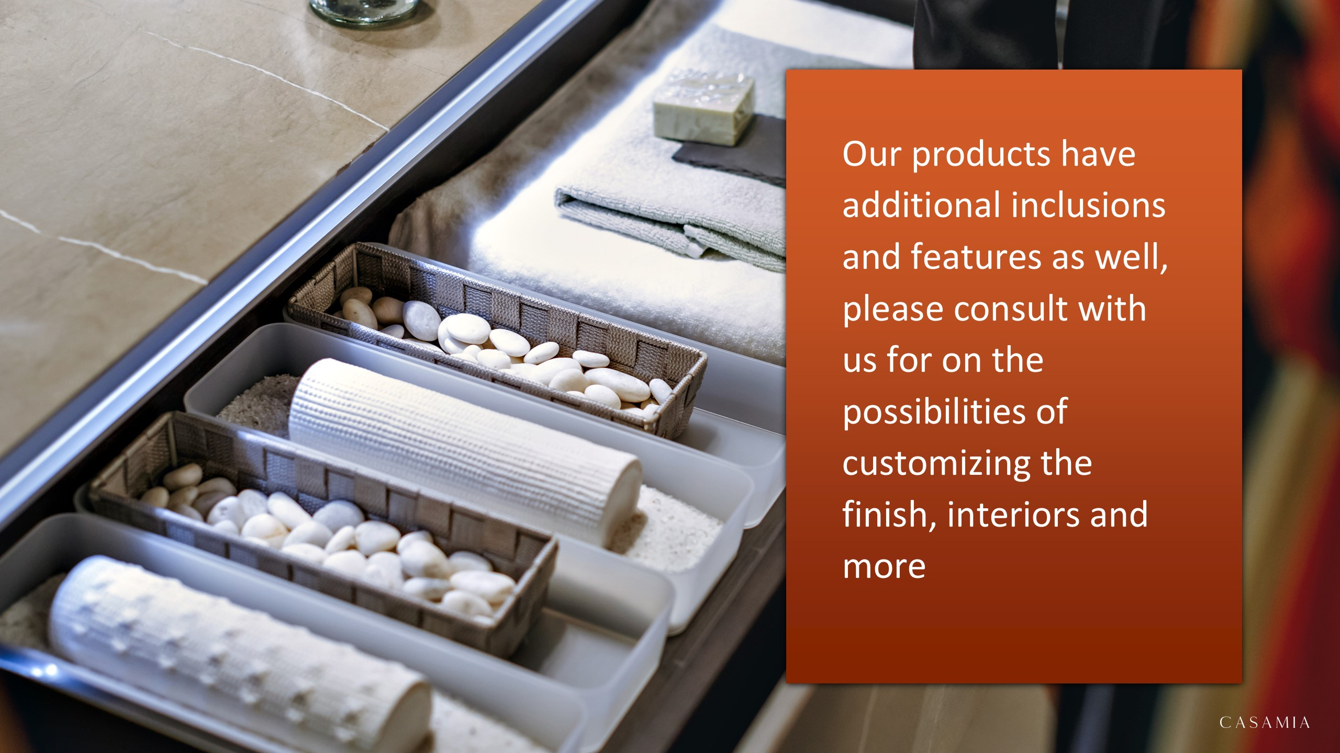

Slide 4

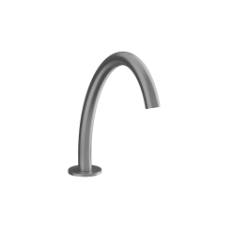
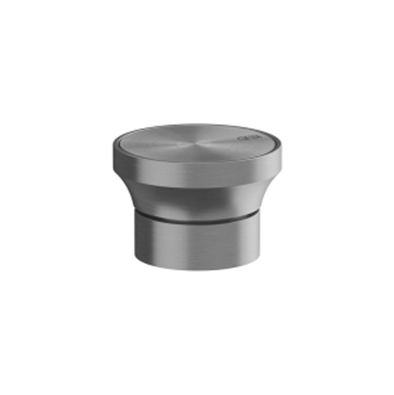
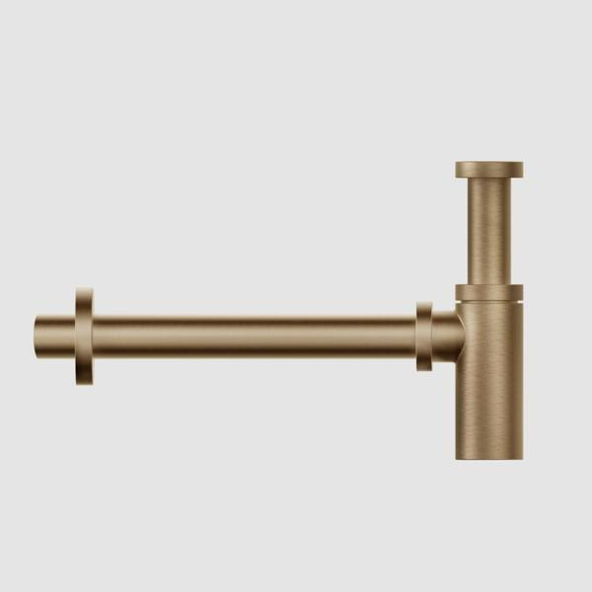
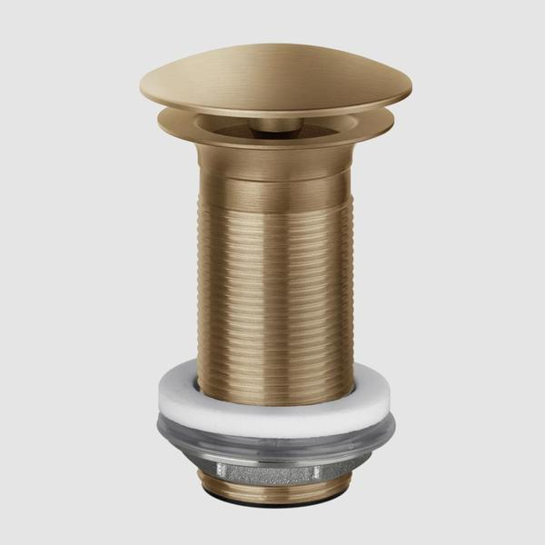
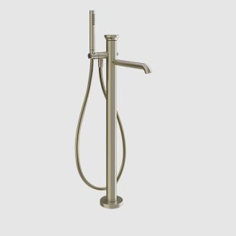
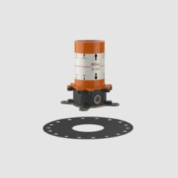
Washbasin & Bathtub
66021726 – Gessi Origini Deck Mounted Basin Spout Warm Bronze Brushed PVD h243mm
66100726 – Gessi Origini Separate control for Spouts. Can be combined with inserts with different finishes: Art. 66600 and Art. 66602. Warm Bronze Brushed PVD
01377726 – Gessi Round Siphon/Bottle Trap Warm Bronze Brushed PVD 1 1/4"
01391726 – Gessi Always Open Long Pop-up Waste without Overflow Warm Bronze Brushed PVD 1 1/4"
66028726 – Gessi Origini Freestanding Bath Mixer with Handshower, Handshower Holder, Flexible Hose and Spout (Can be combined with Inserts Art. 66600 and Art. 66602, Inserts and Built-in part Art. 46189 to be ordered separately) Warm Bronze Brushed PVD h868-948mm
46189031 – Gessi Conceal for Freestanding Basin/Bath Mixer Chrome
UNA-T/L-WMAT – IWW LSC Una Freestanding Bathtub (formerly Comfort) without Overflow White Matt 1690x840xH540mm

Slide 5
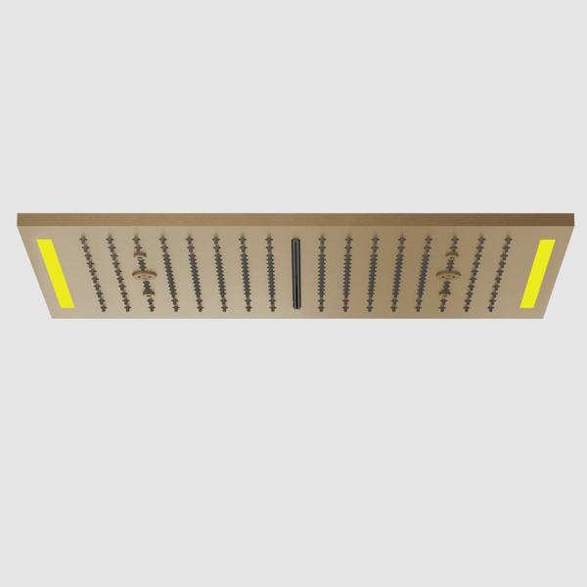
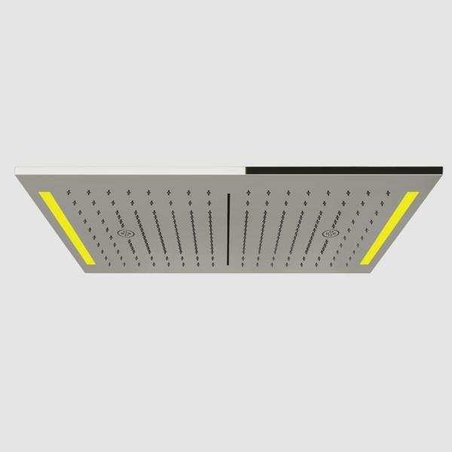
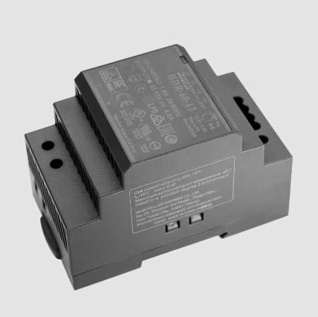
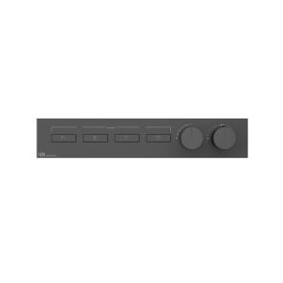
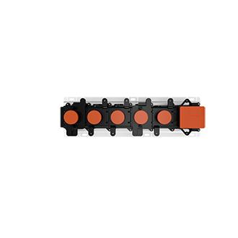
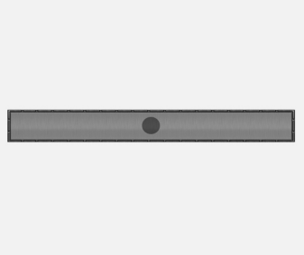

Shower Area
57882726 – Gessi Colour Cover for Ceiling Mounted Multifunction Shower System Art. 57831 (with Lighting System) Warm Bronze Brushed PVD 300x500mm
57831238 – Gessi Colour Ceiling Mounted Multifunction Shower System (Rainfall/Waterfall/Mist/Chromotherapy), with Electronic Parts, Remote Watertight Control and Hook (12V Power Supply and Cover Art. 57882 to be ordered separately) Mirror Steel 300x500mm
01723238 – Gessi Power supply CE 24 Watt DIN Rail. Input voltage 100-240VAC. Output voltage 12VDC Mirror Steel (Old code: RIR5402238)
63016726 – Gessi Hi-fi Linear 4 Exit Thermostatic Diverter with 4 Simultaneous Functions, with Rectangular Cover Plate, Push Button, ON/OFF Control (Exposed part only, built-in part Art. 63015 to be ordered separately) Warm Bronze Brushed PVD
63015031 – Gessi Conceal for 4 Exit Thermostatic Diverter Chrome
E60-304-NAT – IWW Plumbing E60 Linear Tile-in Shower Drain Stainless Steel Natural
63199726 – Gessi Hi-fi Linear Magnetic Handshower Set with Water Outlet, Antilimestone Handshower and Darkflex Flexible Hose Warm Bronze Brushed PVD (Customised)

Slide 6
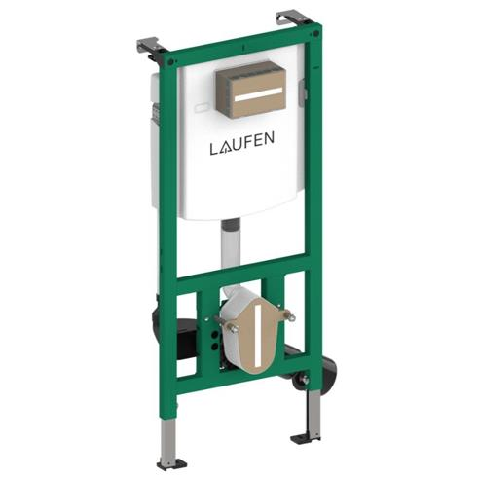
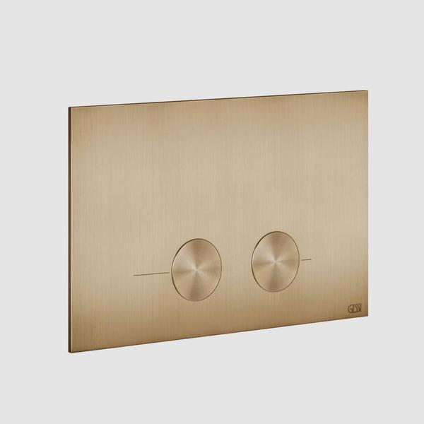
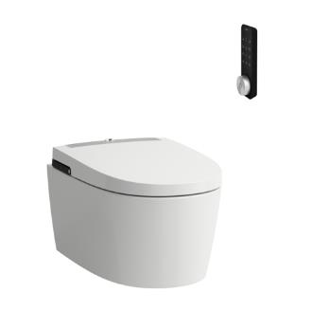
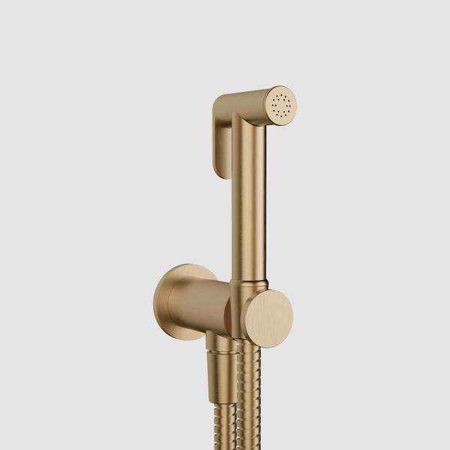

WC Area
H9201100000001 – Laufen Ineolink Concealed Cistern for Wall Hung WC and Shower WC 500x135x1120mm
54611726 – Gessi Dual Flush Plate for Geberit Sigma 8 & 12 Warm Bronze Brushed PVD 243xh155mm
H8211604000001 – Laufen Cleanet Alvia Wall Hung Rimless WC, Washdown, Silent Flush, with Seat Cover with Automatic opening and Lowering System, with Heated Seat, with Remote Control, Wi-fi, Dryer, UV Disinfection and ambient light, with plug for EU White Laufen Clean Coat 600x410x485mm
14331726 – Gessi Trasparenze Shut-off Set with Wall Mounted Handshower Holder with Water Outlet and Flexible Hose Warm Bronze Brushed PVD (Customised)
E13-304-NAT – IWW Plumbing E13 Square Tile-in Shower Drain (2-inch outlet) Natural 133x133mm

Slide 7


