Slide 1

PROPOSED SELECTIONS
SANITARYWARE |
July 02, 2025
PP-YR25-0315
sdfasdfasdf

Slide 2
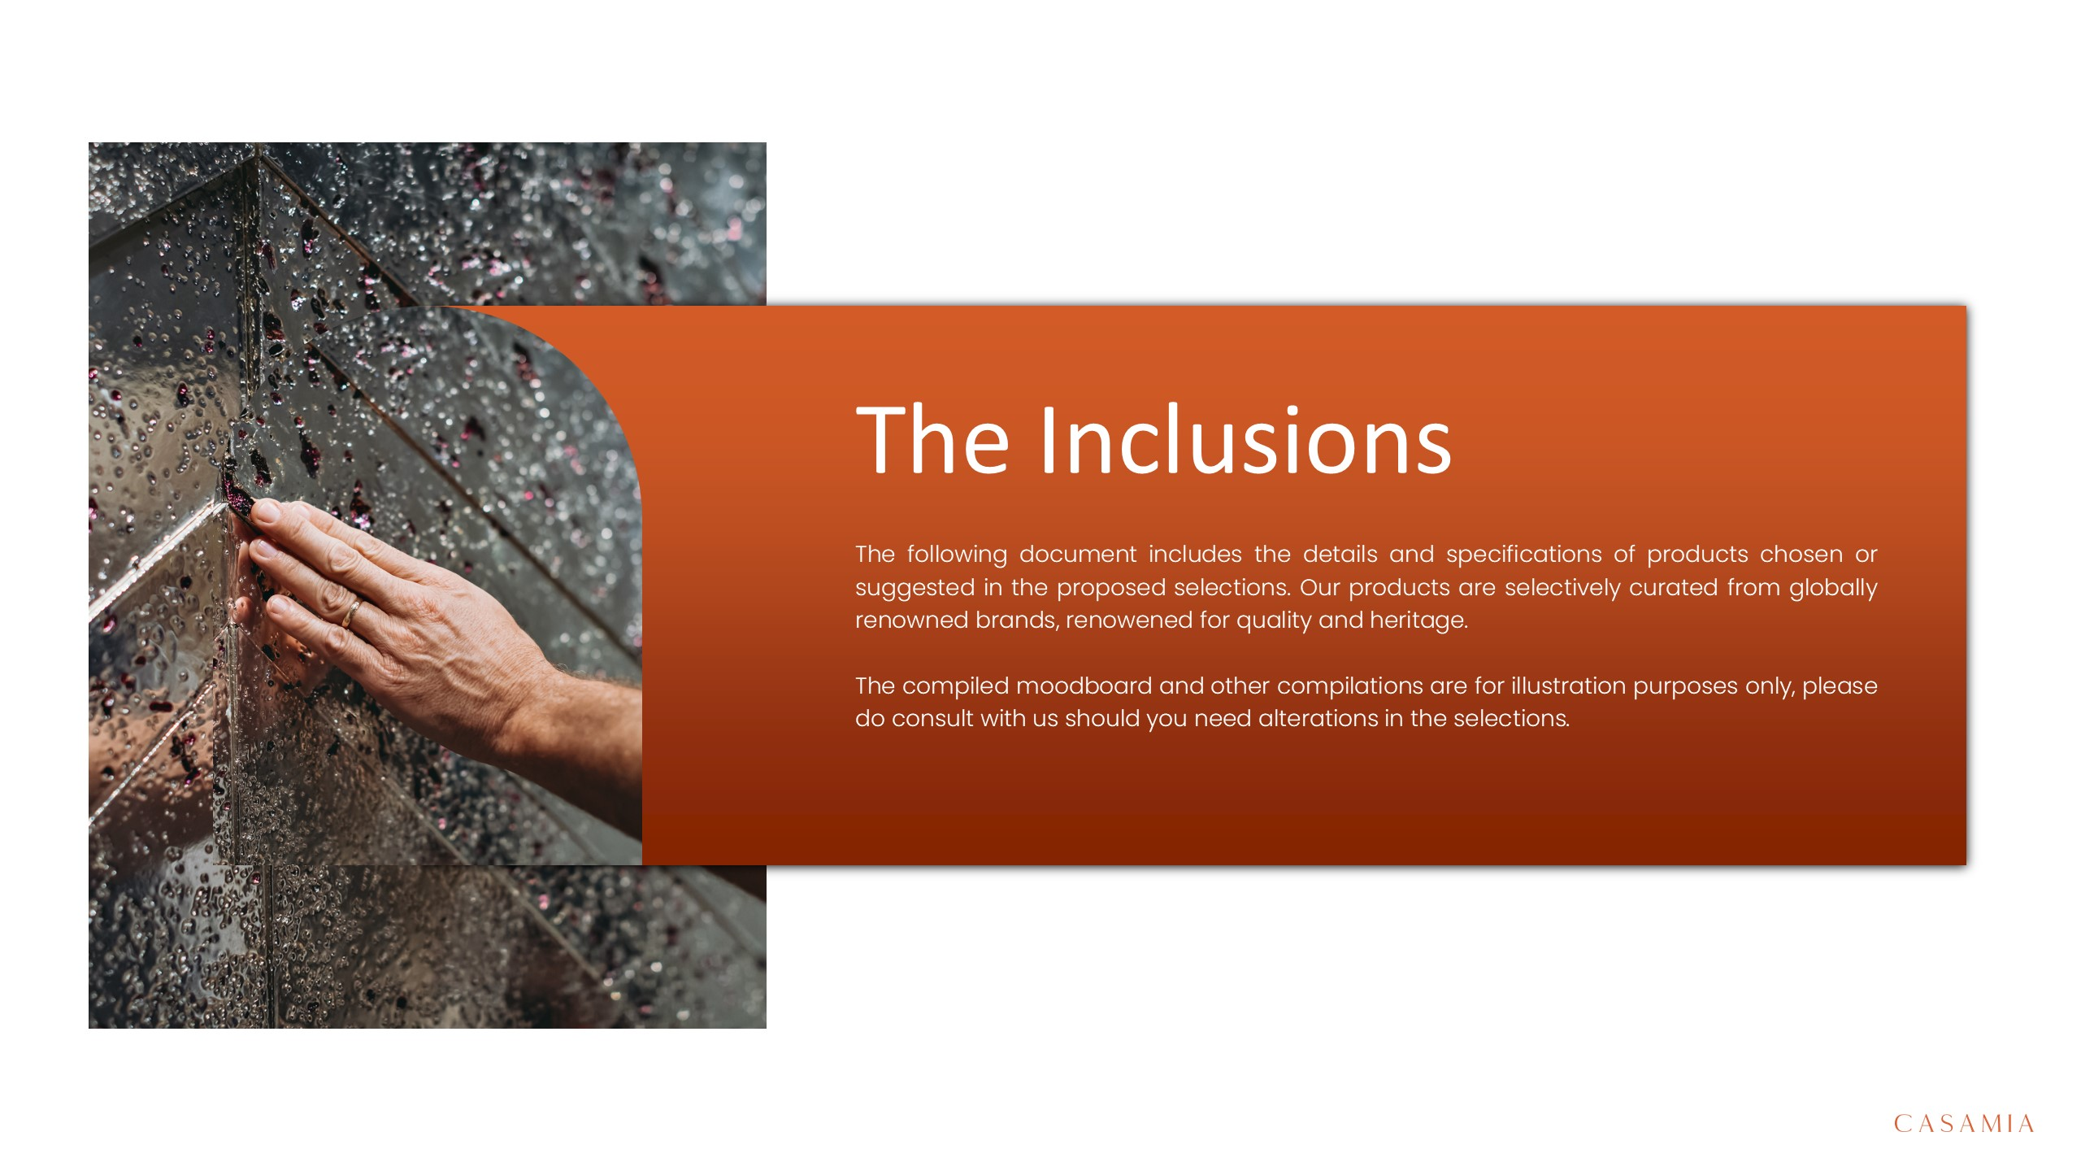

Slide 3
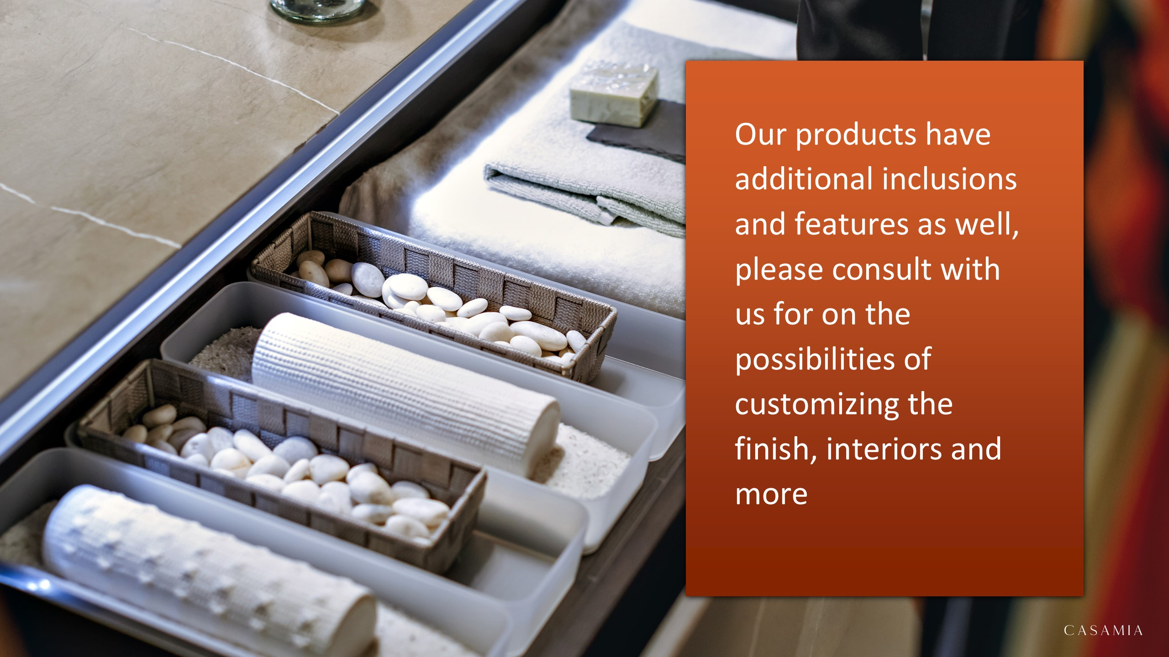

Slide 4

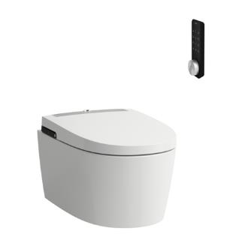
asdfasdfsadf
H8211604000001 – Laufen Cleanet Alvia Wall Hung Rimless WC, Washdown, Silent Flush, with Seat Cover with Automatic opening and Lowering System, with Heated Seat, with Remote Control, Wi-fi, Dryer, UV Disinfection and ambient light, with plug for EU White Laufen Clean Coat 600x410x485mm
H8211604000001 – Laufen Cleanet Alvia Wall Hung Rimless WC, Washdown, Silent Flush, with Seat Cover with Automatic opening and Lowering System, with Heated Seat, with Remote Control, Wi-fi, Dryer, UV Disinfection and ambient light, with plug for EU White Laufen Clean Coat 600x410x485mm
H8211604000001 – Laufen Cleanet Alvia Wall Hung Rimless WC, Washdown, Silent Flush, with Seat Cover with Automatic opening and Lowering System, with Heated Seat, with Remote Control, Wi-fi, Dryer, UV Disinfection and ambient light, with plug for EU White Laufen Clean Coat 600x410x485mm
H8211604000001 – Laufen Cleanet Alvia Wall Hung Rimless WC, Washdown, Silent Flush, with Seat Cover with Automatic opening and Lowering System, with Heated Seat, with Remote Control, Wi-fi, Dryer, UV Disinfection and ambient light, with plug for EU White Laufen Clean Coat 600x410x485mm
H8211604000001 – Laufen Cleanet Alvia Wall Hung Rimless WC, Washdown, Silent Flush, with Seat Cover with Automatic opening and Lowering System, with Heated Seat, with Remote Control, Wi-fi, Dryer, UV Disinfection and ambient light, with plug for EU White Laufen Clean Coat 600x410x485mm
H8211604000001 – Laufen Cleanet Alvia Wall Hung Rimless WC, Washdown, Silent Flush, with Seat Cover with Automatic opening and Lowering System, with Heated Seat, with Remote Control, Wi-fi, Dryer, UV Disinfection and ambient light, with plug for EU White Laufen Clean Coat 600x410x485mm
H8211604000001 – Laufen Cleanet Alvia Wall Hung Rimless WC, Washdown, Silent Flush, with Seat Cover with Automatic opening and Lowering System, with Heated Seat, with Remote Control, Wi-fi, Dryer, UV Disinfection and ambient light, with plug for EU White Laufen Clean Coat 600x410x485mm

Slide 5
