Slide 1
Project Perfume
Chris Chen, Peter Liu, Yueqi Xu

Slide 2
Research Questions
Does the prestige of the brands contribute to the most of the perfume’s retail price?
Does the customer rating, seller, and seller rating contribute to the perfume’s retail price?
Does the perfume's department (female, male, or unisex), scents (woody, floral, fruity, etc.), and notes potentially leads to difference in retail prices?
Notes:
With an overwhelming amount of perfumes in the markets, it is often hard for consumers to identify the perfume that best fits their demands. Moreover, given the perfumes’ high retail prices, a false purchase can lead to great loss of money. In this project, we are interested in exploring some possible factors that affect the price of perfume, which lead to our three research questions.

Slide 3
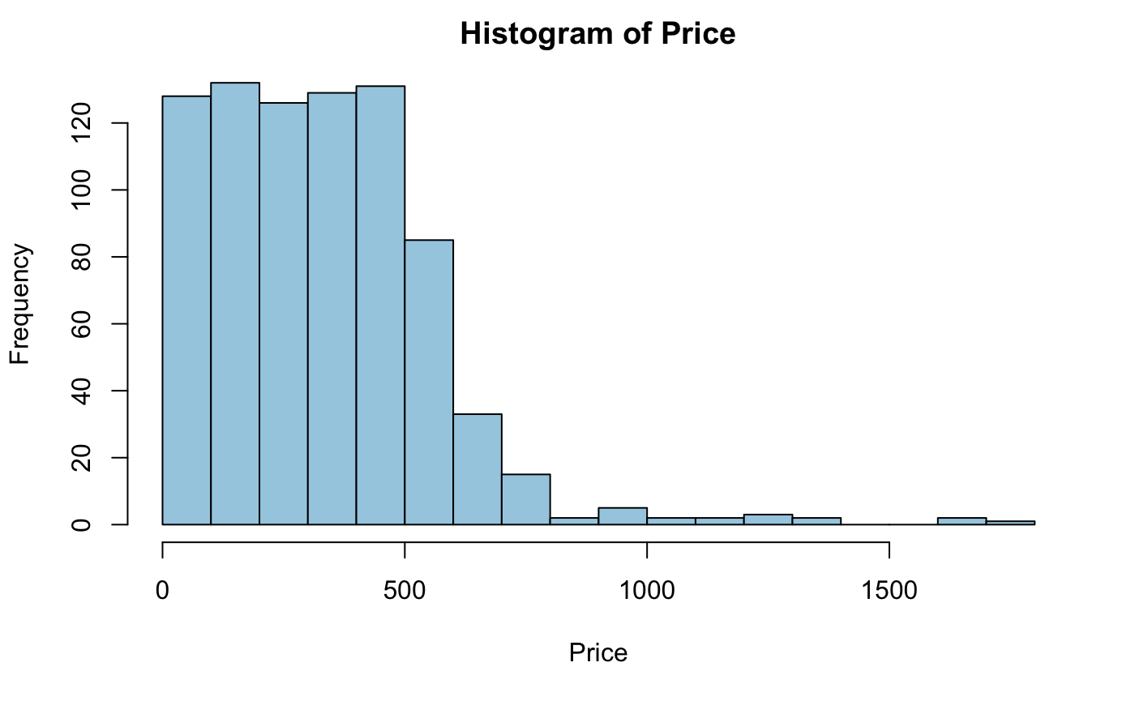
Response and Predictors
Response
Price
Predictors
Brand
Volume
Concentration
Department
Scent
Base note
Middle note
Item rating
Seller
Seller rating
# of seller rating
Notes:
We take price as the response variable, and consider all other variables as the potential predictors, except for perfume ID and perfume name. Here’s the distribution of the price before we do any data cleaning. We will talk about how we deal with the outliers later in the data modeling section.

Slide 4
Data cleaning: Remove Nonsense
The data contains no NA, which is good!
Lots of typos
Characters in other languages (Arabian, Latin, etc.)
Nonsense induced by web page crawling. For instance, considering Yves Saint Laurent (A famous cosmetic brand, often abbreviated into YSL) into three different brands.
889 observations after removing nonsenses
Notes:
Now is the data cleaning part. There’s no missings in our data set, which is good. But there are lots of typos and special characters. We manually correct the typos, and remove observations with special characters. There are also errors such as different abbreviations for the same brand, which we also fixed manually. After these procedures, there are 889 observations left.

Slide 5
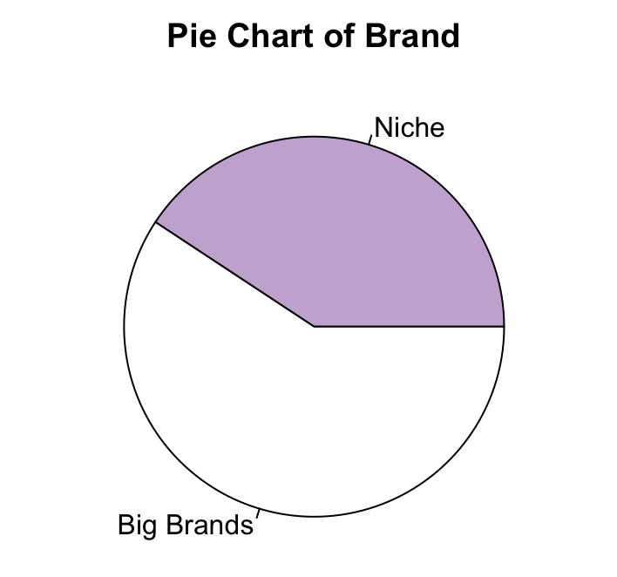
Data Cleaning: Merging Categorical Covariates
Covariate Brand originally contain 148 levels.
We converted it into a categorical variable called big_brand with 2 levels:
1 (Big Brand): brand that contains more than 10 listed individual perfumes;
0 (Niche brand): otherwise.
Notes:
The variable brand originally contains 148 levels. We converted it into a variable with two levels: big brands and niche. Big brands are brands that contains more than 10 perfumes in our dataset, niche are those with 10 or below

Slide 6
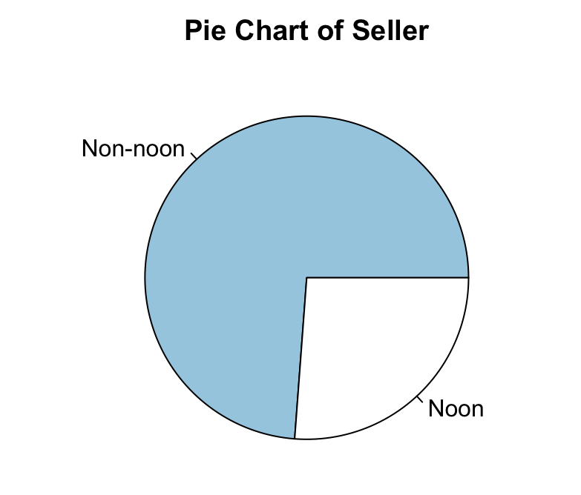
Data Cleaning: Merging Categorical Covariates
Covariate Seller originally contains 115 levels.
We converted it into a categorical variable called is_noon with two levels:
1 (Noon): the perfume is sold by noon official
0 (Non-noon): the perfume is sold by individual sellers
Notes:
Similarly, the variable seller originally contain 115 levels, which we merged to two: Noon or non-noon, where noon is the official seller.

Slide 7
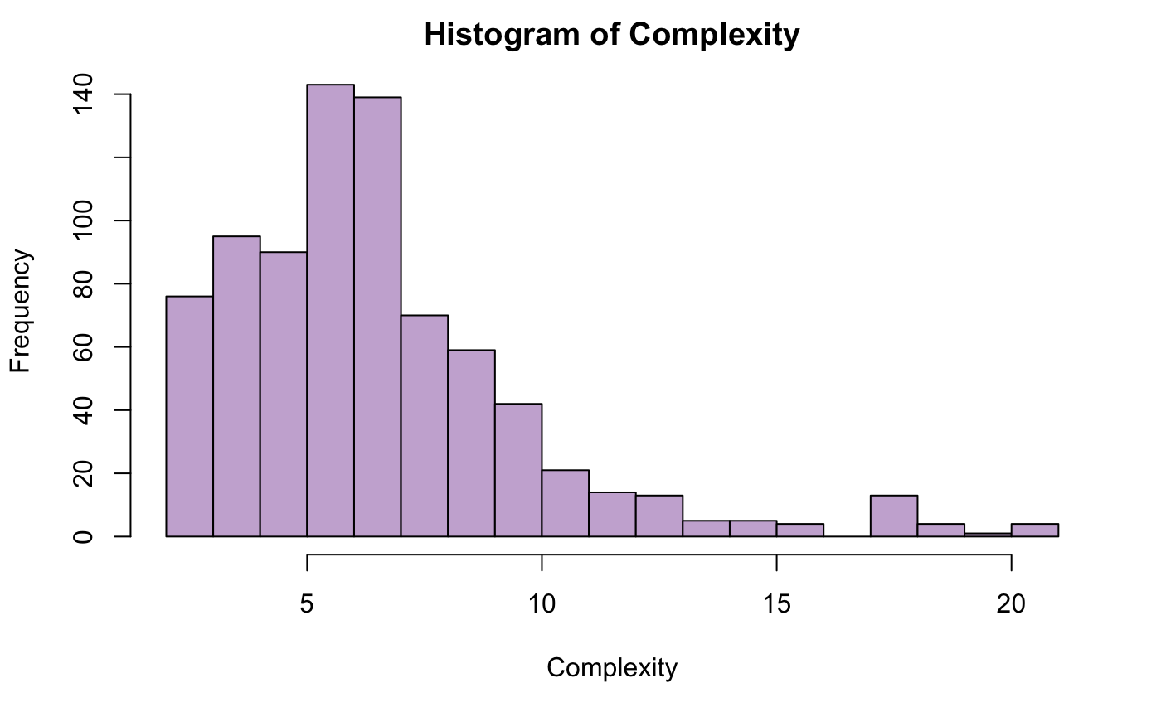
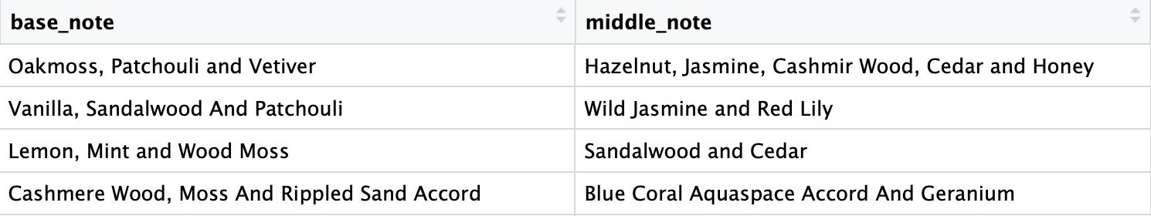
Data Cleaning
Base Notes & Middle Notes: We counted the total number of distinct notes in base notes and middle notes, and stored this information in a new variable called Complexity.
Notes:
There are more than one elements in the variables base notes and middle notes for almost all observations, so we counted the total number of elements, and stored this information in a variable called complexity.

Slide 8
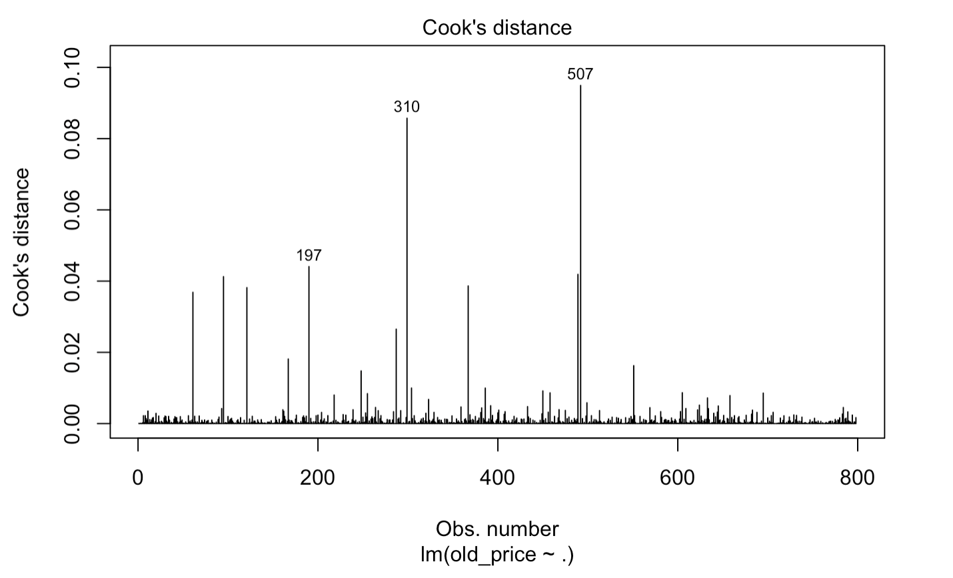
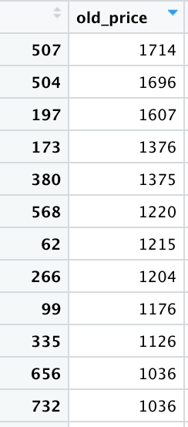
Data Modeling: Outliers
lm(old_price ~ . , data = perfume)

Slide 9
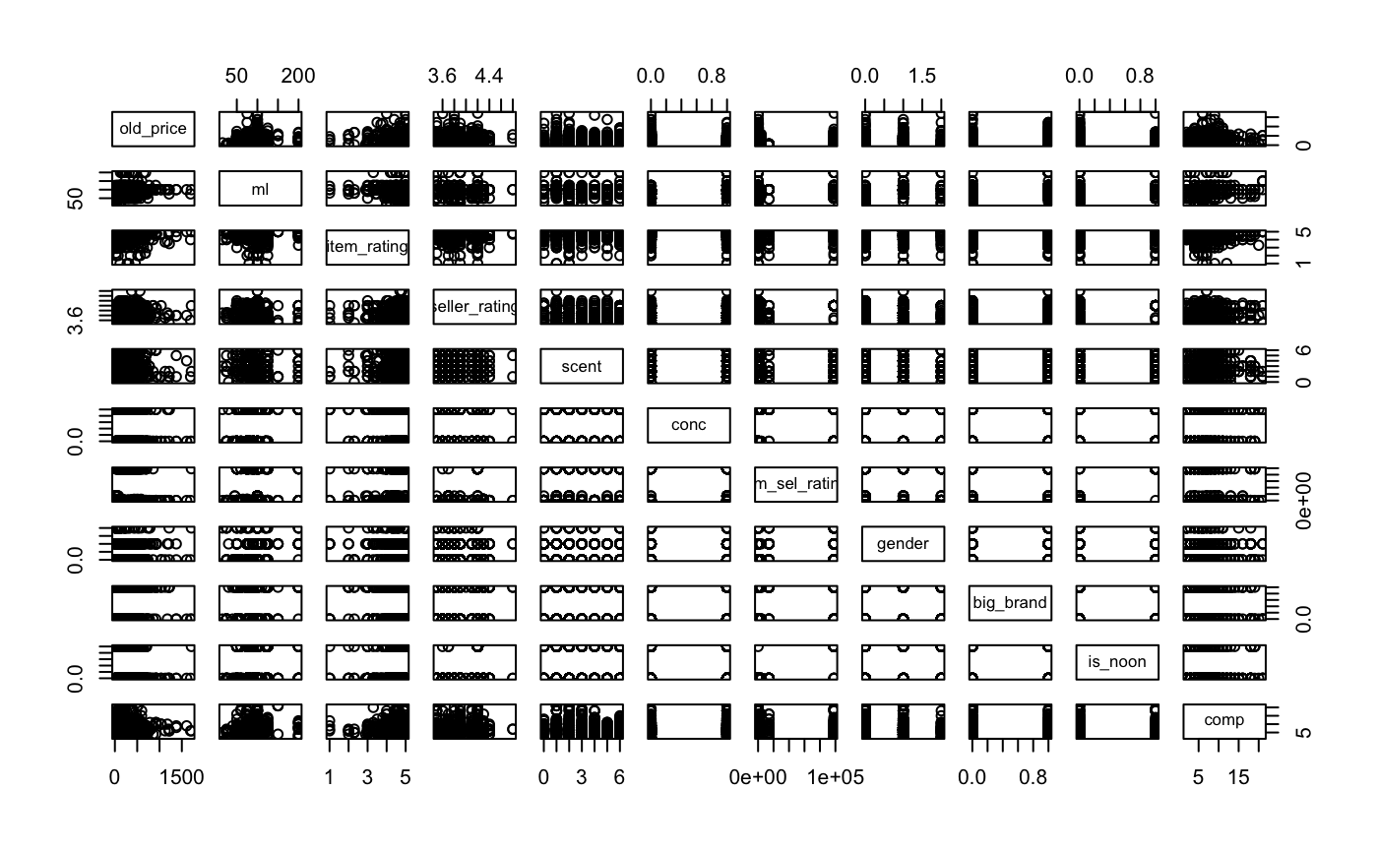
Data Modeling: Interaction

Slide 10
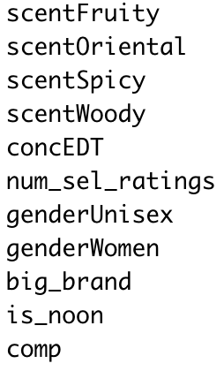
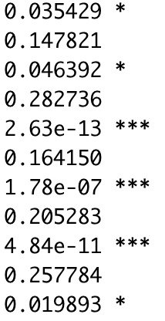
Data Modeling: Interaction

Slide 11
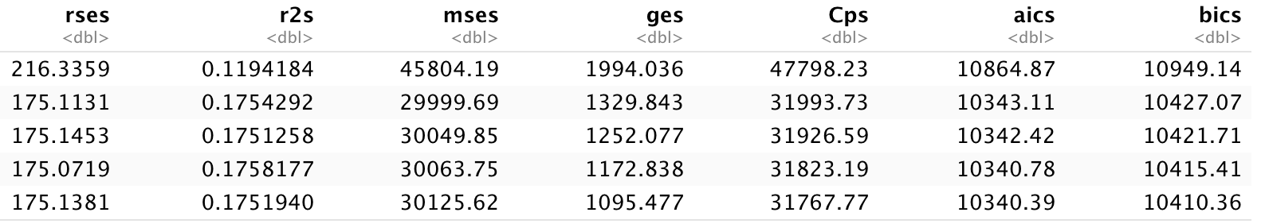
Model Selection: First Round
lm.1 = lm(old_price ~ ., data = perfume_original)
lm.2 = lm(old_price ~ ., data = perfume)
lm.3 = lm(old_price ~ . - is_noon, data = perfume)
lm.4 = lm(old_price ~ . - is_noon - item_rating, data = perfume)
lm.5 = lm(old_price ~ . - is_noon - item_rating - num_sel_ratings, data = perfume)

Slide 12
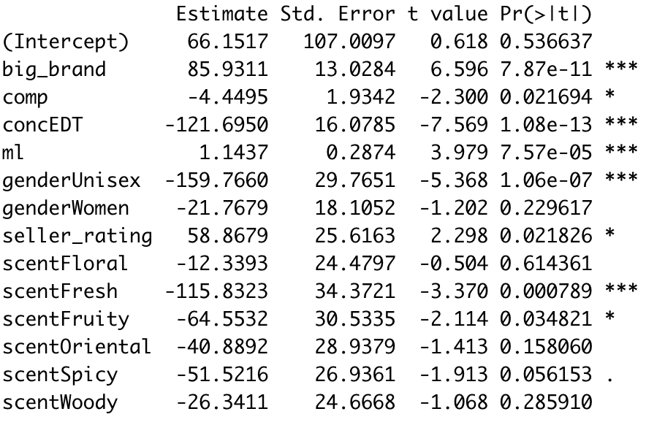
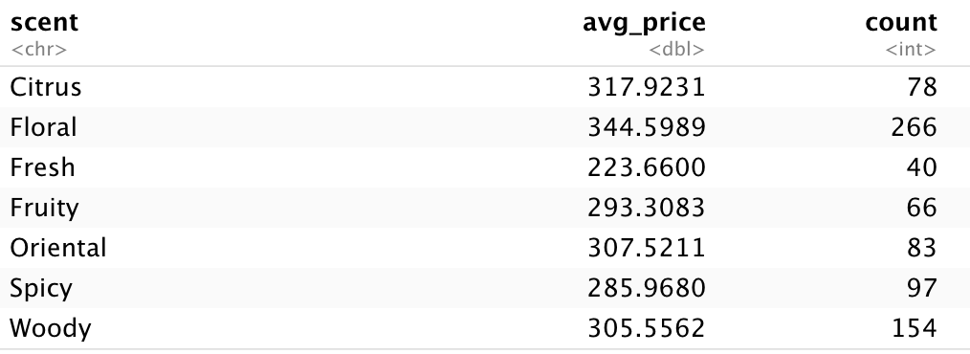
Model Selection: Merging Scent/Gender

Slide 13
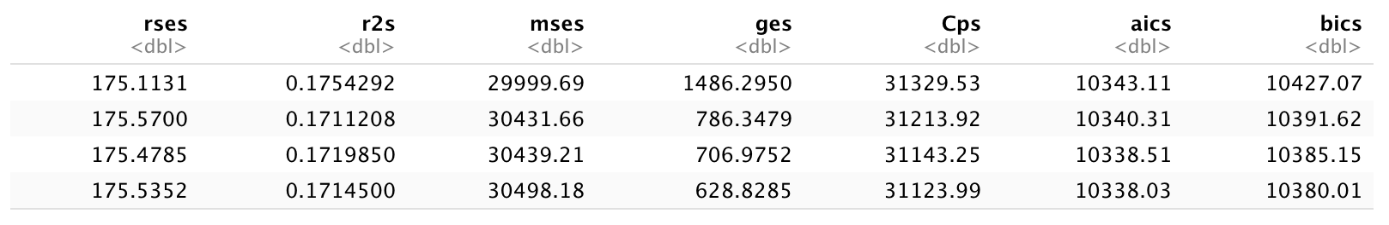
Model Selection: Second Round

Slide 14
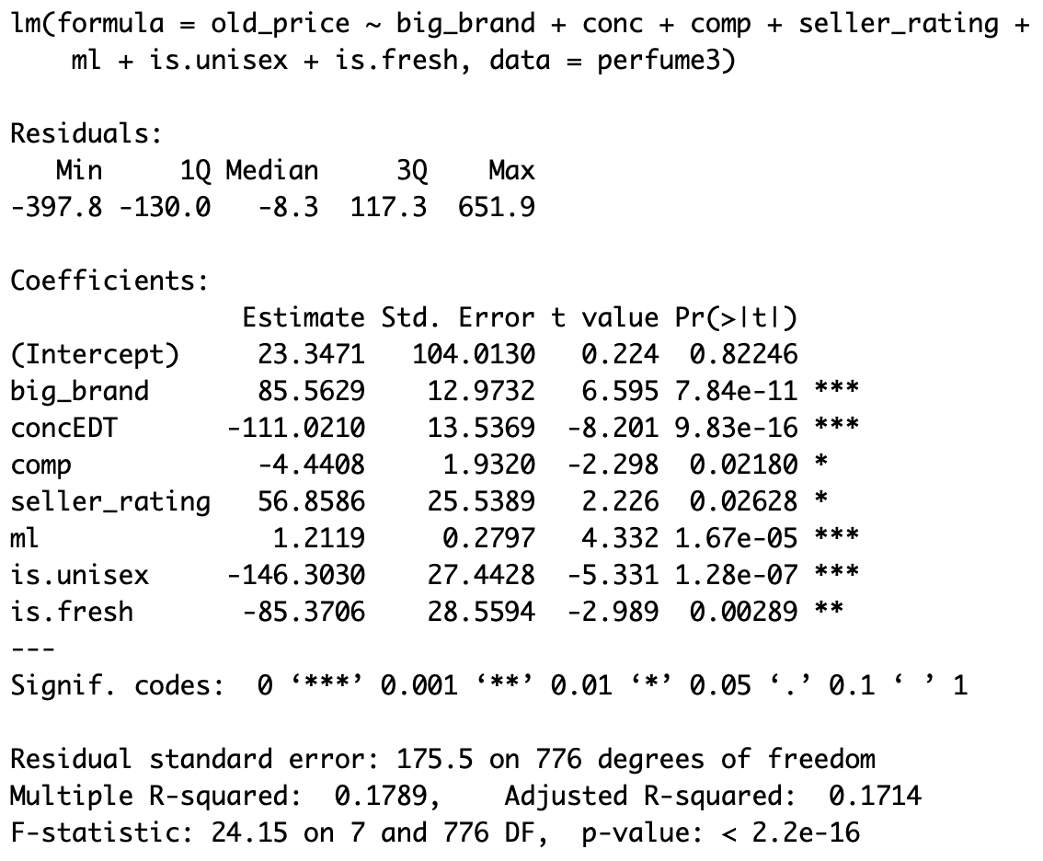
Final Model
Price = 23.34
+ 85.56·big_brand
- 111.02·I(concentration = EDT)
- 4.44·comp
+ 56.85·seller_rating
+ 1.21·volume
- 146.3·I(gender = Unisex)
- 85.37·I(scent = fresh)

Slide 15
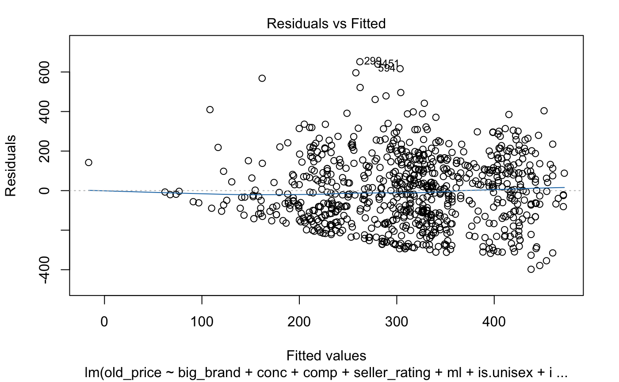
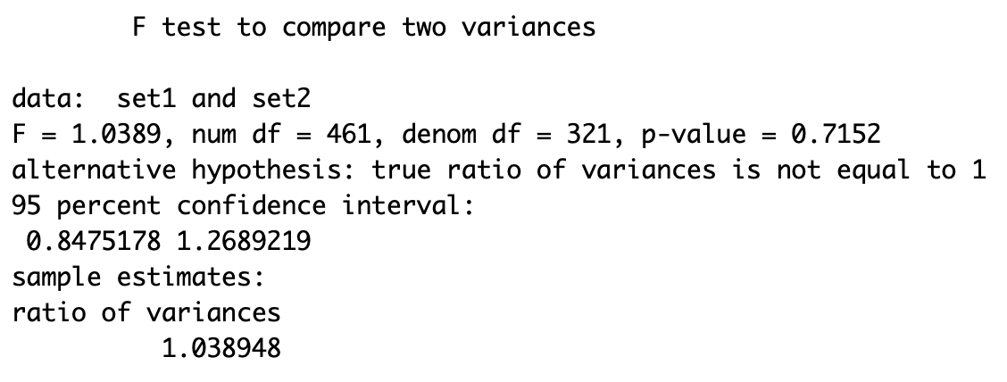
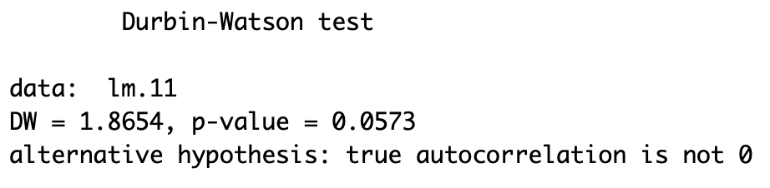
Final Model
Notes:
0 mean

Slide 16
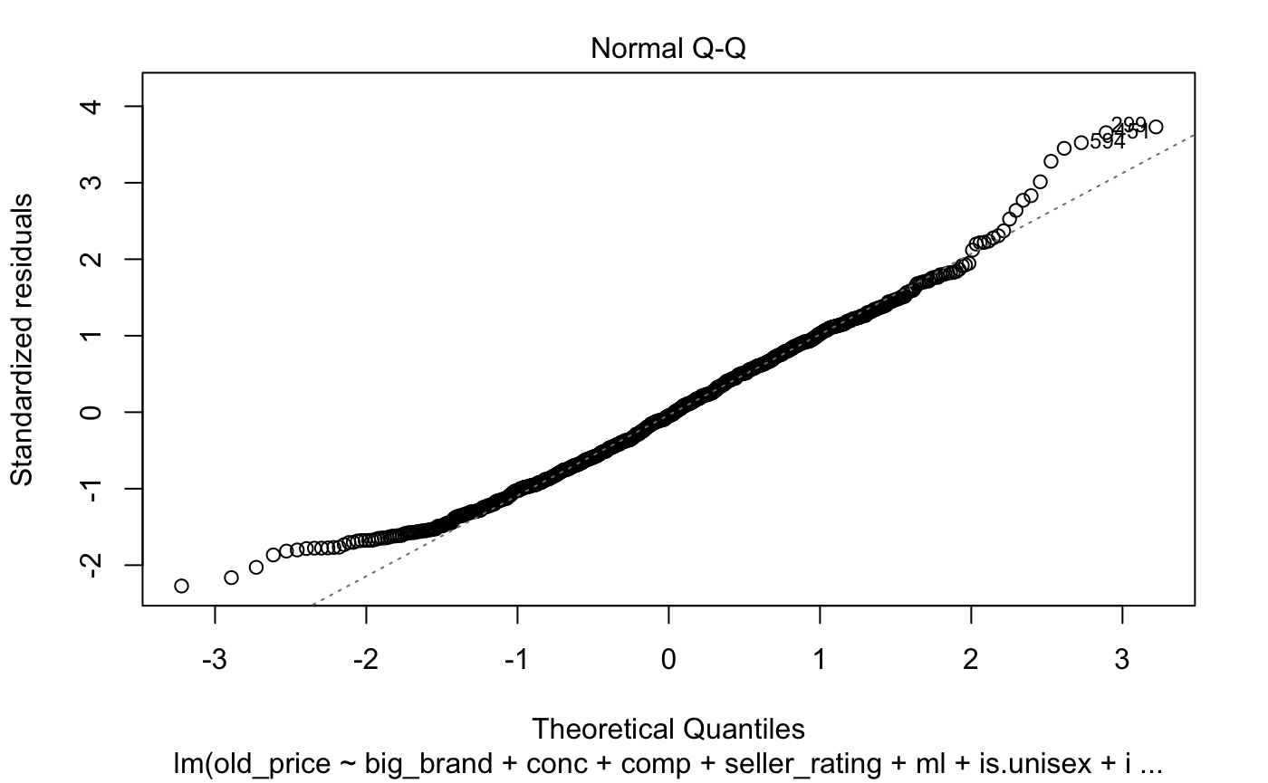
Final Model
Notes:
Approximately normal

Slide 18
Conclusion
The prestige of the brands contribute the most to the perfume’s retail price.
The customer rating and seller do not contribute to the perfume’s retail price. However, seller rating does.
The perfume's department (female/male/unisex), scents (woody/floral/fruity/etc...), and notes leads to difference in retail prices and customer ratings.
Notes:
Expected & significant: brand, dept, scents, notes
Expected & non-sig: customer rating, seller, seller rating

Slide 19
Thanks

