Slide 1

Using Live Feeds to Identify Road Closures
#HurricanePython
Team FXN
Alex Celis | April Griffin
Jamila Holt | Jordan Nelson

Slide 2
Agenda
Define the problem
Data collection
Implementation
Demonstration
Next steps
Conclusions

Slide 3
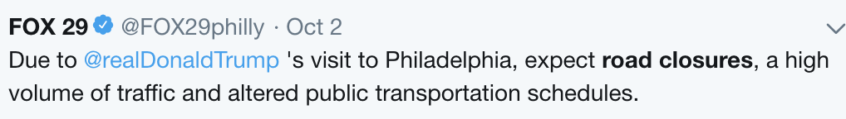
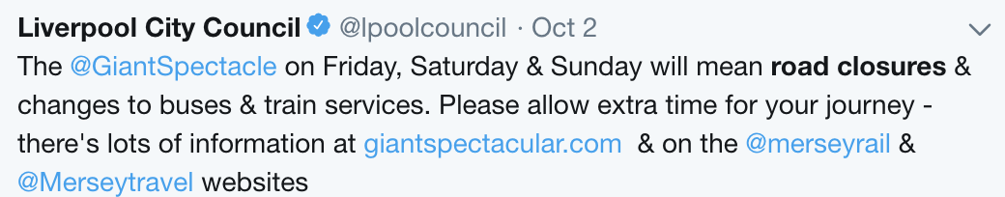
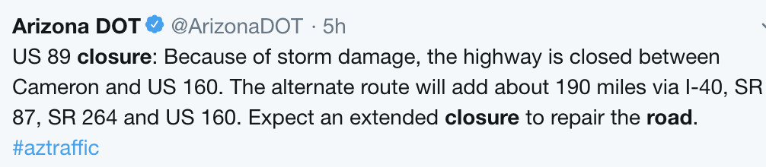
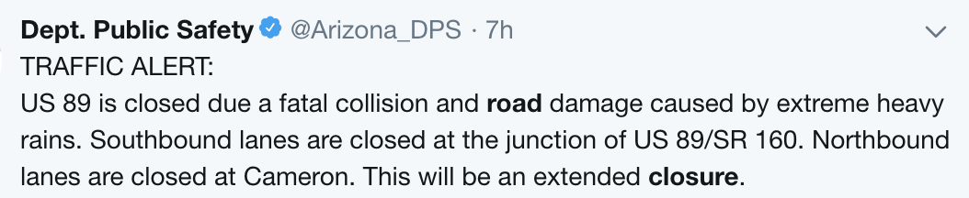
Problem Statement
Use social media and real-time data to
Identify road closures
Allow users to search for condition
Identify location of condition
Notes:
----- Meeting Notes (10/4/18 18:27) -----
- include only 1 #HurricanePython
- include it after the Problem Statement

Slide 4
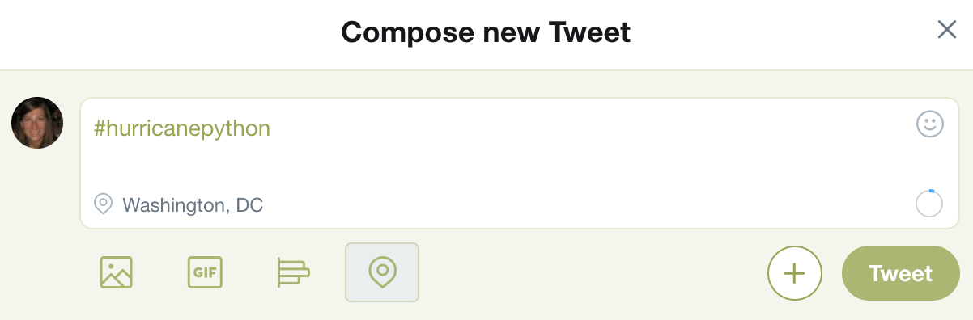
Notes:
1. Just a reminder, take your twitter out and send a tweet using the hashtag #hurricanepython
2. We are going to do a simulation on how this would work in the real-world.
3. I’m a resident of Washington, DC and hurricane python has hit our city! I’m sitting in my apartment looking out the window

Slide 5
1.
Collecting data
Where are we looking for data and how are we getting it?

Slide 6
Terminology
API – Application Programming Interface
Key – secret code used to access APIs
Scrape – extract large amounts of information from web
Parse – manually sift through data

Slide 7
Data Science Techniques: Web Scraping
Developer Tools
Apply for developer access
Receive keys
Scrape using API
Web Scraping
Inspect website’s HTML
Parse
Define functions

Slide 8


The Data
Scraped
Twitter API
Python-Twitter
Tweepy
News API
FEMA App
Collected
Live tweets
Live news articles
Every post from Every page - FEMA

Slide 9
2.
Implementation
We have data.
Now what?

Slide 10


Collect Data
Parse Data
Rank and Display
Results
Notes:
Okay now let’s move on to implementation — using the data we’ve collected to identify road problems.
So we have our data. We’ve pulled it in from all these different sources. The main thing we’re concerned with is the text from these sources. We load the data into Python scripts, and these scripts do 3 main things:
0. Define a list of important words. This includes the search terms the user specifies, but also includes some words we’ve defined in the background that the user may not have specified but which would be important to finding road problems.
- These background words include things like “closed”, “street”, “flood”, “inaccessible”. Part of our efforts to continually improve this project is altering this list of words to be as responsive to road issues as possible.
1. The second step is to extract text features from the data
- For Twitter this would be tweets
- For NewsAPI this would be headlines, summaries, and sometimes full articles
- For FEMA this would be short descriptions.
2. Then finally we use Python to break these texts down into individual, searchable words, and we compare what is in these texts to the words in our important words list. We count the number of occurrences of important words in a text and assign a score. If a text, for example a tweet, has more of the important words than another text, then it will have a higher score, and higher scored texts will be displayed first to the user. This ensures that the most relevant and urgent results rise to the top.
The user can then use the results to find road closures that are important to them, or just identify road closures in general so that they can start rerouting people.

Slide 11
3.
Demonstration
Let’s see this in action.

Slide 12
Notes:
1. Just a reminder, take your twitter out and send a tweet using the hashtag #hurricanepython
2. We are going to do a simulation on how this would work in the real-world.
3. I’m a resident of Washington, DC and hurricane python has hit our city! I’m sitting in my apartment looking out the window and all of a sudden I see a lamppost fall across the intersection of 15th and M.
4. I decide to turn to twitter to tweet what I’m seeing to my followers.

Slide 13
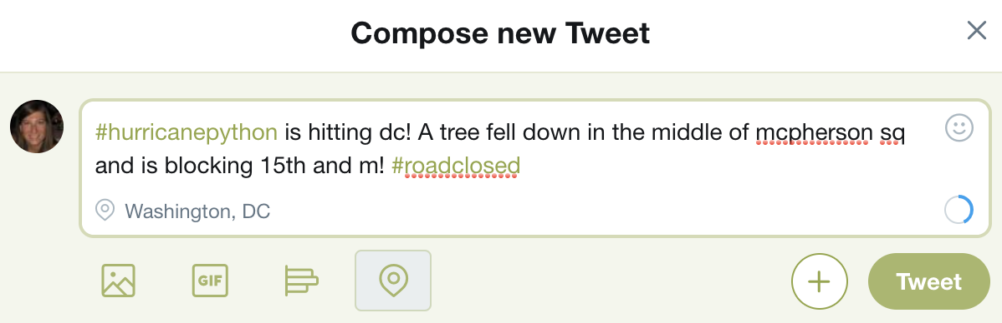
Notes:
I compose my tweet, I share my location and send my tweet.

Slide 14
#HurricanePython Road Closure Search
Keywords you can search:
Event hashtag
Geographic location
Intersection
Condition
Notes:
Now, we are going to look at how the program works on the end of FEMA, and emergency service providers.
Maybe, I want to see if the route to the hospital has any potential blockages, I would search via the event hashtag, the hospital is in dc, and I want to know if the route via 15th st is closed
For this example, I’m specifically interested if this intersection is closed and I want to know about this particular neighborhood.

Slide 15

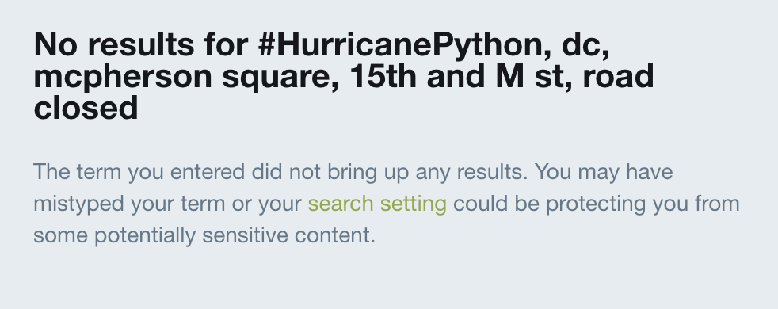
Why not just search Twitter?
Notes:
Because of hashtags, it actually makes it difficult to search twitter for very specific situations; we’ve tweeted out about the hurricane but if I were to go to twitter with these same search terms it returns no results.
Additionally, while these demo mostly focuses on this hypothetically situation remember the value add is that this will return from multiple social media feeds (FEMA and News).
Lastly, when searching for an abbreviated teams you are returning ALL tweets about the hurricane in chronological order which may not yield meaning for your specific situation.

Slide 16
Search Return
Text | Rank
#hurricanepython is hitting dc! A tree fell down in the middle of mcpherson sq and is blocking 15th and m! #roadclosed | 110
#HurricanePython road closed | 108
#HurricanePython business formal?! | 106
#HurricanePython rainbows | 106
A lot going on in these trial runs with the rains #hurricanepython | 106
Notes:
Here’s what returns from out function: the function will return a table with the text of the tweet ranked; however we also export to csv a number of additional features that be customized to your output.

Slide 17
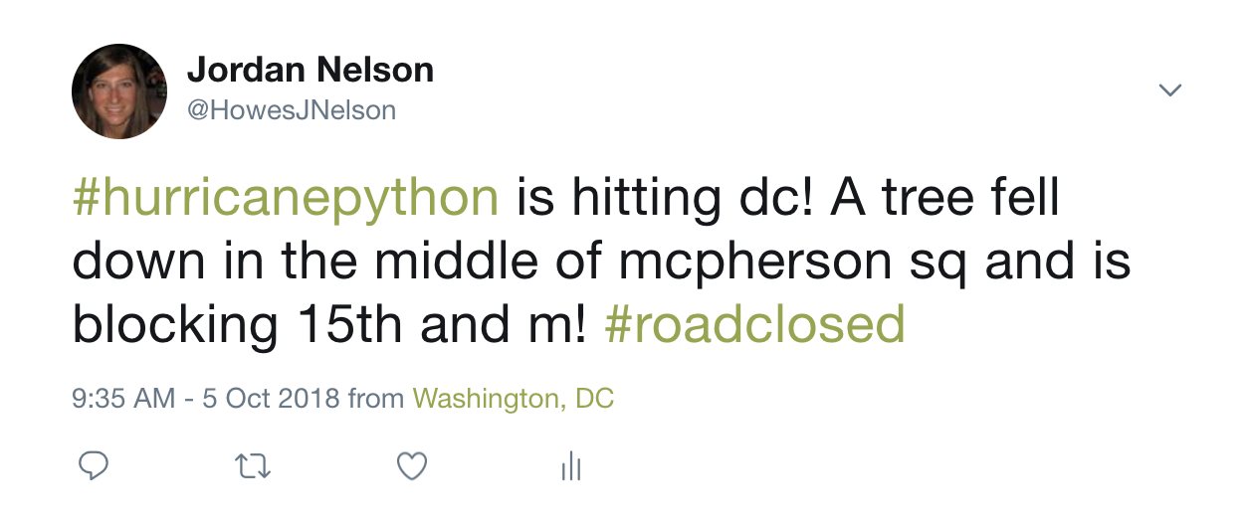
Additional Search Return
Time stamp
Geocoordinates
URL
Images
Notes:
We can return a number of other features via csv: retweets, user information, geocoordinates (if they had been enabled), links to attached images, and url, ect.

Slide 18
4.
Next Steps
What else do we have in mind?

Slide 19
Next Steps
Premium access to Twitter
Access to different map and social media APIs
Cross platform validation

Slide 20
5.
Conclusion
Let’s wrap it up.

Slide 21
Problem
Use live social media updates
Identify road conditions
Data Collection
Twitter
News API
Implementation
Rank results
Show full text
FEMA
Use
Use results to reroute traffic or send help

Slide 22
Thanks!
Any questions?

