Slide 1

HDInsight

Slide 2
Preview
Only Support 64bit operation

Slide 3
HDINSIGHT / HADOOP Eco-System
JavaScript
C#, F#, .NET
Graph
(Pegasus)
Stats processing
(RHadoop)
Machine Learning
(Mahout)
Relational
(SQL Server)
Legend
Red = Core Hadoop
Blue = Data processing
Purple = Microsoft integration points and value adds
Orange = Data Movement
Green = Packages
Pipeline / workflow
(Oozie)
Metadata
(HCatalog)
Scripting
(Pig)
Query
(Hive)
PDW Polybase
Event Driven Processing
NoSQL Database
(HBase)
Data Integration
( ODBC / SQOOP/ REST)
Distributed Processing
(MapReduce)
Event Pipeline
(Flume)
Business Intelligence
(Excel, Power View, SSAS)
Distributed Storage
(HDFS)
Monitoring & Deployment (System Center)
World's Data (Azure Data Marketplace)
Azure Storage Vault (ASV)
Active Directory (Security)

Slide 4
Programming HDInsight
Existing Ecosystem
Hive, Pig, Mahout, Cascading, Scalding, Scoobi, Pegasus…
C#, F# Map/Reduce, LINQ to Hive, .NET management clients
.NET
JavaScript Map/Reduce, Browser hosted console, Node.js management clients
JavaScript
DevOps / IT Pros
PowerShell, Cross Platform CLI tools

Slide 5
Javascript
http://nodejs.org/
http://visualstudiogallery.msdn.microsoft.com/885a8a68-e38b-4e6a-b96d-083d5572b645

Slide 6
New
var test = function(){
this.a = ‘123’
this.b=‘456’
}
test();
var test2=new test();

Slide 7
Prototype

Slide 8
Prototype
var test = function(){
this.a = ‘123’
this.b=‘456’
}
test.prototype = {
yyy:‘12345’,
printA:function(){
console.log(this.a)
}
}

Slide 9
Prototype
var test3=new test();
var test2=new test();
test3.yyy=‘yyy’;
console.log(test2.yyy)
test3.printA();
test3.a=‘bbb’
test3.printA();
test2.printA();

Slide 10
this

Slide 11
this
var test = function(){
this.a = ‘123’
}
test.prototype = {
yyy:‘12345’,
printA:function(){
setTimeout(function(){
      console.log(this.a)
    },1000)
}
}

Slide 12
Closure
for(var i=0;i<10;i++){
setTimeout(function(){
console.log(i)
},1000)
}

Slide 13
WordCount.js

Slide 14
Map
var map = function (key, value, context) { var words = value.split(/[^a-zA-Z]/); for (var i = 0; i < words.length; i++) { if (words[i] !== "") { context.write(words[i].toLowerCase(), 1); } }};

Slide 15
Reduce
var reduce = function (key, values, context) { var sum = 0; while (values.hasNext()) { sum += parseInt(values.next()); } context.write(key, sum);};

Slide 16
練習 PI

Slide 17
As = (2r)²
As = 4r²

Slide 18
Ac = pi * r²

Slide 19
pi = Ac / r²
As = 4r² r² = As / 4 pi = 4 * Ac / As

Slide 20
File System
Option One : Javascript Console
Option Two:Command Line

Slide 21
Linux Command Line

Slide 22

Javascript Console

Slide 23
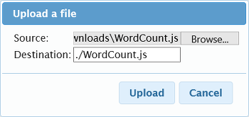
fs.put() , #put

Slide 24

#ls , #lsr

Slide 25
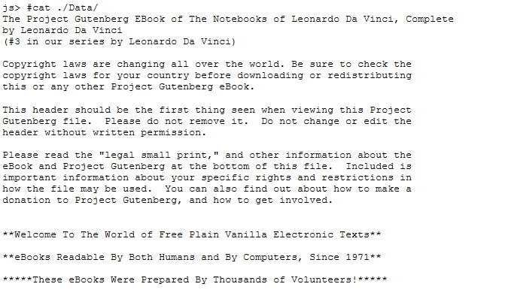
#cat

Slide 26
#rm , #rmr

Slide 27
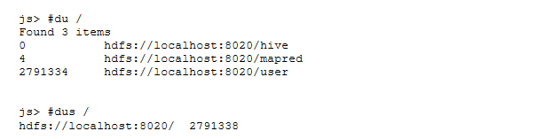
#du , #dus

Slide 28
#cp
#cp <src> <dst>

Slide 29
#mv
mv src dst

Slide 30
#copyFromLocal, #moveFromLocal
#command <localsrc> <dst>

Slide 31
#moveToLocal
#copyToLocal
#command <src> <localdst>

Slide 32
#mkdir
#mkdir <path>

Slide 33
expunge
#expunge
Recycle bin

Slide 34
#get , #getmerge
#get <src> <dst>
#getmerge <src-directory> <dst> [addnl]
getmerge
file in directory ,
concat to dest

Slide 35
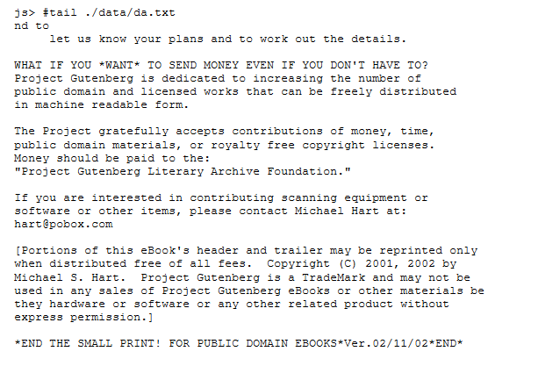
#tail
last kilobyte of the file to stdout

Slide 36
#touchz
#touchz <path>

Slide 37
#setrep
#setrep [-R] <rep> <path/file>
#setrep -w 3 -R /user/hadoop/dir

Slide 38
#text
#text <path>

Slide 39
#test
#test -[ezd] <path>
e : exist
z : size is 0 or not
d : is directory

Slide 40
#chmod, #chgrp , #chown
#chmod 777 <path>
#chgrp -R <group> <path>
#chown owner:group <path>

Slide 41
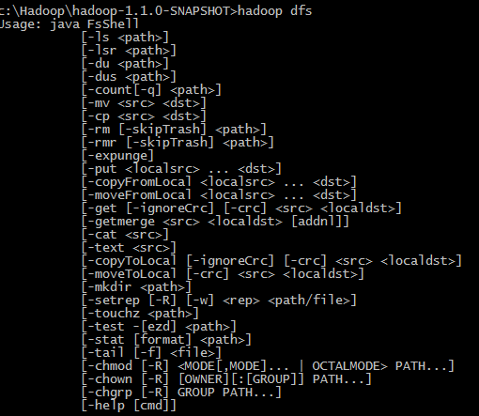
Hadoop FileSystem

Slide 42
Operation Time

Slide 43
Sqoop

Slide 44
Export

Slide 45
bin\sqoop.cmd export --connect "jdbc:sqlserver://<servername>.database.windows.net:1433;database=<dbname>;user=<username>@<servername>;password=<password>" --table <to_table> --export-dir <from_hdfs_folder> --input-fields-terminated-by "<delimiter>"

Slide 46
Import

Slide 47
bin\sqoop.cmd import --connect "jdbc:sqlserver://<servername>.database.windows.net:1433;database=<dbname>;user=<username>@<servername>;password=<password>" --table <from_table> --target-dir <to_hdfs_folder> --split-by <from_table_column>

Slide 48

Pig

Slide 49
Identifier
Correct
A
A123
abc_123_BeX_
Incorrect
_A123
abc_$
A!B

Slide 50
DataType
chararray
int
float

Slide 51
Pig 指令
讀取 : LOAD
儲存 : STORE
資料處理 : FILTER, FOREACH, GROUP, COGROUP, inner JOIN, outer JOIN, UNION, SPLIT, …
彙總運算 : AVG, COUNT, MAX, MIN, SIZE, …
數學運算 : ABS, RANDOM, ROUND, …
字串處理 : INDEXOF, SUBSTRING, REGEX EXTRACT, …
Debug : DUMP, DESCRIBE, EXPLAIN, ILLUSTRATE
HDFS 或本機的檔案操作 : cat, ls, cp, mkdir, …

Slide 52
Sample Log file
http://www.microsoft.com/en-us/download/details.aspx?id=37003

Slide 53
load
LOGS = LOAD '/sample.log';

Slide 54
dumps
dump logs;

Slide 55
REGEX_EXTRACT
RegexExtract(String expression, String regex, int match_index)

Slide 56
foreach
LEVELS = foreach LOGS generate REGEX_EXTRACT($0, '(TRACE|DEBUG|INFO|WARN|ERROR|FATAL)', 1) as LOGLEVEL;

Slide 57
FILTER
FILTEREDLEVELS = FILTER LEVELS by
LOGLEVEL is not null;

Slide 58
Group
GROUPEDLEVELS = GROUP FILTEREDLEVELS by LOGLEVEL;

Slide 59
COUNT
FREQUENCIES = foreach GROUPEDLEVELS generate group as LOGLEVEL, COUNT(FILTEREDLEVELS.LOGLEVEL) as COUNT;

Slide 60
ORDER
RESULT = order FREQUENCIES by COUNT desc;

Slide 61
pigscript.pig
- load the log file LOGS = LOAD '/sample.log';- iterate through each line and match on the 6 log levels LEVELS = foreach LOGS generate REGEX_EXTRACT($0, '(TRACE|DEBUG|INFO|WARN|ERROR|FATAL)', 1) as LOGLEVEL;- filter out non-match rows, i.e. empty rows FILTEREDLEVELS = FILTER LEVELS by LOGLEVEL is not null;- now group/consolidate all of the log levels into their own row, counting is not done yet GROUPEDLEVELS = GROUP FILTEREDLEVELS by LOGLEVEL;- for each group, now count the occurrences of log levels which will be the frequencies of each log level FREQUENCIES = foreach GROUPEDLEVELS generate group as LOGLEVEL, COUNT(FILTEREDLEVELS.LOGLEVEL) as COUNT;- sort the frequencies in descending order RESULT = order FREQUENCIES by COUNT desc;- write the result to a file store RESULT into 'sampleout';

Slide 62
hadoop fs -cat sampleout/part-r-00000

Slide 63
線上操作

Slide 64
MapReduce

Slide 65
pig.from("/example/data/davinci.txt").mapReduce("WordCount.js", "word, count:long").orderBy("count DESC").take(10).to("DaVinciTop10Words")

Slide 66
js> file = fs.read("DaVinciTop10Words") js> data = parse(file.data, "word, count:long") js> graph.bar(data)

Slide 67
線上操作

