Slide 1

DEPTH ESTIMATION FROM STEREO IMAGES USING CENSUS TRANSFORM AND HAMMING DISTANCE
Name: Cristian Casian-Cristi
Group: 30432

Slide 2

Project requirment
You are given the left and the right rectified stereo images and you have to create the disparity map. The images must be transformed using Census transform and compared each other using Hamming distance. The results of the comparison represents the result of the depth estimation algorithm.

Slide 3


Inputs look like
Left perspective
Right perspective

Slide 4
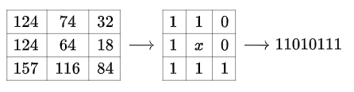
Census Transform
The census transform is a robust feature descriptor used in image processing and computer vision, particularly for stereo vision tasks. It encodes the local spatial structure of an image by comparing the intensity value of a pixel with its neighbors within a specified window. Each comparison generates a binary result, forming a bit string or "census signature" for each pixel. This bit string effectively captures the local texture and is invariant to monotonic changes in illumination, making it suitable for disparity estimation in stereo matching.

Slide 5

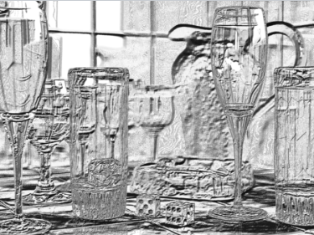
Input and output after Census transform
Input image
Output after Census transform

Slide 6
Hamming distance
Hamming distance is a measure of the difference between two binary strings of equal length. It counts the number of positions at which the corresponding bits are different. In the context of image processing and computer vision, particularly for tasks like stereo vision, Hamming distance is used to compare binary descriptors, such as those generated by the census transform.

Slide 7
Disparity
The function disparity computes the disparity map between two images using the census transform and hamming distance.
For each pixel in the initial image initialize min_hamming and best_disparity after each pixel iteration. Loop over a range of disparities. Check if the pixel j-d, i+u, j+v, j+v-d are in the image and are not outside, and for those values which are in the image calculate the sum of hamming distances.
Update the min_hamming and best_disparity if the current Hamming distance is smaller than the minimum Hamming distance found so far and put the minimum value in the result matrix.

Slide 8
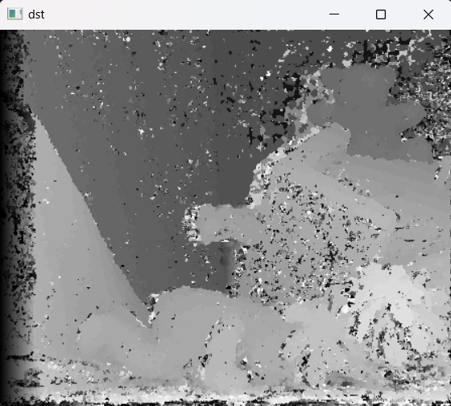
Output
The output is a disparity map where each pixel indicates the disparity (difference in horizontal position) between the corresponding pixels in the left and right images. This disparity map is represented as a grayscale image, where darker pixels indicate closer objects and lighter pixels indicate farther objects.

Slide 9
User manual
Place the input stereo images in the specified directory(‘Images/proiect/’) with filenames ‘teddy1.png’ and ‘teddy2.png’
The program reads the stereo images, computes the disparity using the Census Transform and Hamming distance, and displays the input images and the disparity map
The program compares the computed disparity map with a ground truth disparity map and calculates the error percentage, which is printed to the console.

Slide 10
Conclusions
This project was a good training working with OpenCV.
Calculating disparity maps accurately is challenging due to issues such as occlusions, textureless regions, and varying disparity ranges.
The project reveals that while the census transform and Hamming distance provide a solid foundation for disparity calculation, optimizing these methods to handle edge cases and improve accuracy across diverse scenes remains a critical area for further research and refinement.

Slide 11
Bibliography
https://en.wikipedia.org/wiki/Census_transform#
https://www.cs.cornell.edu/~rdz/Papers/ZW-ECCV94.pdf
https://vision.middlebury.edu/stereo/data/scenes2014/

