Slide 1
Playing Atari with deep reinforcement learning Vladimir Mnih ET AL. published in dec 2013
Presenter: Bruno Casella

Slide 2

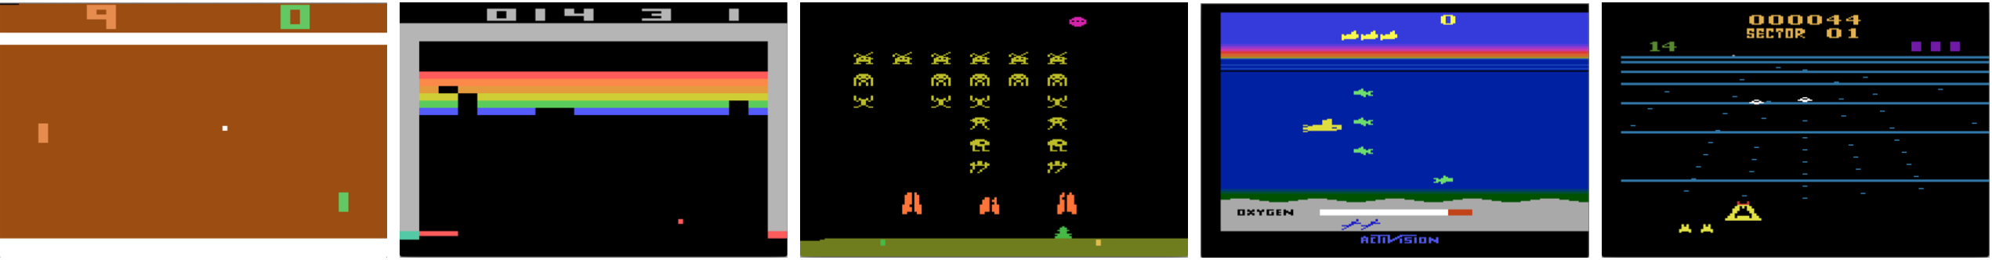
Motivation
The goal is to create a single NN agent that is able to learn to play as many Atari 2600 Games as possible
Learn control policies (state-action mappings, strategies in order to achieve a goal). That’s the task of Reinforcement Learning.
Games (Atari emulator) are learning environment (you can move inside for example with a joystick).
Pro about environments: actions are always the same, but they mean different things in different games
The objective is to maximize the reward (for ex. #goals in Pong, or #kills in Breakout, and so on).

Slide 3
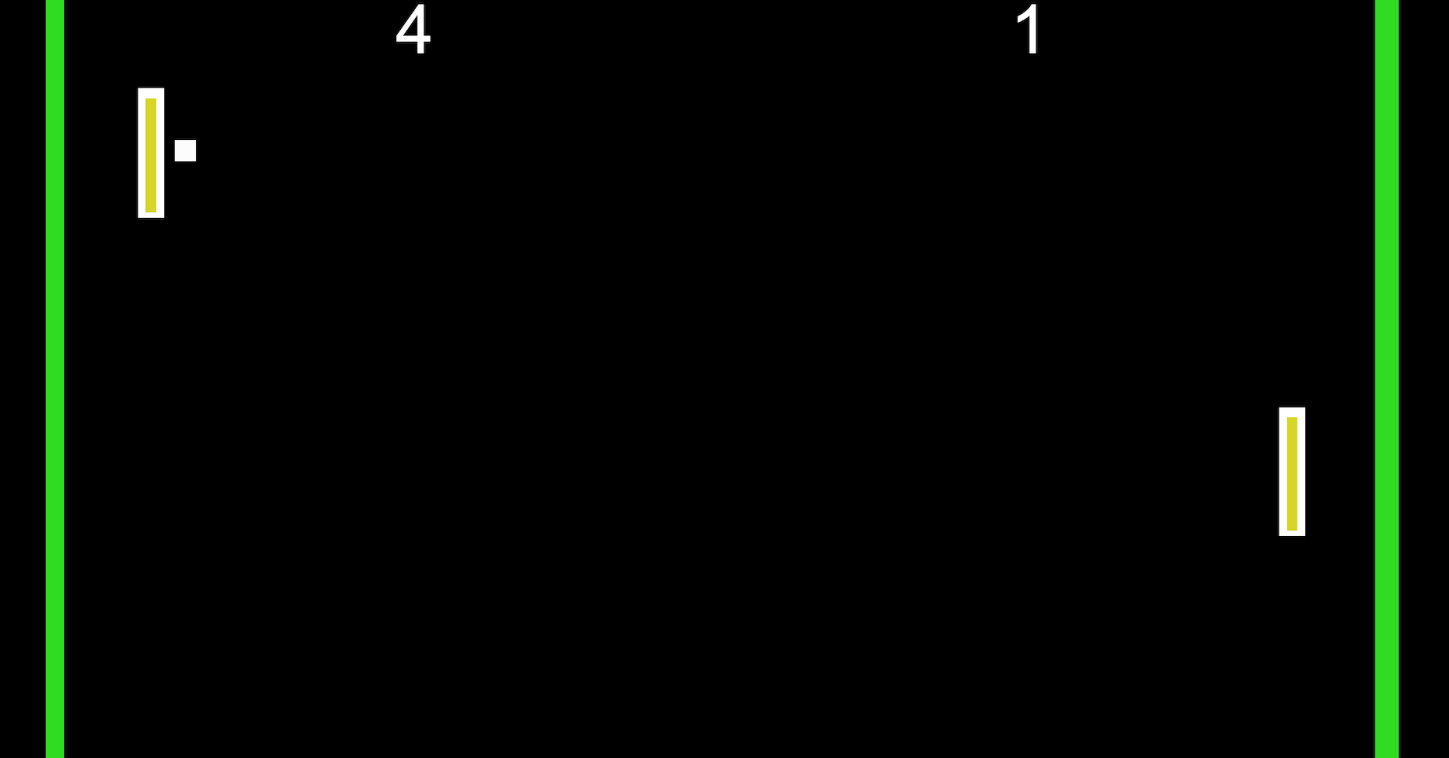
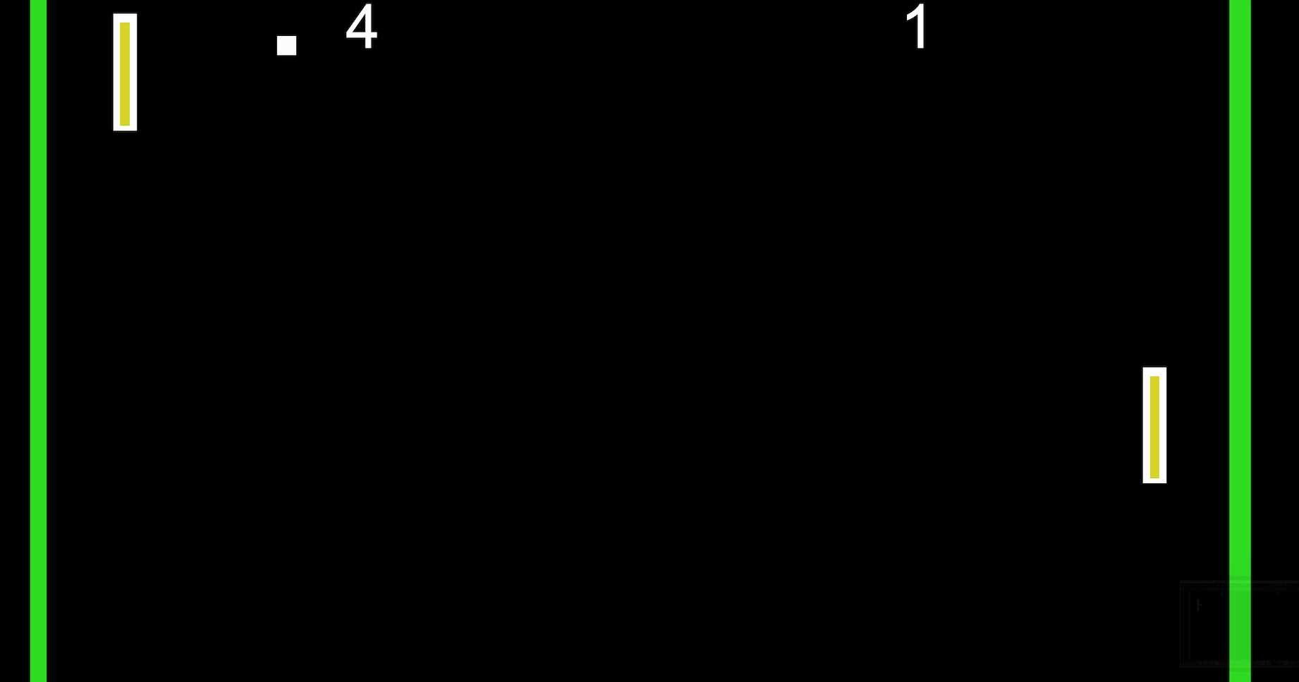
Motivation
The goal is to create a single NN agent that is able to learn to play as many Atari 2600 Games as possible
Reinforcement Learning presents several challenges from a deep learning perspective.
DL applications requires large amounts of hand-labelled training data., while RL algorithms must be able to learn from a scalar reward signal that is frequently sparse.
DL algorithms assume the data samples to be independent, while in RL we typically encounter sequences of highly correlated states.

Slide 4
Contribution
Power of Deep Neural Networks to Reinforcement Learning
Use of CNNs to figure out which of the input images gave a good score.
The model is trained with a variant of Q-Learning.
The method is applied to the games with no adjustment of the architecture or learning algorithm.

Slide 5
State of the art
TD-Gammon[1] was one of the best-known success story of RL. A backgammon-playing program learnt by RL, that achieved a superhuman level of play, using an algorithm similar to Q-learning.
Neural fitted Q-learning (NFQ)[2] optimizes the same loss function of this paper.
Arcade Learning Environment (ALE)[3] introduced the use of Atari 2600 emulator as RL platform.
[1]. Tesauro G., Temporal difference learning and td-gammon, Communications of the ACM, 1995
[2]. Riedmiller M., Neural fitted q iteration-first experiences with a data efficient neural reinforcement learning method, Machine Learning: ECML 2005, 2005
[3]. Bellemare M. et al., The arcade learning environment: an evaluation platform for general agents, Journal of Artificial Intelligence Research, 2013

Slide 6
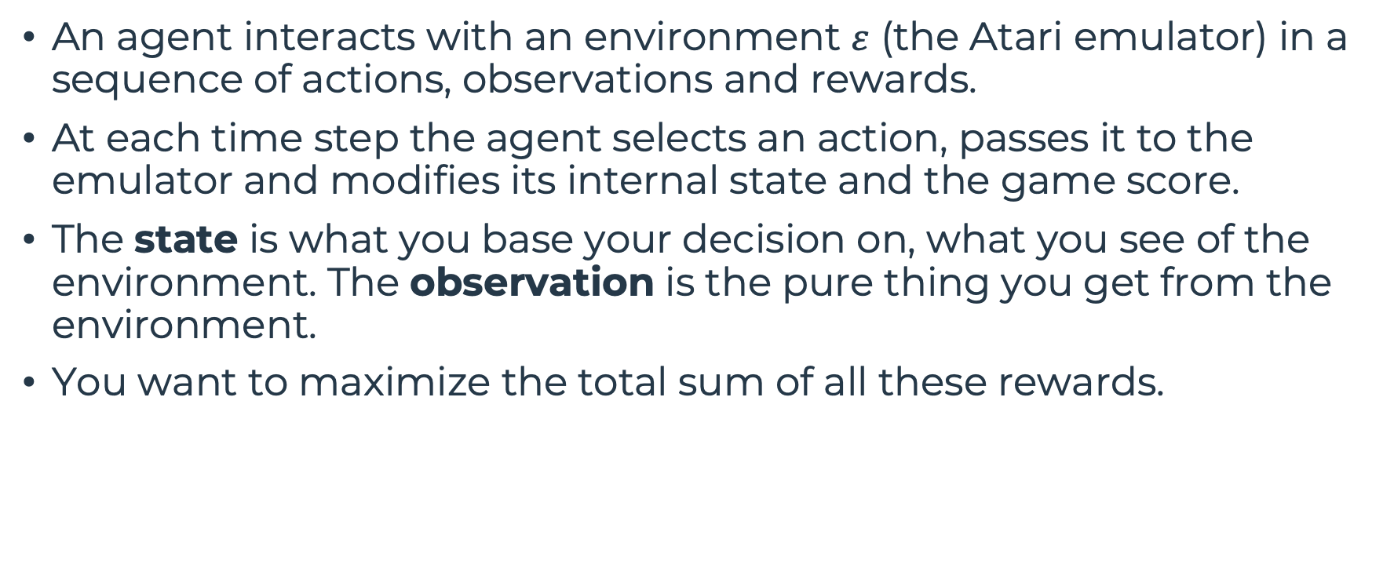
Proposed approach
An agent interacts with an environment $ε$ (the Atari emulator) in a sequence of actions, observations and rewards.
At each time step the agent selects an action, passes it to the emulator and modifies its internal state and the game score.
The state is what you base your decision on, what you see of the environment. The observation is the pure thing you get from the environment.
You want to maximize the total sum of all these rewards.
r₁
r₂
r₃
+

Slide 7
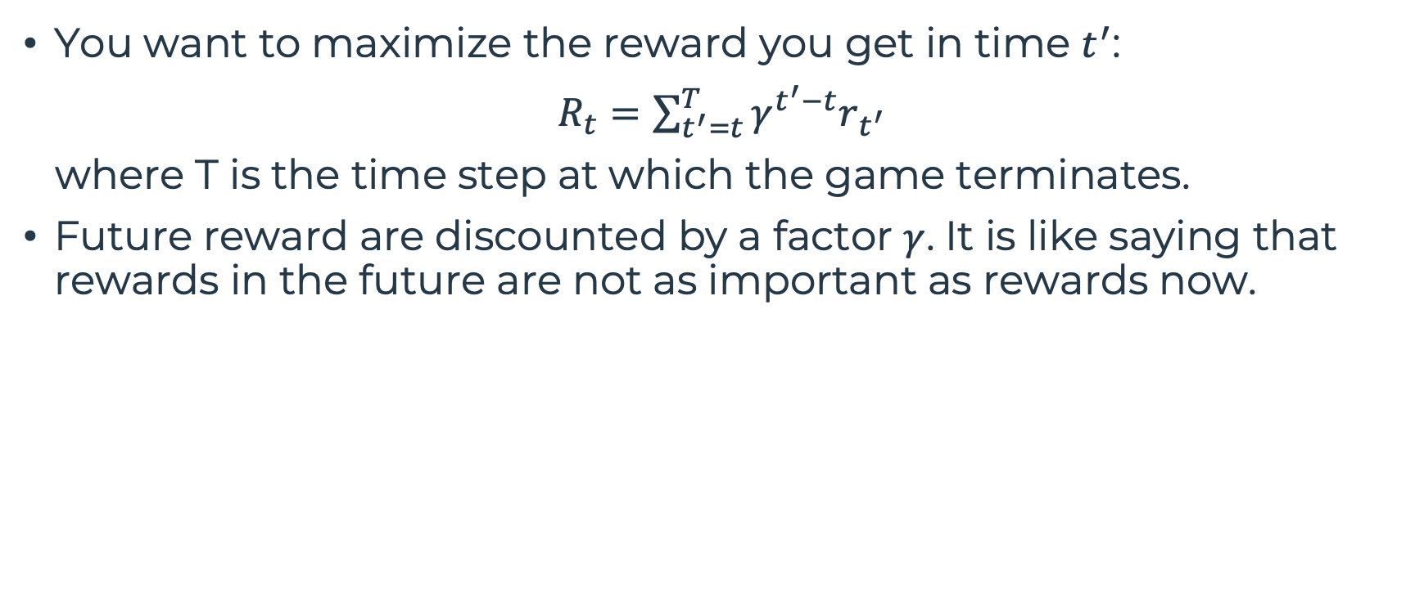
Proposed approach
You want to maximize the reward you get in time $t^{′}$:
$R_{t}=\sum_{t^{′}=t}^{T}{γ^{t^{′}−t}r_{t^{′}}}$
where T is the time step at which the game terminates.
Future reward are discounted by a factor $γ$. It is like saying that rewards in the future are not as important as rewards now.

Slide 8
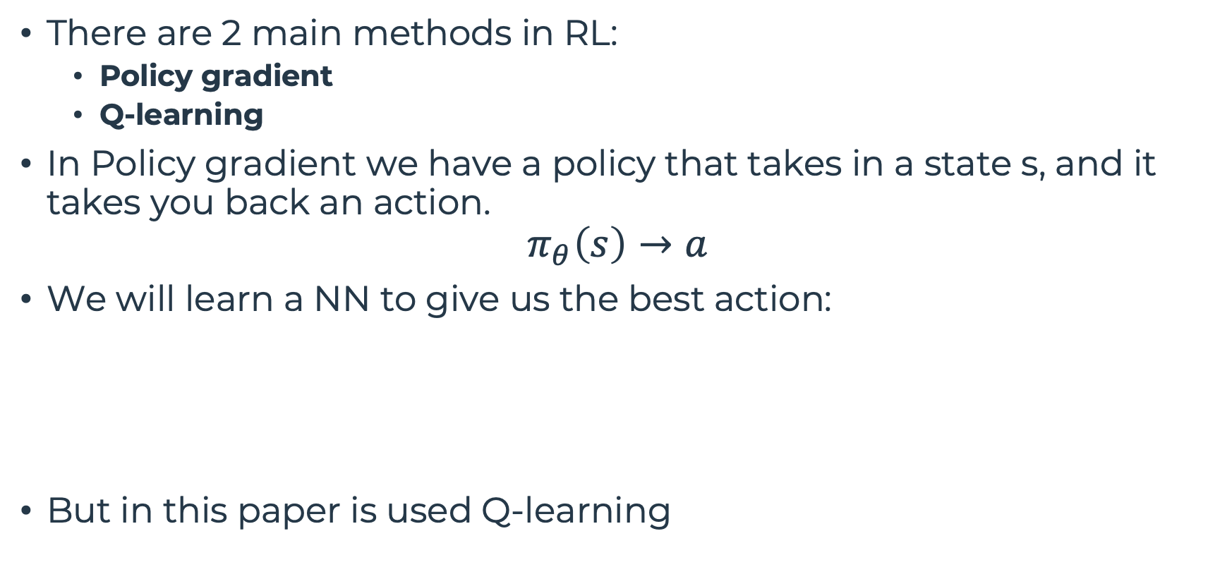
Proposed approach
There are 2 main methods in RL:
Policy gradient
Q-learning
In Policy gradient we have a policy that takes in a state s, and it takes you back an action.
$$π_{θ}\left(s\right)→a$$
We will learn a NN to give us the best action:
But in this paper is used Q-learning
a₁
s
a₂
a₃
a₄

Slide 9



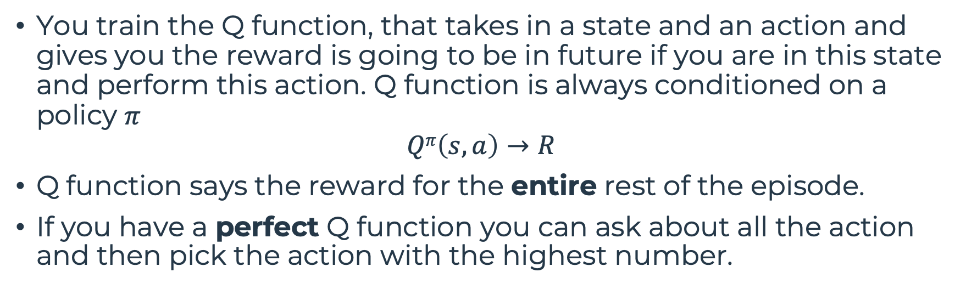



Q-Learning
You train the Q function, that takes in a state and an action and gives you the reward is going to be in future if you are in this state and perform this action. Q function is always conditioned on a policy $π$
$$Qπ\left(s, a\right)→R$$
Q function says the reward for the entire rest of the episode.
If you have a perfect Q function you can ask about all the action and then pick the action with the highest number.
a₁
$$Qπ\left(s, a1\right)→4$$
a₁
$$50→40→2000=2090$$
s
a₂
$$Qπ\left(s, a2\right)→7$$
s
a₂
$$50→10→0=60$$
a₃
$$Qπ\left(s, a3\right)→1$$
a₃
$$100→0→0=100$$

Slide 10
Q-Learning
We build a NN which takes the state and train it to output Q for state s and action 1, Q for state s and action 2, and so on.
Of course we do not have a perfect Q function. We need to train it
To train you can play an episode, collect the rewards, and then you have a labeled sample in the form (s, a, reward).
Q(s,a₁)
s
Q(s,a₂)
Q
s
a
Q(s,a₃)
Q(s,a₄)
a₁
$50→40→2000=2090$ training sample: (s, a₁, 2090)
s
a₂
$50→10→0=60$ training sample: (s, a₂, 60)
a₃
$100→0→0=100$ training sample: (s, a₃, 100)

Slide 11


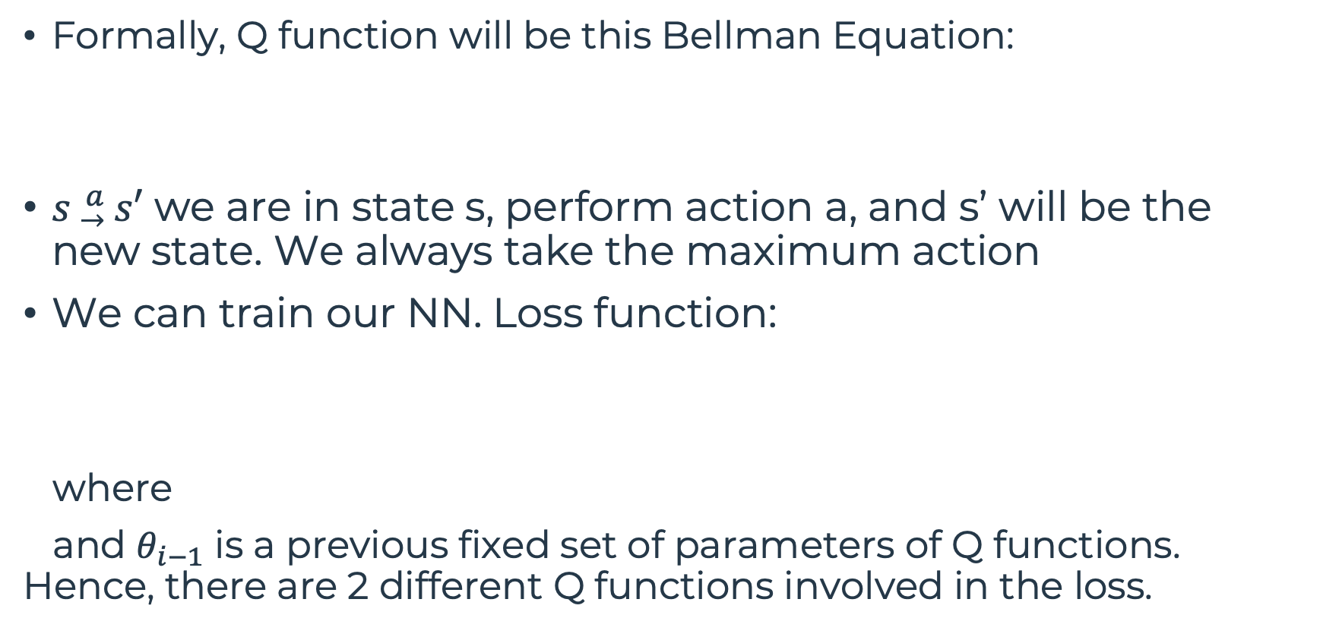
Q-Learning
Formally, Q function will be this Bellman Equation:
$s{}_{ →}^{a}{ s′}$ we are in state s, perform action a, and s’ will be the new state. We always take the maximum action
We can train our NN. Loss function:
where
and $θ_{i−1}$ is a previous fixed set of parameters of Q functions. Hence, there are 2 different Q functions involved in the loss.

Slide 12
Experience Replay
Let’s look at these 2 states:
They are very correlated, especially if you build a mini-batch of size 2, there is almost no variability.
Rather than using data samples as we collect, we put them into a buffer, and we sample at random.
This means that some samples might not be used, some samples can be used twice or more.

Slide 13
Model Architecture
NN they used was very small.
The input to NN consists in an 84x84x4 image.
1st hidden layer convolves 16 8x8 filters with stride 4 and applies ReLU.
2nd hidden layer convolves 32 4x4 filters with stride 2 and applies ReLU.
Final hidden layer is fully-connected and consists of 256 ReLU.
Output is a fully-connected layer with a single output for each valid action (between 4 and 18 actions according to the game considered).

Slide 14
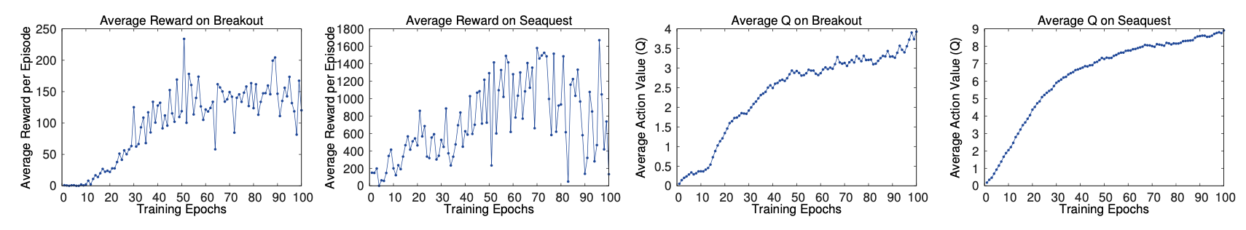
Experimental Results
They showed that average reward is noisy but improves over time.
This is because small changes to the weights of a policy can lead to large changes in the distribution of states the policy visits.
A more stable metric is the average Q function, which provides an estimate of how much discounted reward the agent can obtain by following its policy from any given state.
So, it is a successful training.

Slide 15
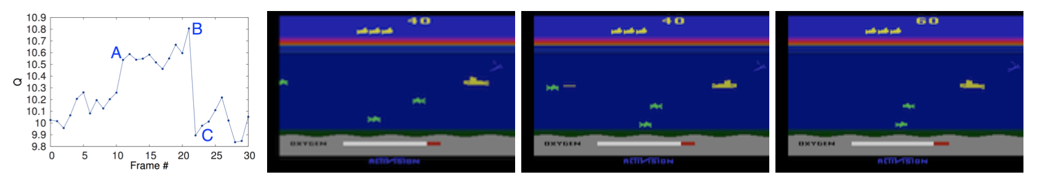
Experimental Results
In the first frame an enemy has just appeared, and you can see that Q function jumps to A. So, the enemy is not killed yet, but its appearance jumps the Q function because it anticipates a future reward.
Then the agent shots and we go from A to B.
Once the enemy is shot, there is no more enemy and the Q function drops drastically (point C).

Slide 16
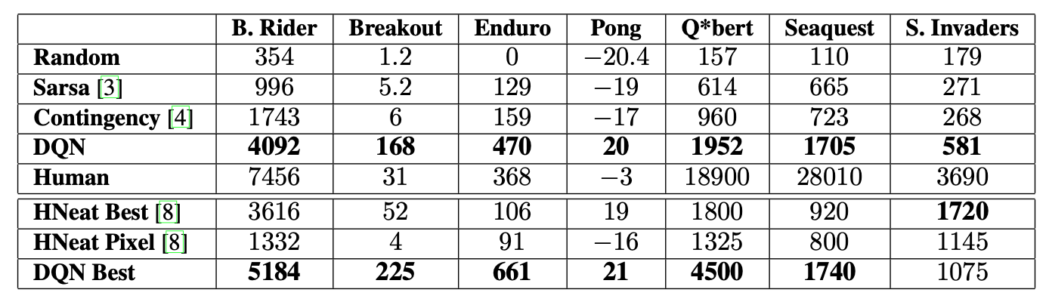
Experimental Results
Comparison with methods of RL literature: DQN outperformed them almost everywhere.
These methods used engineered features or handcrafted object detectors (for example you know all enemies are green, so they make channels for those green enemies)

Slide 17
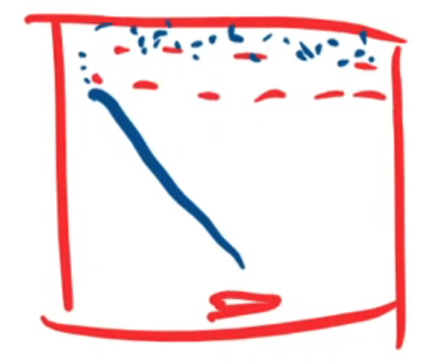

Experimental Results
Comparison against an expert human: in some games humans were vastly superior, due to the difficulty of the problem.
In Breakout, the agent figured out a strategy of shooting the ball into a hole, so the ball bounces and the agent does nothing anymore.

Slide 18
Conclusion
Authors are challenged from these games: Q*bert, Seaquest and Space Invaders.
These games require the network to find a strategy that extends over long time scales.
Their approach gave state-of-the-art in 6 of 7 games it was tested on, without adjustment of the architecture or hyperparameters.

Slide 19
Take-home message
I have noticed some dissimilarities in the network architecture from the trend of today:
No avg/max pooling
A small network
Big filters
It was pretty interesting also the way in which authors explained the experiments. In particular the correlation between what is happening in the game and the Q function.

