Slide 1
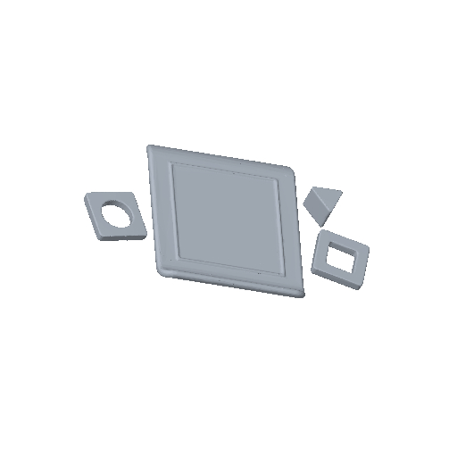
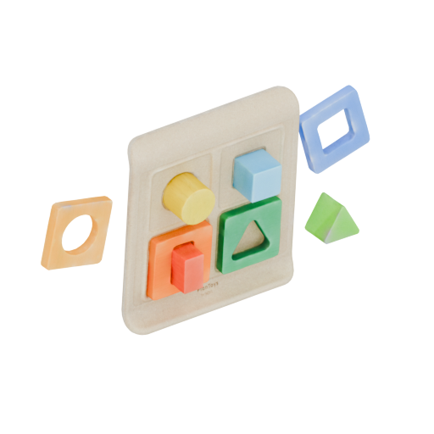
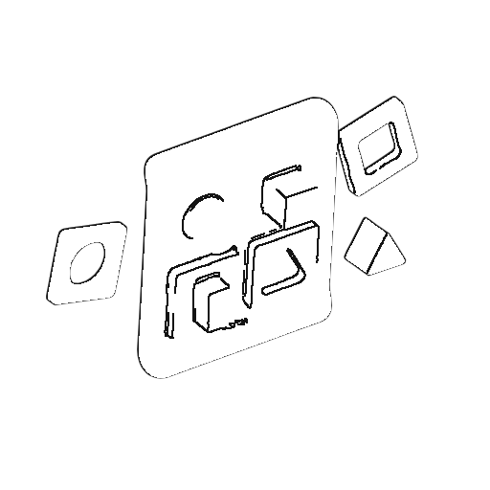


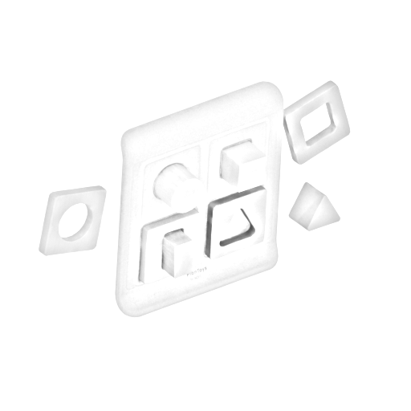
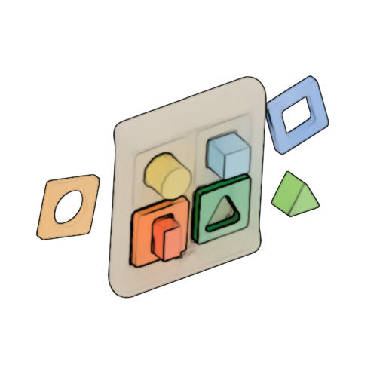
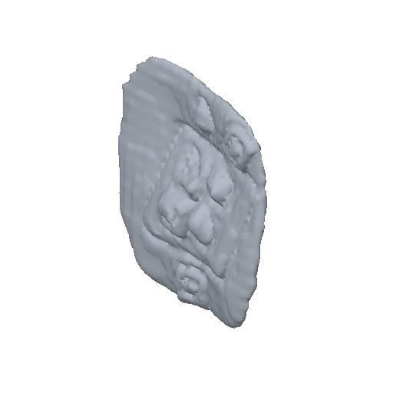
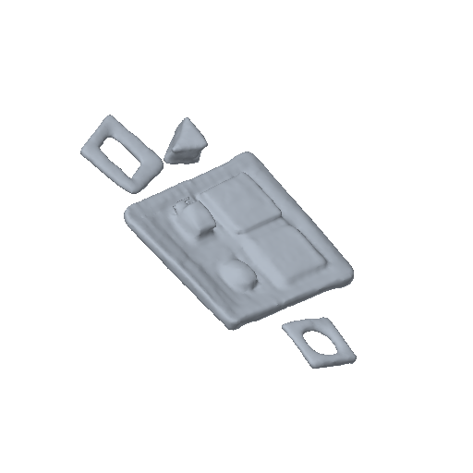
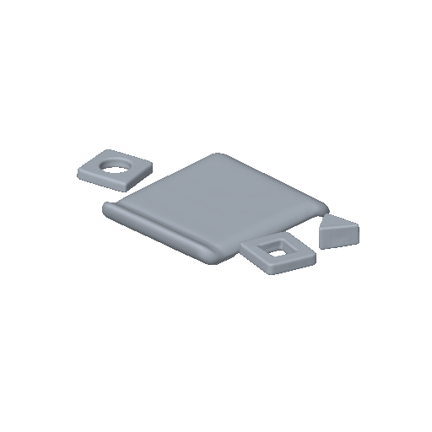

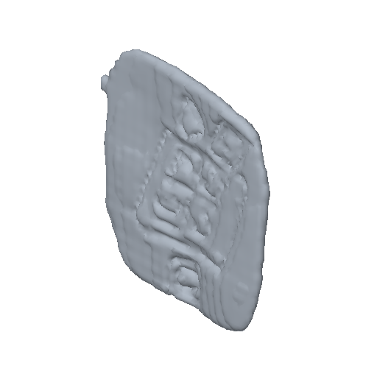
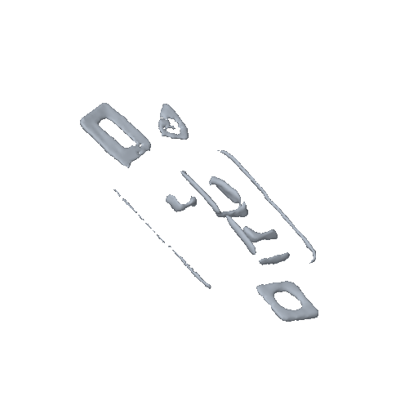
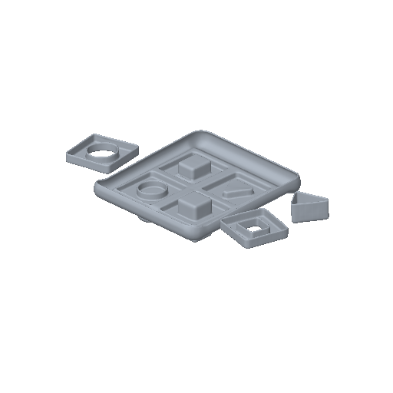

A
Matched depictions of one known object
3D reference
Photo
Edge
Flat colour
Low detail
Sketch
Watercolour
B
Same object and view across four fixed models
TripoSR | InstantMesh | Hunyuan3D 2.1 | TRELLIS
C
Paired outputs expose model-specific style responses
D
Paired evaluation
TripoSR
InstantMesh
Hunyuan3D 2.1
TRELLIS
Surface: F-score, Chamfer
Solid: IoU, volume
Topology: parts, edges
Six-view: silhouette, normals
Photo
Sketch
Notes:
[Sources]
- Experimental inputs and outputs: M03 C120 object c120_017, generated by the frozen confirmatory protocol.
- Model outputs: official TripoSR, InstantMesh, Hunyuan3D 2.1, and TRELLIS checkpoints recorded in the experiment manifest.
- Ground truth: Google Scanned Objects asset processed with the frozen solid-GT construction pipeline.
[/Sources]

