Slide 1
LDA
Amazon Fashion Dataset

Slide 2
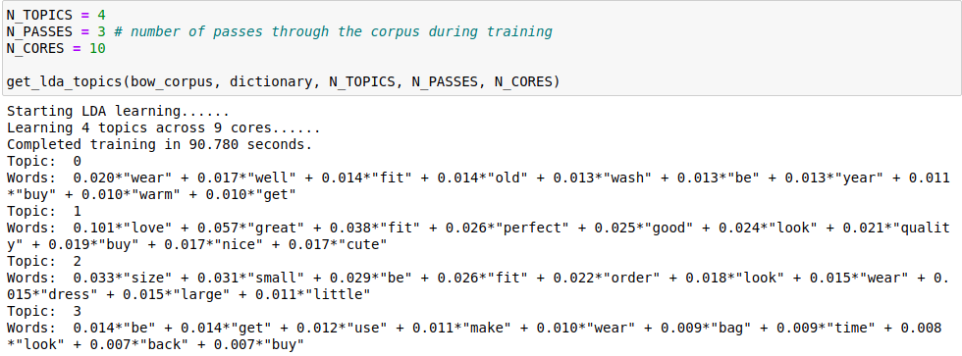
Topics = 4
Topic 0: No clear indication of the words being related to a specific aspects / types of fashion products.
Topic 1: predominantly related to positive words
Topic 2: weakly related to size of fashion items.
Topic 4: No clear indication of the words being related to a specific aspects / types of fashion products.
Conclusion: The number of topic is not sufficient to learn more meaningful, distinct and granular topics of the review dataset.

Slide 3
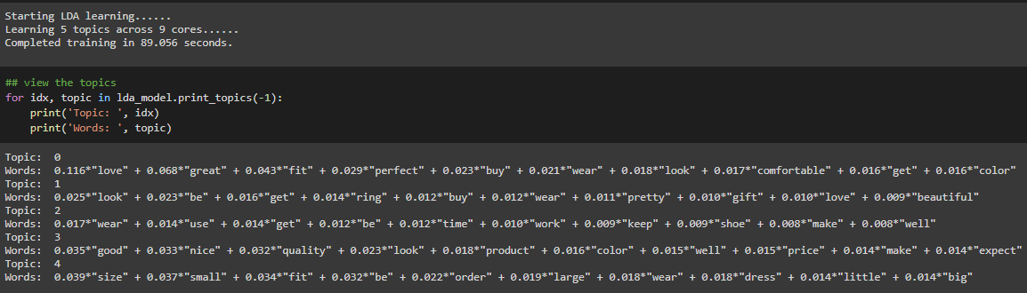
Topics = 5
Topic 0: A mixture of positive words (love, great) and quality (color, comfortable, look) of fashion items.
Topic 1: Predominantly positive words and “ring” that is relevant to reviews of fashion item ring.
Topic 2: Predominantly verbs related to using the fashion items, and a distinctive “shoes” that is relevant to reviews of shoes.
Topic 3: A mixture of positive words and quality of fashion items.
Topic 4: Predominantly adjective and nouns related to the size of fashion items.
Conclusion: More characteristics keywords related to aspects and types of fashion items could be learned. However, the characteristics are not sufficiently distinct yet.

Slide 4
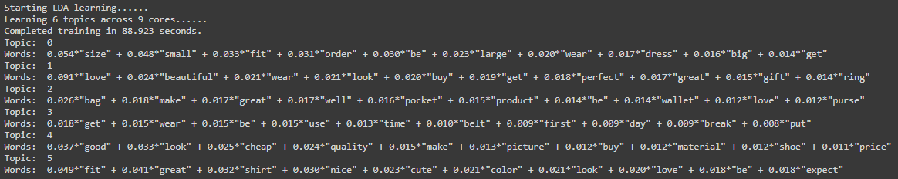
Topics = 6
Topic 0: item type: dress; size: size, small, large, big
Topic 1: item type: ring; General positive words: love, beautiful, perfect, great
Topic 2: item type: bag, purse, wallet; functionality: pocket
Topic 3: item type: belt; time: day, break, time
Topic 4: item type: shoe; quality: material, quality; price: price, cheap; appearance: good, look, picture
Topic 5: item type: shirt; appearance: great, cute, color, look

Slide 5
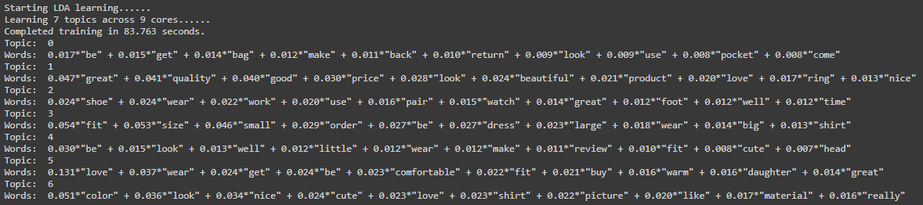
Topics = 7
Topic 0: item type: bag; functionality: pocket
Topic 1: item type: ring; price: price; appearance: look, beautiful; General positive words: nice, great, love
Topic 2: item type: shoe, pair, watch, foot; comfort: work
Topic 3: item type: dress, shirt; size: size, small, large, big
Topic 4: General words
Topic 5: comfort: comfortable, warm; special: daughter
Topic 6: item type: shirt; appearance: color, nice, look, cute, picture; quality: material

Slide 6
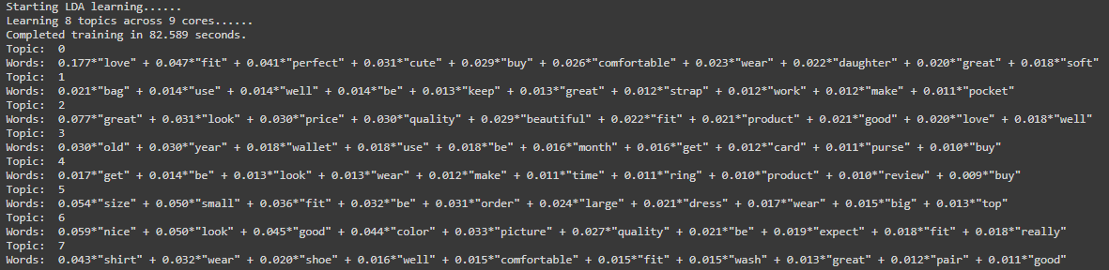
Topics = 8
Topic 0: comfort: comfortable, soft; appearance: cute; special: daughter
Topic 1: item type: bag; functionality: strap, pocket, work
Topic 2: Mixture of positive words, likely positive reviews
Topic 3: item type: wallet, purse; functionality: card; time: year, old, month
Topic 4: item type: ring
Topic 5: item type: dress; size: small, large, big, size
Topic 6: appearance: nice, look, color, picture; quality: quality
Topic 7: item type: shirt, shoe, pair; comfort: comfortable

Slide 7
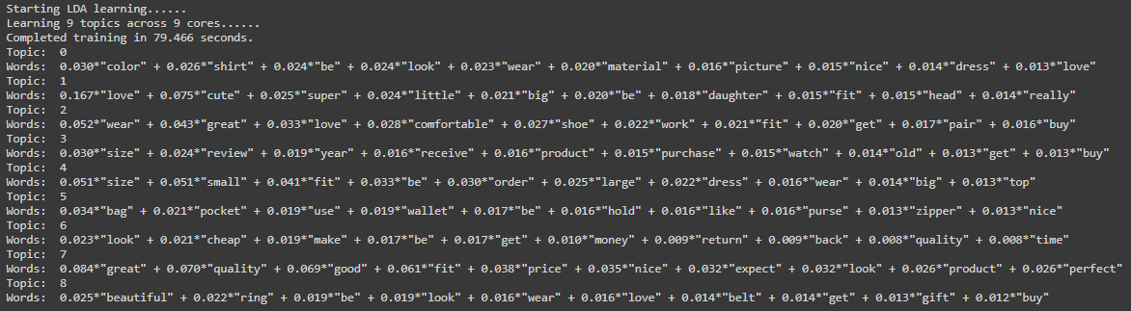
Topics = 9
Topic 0: item type: shirt, dress; appearance: color, look, nice, picture; quality: material
Topic 1: size: big; special: daughter
Topic 2: item type: shoe, pair; comfort: comfortable, work;
Topic 3: size: size
Topic 4: item type: dress, top; size: size, small, large, big
Topic 5: item type: wallet, purse; functionality: zipper, hold, pocket
Topic 6: price: cheap, money
Topic 7: General positive words
Topic 8: item type: ring, belt; appearance: beautiful, look; special: gift
Weird separation for size
Missing watch as item

Slide 8
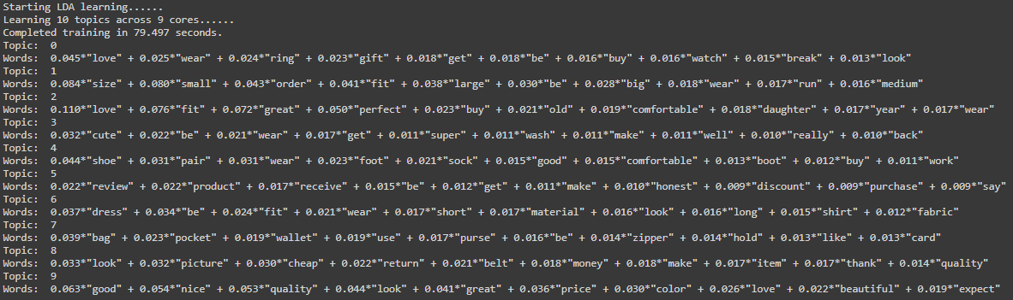
Topics = 10
Topic 0: item type: ring, watch; special: gift
Topic 1: size: size, small, fit, large, big, medium
Topic 2: comfort: comfortable; special: daughter; time: year, old
Topic 3: General words
Topic 4: item type: shoe, pair, foot, sock, boot; comfort: comfortable, work
Topic 5: price: discount, purchase, honest
Topic 6: item type: dress, shirt; appearance: short, long; quality: material, fabric
Topic 7: item type: bag, wallet, purse; functionality: pocket, zipper, hold, card
Topic 8: item type: belt; price: cheap, money; quality: quality
Topic 9: General positive words and aspects: good, nice, quality, look, great, price, color, beautiful
Special words: appearing occasionally when learning with other number of topics, but tend to appear with different item types or aspects.
With 10 topics, the segregation of item types and aspects seem to make more sense:
Watch and ring tend to be purchased as gifts.
Users tend to prioritize comfort when purchasing footwear.
Standalone topics related to price, which is a general aspects that are relevant to all item types.
Standalone topics related to size, which is a general aspects that are relevant to almost all item types.
Users tend to talk about appearance and fabric quality of dress and shirts.
Users tend to pay attention to functionality of items like bags, wallet and purse.
Standalone topics related to belt.

