Slide 1


Where's the money at?
By: Casey Freimund, Felipe Pincheira-Berthelon,
and Eagan Norman

Slide 2
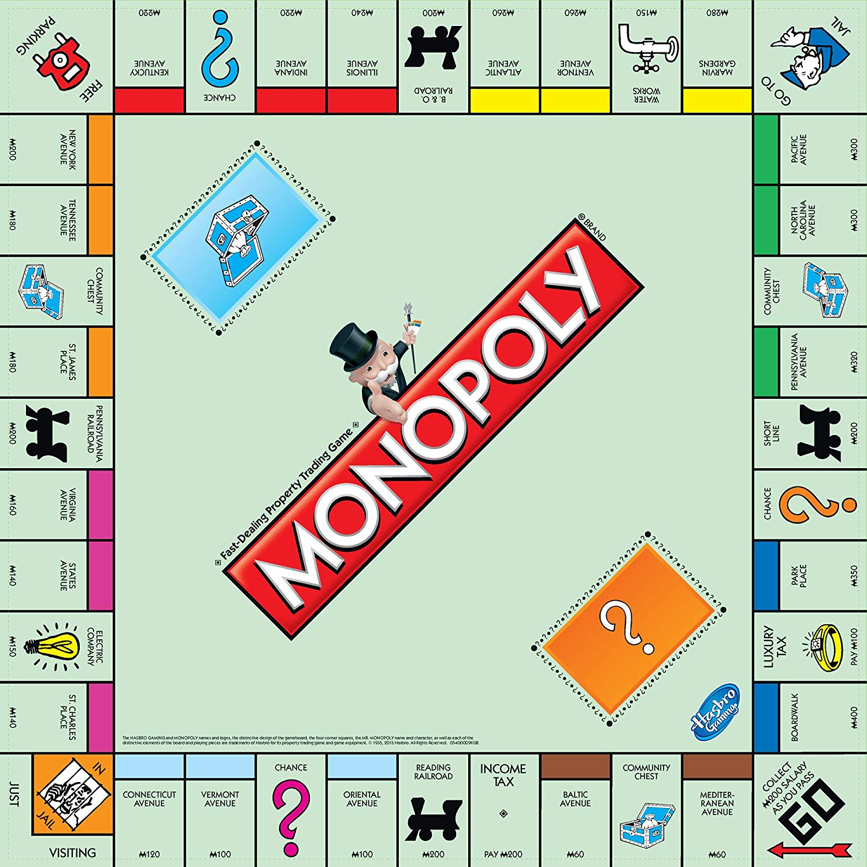
The Game
Movement:
Dice
Doubles
Jail:
Getting out of Jail
Chance & Community Chest:
Drawing a Card
"Get Out of Jail Free"
Special Spaces:
Income Tax/Luxury Tax
Go To Jail
Free Parking

Slide 3
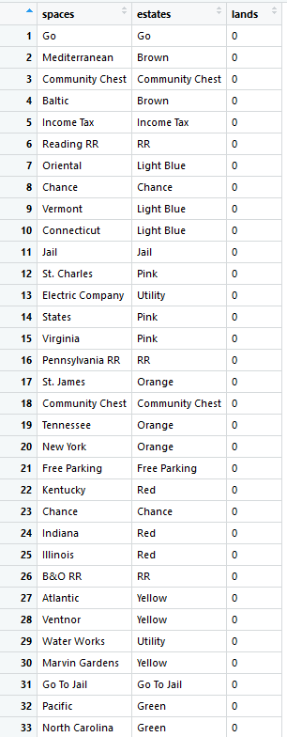
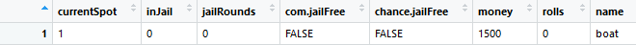
The Board and Players

Slide 4
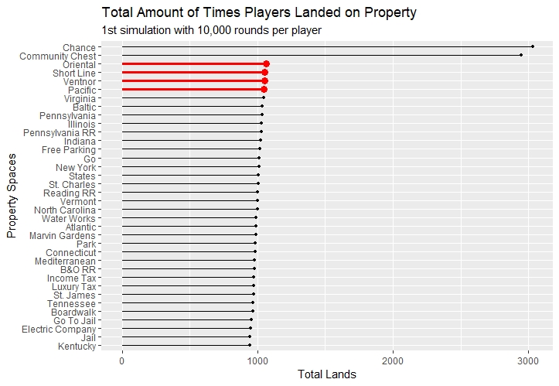
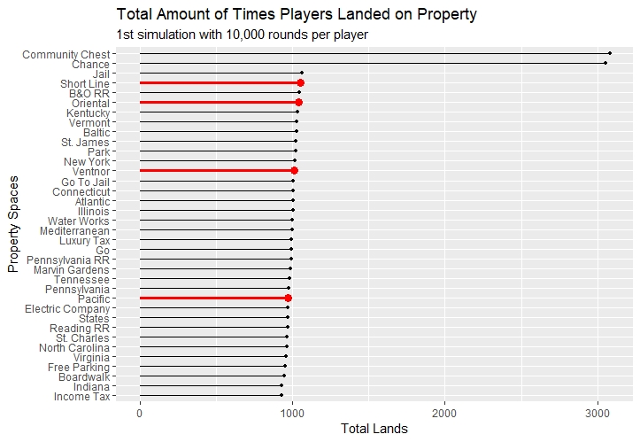
Simple Movement Around The Board

Slide 5
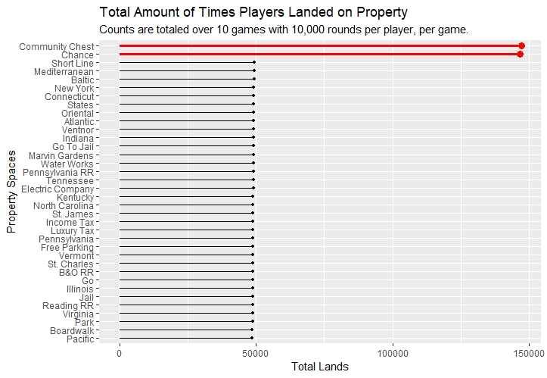
Simple Movement Around The Board

Slide 6
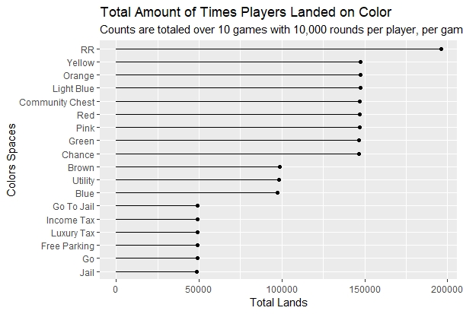
Simple Movement Around The Board

Slide 7
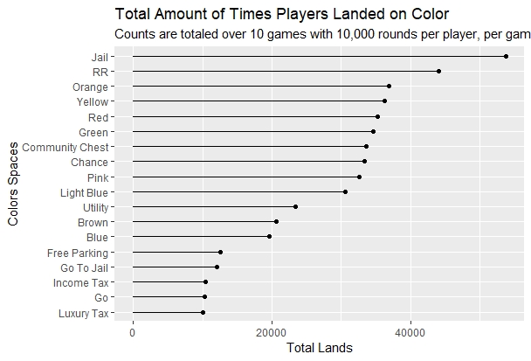
Moving with Jail and Doubles

Slide 8
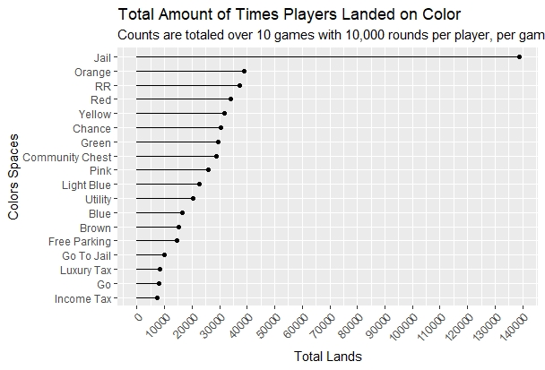
Adding Community Chest and Chance Decks

Slide 9
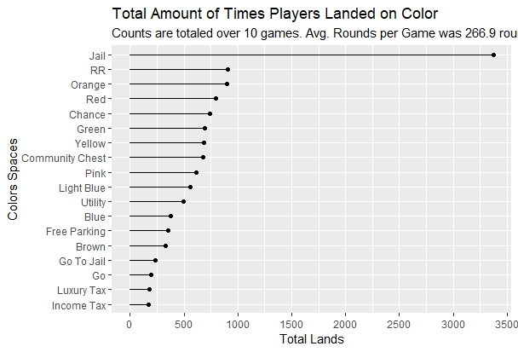
Adding Money

Slide 10
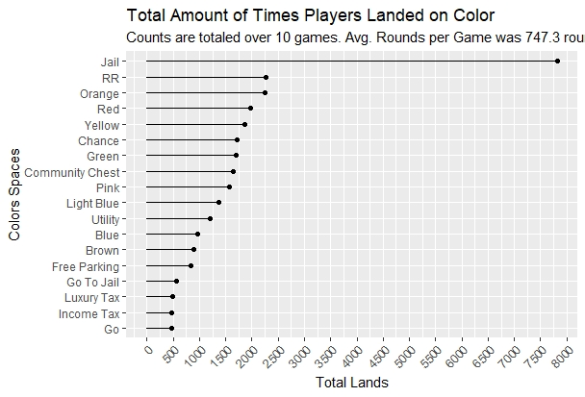
Adding Free Parking
(full game minus property purchasing)

Slide 11
Hot Zones?

Slide 12
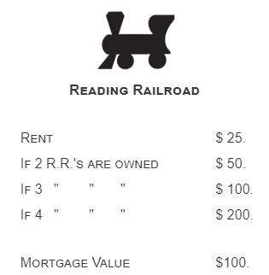
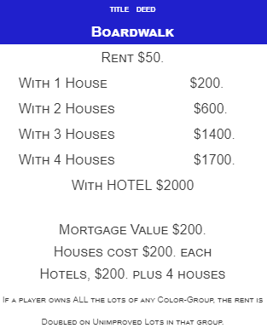
Incorporating Money and Properties

Slide 13


