Slide 1


Slide 2
1.6 Object Technology
Objects, or more precisely the classes objects come from, are essentially reusable software components.
There are date objects, time objects, audio objects, video objects, automobile objects, people objects, etc.
Almost any noun can be reasonably represented as a software object in terms of attributes (e.g., name, color and size) and behaviors (e.g., calculating, moving and communicating).
Using a modular, object-oriented design-and-implementation approach can make software-development groups much more productive than was possible with earlier techniques—object-oriented programs are often easier to understand, correct and modify.

Slide 3
1.6 Object Technology (Cont.)
The Automobile as an Object
Let’s begin with a simple analogy.
Suppose you want to drive a car and make it go faster by pressing its accelerator pedal.
Before you can drive a car, someone has to design it.
A car typically begins as engineering drawings, similar to the blueprints that describe the design of a house.
Drawings include the design for an accelerator pedal.
Pedal hides from the driver the complex mechanisms that actually make the car go faster, just as the brake pedal hides the mechanisms that slow the car, and the steering wheel hides the mechanisms that turn the car.

Slide 4
1.6 Object Technology (Cont.)
Enables people with little or no knowledge of how engines, braking and steering mechanisms work to drive a car easily.
Before you can drive a car, it must be built from the engineering drawings that describe it.
A completed car has an actual accelerator pedal to make the car go faster, but even that’s not enough—the car won’t accelerate on its own (we hope), so the driver must press the pedal to accelerate the car.

Slide 5
1.6 Object Technology (Cont.)
Methods and Classes
Performing a task in a program requires a method.
Houses the program statements that actually perform its task.
Hides these statements from its user, just as the accelerator pedal of a car hides from the driver the mechanisms of making the car go faster.

Slide 6
1.6 Object Technology (Cont.)
In object-oriented programming languages, we create a program unit called a class to house the set of methods that perform the class’s tasks.
A class is similar in concept to a car’s engineering drawings, which house the design of an accelerator pedal, steering wheel, and so on.

Slide 7
1.6 Object Technology (Cont.)
Making Objects from Classes
Just as someone has to build a car from its engineering drawings before you can actually drive a car, you must build an object from a class before a program can perform the tasks that the class’s methods define.
The process of doing this is called instantiation.
An object is then referred to as an instance of its class.

Slide 8
1.6 Object Technology (Cont.)
Reuse
Just as a car’s engineering drawings can be reused many times to build many cars, you can reuse a class many times to build many objects.
Reuse of existing classes when building new classes and programs saves time and effort.

Slide 9
1.6 Object Technology (Cont.)
Reuse also helps you build more reliable and effective systems, because existing classes and components often have gone through extensive testing, debugging and performance tuning.
Just as the notion of interchangeable parts was crucial to the Industrial Revolution, reusable classes are crucial to the software revolution that has been spurred by object technology.

Slide 10
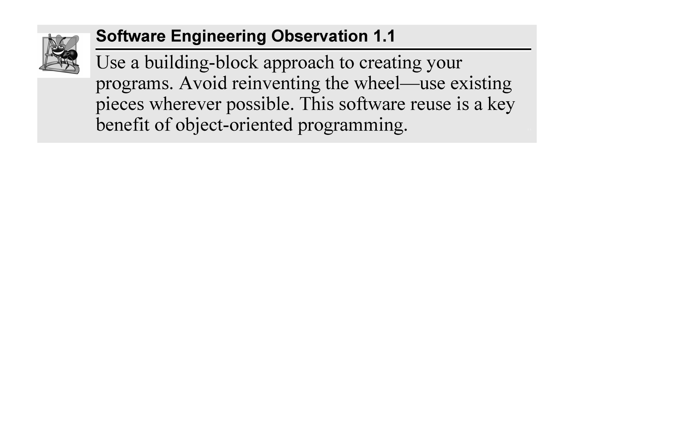

Slide 11
1.6 Object Technology (Cont.)
Messages and Method Calls
When you drive a car, pressing its gas pedal sends a message to the car to perform a task—that is, to go faster.
Similarly, you send messages to an object.
Each message is implemented as a method call that tells a method of the object to perform its task.

Slide 12
1.6 Object Technology (Cont.)
Attributes and Instance Variables
A car has attributes
Its color, its number of doors, the amount of gas in its tank, its current speed and its record of total miles driven (i.e., its odometer reading).
The car’s attributes are represented as part of its design in its engineering diagrams.
Every car maintains its own attributes.
Each car knows how much gas is in its own gas tank, but not how much is in the tanks of other cars.

Slide 13
1.6 Object Technology (Cont.)
An object has attributes that it carries along as it’s used in a program.
Specified as part of the object’s class.
A bank account object has a balance attribute that represents the amount of money in the account.
Each bank account object knows the balance in the account it represents, but not the balances of the other accounts in the bank.
Attributes are specified by the class’s instance variables.

Slide 14
1.6 Object Technology (Cont.)
Encapsulation
Classes encapsulate (i.e., wrap) attributes and methods into objects—an object’s attributes and operations are intimately related.
Objects may communicate with one another, but they’re normally not allowed to know how other objects are implemented—implementation details are hidden within the objects themselves.
Information hiding is crucial to good software engineering.

Slide 15
1.6 Object Technology (Cont.)
Inheritance
A new class of objects can be created quickly and conveniently by inheritance—the new class absorbs the characteristics of an existing class, possibly customizing them and adding unique characteristics of its own.
In our car analogy, an object of class “convertible” certainly is an object of the more general class “automobile,” but more specifically, the roof can be raised or lowered.

Slide 16
1.6 Object Technology (Cont.)
Object-Oriented Analysis and Design (OOAD)
To create the best solutions, you should follow a detailed analysis process for determining your project’s requirements (i.e., defining what the system is supposed to do)
Develop a design that satisfies them (i.e., deciding how the system should do it).
Carefully review the design (and have your design reviewed by other software professionals) before writing any code.

Slide 17
1.6 Object Technology (Cont.)
If this process involves analyzing and designing your system from an object-oriented point of view, it’s called an object-oriented analysis and design (OOAD) process.
Languages like C# are object oriented.
Object-oriented programming (OOP) allows you to implement an object-oriented design as a working system.

Slide 18
1.6 Object Technology (Cont.)
The UML (Unified Modeling Language)
The Unified Modeling Language (UML) is now the most widely used graphical scheme for modeling object-oriented systems.

Slide 19
1.8 C#
In 2000, Microsoft announced the C# programming language.
C# has roots in C, C++ and Java.
C# has similar capabilities to Java and is appropriate for the most demanding app-development tasks, especially for building today’s large-scale enterprise apps, and web-based, mobile and “cloud”-based apps.

Slide 20
1.8.1 Object-Oriented Programming
C# is object oriented.
C# has access to the powerful .NET Framework Class Library—a vast collection of prebuilt classes that enable you to develop apps quickly.

Slide 21
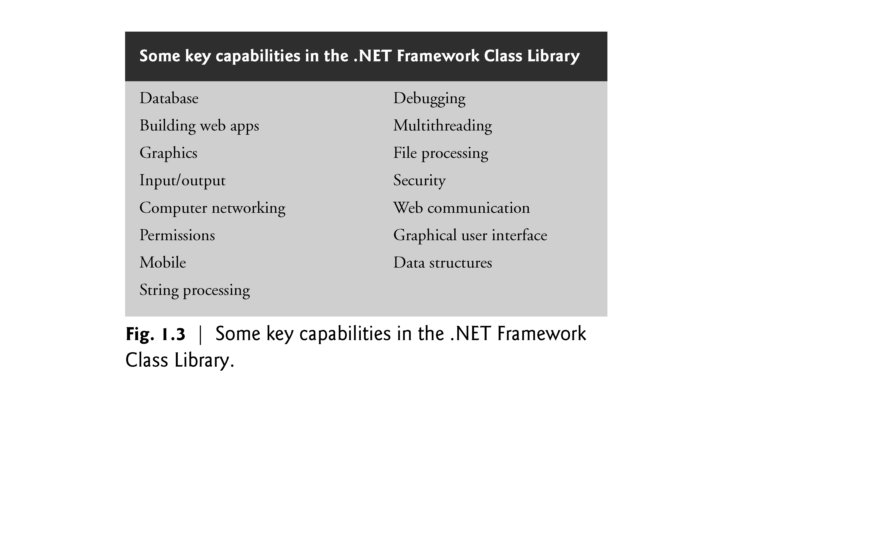

Slide 22
1.8.2 Event-Driven Programming
C# is event driven.
You’ll write programs that respond to user-initiated events such as mouse clicks, keystrokes, timer expirations and—new in Visual C# 2012—touches and finger swipes—gestures that are widely used on smartphones and tablets.

Slide 23
1.8.3 Visual Programming
Microsoft’s Visual C# is a visual programming language—in addition to writing program statements to build portions of your apps, you’ll also use Visual Studio’s graphical user interface to conveniently drag and drop predefined objects like buttons and textboxes into place on your screen, and label and resize them.
Visual Studio will write much of the GUI code for you.

Slide 24
1.8.4 An International Standard; Other C# Implementations
C# has been standardized internationally.
This enables other implementations of the language besides Microsoft’s Visual C#, such as Mono (www.mono-project.com) that runs on Linux systems, iOS (for Apple’s iPhone, iPad and iPod touch), Google’s Android and Windows.
You can find the C# standard document at: www.ecma-international.org/publications/ standards/Ecma-334.htm

Slide 25
1.8.5 Internet and Web Programming
Today’s apps can be written with the aim of communicating among the world’s computers.
As you’ll see, this is the focus of Microsoft’s .NET strategy.
In Chapters 23, 29 and 30, you’ll build web-based apps with C# and Microsoft’s ASP.NET technology.

Slide 26
1.8.6 Introducing async/await
In most programming today, each task in a program must finish executing before the next task can begin.
This is called synchronous programming and is the style we use for most of this book.
C# also allows asynchronous programming in which multiple tasks can be performed at the same time.
Asynchronous programming can help you make your apps more responsive to user interactions, such as mouse clicks and keystrokes, among many other uses.
Visual C# 2012’s new async and await capabilities simplify asynchronous programming, because the compiler hides much of the associated complexity from the developer.

Slide 27
1.8.7 Other Key Contemporary Programming Languages
Figure 1.4 summarizes some popular programming languages with features comparable to those of C#.

Slide 28
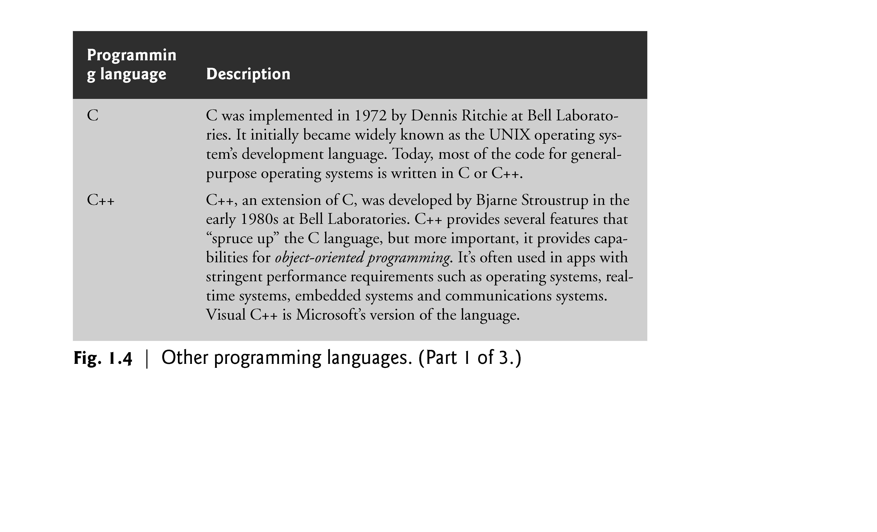

Slide 29
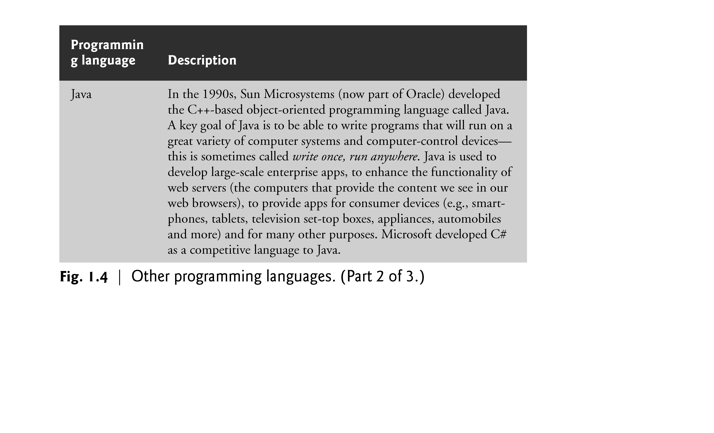

Slide 30
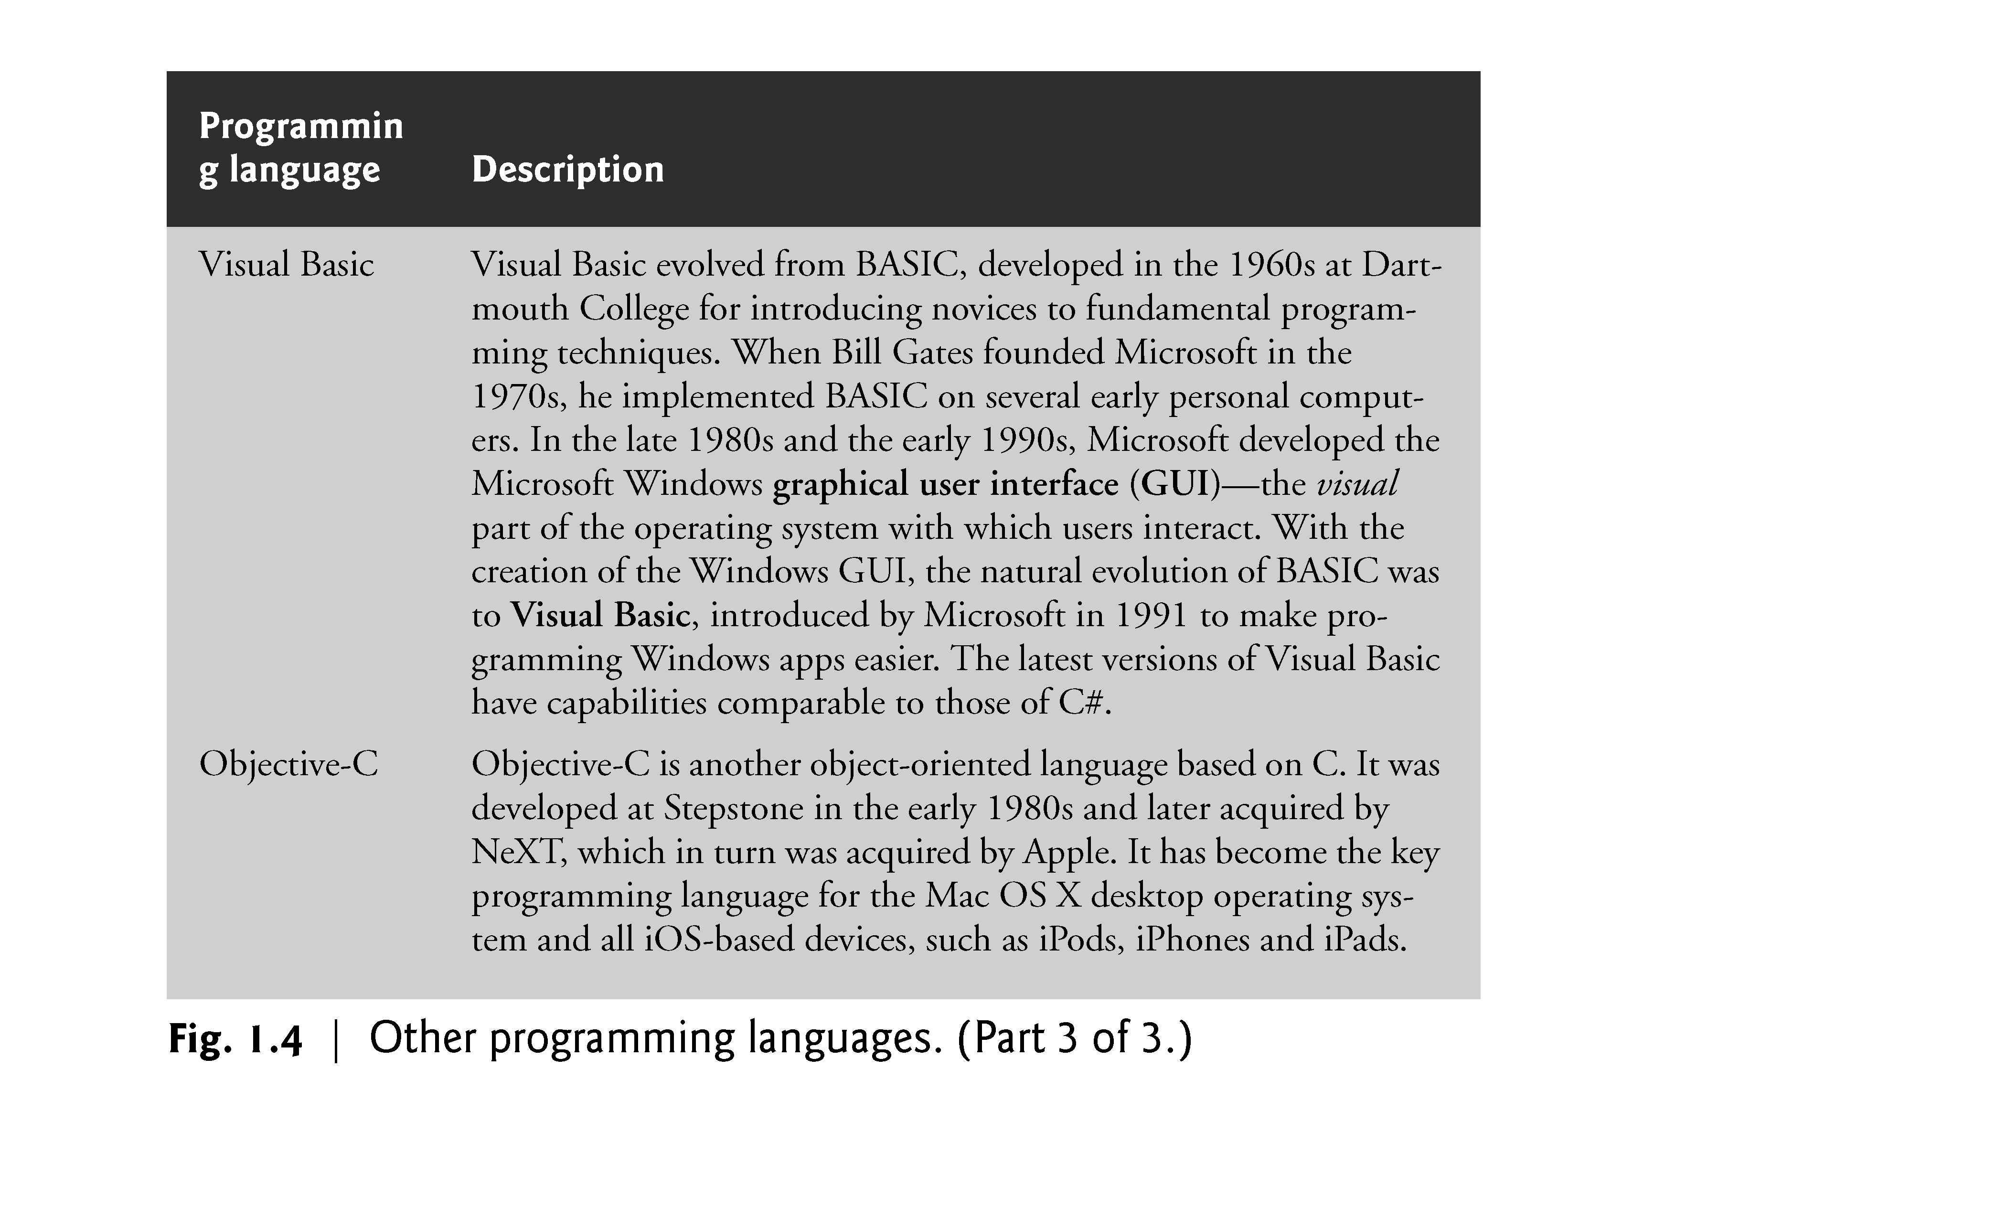

Slide 31
1.9 Microsoft’s .NET
In 2000, Microsoft announced its .NET initiative, a broad vision for using the Internet and the web in the development, engineering, distribution and use of software.
.NET permits developers to create apps in any .NET-compatible language (such as C#, Visual Basic and many others).
Part of the initiative includes Microsoft’s ASP.NET technology, which is used to create web apps that users interact with via their web browsers.

Slide 32
1.9.1 .NET Framework
The .NET Framework contains the .NET Framework Class Library, which provides many capabilities that you’ll use to build substantial C# apps quickly and easily.
The .NET Framework Class Library has thousands of valuable prebuilt classes that have been tested and tuned to maximize performance.
You’ll learn how to create your own classes, but you should re-use the .NET Framework classes when possible to speed up the software development process, while enhancing the quality and performance of the software you develop.

Slide 33
1.9.2 Common Language Runtime
The Common Language Runtime (CLR) executes .NET programs and provides functionality to make them easier to develop and debug.
The CLR is a virtual machine (VM)—software that manages the execution of programs and hides from them the underlying operating system and hardware.
The source code for programs that are executed and managed by the CLR is called managed code.

Slide 34
1.9.2 Common Language Runtime (Cont.)
The CLR provides various services to managed code, such as integrating software components written in different .NET languages, error handling between such components, enhanced security, automatic memory management and more.
Unmanaged-code programs do not have access to the CLR’s services, which makes unmanaged code more difficult to write. (msdn.microsoft.com/en-us/library/8bs2ecf4.aspx)

Slide 35
1.9.2 Common Language Runtime (Cont.)
Managed code is compiled into machine-specific instructions in the following steps:
First, the code is compiled into Microsoft Intermediate Language (MSIL). Code converted into MSIL from other languages and sources can be woven together by the CLR—this allows programmers to work in their preferred .NET programming language. The MSIL for an app’s components is placed into the app’s executable file—the file that causes the computer to perform the app’s tasks.

Slide 36
1.9.2 Common Language Runtime (Cont.)
When the app executes, another compiler (known as the just-in-time compiler or JIT compiler) in the CLR translates the MSIL in the executable file into machine-language code (for a particular platform).
The machine-language code executes on that platform.

Slide 37
1.9.3 Platform Independence
If the .NET Framework exists and is installed for a platform, that platform can run any .NET program.
The ability of a program to run without modification across multiple platforms is known as platform independence.
Code written once can be used on another type of computer without modification, saving time and money.
Previously, companies had to decide whether converting their programs to different platforms—a process called porting—was worth the cost.
With .NET, porting programs is no longer an issue, at least once .NET itself has been made available on the platforms.

Slide 38
1.9.4 Language Interoperability
The .NET Framework provides a high level of language interoperability.
Because software components written in different .NET languages (such as C# and Visual Basic) are all compiled into MSIL, the components can be combined to create a single unified program.
Thus, MSIL allows the .NET Framework to be language independent.
.NET 4.5 features .NET for Windows Store Apps—a subset of .NET that’s used to create Windows 8 UI (user interface) style apps.

Slide 39
1.10 Microsoft’s Windows® Operating System
Windows is the most widely used desktop operating system worldwide.
Operating systems are software systems that make using computers more convenient for users, app developers and system administrators.
They provide services that allow each app to execute safely, efficiently and concurrently (i.e., in parallel) with other apps.

Slide 40
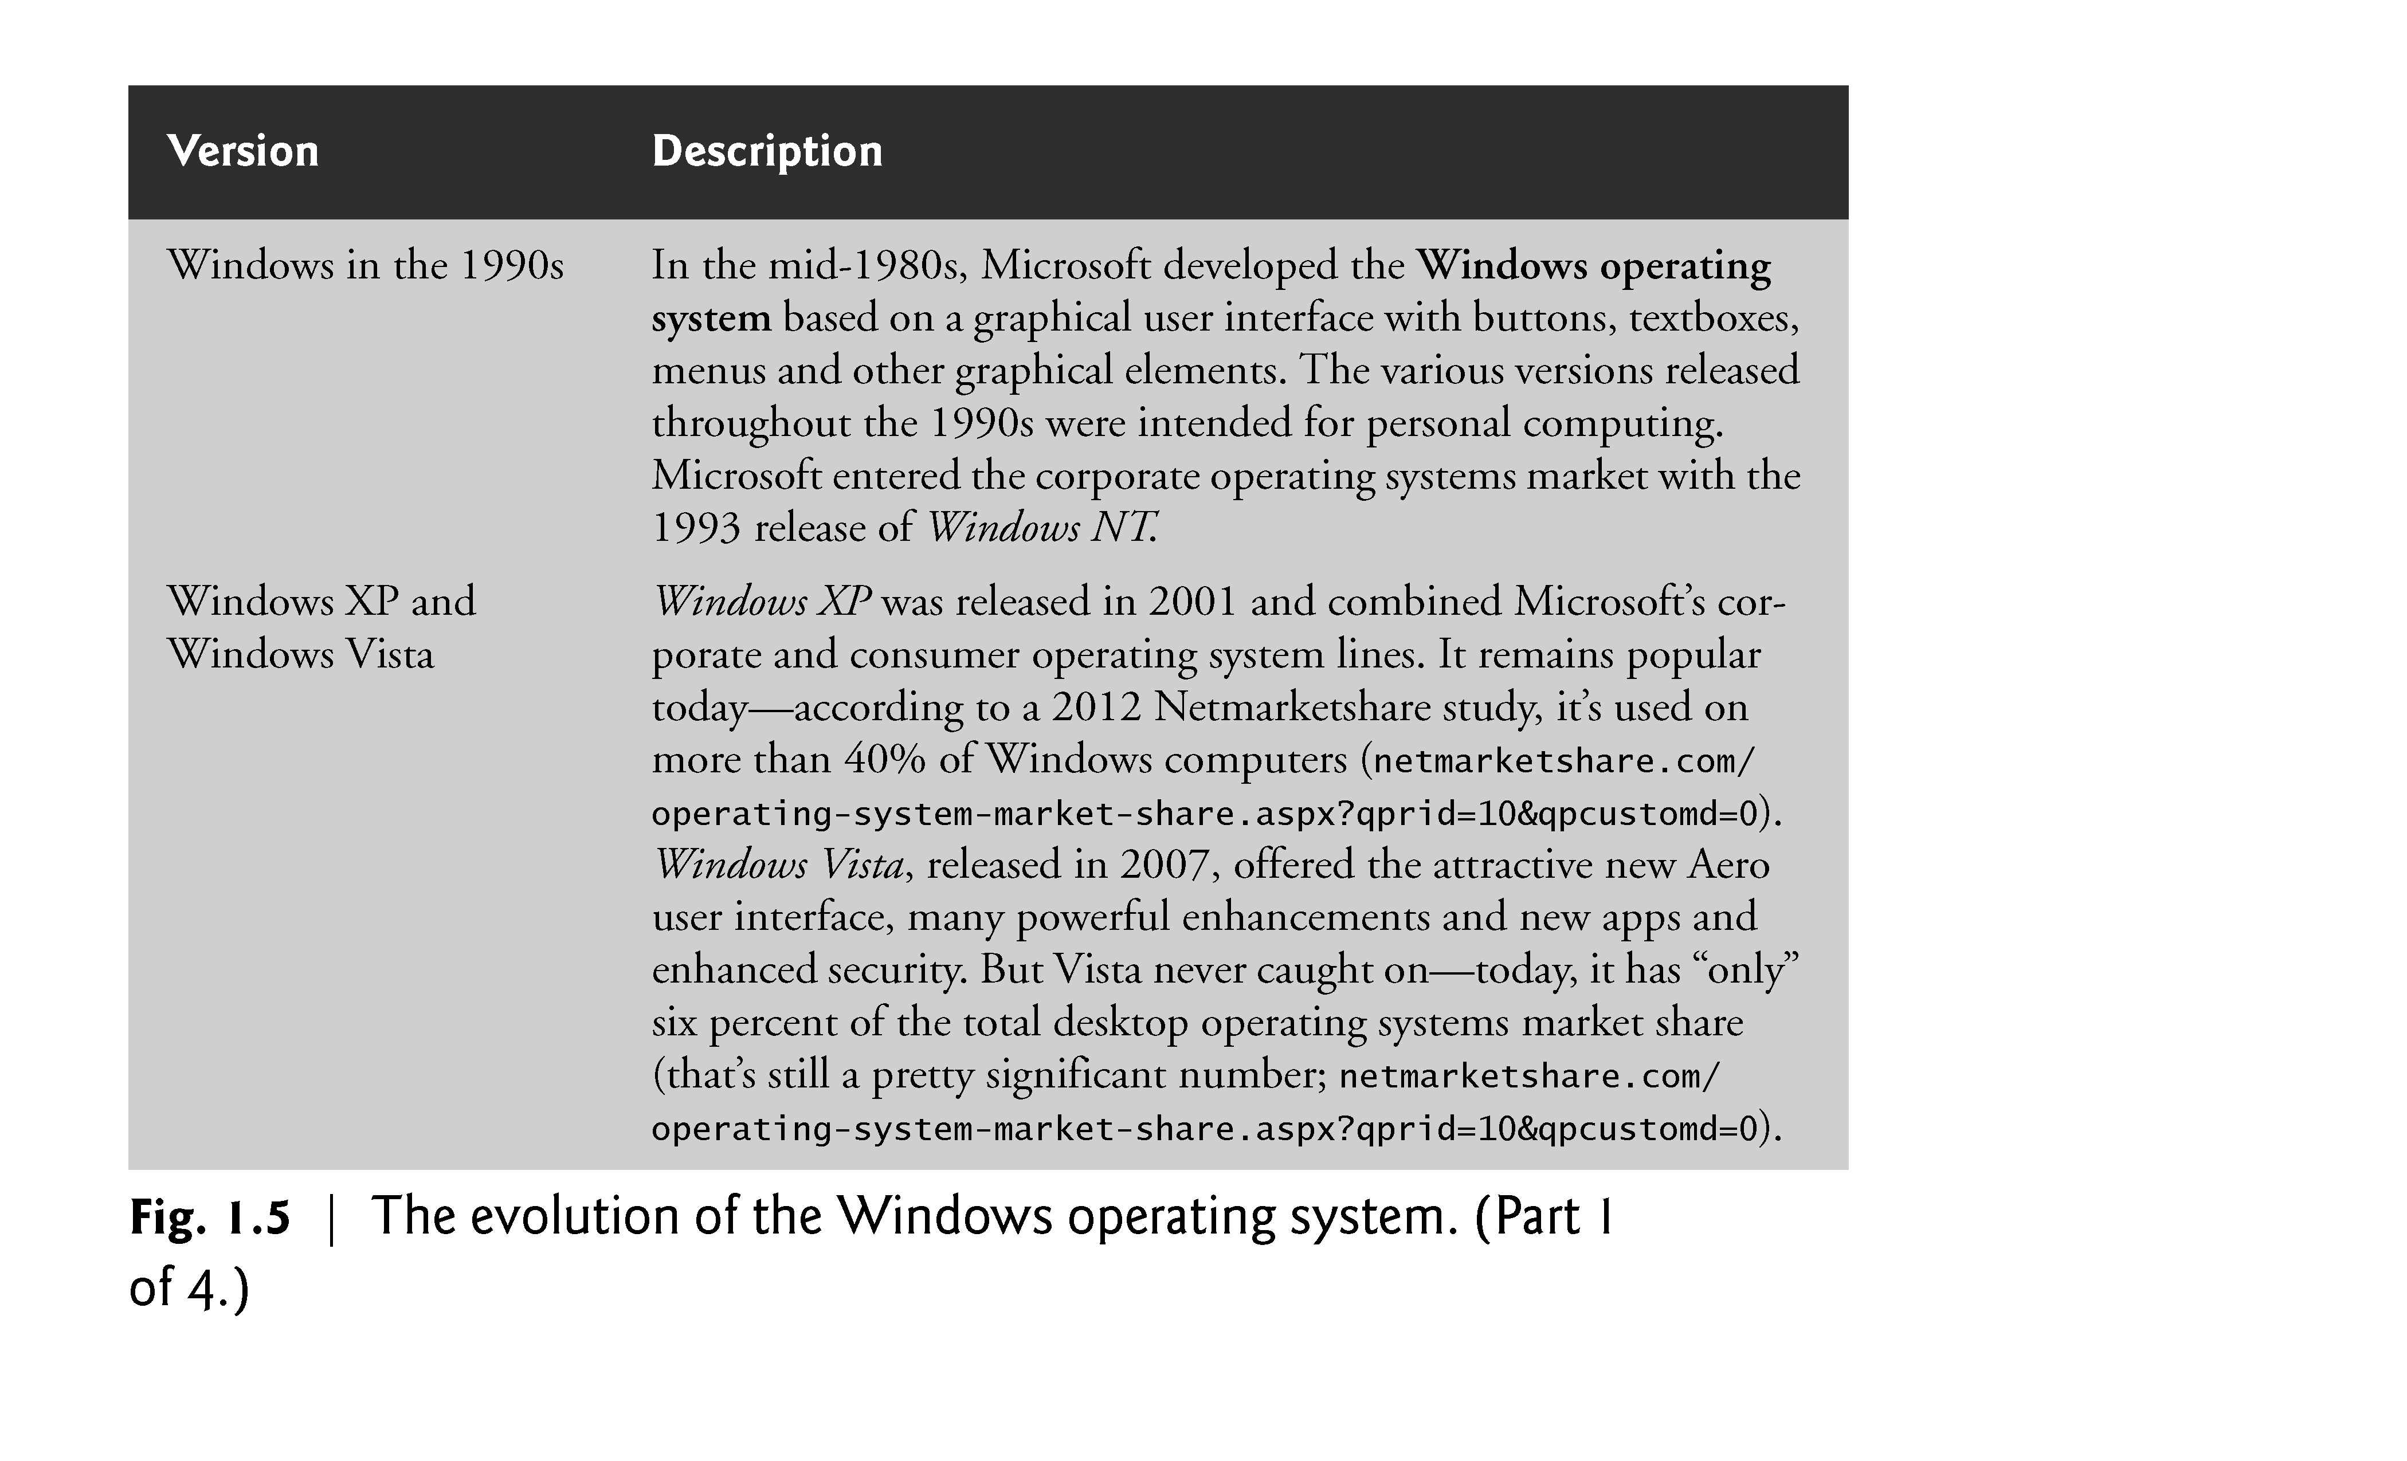

Slide 41
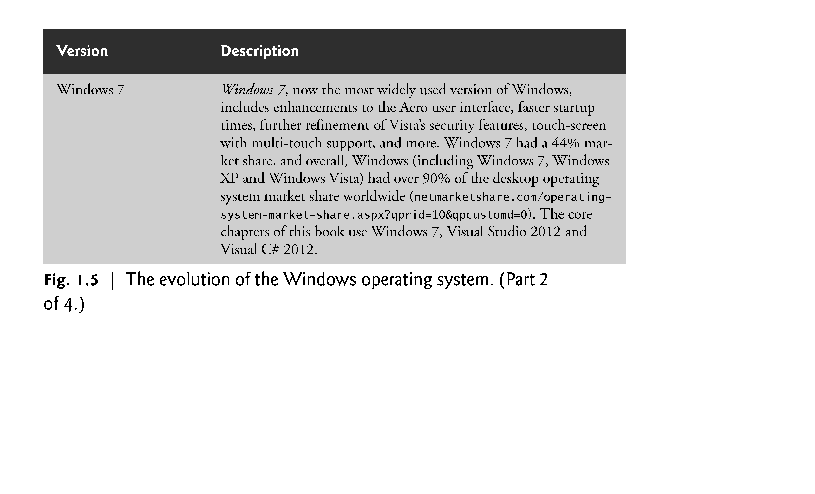

Slide 42
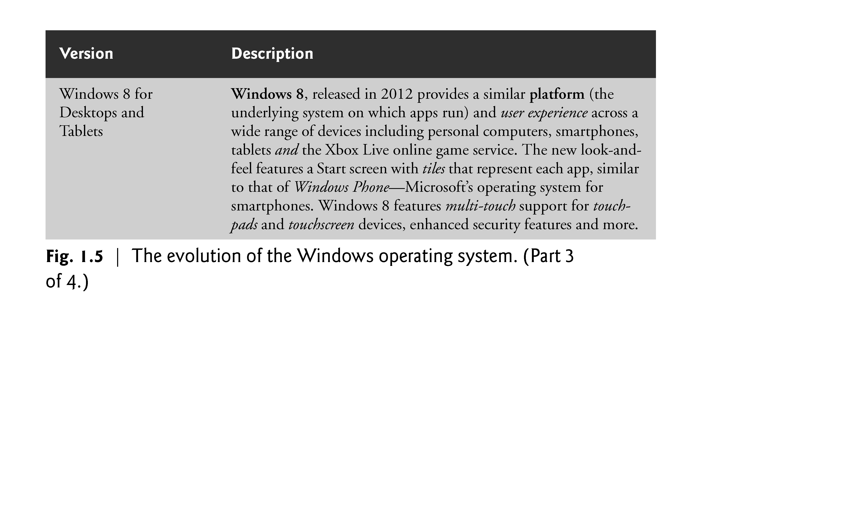

Slide 43
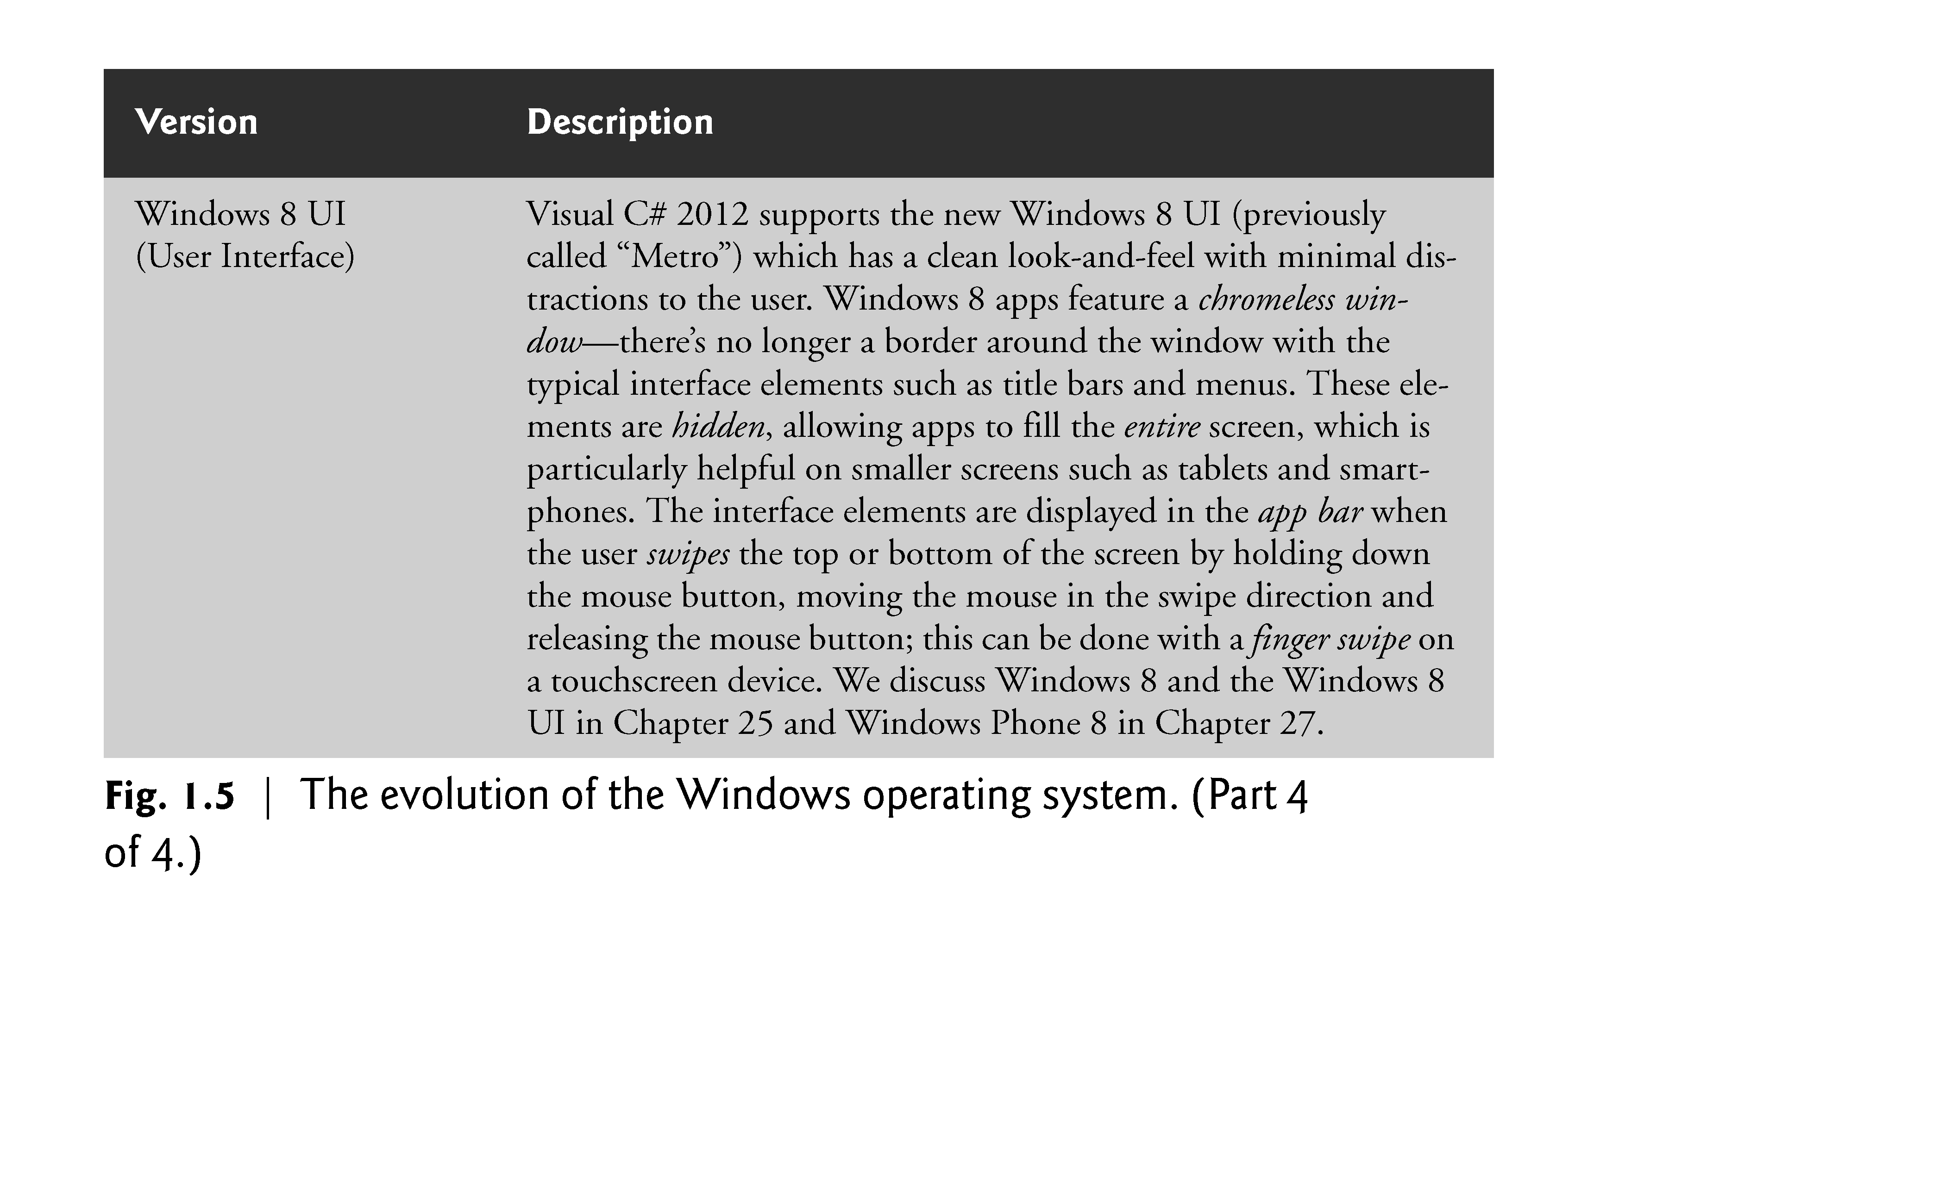

Slide 44
1.10 Microsoft’s Windows® Operating System (Cont.)
Windows Store
You can sell Windows 8 UI desktop and tablet apps or offer them for free in the Windows Store.
The fee is waived for Microsoft DreamSpark program students (see the Preface).
To learn more about the Windows Store and monetizing your apps, visit msdn.microsoft.com/en-us/library/windows/ apps/br229519.aspx.

Slide 45
1.11 Windows Phone 8 for Smartphones
Windows Phone 8 is a pared down version of Windows 8 designed for smartphones.
Windows Phone 8 has the same core operating systems services as Windows 8, including a common file system, security, networking, media and Internet Explorer 10 (IE10) web browser technology.
However, Windows Phone 8 has only the features necessary for smartphones, allowing them to run efficiently, minimizing the burden on the device’s resources.

Slide 46
1.11.1 Selling Your Apps in the Windows Phone Marketplace
You can sell your own Windows Phone apps in the Windows Phone Marketplace (www.windowsphone.com/marketplace).
You can also earn money by making your apps free for download and selling virtual goods (e.g., additional content, game levels, e-gifts and add-on features) using in-app purchase.

Slide 47
1.11.2 Free vs. Paid Apps
Paid Windows Phone 8 apps range in price from $1.49 (which is higher than the $0.99 starting price for apps in Google Play and Apple’s App Store) to $999.99.
The average price for mobile apps is approximately $1.50 to $3, depending on the platform.
For Windows Phone apps, Microsoft retains 30% of the purchase price and distributes 70% to you.

Slide 48
1.11.3 Testing Your Windows Phone Apps
You can test your phone apps on the Windows Phone Emulator that Microsoft provides with the Windows Phone 8 SDK (software development kit).
To test your apps on a Windows phone and to sell your apps or distribute your free apps through the Windows Phone Marketplace, you'll need to join the Windows Phone Dev Center.
The program is free to DreamSpark students.
The website includes development tools, sample code, tips for selling your apps, design guidelines and more.
To join the Windows Phone Dev Center and submit apps, visit dev.windowsphone.com/en-us/downloadsdk.

Slide 49
1.12 Windows Azure™ and Cloud Computing
Cloud computing allows you to use software and data stored in the cloud—i.e., accessed on remote computers (or servers) via the Internet and available on demand—rather than having it stored on your desktop, notebook computer or mobile device.
Gives you the flexibility to increase or decrease computing resources to meet your resource needs at any given time.
More cost effective than purchasing expensive hardware to ensure that you have enough storage and processing power at their occasional peak levels.

Slide 50
1.12 Windows Azure™ and Cloud Computing (Cont.)
Also saves money by shifting the burden of managing these apps to the service provider.
With Windows Azure, your apps can store their data in the cloud so that the data is available at all times from any of your desktop computer and mobile devices.
Verified DreamSpark students can download Visual Studio 2012 Professional which includes built-in support for Windows 8 and Windows Azure.
You can sign up for a free 90-day trial of Windows Azure at www.windowsazure.com/en-us/pricing/free-trial/.

Slide 51
1.13 Visual Studio Integrated Development Environment
C# programs are created using Microsoft’s Visual Studio—a collection of software tools called an Integrated Development Environment (IDE).
The Visual Studio 2012 IDE enables you to write, run, test and debug C# programs quickly and conveniently.

