Slide 1
Forms

Slide 2

Overview of Forms
Forms are used all over the Web to
Accept information
Provide interactivity
Types of forms:
Search form, Order form, Newsletter sign-up form, Survey form, Add to Cart form, and so on…

Slide 3
Overview of Forms (2)
Form
An HTML element that contains and organizes form controls such as text boxes, check boxes, and buttons that can accept information from Web site visitors.

Slide 4
Two Components of Using Forms
1. The HTML form
-- the Web page user interface
and
2. The server-side processing
Server-side processing works with the form data and sends e-mail, writes to a text file, updates a database, or performs some other type of processing on the server.

Slide 5
HTML Using Forms
<form> tag
Contains the form elements on a web page
Container tag
<input /> tag
Configures a variety of form elements including text boxes, radio buttons, check boxes, and buttons
Stand alone tag
<textarea> tag
Configures a scrolling text box
Container tag
<select> tag
Configures a select box (drop down list)
Container tag
<option> tag
Configures an option in the select box
Container tag

Slide 6
HTML <form> element
The form tag attributes:
action
Specifies the server-side program or script that will process your form data
method
get – default value, form data passed in URL
post – more secure, form data passed in HTTP Entity Body
name
Identifies the form
id
Identifies the form

Slide 7

HTML<input /> Text box
Accepts text information
Attributes:
type=“text”
name
id
size
maxlength
value

Slide 8

HTML<input /> Password box
Accepts text information that needs to be hidden as it is entered
Attributes:
type=“password”
name
id
size
maxlength
value

Slide 9
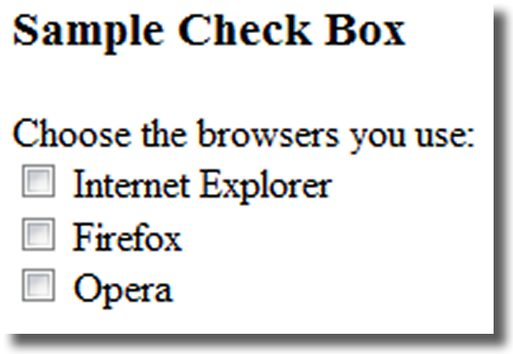
HTML<input /> Check box
Allows the user to select one or more of a group of predetermined items
Attributes:
type=“checkbox”
name
id
checked
value

Slide 10
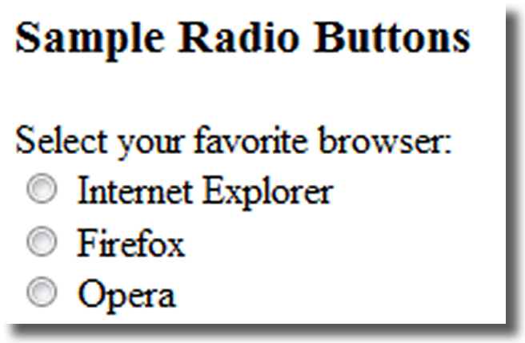
HTML<input /> Radio Button
Allows the user to select exactly one from a group of predetermined items
Each radio button in a group is given the same name and a unique value
Attributes:
type=“radio”
name
id
checked
value

Slide 11
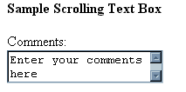
HTML<textarea> Scrolling Text Box
Configures a scrolling text box
Attributes:
name
id
cols
rows

Slide 12

HTML<select> Select List
Configures a select list (along with <option> tags)
Also known as: Select Box, Drop-Down List, Drop-Down Box, and Option Box.
Allows the user to select one or more items from a list of predetermined choices.
Attributes:
name
id
size
multiple

Slide 13
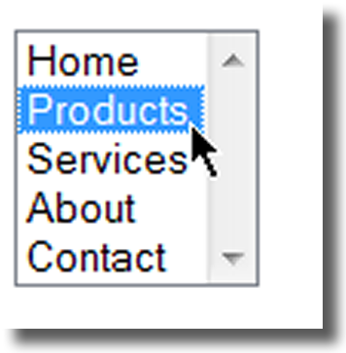
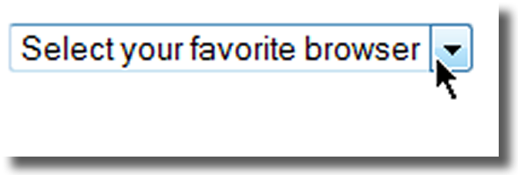
HTML<option> Options in a Select List
Configures the options in a Select List
Attributes:
value
selected

Slide 14
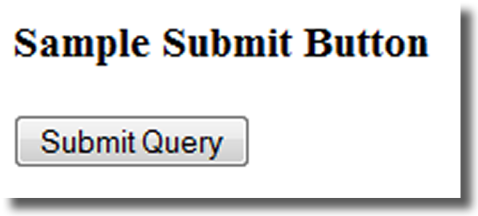
HTML<input /> Submit Button
Submits the form information
When clicked:
Triggers the action method on the <form> tag
Sends the form data (the name=value pair for each form element) to the web server.
Attributes:
type=“submit”
name
id
value

Slide 15
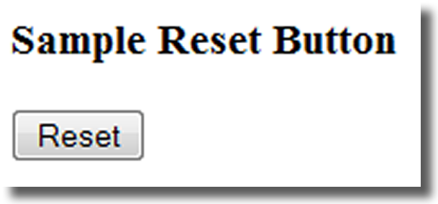
HTML<input /> Reset Button
Resets the form fields to their initial values
Attributes:
type=“reset”
name
id
value

Slide 16
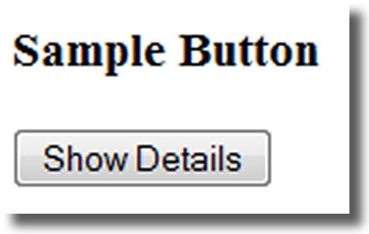
HTML<input /> Button
Offers a flexible user interface
There is no default action when the button is clicked
Usually a JavaScript function is invoked when a button is clicked
Attributes:
type=“button”
name
id
value

Slide 17
HTML<input /> Hidden form data
This form control is not displayed on the Web page.
Hidden form fields
Can be accessed by both client-side and server-side scripting
Sometimes used to contain information needed as the visitor moves from page to page.
Attributes:
type=“hidden”
name
id
value

Slide 18
HTML Using a Table to Format a Form
<form>
<table border="0" width="75%">
<tr>
<td align="right" width="10%">Name: </td>
<td> <input type="text" name= "CustName" id= "CustName " size="30" /></td>
</tr>
<tr>
<td align="right" width="10%">Email: </td>
<td> <input type="text" name="CustEmail" id="CustEmail" /></td>
</tr>
<tr>
<td align="right" width="10%"> <input type="submit" value="Submit" /></td>
<td><input type="reset" /></td>
</tr>
</table>
</form>

Slide 19
HTML Form Enhancements <label> Tag
Associates a text label with a form control
Two Different Formats: <label>Email: <input type="text" name="CustEmail" id ="CustEmail" /></label>
Or <label for="email">Email: </label> <input type="text" name="CustEmail" id= "email" />

Slide 20
HTML Form Enhancements <fieldset> & <legend> Tags
The Fieldset Element
Container tag
Creates a visual group of form elements on a web page
The Legend Element
Container tag
Creates a text label within the fieldset
<fieldset><legend>Customer Information</legend>
<label>Name: <input type="text" name="CustName" id="CustName" size="30" /></label><br />
<label>Email: <input type="text" name="CustEmail" id="CustEmail" /></label>
</fieldset>

Slide 21
HTML Form Enhancements tabindex attribute
Attribute that can be used on form controls and anchor tags
Modifies the default tab order
Assign a numeric value
<input type="text" name="CustEmail" id="CustEmail" tabindex="1" />

Slide 22
HTML Form Enhancements accesskey attribute
Attribute that can be used on form controls and anchor tags
Create a “hot-key” combination to place the focus on the component
Assign a value of a keyboard letter
On Windows use the CTRL and the “hot-key” to move the cursor
<input type="text" name="CustEmail" id="CustEmail" accesskey="E" />

Slide 23
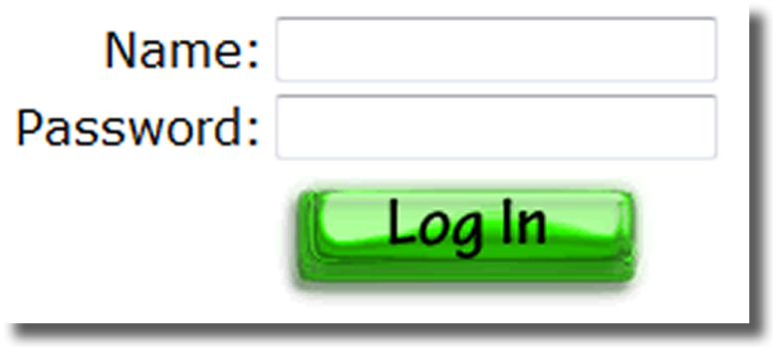
HTML Form Enhancements <input /> Image Button
Submits the form
When clicked:
Triggers the action method on the <form> tag
Sends the form data (the name=value pair for each form element) to the Web server.
Attributes:
type=“image”
name
id
src

Slide 24
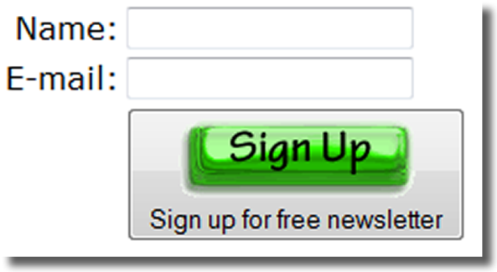
HTML Form Enhancements <button> Element
A container tag
When clicked, its function depends on the value of the type attribute.
Can contain a combination of text, images, and media
Attributes:
type=“submit”, type=“reset”, type=“button”
name
id
alt
value

Slide 25
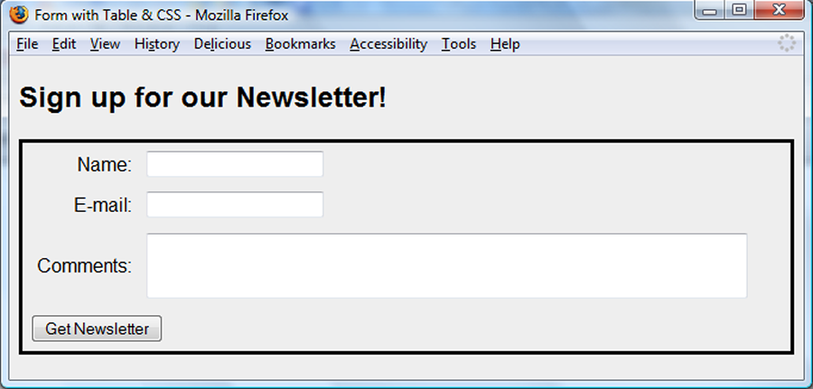
Using CSS to Style a Form
Moderate Approach
Use a table to format the form but configure styles instead of HTML table attributes.
table { border: 3px solid #000000;
width: 100%;}
td { padding: 5px;
margin: 0px;}
.mylabel { text-align: right;}

Slide 26
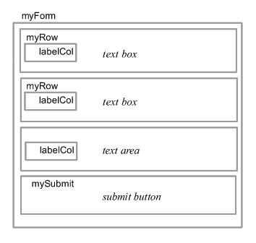
Using CSS to Style a Form
“Pure" CSS Approach
Do not use a table to format the form.
Use CSS divs and spans with positioning properties to configure the page.
#myForm {border:3px solid #000000;
padding:10px;margin:10px;}
.myRow {padding-bottom: 20px;
.labelCol {float:left;width:100px; text-align:right;}

Slide 27

Server-Side Processing
Your web browser requests web pages and their related files from a web server.
The web server locates the files and sends them to your web browser.
The web browser then renders the returned files and displays the requested web pages for you to use.

Slide 28
CGI Common Gateway Interface
A protocol for a web server to pass a web page user's request to an application program and accept information to send to the user.

Slide 29
Server-Side Scripting
One of many technologies in which a server-side script is embedded within a Web page document saved with a file extension such as:
.php (PHP)
.asp (Active Server Pages)
.cfm (Adobe ColdFusion)
.jsp (Sun JavaServer Pages)
.aspx (ASP.Net).
Uses direct execution — the script is run either by the Web server itself or by an extension module to the Web server.

Slide 30
Steps in Utilizing Server-Side Processing
Web page invokes server-side processing by a form or hyperlink.
Web server executes a server-side script.
Server-side script accesses requested database, file, or process.
Web server returns Web page with requested information or confirmation of action.

Slide 31
Common Uses of Server-Side Scripting
Search a database
Place an order at an online store
Send a web page to a friend
Subscribe to a newsletter

