Slide 1
Tables
Key Concepts

Slide 2
Table
Tables are commonly used on Web pages in two ways:
To organize information
To format the layout of an entire Web page

Slide 3
Using Tables
Composed of rows and columns – similar to a spreadsheet.
Each individual table cell is at the intersection of a specific row and column.
Configured with <table>, <tr>, and <td> elements

Slide 4
Table Elements
<table> Element
Contains the table Common attributes: border, width, align
<tr> Element Contains a table row
<td> Element Contains a table cell
<caption> Element
Configures a description of the table

Slide 5
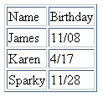
Table Example
<table border="1"> <caption>Birthday List</caption>
<tr>
<td>Name</td>
<td>Birthday</td>
</tr>
<tr>
<td>James</td>
<td>11/08</td>
</tr>
<tr>
<td>Karen</td>
<td>4/17</td>
</tr>
<tr>
<td>Sparky</td>
<td>11/28</td>
</tr>
</table>
Birthday List

Slide 6
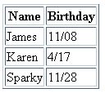
Table Example 2
<table border="1">
<tr>
<th>Name</th>
<th>Birthday</th>
</tr>
<tr>
<td>James</td>
<td>11/08</td>
</tr>
<tr>
<td>Karen</td>
<td>4/17</td>
</tr>
<tr>
<td>Sparky</td>
<td>11/28</td>
</tr>
</table>
Using the <th> Element

Slide 7
Common Table Attributes
align (deprecated)
bgcolor (deprecated)
border
cellpadding
cellspacing
summary
width
Percentage or pixels?

Slide 8
Common Table Cell Attributes
align
bgcolor (deprecated)
colspan
rowspan
valign
height (deprecated)
width (deprecated)

Slide 9

colspan Attribute
<table border="1">
<tr>
<td colspan=“2”> Birthday List</td>
</tr>
<tr>
<td>James</td>
<td>11/08</td>
</tr>
<tr>
<td>Karen</td>
<td>4/17</td>
</tr>
</table>

Slide 10
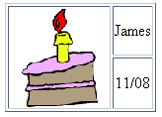
rowspan Attribute
<table border="1">
<tr>
<td rowspan=“2>
<img src=“cake.gif” alt=“cake” height=“100” width=“100” /></td>
<td>James</td>
</tr>
<tr>
<td>11/08</td>
</tr>
</table>

Slide 11
Accessibility and Tables
Use <th> elements to indicate column or row headings.
Table element summary attribute
provide an overview of the table contents
Complex tables: Associate table cell values with their corresponding headers
<th> tag id attribute
<td> tag headers attribute

Slide 12
Table Row Groups
<table border="1" width="75%"
summary="This table lists my educational background.">
<thead>
<tr>
<th>School Attended</th>
<th>Years</th>
</tr>
</thead>
<tbody>
<tr>
<td>Schaumburg High School</td>
<td>2005 - 2009</td>
</tr>
<tr>
<td>Harper College</td>
<td>2009 - 2010</td>
</tr>
</tbody>
</table>
<thead> table head rows
<tbody > table body rows
<tfoot> table footer rows

Slide 13
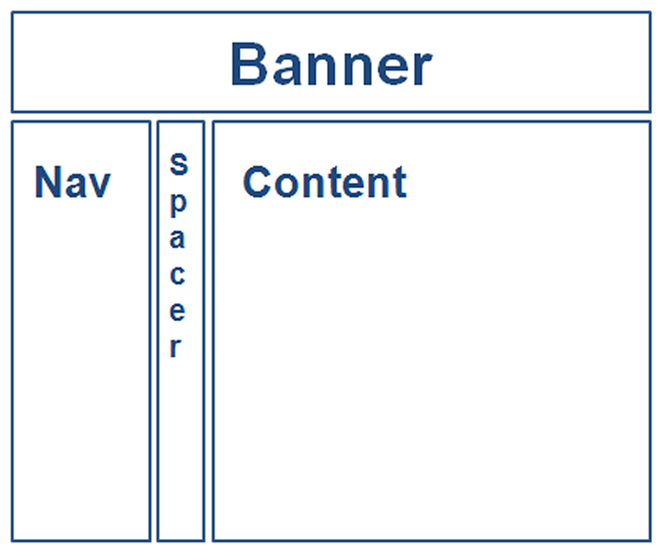
Using a Table to Format a Web Page
<table border="0" width="80%">
<tr>
<td colspan="3"> <h1>This is the banner area</h1> </td>
</tr>
<tr>
<td width="20%" valign="top"> Place Navigation here</td>
<td width="10">&nbsp;</td>
<td>Page content goes here</td>
</tr>
</table>

Slide 14
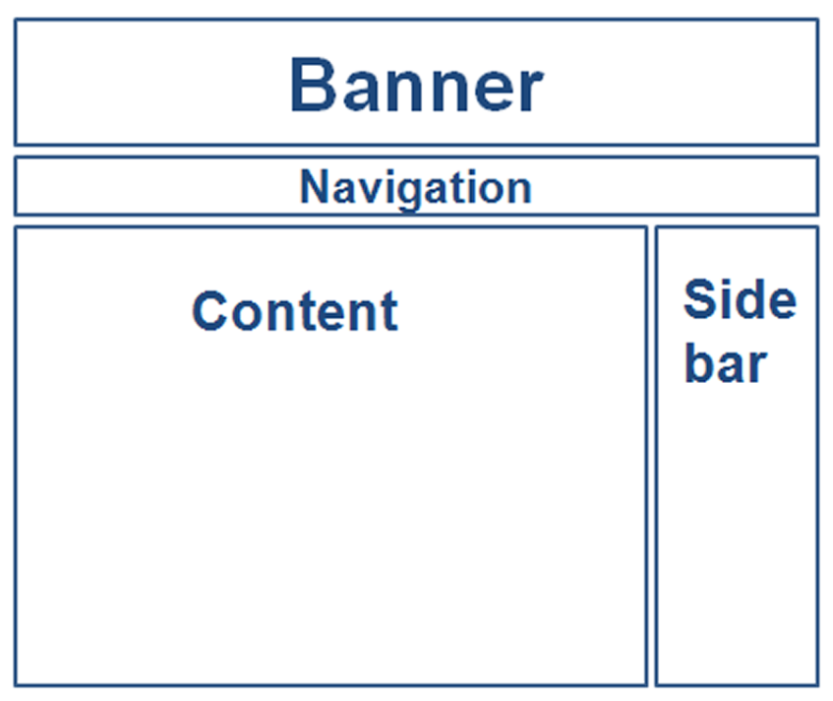
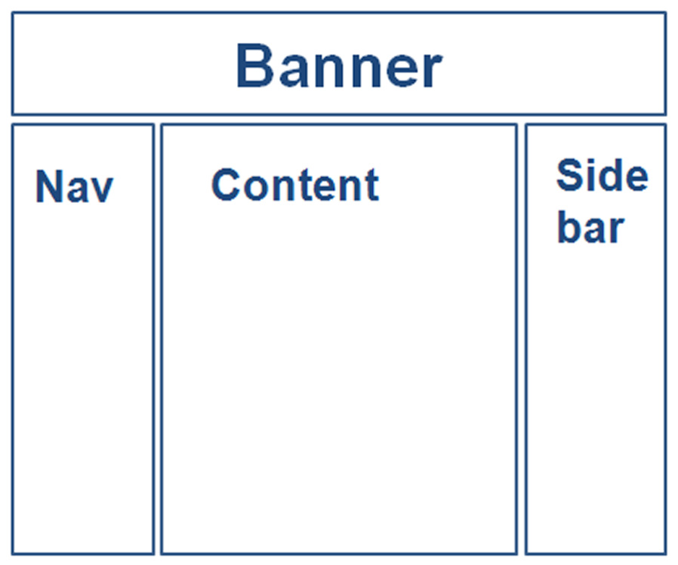
Additional Table Layouts

Slide 15
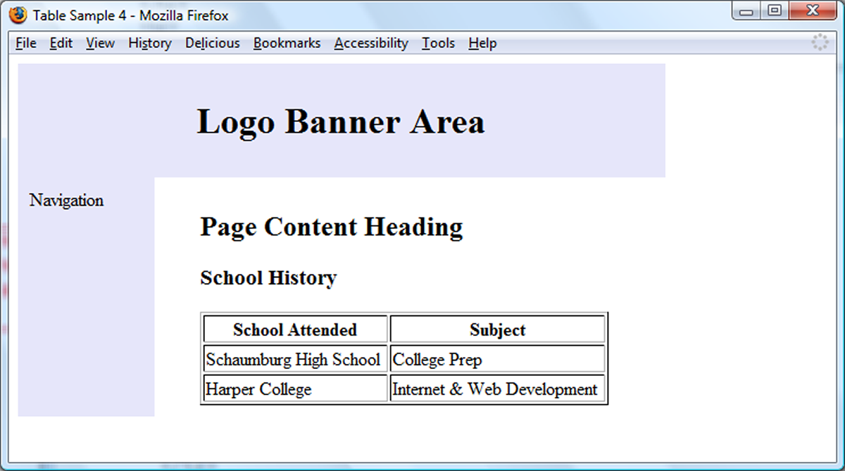
Nested Tables
Outer table configures page layout
Inner table organizes some information on the page

Slide 16
Using CSS to Style a Table
HTML Attribute | CSS Property
align | Align a table: table { width: 75%; margin: auto; } Align within a table cell: text-align
bgcolor | background-color
cellpadding | padding
cellspacing | To configure a shared common border and eliminate space between table cells: table, td, th { border-collapse: collapse; }
height | height
valign | vertical-align
width | width
 | background-image

