Slide 1


Wilderness Survival Systems
WSS2
Feature-Rich Survival Simulation
PRESENTED BY
Casey Wong
Notes:
Hi everyone, I'm Casey Wong, and this is my teammate Raymond Julian. Today we're presenting WSS2 -- the Wilderness Survival System. It's a feature-rich survival simulation where AI agents navigate procedurally generated terrain, manage resources, trade with merchants, and try to survive. Think of it as a zero-player game where you watch AI make decisions in real time. We have a working prototype live right now that I'll demo later.

Slide 2
Executive Pitch
REAL-TIME SIMULATION
WSS2 offers an engaging real-time multi-agent survival simulation, allowing players to explore, manage resources, and complete objectives while navigating a rich wilderness environment.
MODULAR AI ARCHITECTURE
The unique modular AI architecture separates perception from decision-making, enabling measurable strategy comparisons and providing deep insights into AI behavior dynamics within the simulation.
Notes:
So what is WSS2? At its core, it's a real-time multi-agent survival simulation. You drop AI agents into a procedurally generated wilderness and watch them figure out how to survive. They explore, gather resources, avoid hazards, and trade with NPC merchants -- all on their own. What makes this different from other AI simulations is our modular architecture. We separate perception from decision-making. The Vision system handles what the agent can see, and the Brain system decides what to do about it. This means we can swap out different brain strategies and compare how they perform in the same environment.

Slide 3
Product Goals and Outcomes
STABLE CORE LOOP
Our primary objective is to deliver a stable, replayable core loop where players complete objectives, unlock the portal, and coordinate their evacuation seamlessly, ensuring engaging gameplay.
OBSERVABLE AI BEHAVIOR
We aim to make AI behavior observable and debuggable, enabling developers to analyze intent selection and event-driven interrupts, fostering a deeper understanding of AI interactions during gameplay.
Notes:
Our two main goals for this project. First, a stable core loop -- meaning the simulation runs reliably, agents can complete objectives, find the portal, and evacuate. It needs to be replayable, so every time you generate a new world, it's a different experience. Second, observable AI behavior. This is big for us. We want you to be able to watch an agent and understand WHY it made a decision. Not just "it moved left" but "it moved left because it saw water ahead and its thirst was high." That's the explainable AI aspect -- you can actually debug and analyze the agent's thought process.

Slide 4
End-to-End System Flow Overview
SENSE
DECIDE
ACT
The system begins by updating vision and fog states, detecting threats, loot, traders, and objectives, enabling agents to maintain situational awareness in real-time.
Agents evaluate their self-status, goals, and urgency to select intents, while immediate interruptions arise from critical events to ensure quick reactions to changes in the environment.
In this phase, agents execute moves, interact, fight, trade, or accomplish objectives, translating decisions into physical actions within the simulation to progress towards survival goals.
Notes:
This is the heart of our AI system -- the Sense-Decide-Act loop. Every tick of the simulation, each agent goes through these three phases. SENSE: The agent looks around using its Vision system. It checks what terrain is nearby, spots traders, finds loot, detects threats -- all within its vision range. DECIDE: Based on what it sensed, the Brain picks an intent. Should I explore? Should I trade? Should I run? This is where the different brain strategies really matter. ACT: The agent executes its decision -- it moves, picks up items, enters a trade, or fights. Then the cycle repeats. This runs at 60 ticks per second in the full version, so decisions happen fast.

Slide 5
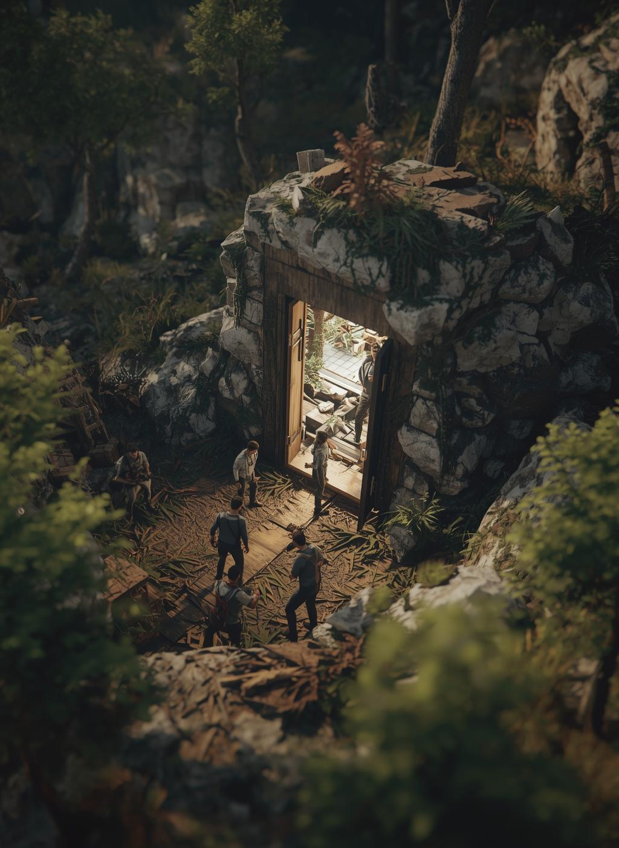
Locked Scope
The WSS2 simulation runs at 60 ticks per second, ensuring real-time combat and movement. Players must evacuate all survivors through a locked portal, navigating fog-of-war and objectives.
Notes:
This slide defines what we've locked in for the scope. We're not trying to build everything at once. The simulation targets 60 ticks per second for smooth real-time action. The win condition is portal evacuation -- agents need to find and reach the exit portal to survive. And fog of war means agents can only see what's within their vision range, so they have to explore to discover the map. These constraints keep the project focused and achievable within our semester timeline.

Slide 6
World and Map Design
CONFIGURABLE MAP SIZES
WSS2 offers flexible map sizes of 30×30, 40×40, and 60×60 grids, accommodating varying survivor counts from 1 to 5. This allows for tailored gameplay experiences.
PROCEDURAL GENERATION
The game leverages procedural generation techniques for terrain, buildings, and loot placements, ensuring unique environments for each playthrough while enhancing immersion and replayability.
Notes:
The world itself is procedurally generated -- meaning every playthrough has a unique map. You saw in the prototype configuration screen that you can set map width and height using sliders. The terrain includes grass, bushes, mountains, desert, water, and swamp -- each with different movement costs and effects on the agent. Mountains are hard to cross, water replenishes thirst, desert drains stamina faster. This makes every map a different puzzle for the AI to solve.

Slide 7
Loot, Economy, and Progression Overview
LOOT DISTRIBUTION
LOOT SOURCES
QUALITY SCALES
Loot is strategically clustered in buildings and limited outdoor spawns, allowing players to explore and gather resources efficiently while increasing the thrill of discovery in diverse terrains.
Loot is generated from pre-placed sources within the environment and drops from defeated human enemies, ensuring a dynamic and rewarding collection experience throughout gameplay.
The quality of loot scales with difficulty levels, featuring themed containers that enhance immersion, such as medical vs military supplies, which cater to various survival strategies.
Notes:
Resources and economy are a big part of survival. Loot is scattered across the map in buildings and outdoor areas. Agents can also get items from trading with merchants. There's a quality scale system -- items range from basic to rare, and the quality affects how useful they are. This ties directly into the trading system you'll see in the demo. An agent might find a health potion but decide to trade it for food because their hunger is more urgent. The economy creates interesting decision-making for the AI.

Slide 8
Combat Mechanics and Weaponry Overview
WEAPONS
FRIENDLY FIRE
ARSENAL EXPANSION
The game features a diverse arsenal with melee and ranged weapons, incorporating durability mechanics for realism and strategy in combat scenarios, enhancing the player's tactical choices.
Enabling friendly fire mechanics will encourage teamwork and coordination among players, as positioning becomes crucial to avoid unintended damage during intense encounters and chaotic situations.
The system supports broad expansion of weapon types and functionalities without disrupting core combat rules, allowing continuous engagement and innovation in gameplay for players seeking variety.
Notes:
Combat is part of the survival challenge. Agents can encounter threats in the wilderness and need to fight or flee. We have both melee and ranged weapons with durability mechanics -- so weapons break over time and agents need to manage their arsenal. Friendly fire is also a thing, which forces the AI to be smart about positioning. The weapon system is expandable -- we can add new weapon types without rewriting the combat core. This is part of our plan for later sprints, but the foundation is already in place.

Slide 9
AI Architecture Overview
BRAIN MODEL
The brain model is designed to operate on a tick-based system, executing the Sense → Decide → Act cycle continuously, while incorporating event-driven interrupts to respond quickly to urgent stimuli.
CONFIGURABLE TICK RATE
This system allows for a configurable brain tick rate, adjusting the responsiveness of AI agents. Default settings run every tick, with a fallback to every five ticks for performance optimization.
6 BRAIN TYPES:
Balanced | Explorer | Cautious | Aggressive | Hoarder | Social
Each brain type has unique priorities for survival, combat, exploration, and resource management.
Notes:
This is where it gets really cool. The brain model runs on a tick-based system -- Sense, Decide, Act, every single tick. But here's the key innovation: we have 6 different brain types. Balanced tries to do a bit of everything. Explorer prioritizes discovering new tiles. Cautious plays it safe and avoids risk. Aggressive charges into threats. Hoarder stockpiles resources. And Trader focuses on finding and negotiating with merchants. You can actually pick which brain to use in the prototype -- I'll show you that in the live demo. The tick rate is configurable too, so you can speed up or slow down the simulation to observe behavior. [TRANSITION: Let me switch over to the live demo now and show you this in action.]

Slide 10
Roadmap and Risks
Sprint 1 (Feb): Business plan, prototype PoC, UML diagrams
Sprint 2 (Mar): Phase 0 - Core architecture, map system, entity framework
Sprint 3 (Apr): Phase 1-2 - Gameplay loop, AI brain system, trading
Sprint 4 (May): Phase 3-4 - Director AI, polish, final presentation
Key Risks:
- Scope creep from WSS1 to WSS2 feature expansion
- AI complexity vs. timeline constraints
- Solo developer bandwidth limitations
Notes:
[After the live demo, come back to slides.] So here's our plan going forward. We're in Sprint 1 right now -- this presentation, the business plan, and the prototype you just saw. Sprint 2 in March is Phase 0, where we build the core architecture -- the map system, entity framework, and base AI pipeline in the actual codebase. Sprint 3 in April tackles the gameplay loop, the full brain system with all 6 types, and the trading mechanics. Sprint 4 in May is polish -- the Director AI that manages difficulty, UI improvements, and our final presentation. For risks -- the biggest one is scope creep. WSS started as a simpler project and the vision keeps growing. We're managing that by locking scope per sprint. AI complexity vs. timeline is real, and it's just the two of us, so bandwidth is a factor.

Slide 11
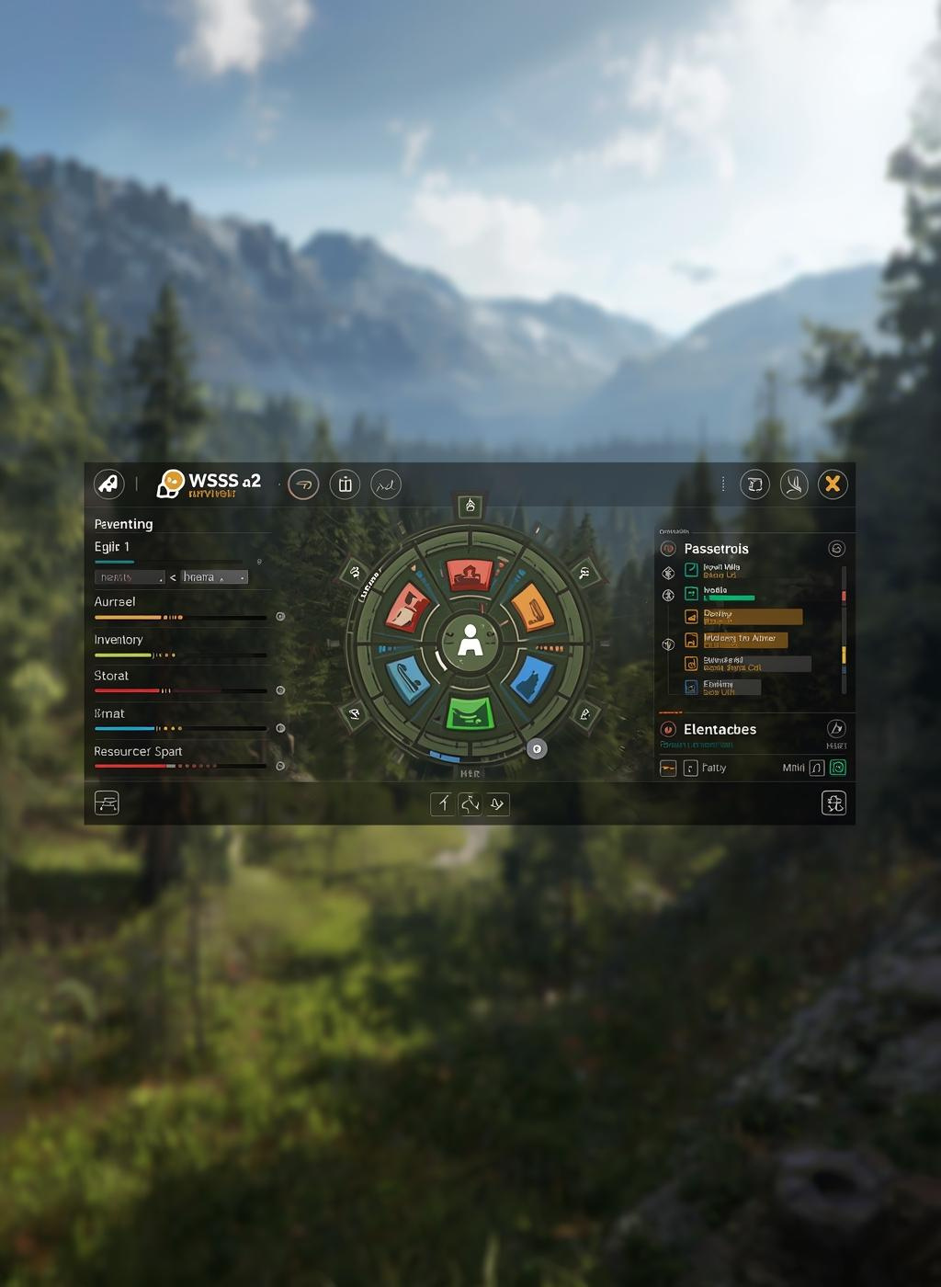
Success Criteria
SUCCESS METRICS
PROJECT MILESTONES
WSS2 Development Goals
Stable core gameplay loop running at 60 tps
AI agents with observable, explainable behavior
Modular Vision-Brain architecture operational
6 distinct brain types demonstrating unique strategies
Functional trading and economy system
Replit prototype as proof of concept (WSS1)
Notes:
So how do we know we've succeeded? These are our measurable milestones. A stable core loop running at 60 ticks per second -- not crashing, not freezing. AI agents that you can actually watch and understand their decisions. The Vision-Brain architecture working as designed -- modular, swappable, testable. All 6 brain types showing genuinely different behavior in the same environment. A functional trading system where agents negotiate with NPCs. And the big one for today -- we already have a working Replit prototype as proof of concept. That's what you just saw in the demo. We're not starting from zero. We have a foundation and we're building WSS2 on top of it.

Slide 12

Thank You!
QUESTIONS?
ANY QUESTIONS ABOUT WSS2?
LIVE DEMO
wss-revised.replit.app
PRESENTER
Casey Wong - CS4800
Notes:
That's WSS2 -- the Wilderness Survival System. To recap: it's a real-time AI survival simulation with procedural worlds, 6 different brain strategies, a full trading economy, and a working prototype you can try right now at wss-revised.replit.app. We're Casey Wong and Raymond Julian, and we're excited to keep building this over the semester. The live demo link is right there if you want to try it yourself. Any questions?

