Slide 1
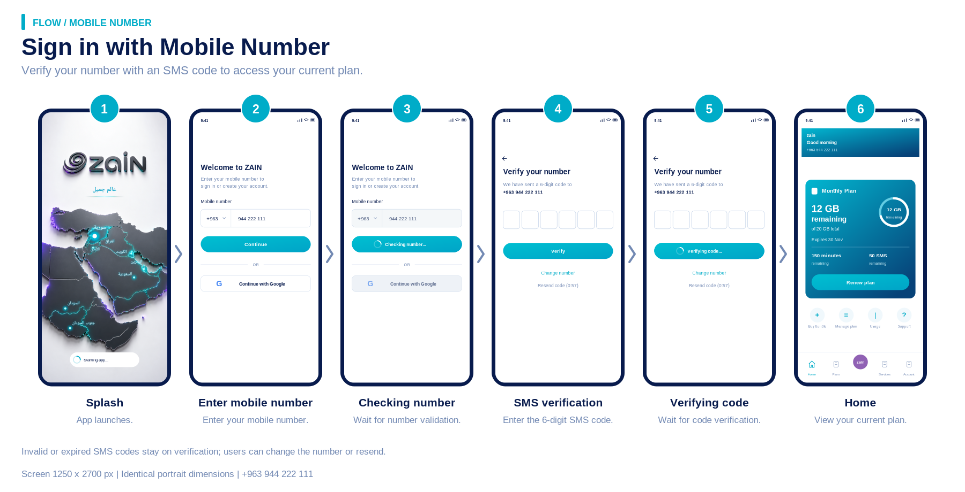
Notes:
Mobile number sign-in
Splash, number entry, number validation loading, SMS verification, verification loading, Home.
Source: flow-boards/01-mobile-number.png
Phone format: +963 944 222 111. Individual screen dimensions: 1250 x 2700 px.

Slide 2
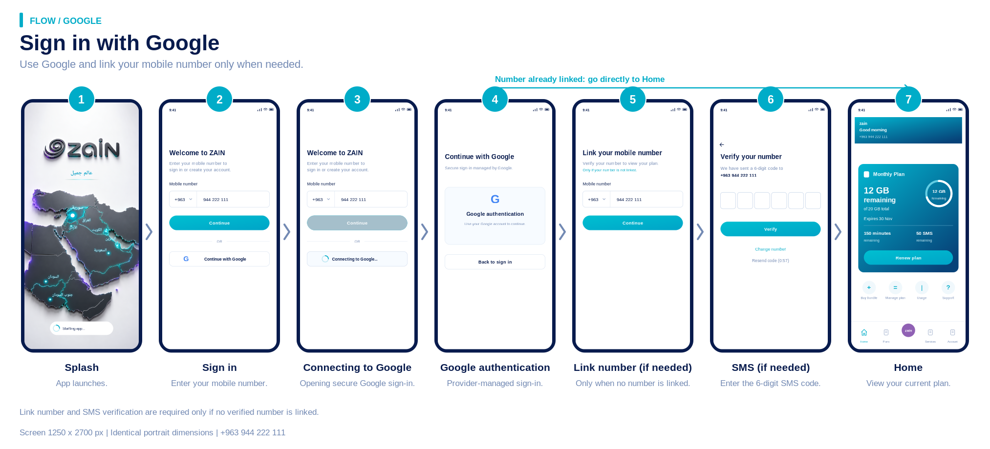
Notes:
Google sign-in
Google connection and provider authentication. If a subscriber number is already linked, go directly to Home; otherwise link and verify the number.
Source: flow-boards/02-google.png
Phone format: +963 944 222 111. Individual screen dimensions: 1250 x 2700 px.

Slide 3
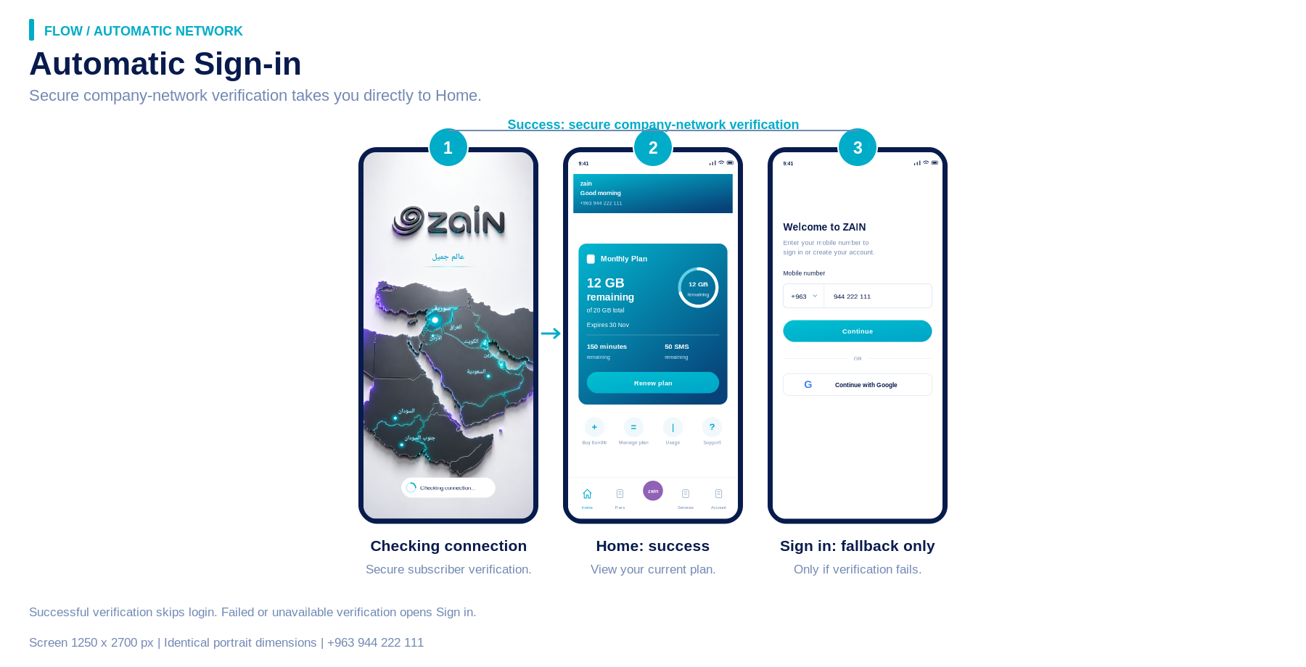
Notes:
Automatic network sign-in
Secure company-network identification during Splash opens Home. Failed or unavailable verification opens Sign in.
Source: flow-boards/03-automatic-network.png
Phone format: +963 944 222 111. Individual screen dimensions: 1250 x 2700 px.

Slide 4
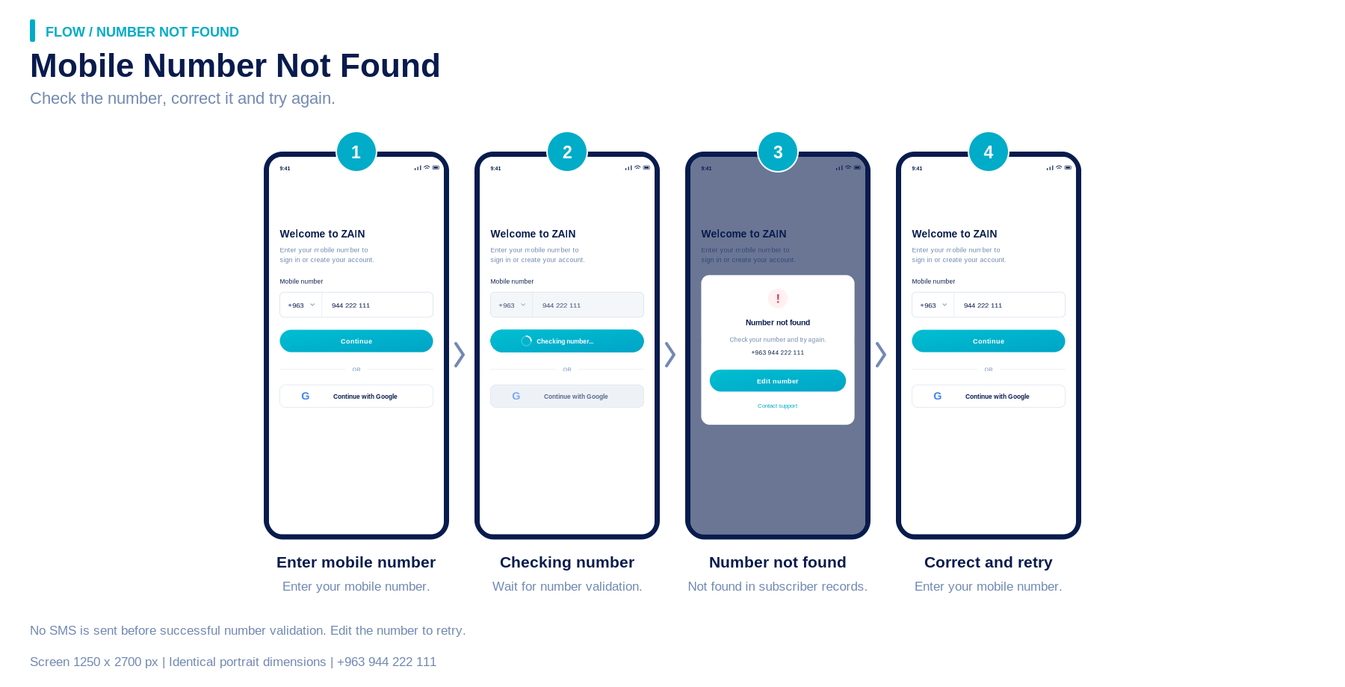
Notes:
Number not found
Number validation loading, actionable error, edit number and retry. No SMS is sent for rejected numbers.
Source: flow-boards/04-number-not-found.png
Phone format: +963 944 222 111. Individual screen dimensions: 1250 x 2700 px.

Slide 5
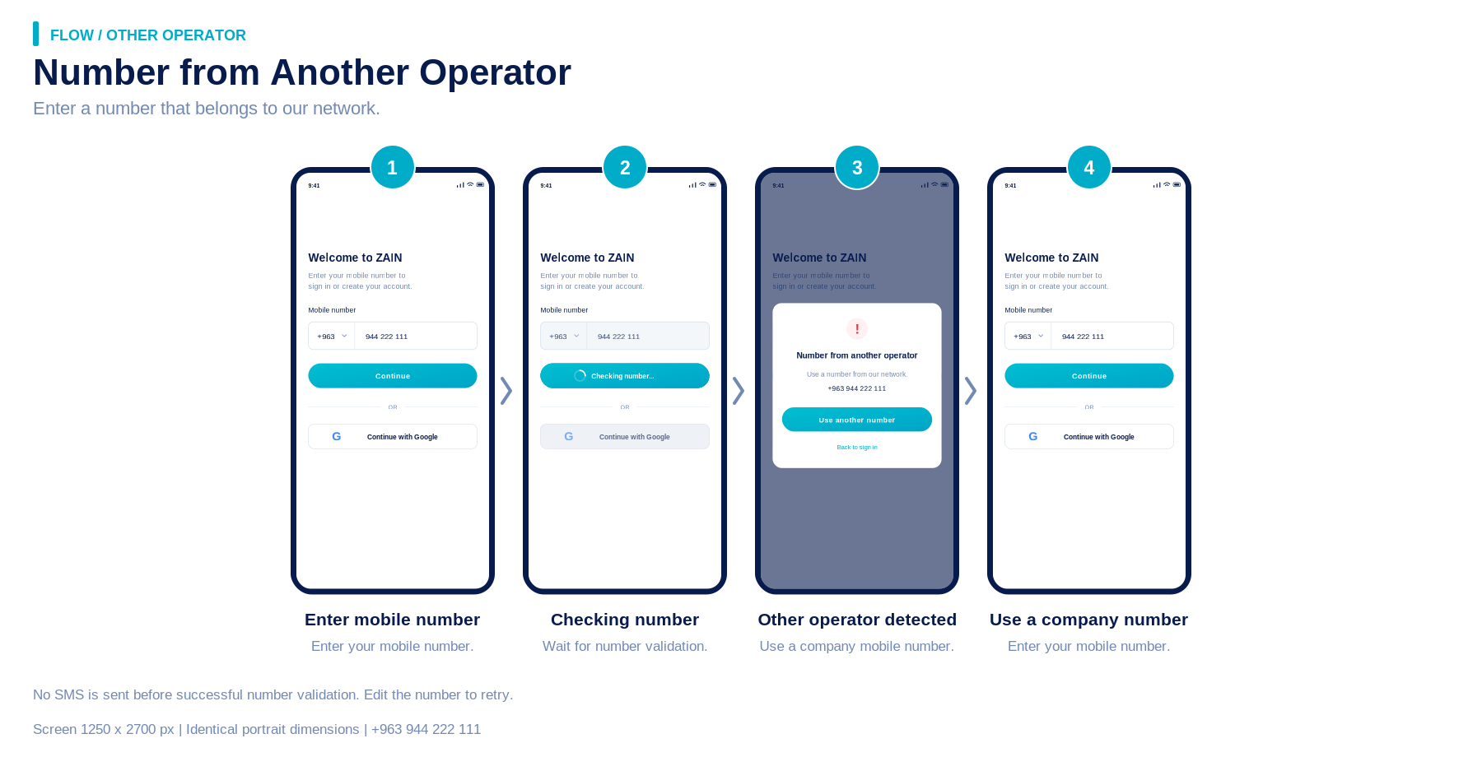
Notes:
Other operator
Number validation loading, operator eligibility error, use a company number and retry.
Source: flow-boards/05-other-operator.png
Phone format: +963 944 222 111. Individual screen dimensions: 1250 x 2700 px.

Slide 6
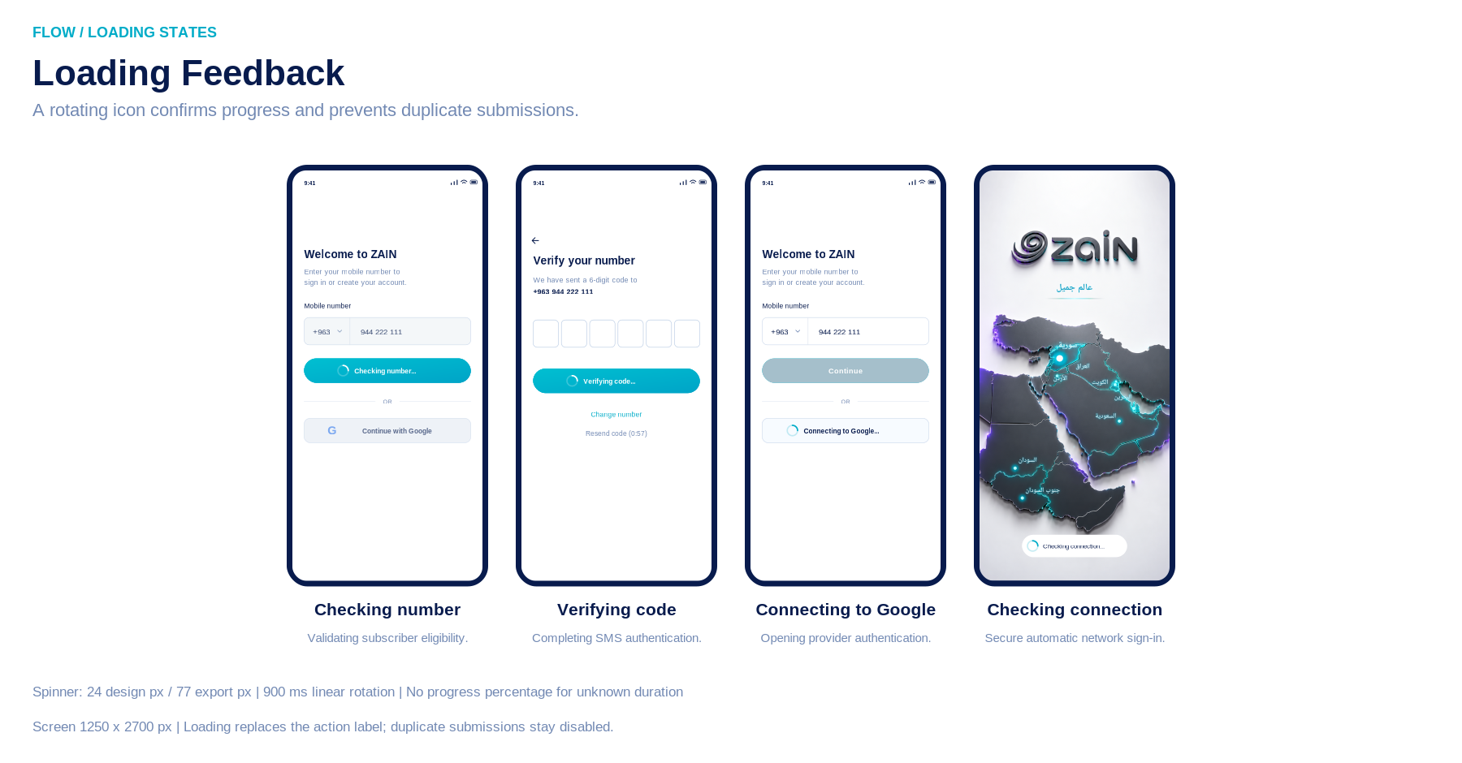
Notes:
Loading states
Contextual spinner states for number validation, SMS verification, Google connection and automatic network verification. PNG snapshots are static; animations are in the accompanying SVG/HTML files.
Source: flow-boards/06-loading-states.png
Phone format: +963 944 222 111. Individual screen dimensions: 1250 x 2700 px.

