Slide 1

LINQ
Introduction to LINQ

Slide 2
Introduction to LINQ
Language-Integrated Query (LINQ) was introduced in the .NET Framework version 3.5
Traditionally, queries against data are expressed as simple strings without type checking at compile time or IntelliSense support.

Slide 3
Introduction to LINQ
LINQ makes a query a first-class language construct in C#. You write queries against strongly typed collections of objects by using language keywords and familiar operators.
You can write LINQ queries in C# for SQL Server databases, XML documents, ADO.NET Datasets, and any collection of objects that supports IEnumerable or the generic IEnumerable<T> interface.

Slide 4
LINQ to Objects
The term "LINQ to Objects" refers to the use of LINQ queries with any IEnumerable or IEnumerable<T> collection directly

Slide 5
LINQ to Objects
LINQ to Objects represents a new approach to collections
In the old way, you had to write complex foreach loops that specified how to retrieve data from a collection.
In the LINQ approach, you write declarative code that describes what you want to retrieve.

Slide 6
LINQ to Objects
LINQ queries offer three main advantages over traditional foreach loops:
They are more concise and readable, especially when filtering multiple conditions.
They provide powerful filtering, ordering, and grouping capabilities with a minimum of application code.
They can be ported to other data sources with little or no modification.

Slide 7
LINQ to Objects
In general, the more complex the operation you want to perform on the data, the more benefit you will realize by using LINQ instead of traditional iteration techniques.

Slide 8
Introduction to LINQ Queries
A query is an expression that retrieves data from a data source.
LINQ offers a consistent model for working with data across various kinds of data sources and formats.
In a LINQ query, you are always working with objects.

Slide 9
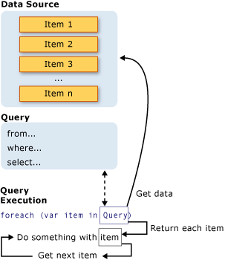
Introduction to LINQ Queries
All LINQ query operations consist of three distinct actions:
Obtain the data source.
Create the query.
Execute the query.

Slide 10
Introduction to LINQ Queries
In LINQ the execution of the query is distinct from the query itself; in other words you have not retrieved any data just by creating a query variable.

Slide 11
Introduction to LINQ Queries
The Data Source
A queryable type requires no modification or special treatment to serve as a LINQ data source.
If the source data is not already in memory as a queryable type, the LINQ provider must represent it as such.
For example, LINQ to XML or LINQ to SQL

Slide 12


Introduction to LINQ Queries
Query Syntax
Method Syntax

Slide 13
Query Syntax vs. Method Syntax
Which style should you use?
Functionally equivalent
They produce the exact same IL (Intermediate Language), which is what the compiler converts the code into
Not all LINQ queries can be written using query syntax
Query syntax may be more “familiar” to developers used to SQL

Slide 14
What is a Query and What Does It Do?
Given a source sequence, a query may do one of three things:

Slide 15
What is a Query and What Does It Do?
Retrieve a subset of the elements to produce a new sequence without modifying the individual elements. The query may then sort or group the returned sequence in various ways.
Retrieve a sequence of elements as in the previous example but transform them to a new type of object.
Retrieve a singleton value about the source data, such as:
The number of elements that match a certain condition.
The element that has the greatest or least value.
The first element that matches a condition, or the sum of particular values in a specified set of elements.

Slide 16
Introduction to LINQ Queries
Query Execution
Deferred Execution
The query variable itself only stores the query.
The actual execution of the query is deferred until you iterate over the query variable in a foreach statement.
This concept is referred to as deferred execution.

Slide 17
Introduction to LINQ Queries
Query Execution
Forcing Immediate Execution
Queries that perform aggregation functions over a range of source elements must first iterate over those elements.
Examples of such queries are Count, Max, Average, and First.
Note also that these types of queries return a single value, not an IEnumerable collection.
You can also force execution by putting the foreach loop immediately after the query expression. However, by calling ToList or ToArray you also cache all the data in a single collection object.

Slide 18
Lambda Expressions
This form of query is called a method-based query.
The arguments to the Where, OrderBy, and Select operators are called lamdba expressions, which are fragments of code.
They allow the standard query operators to be defined individually as methods and strung together using dot notation.
Together, these methods form the basis for an extensible query language.

Slide 19
Lambda Expressions
Many query operators allow the user to provide a function that performs filtering, projection, or key extraction.
The query facilities build on the concept of lambda expressions, which provide developers with a convenient way to write functions that can be passed as arguments for subsequent evaluation.

Slide 20
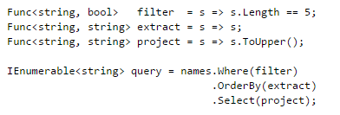
Lambda Expressions
Lambdas are similar to delegates.
We could rewrite the statement above into an equivalent but more explicit form using the Func delegate type.

Slide 21
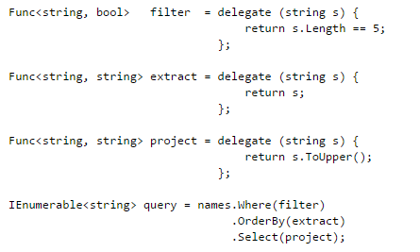
Lambda Expressions
Lambdas are an evolution of anonymous methods in C# 2.0.
We could rewrite the previous example using anonymous methods.

Slide 22
Lambda Expressions
In general, a developer is free to use named methods, anonymous methods, or lambda expressions with query operators.
Lambda expressions have the advantage of providing the most direct and compact syntax for authoring.
More importantly, lambda expressions can be compiled as either code or data, which allows lambda expressions to be processed at runtime by optimizers, translators, and evaluators.

Slide 23
References
MSDN LINQ: https://msdn.microsoft.com/en-us/library/mt693024.aspx
101 LINQ Samples: https://code.msdn.microsoft.com/101-LINQ-Samples-3fb9811b
http://linq101.nilzorblog.com/linq101-lambda.php
http://linqsamples.com/

