Slide 1
Calculator
Using Bash Script

Slide 2
Introduction
Welcome to our presentation on creating an advanced calculator using Bash scripting. In this presentation, we'll walk through the code and functionalities of our calculator script.

Slide 3
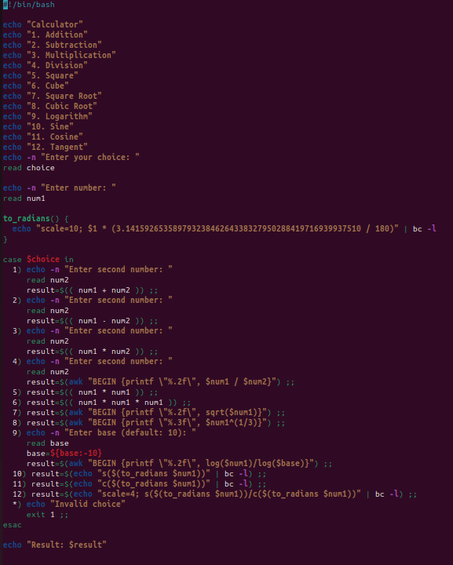
Overview of the script
The script provides a command-line interface for performing various mathematical operations. Users can choose from a menu of operations, including basic arithmetic, logarithms, and trigonometric functions.

Slide 4
Let's break down the elements in the script
case: Control statement that performs different actions based on the value of an expression. It is often used with esac, which marks the end of the case block.
awk: A powerful programming language for pattern scanning and processing. In this script, it's used to perform arithmetic operations or more complex computations.
BEGIN: To initialize some variables, set the output format, or print some initial information.
log: A mathematical function that calculates the natural logarithm of a given expression.
bc: An arbitrary precision calculator language. It's used in this script for more advanced mathematical calculations.
scale: A variable used in bc to define the number of decimal places used in division and other operations.
to_radians(): This function takes an angle in degrees as input and converts it to radians

Slide 5
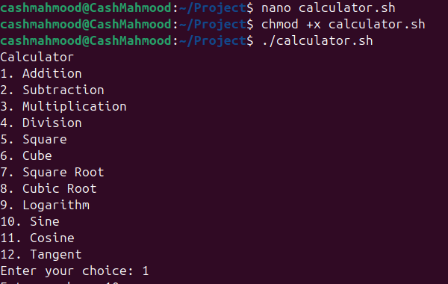
User Interface
Users are presented with a menu displaying different operations. They can select an operation by entering the corresponding number.

Slide 6
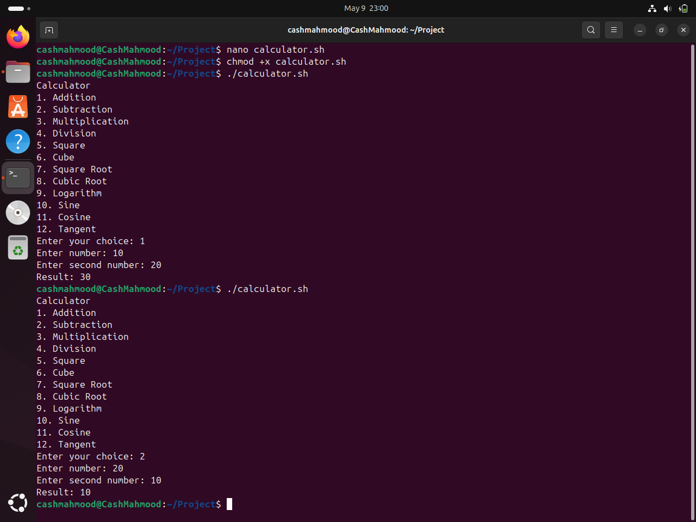
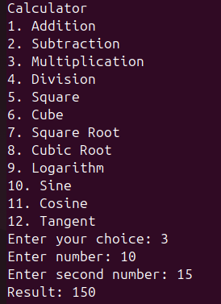
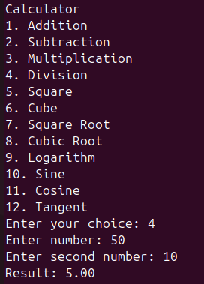
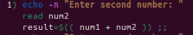
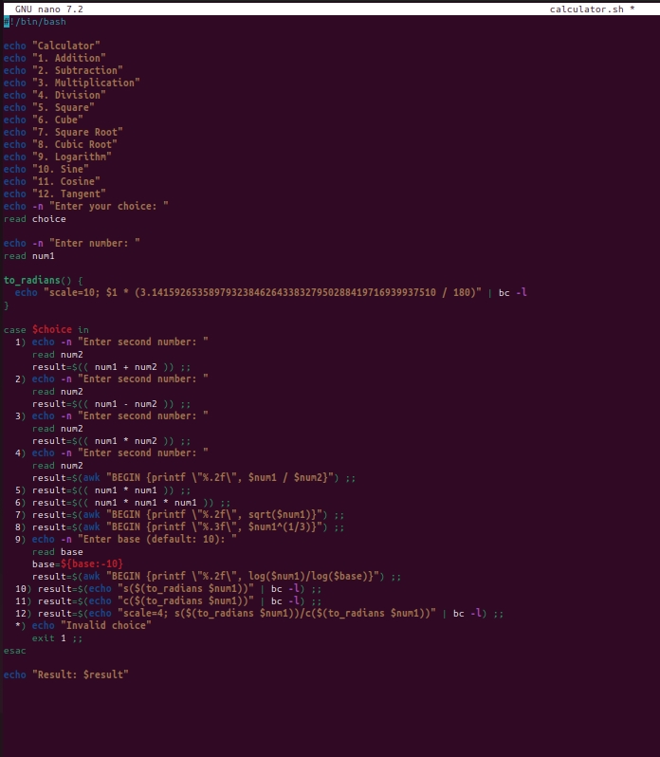
Basic Arithmetic
The script supports addition, subtraction, multiplication, and division. Users input two numbers for these operations, and the script computes the result.
Addition
Subtraction
Multiplication
Division

Slide 7
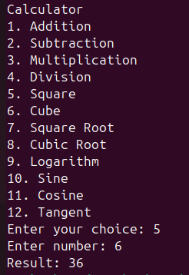
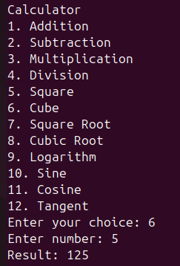


Exponentiation and Roots
Users can calculate squares, cubes, square roots, and cubic roots of a single number.
Square
Cube
Square Root
Cubic Root

Slide 8
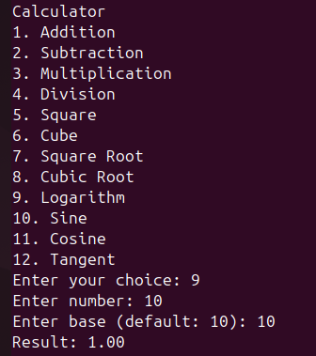
Logarithms
The script computes the logarithm of a number with a specified base.
Logarithm

Slide 9
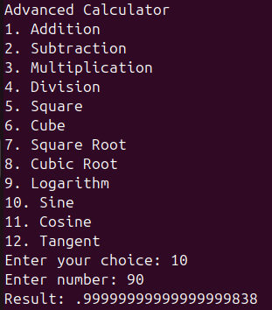
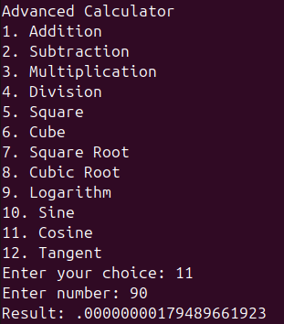
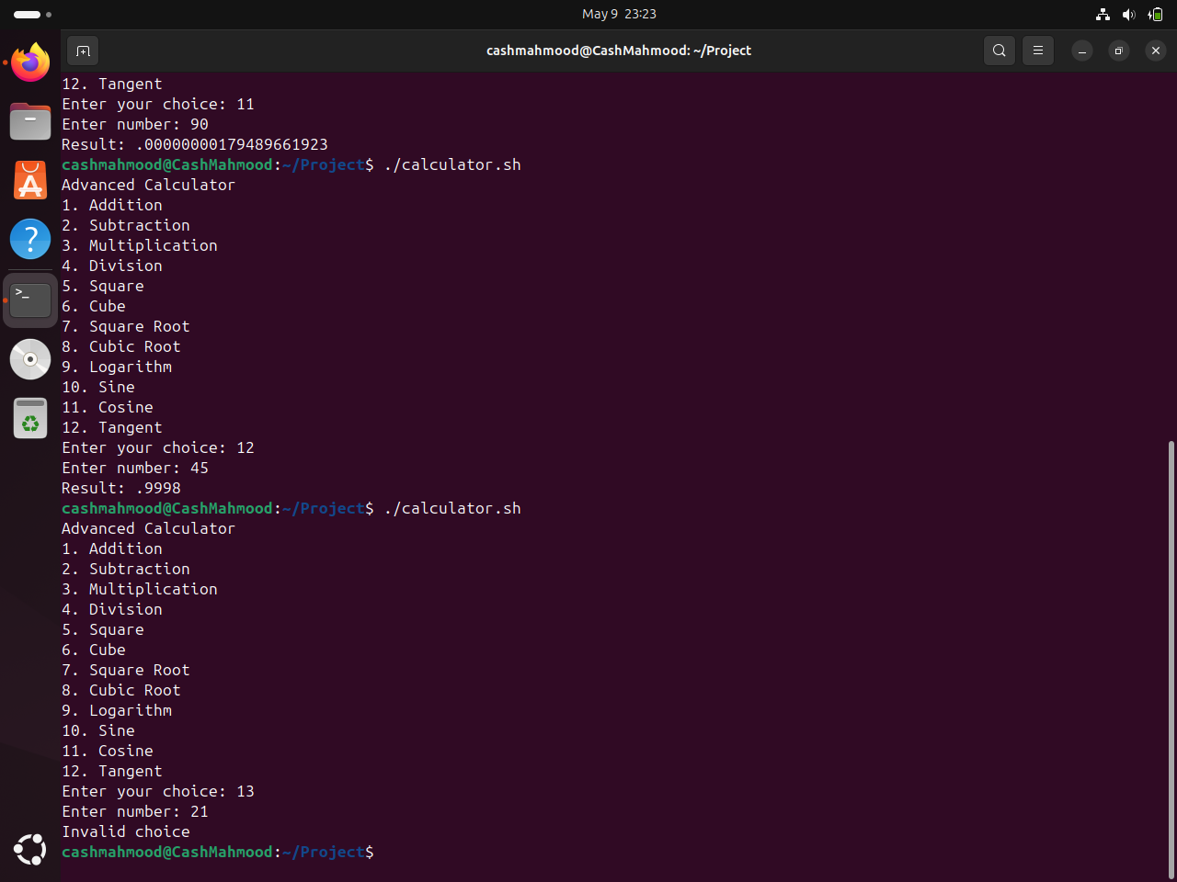
Trigonometric Functions
Sine, cosine, and tangent functions are supported. Angles are expected in degrees and converted to radians for computation.
Sin
Cos
Tan
Out of range

Slide 10
Conclusion
Our Bash script provides a calculator with a wide range of mathematical functionalities.
It demonstrates the flexibility of scripting languages for solving computational tasks.

Slide 11
Thank You
Presented by
Name | : | Kayes Mahmood
ID | : | 2215151030
Section | : | 5A2
Name | : | Minhazur Rahman
ID | : | 2215151032
Section | : | 5A2
Name | : | Redwanul Islam Rafi
ID | : | 2215151043
Section | : | 5A2

