Slide 1


Game Logic Overview
Third-Person Hero, Shark Enemy, Dinosaur Boss, Homing Rockets, Health System

Slide 2
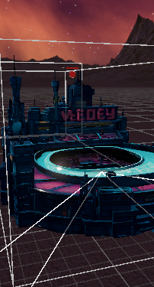
Core Gameplay Loop
Player controls a third-person character that moves, jumps and sprints through the level.
Enemies (Shark and Dinosaur) create dynamic danger zones the player must avoid.
Dinosaur periodically fires homing rockets that track the player.
All damage to the player goes through a single HealthSystem, updating UI and VFX/SFX.
Death and regeneration are centralized, making it easy to balance and expand gameplay.

Slide 3
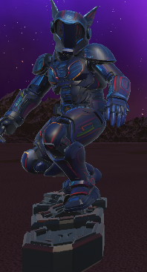
Player Controller & Camera
Third-person controller reads WASD input, applies gravity and jump logic.
Movement is camera-relative: input is projected in camera space for intuitive control.
Cinemachine (FreeLook or similar) handles smooth orbiting and following of the player.
CharacterController (not Rigidbody) is used for stable movement and ground checks.
Animator blend tree uses Speed parameter to smoothly blend idle/walk/run animations.

Slide 4

Health System – Structure
HealthSystem is a singleton (HealthSystem.Instance) attached to the Player.
Stores current and maximum hit points (hitPoint / maxHitPoint).
Optionally supports mana, but current gameplay focuses only on health.
Provides public methods: TakeDamage(), HealDamage(), SetMaxHealth(), etc.
Central entry point for all damage and healing in the game.

Slide 5
Health System – UI, Regen & Death
Updates health bar and health globe positions based on hitPoint / maxHitPoint ratio.
Text label shows current HP and max HP (e.g. '75 / 100').
Optional regeneration tick uses a timer (regenUpdateInterval) to heal over time.
TakeDamage() triggers hurt VFX/SFX and a short coroutine (PlayerHurts).
When hitPoint reaches 0, PlayerDied coroutine runs, playing death feedback and allowing respawn logic.

Slide 6

Shark Enemy – Movement & Targeting
Shark starts in a patrol state, swimming along a spiral path around its origin position.
Patrol uses patrolBaseRadius + animated offset to create a dynamic circular path.
Vertical bobbing and wobble add life-like motion to the shark’s movement.
When the Player enters detectionRadius, shark switches to chase mode with spiral-orbit behaviour.
ChaseSpiral blends direction-to-player with a tangent vector for orbit-style movement.

Slide 7
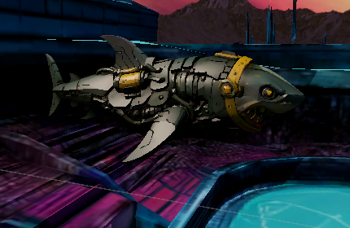
Shark Enemy – Damage & Lifetime
OnTriggerEnter/Stay and OnCollisionEnter call TryDamagePlayer().
Checks for the Player tag and respects a damage cooldown (damageInterval).
If HealthSystem.Instance exists, shark calls TakeDamage(contactDamage).
Bite VFX/SFX are spawned at the contact point to visualize attacks.
Optional lifeTime causes the shark to despawn after a duration, optionally healing the player via HealOnDespawn.

Slide 8
Dinosaur Boss – Navigation & Attack State
Uses NavMeshAgent + CharacterController for navigation on a baked NavMesh.
Agent calculates desiredVelocity; CharacterController.Move() applies it with gravity.
Dino tracks the player within detectionRadius and faces them with smooth rotation.
When within attackDistance and attackCooldown is ready, the dino enters attack state.
Attack state plays roar SFX, sets Animator bool/trigger, and eventually calls FireRocket() via Animation Event.

Slide 9
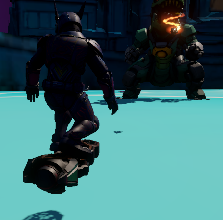
Dinosaur Boss – Rockets & Melee Damage
FireRocket() instantiates a HomingRocket prefab at the firePoint transform.
Rocket is initialized with target, speed and lifeTime from DinosaurController.
Muzzle flash VFX and shoot SFX are played at the moment of firing.
Optional melee damage: OnControllerColliderHit / OnCollisionEnter can hurt the player on direct contact.
contactDamage and contactDamageInterval control how dangerous close-range interaction is.

Slide 10
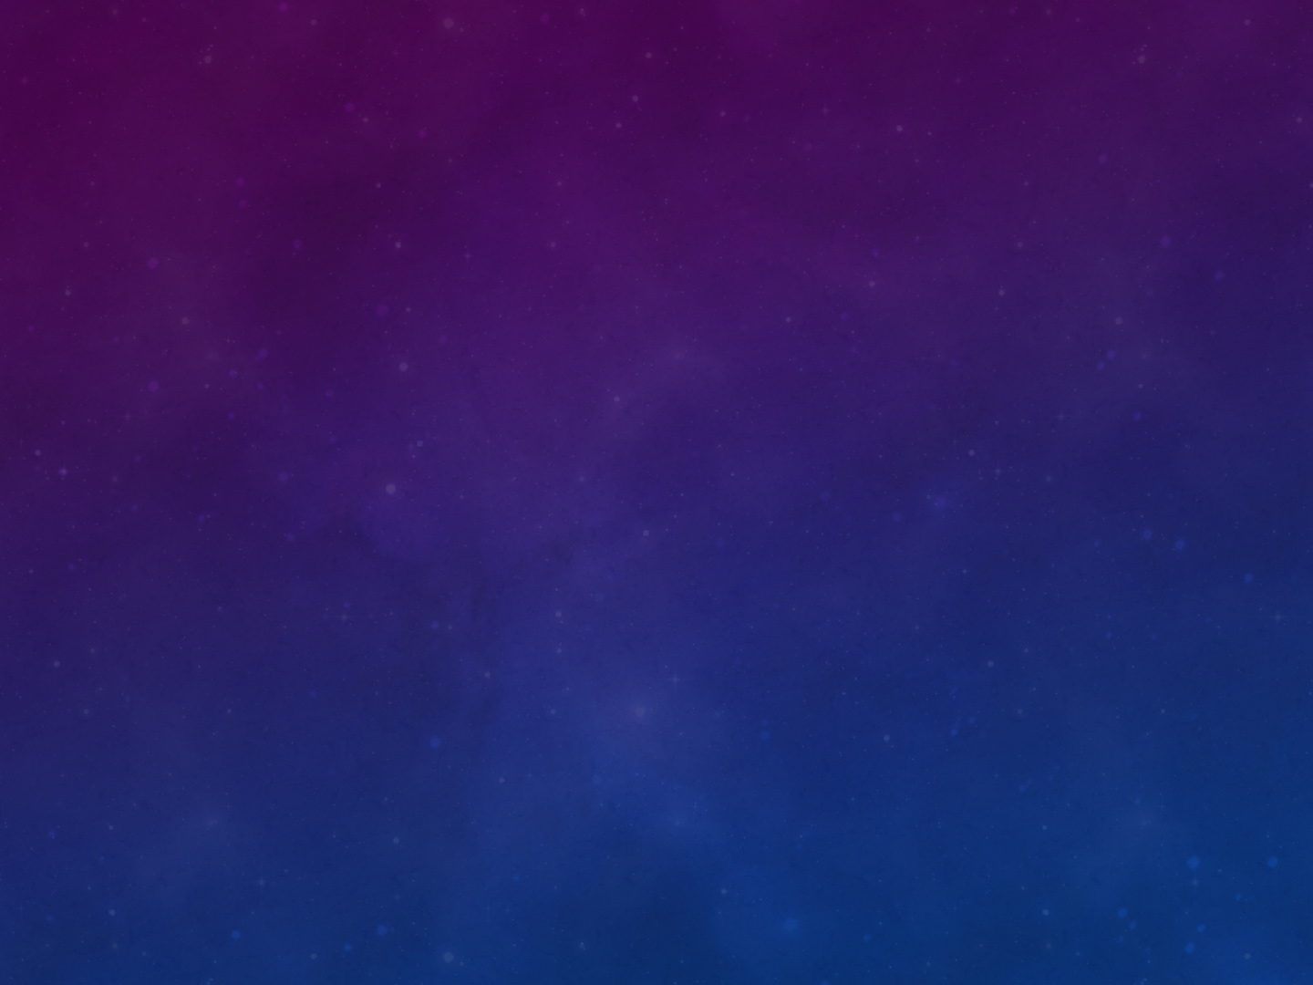
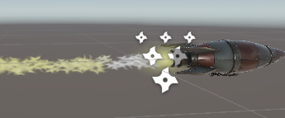
Homing Rocket – Tracking & Impact
Awake() sets life timer and plays launch SFX, then starts a flying loop sound (optional).
Update() rotates the rocket towards the target each frame using Quaternion.Slerp.
A wobble component adds sinusoidal offset for a more interesting flight path.
OnTriggerEnter / OnCollisionEnter call HandleHit(), which checks if the hit object is the Player.
If Player is hit, HealthSystem.Instance.TakeDamage(damage) is called, hit VFX/SFX play, then Explode() spawns explosion VFX/SFX and destroys the rocket.

Slide 11
VFX / SFX Integration
Each major event (spawn, bite, rocket launch, rocket hit, death) has dedicated VFX/SFX hooks.
AudioSource components on Shark, Dinosaur, Rocket and Player play context-specific clips.
Particles and prefab VFX are instantiated at impact points or character positions and destroyed after a short lifetime.
This separation of logic and visuals makes it easy to swap assets without touching core code.
Consistent feedback loop: every damage, heal, spawn or death event is both visible and audible.

Slide 12
Technical Glue – Tags, Colliders, Singletons
Player object uses the 'Player' tag; all enemy scripts rely on this tag for damage checks.
Colliders and, where needed, Rigidbody components ensure Unity collision/trigger events fire.
HealthSystem uses a singleton pattern, so any script can call HealthSystem.Instance.TakeDamage().
Timers (cooldowns, lifetimes, regen intervals) control pacing without complex state machines.
This structure keeps gameplay logic modular: new enemies can re-use HealthSystem and damage patterns.

Slide 13
Extensibility & Future Features
Add more enemy types that follow the same pattern: AI movement + damage hooks into HealthSystem.
Introduce items and pickups that heal, buff, or protect the player using HealDamage()/SetMaxHealth().
Implement death/respawn flows: fade out, reload scene, or checkpoint system.
Expand UI with hit indicators, damage numbers and boss health bars using existing event hooks.
Refine difficulty by tuning damage values, cooldowns, detection radii and regeneration speed.

