Slide 1
OpenGL FrameBuffer
2018/11/21

Slide 2
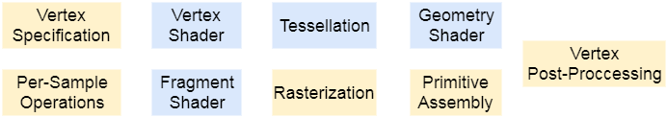
Rendering Pipeline Review
Per vertex operations
Clipping
Stencil test
Depth test
Texture
Back face culling
Per pixel operations
Notes:
Vertex shader負責做點和點的轉換
Fragment shader負責做pixel(fragment)的轉換，可以改變color和depth值，不能改stencil值
Geometry shader負責做primitive的轉換，不過這是比較新的功能，我們這次不會用到

Slide 3
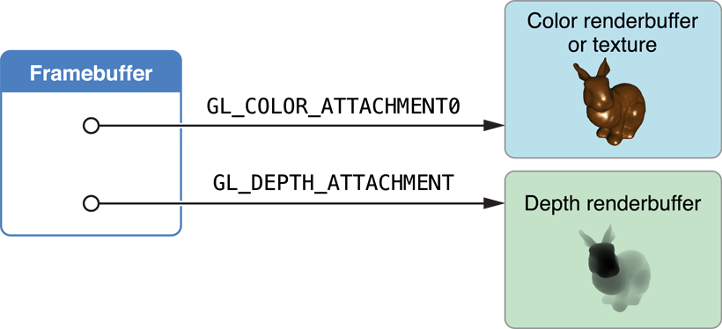

Slide 4
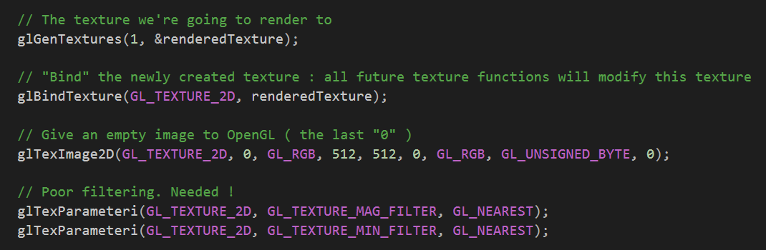
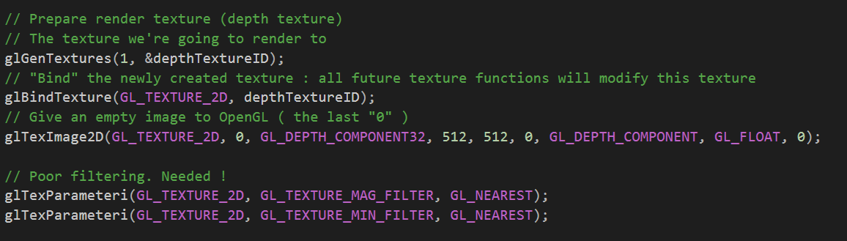
Frame Buffers – Prepare Texture
Or …
Notes:
You can replace GL_NEAREST with something else and see the difference.

Slide 5
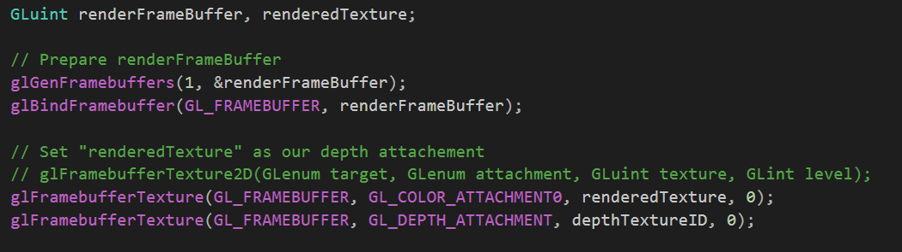
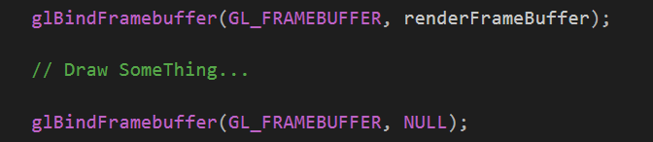
Frame Buffers – Setup & Use
Display Function →

Slide 6
Frame Buffers – Reminder
In Depth Texture, color = depth in view space
That is, for most object near the camera, the color may looks all same and pure white.

Slide 7
Homework 3
Due: 2018/12/12 23:59:59
Spec : https://hackmd.io/x-ZnZPMzR7iXS8fcQRhVbw

Slide 8
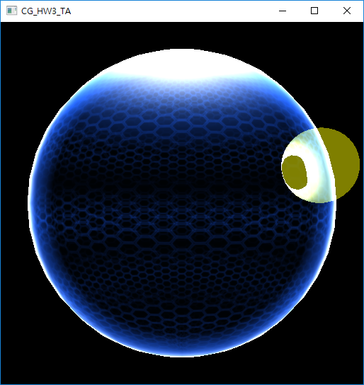
Overview
Render the scene and the barrier with
Pulsing effect
Pole highlight
Rim effect
Intersect highlight
Please notice that all code pieces mentioned (in the slides and in provided references) are meant to help you understand the concept, it's not meant for you to copy paste (though it's not forbidden)!
Note this is not the final scene you should present, it’s just a demo.

Slide 9
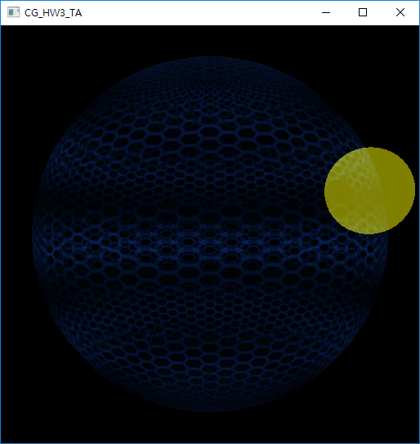
Review: Pulsing Effect
Create pulsing effect using object space position Y and time
// create tiling texture
vec2 uv = vec2(texcoord.x * 5, texcoord.y * 9);
vec4 mainTex = texture2D(u_ColorMap, mainUV);
// multiplier is affected by fragment’s position in object space and
// system time
float multiplier = func( objectPosition, time );
vec4 pulsedTexColor = multiplier * mainTex * _Color;

Slide 10
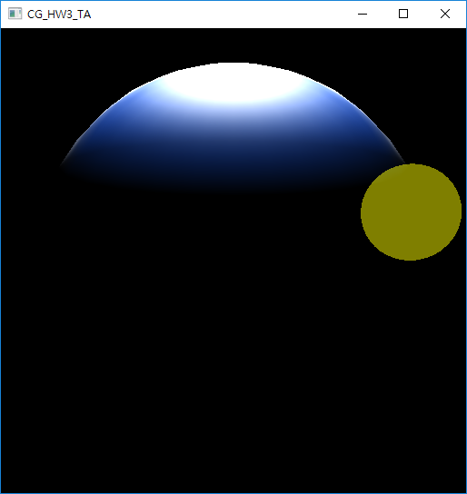
Review: Pole Highlight
Use object space position Y to determine the pole
// the further a fragment is from the north pole (object space (0, 1, 0))
// the smaller this value is
float northPole = pole_value(objectPosition.y);
// Please notice that the upper and lower bound of this model in object space
Is 1 and -1 respectively, and the “northPole” value should be between 0 and 1

Slide 11
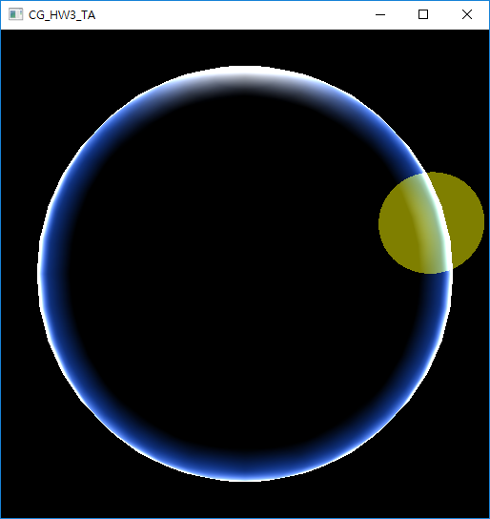
Review: Rim Effect
Rim effects only shows on the silhouette of the object
Hint: use view vector to check is it silhouette or not
// please notice that both position need to be under the same space
// whether it’s object or world
vec3 viewDir = camera_position - position;
float r = func(normal, viewDir);
vec4 rim = vec4(r, r, r, 1);

Slide 12
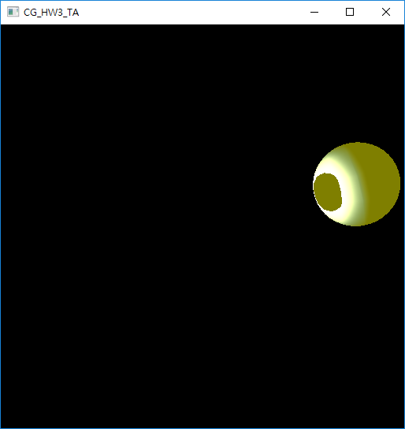
Review: Intersection Highlight
Object Intersects means depth intersects
If Object is occluded, depth value is larger than the value from depth texture
However, you need to linearize depth to [0, 1] first.
float raw = texture2D(depthTexture, some_coordinate);
float isIntersect = checkIntersect(linearize(raw));
vec4 intersect = vec4(isIntersect, isIntersect, isIntersect, 1);

Slide 13
vec4 _Color = color you wish ( in our demo it’s vec4(16, 59, 159, 4) / 255.0 )
float glow = max(max(Intersect, Rim), Pole);
vec4 glowColor = interpolate _Color to (1,1,1) with respect to glow
outColor = pulsedTexColor + (northPole + rim + intersect) * glowColor;

Slide 14
More…
If you have questions, you can send emails to TA.
If you find any errors in template project, please contact TA ASAP.

