Slide 1
OpenGL Shader & GLSL
2018/11/01

Slide 2
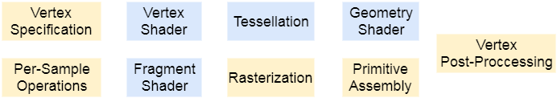
Rendering Pipeline Review
Per vertex operations
Clipping
Stencil test
Depth test
Texture
Back face culling
Per pixel operations
Notes:
Vertex shader負責做點和點的轉換
Fragment shader負責做pixel(fragment)的轉換，可以改變color和depth值，不能改stencil值
Geometry shader負責做primitive的轉換，不過這是比較新的功能，我們這次不會用到

Slide 3
Shader & Shader Program
char* vertex_shader_resource = "...void main(){...}"; // shader source code
GLuint vert_id = glCreateShader(GL_VERTEX_SHADER); // GL_FRAGMENT_SHADER
glShaderSource(vert_id, 1, &vertex_shader_resource, NULL);
glCompileShader(vert_id);
GLuint program_id = glCreateProgram();
glAttachShader(program_id, vert_id);
/* you can attach another shader (fragment shader) */
glLinkProgram(program_id);
glDetachShader(program_id, vert_id);
/* detach another shader (fragment shader)*/
Notes:
void glShaderSource(GLuint shader, GLsizei count, const GLchar **string, const GLint *length);
第一個參數指要用哪個Shader物件。
第二個(count) the number of elements in the string and length arrays.
第三個(string) an array of pointers to strings containing the source code
第四個(length) an array of string lengths，使用NULL代表就是不指定，讀取到NULL為止。

Slide 4
Shader & Shader Program
void display() {
glUseProgram(program);
/* Shader program affect in this block. */
glUseProgram(NULL);
glUseProgram(another_program);
/* Another shader program effect. */
glUseProgram(NULL);
}

Slide 5
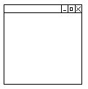
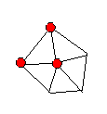
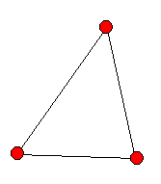
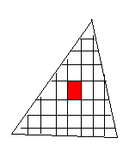

Data Connection: Qualifiers
Uniform
application → any shader
Attrtibute (deprecated)
application → vertex shader
Varying (deprecated)
vertex shader → fragment shader
varying
attribute
in
(x,y,z)
(x’,y’,z’)
in
out
Vertex
Shader
rasterizer
Fragment Shader
varying
varying
uniform

Slide 6
Data Connection: Qualifiers
// vertex shader
uniform mat4 ModelViewMatrix;
uniform float delta;
attribute vec3 Normal; //old syntex
layout(location = 0) in vec3 Normal;
varying vec3 vNormal; //old syntex
out vec3 vNormal;
void main() {
/* ... */
}
// fragment shader
uniform float gamma;
uniform float delta;
varying vec3 vNormal; //old syntex
in vec3 vNormal;
void main() {
/* ... */
}

Slide 7
Data Connection: Uniform
/* in vertex shader */
#version 400
uniform mat4 Projection;
uniform vec3 Light_position;
void main() {
/* use the uniform values */
}
Can’t be modify in shaders
void display(){
glUseProgram(program);
GLfloat mtx[16];
glGetFloatv(GL_PROJECTION_MATRIX, mtx);
GLfloat light_position[3] = { /* ... */ };
GLint loc = glGetUniformLocation(program, "Projection");
glUniformMatrix4fv(loc, 1, GL_FALSE, mtx);
loc = glGetUniformLocation(program, "Light_position");
glUniform3fv(loc, 1, light_position);
glDrawArrays(GL_TRIANGLES, vertex_index, vertex_count); // draw objects
glUseProgram(NULL);
}
Notes:
glUniformMatrix4fv(loc, 1, GL_FALSE, mtx); //false for transpose or not
一系列都叫glUniform的函數

Slide 8
Data Connection: VBO
To use data in GPU, we first send our data from CPU memory to GPU memory
Sending data to the graphics card from the CPU is relatively slow, so we use VBO to try to send as much data as possible at once.
Notes:
VBO: 儲存頂點資料的buffer
可以有很多個

Slide 9
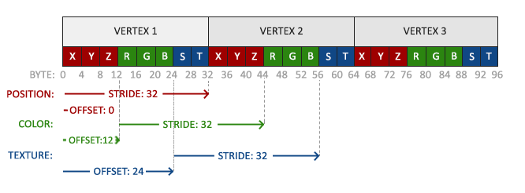
Data Connection: VBO
VBO: Vertex Buffer Object
Notes:
VBO: 儲存頂點資料的buffer
可以有很多個

Slide 10
/* in vertex shader */
#version 400
layout(location = 0) in vec3 pos;
void main() {
gl_Position = vec4(pos, 1.0);
}
struct VertexAttribute{
GLfloat position[3];
};
GLunint vbo_id;
glGenBuffers(1, &vbo_id);
glBindBuffer(GL_ARRAY_BUFFER, vbo_id);
VertexAttribute *vertices = [ /* the data set of each vertex */ ];
glBufferData(GL_ARRAY_BUFFER,
sizeof(VertexAttribute) * vertices_length, // size of the data set
vertices,
GL_STATIC_DRAW); //GL_STREAM_DRAW, GL_DYNAMIC_DRAW
glEnableVertexAttribArray(0); // index in vertex shader
glVertexAttribPointer(0, // same as above
3, // # of components ex: (x,y,z)
GL_FLOAT, // type of components
GL_FALSE, // should normalize or not
sizeof(VertexAttribute), // stride
(void*)(offsetof(VertexAttribute, position)) // offset
);
Notes:
GL_STREAM_DRAW,GL_DYNAMIC_DRAW: 數值變化的頻率
GenBuffer: 產生(1個)我們要使用的buffer
Bind Buffer: 綁定要用的buffer和剛才得到的buffer id
EnableVertexAttribArray 開啟vertex shader的第index個屬性
GL_STREAM_DRAW: 每次都會變
GL_DYNAMIC_DRAW: 經常改變
glBufferData function that copies the previously defined vertex data into the buffer's memory:

Slide 11
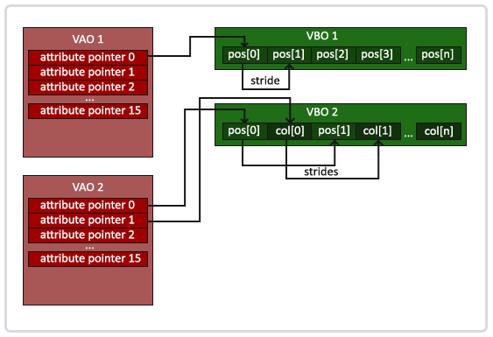
Data Connection: VAO
VAO: Vertex Array Object
Notes:
This has the advantage that when configuring vertex attribute pointers you only have to make those calls once and whenever we want to draw the object, we can just bind the corresponding VAO.
Core OpenGL requires that we use a VAO so it knows what to do with our vertex inputs. If we fail to bind a VAO, OpenGL will most likely refuse to draw anything.

Slide 12
GLuint vaoHandle;
GLunit vbo_ids[2];
void init(){
glGenBuffers(2, vbo_ids);
glBindBuffer(GL_ARRAY_BUFFER, vbo_ids[0]);
glBufferData( /* ... */ );
glBindBuffer(GL_ARRAY_BUFFER, vbo_ids[1]);
glBufferData( /* ... */);
glGenVertexArrays(1,&vaoHandle);
glBindVertexArray(vaoHandle);
glEnableAttribArray(0);
glEnableAttribArray(1);
glBindBuffer(GL_ARRAY_BUFFER, vbo_ids[0]);
glVertexAttribPointer(0, /* ... */ );
glBindBuffer(GL_ARRAY_BUFFER, vbo_ids[1]);
glVertexAttribPointer(1, /* ... */ );
}
void display(){
glUseProgram(program);
glBindVertexArray(vaoHandle);
/* draw objects with the VAO */
glDrawArrays(GL_TRIANGLES, 0, 3);
/* 0 for start index, 3 for how many vertices you want to draw */
glBindVertexArray(0);
glUseProgram(NULL);
}

Slide 13
Data Connection: Texture
/* in fragment shader */
#version 400
uniform sampler2D MyTexture_1;
in vec2 texcoord;
out vec4 outColor;
void main() {
outColor = texture2D(MyTexture_1, texcoord);
}
void display(){
GLuint texture_id = /* ... */;
glEnable(GL_TEXTURE_2D);
glUseProgram(program);
GLint loc = glGetUniformLocation(program, "MyTexture_1");
glActiveTexture(GL_TEXTURE0 + 0); //GL_TEXTUREi = GL_TEXTURE0 + i
glBindTexture(GL_TEXTURE_2D, tex);
glUniform1i(loc, 0);
/* draw objects */
glBindTexture(GL_TEXTURE_2D, NULL);
glUseProgram(NULL);
}
Notes:
GL_TEXTUREi = GL_TEXTURE0+i

Slide 14
Other GLSL Syntax
Variables
Functions
Examples
vec2, vec3, vec4, ... // orders: xyzw, rgba, stpq
mat2, mat3, mat4, ...
float, int, bool, ...
sampler2D, ...
max, min, sin, cos, pow, log, ..
dot, normalize, reflect, ...
transpose, inverse, ...
+, -, *, /
vec3 c8 = vec3(1.0, 1.0, 9.0);
vec4 v2 = (c8 * 7.63).xyxz + vec4(5.0, 5.0, 6.0, 6.0);
vec3 c1 = normalize(v2.rgb);
mat3x2 m1 = mat3x2(c8, c1); // column major
mat4 m2 = mat4(v2, vec4(1.0), vec4(c8, 0.0), c1.gggg);
mat3 m3 = mat3(m2); // get left top of mat4
ivec2 iv1 = ivec2(c8.z, c1.r);
Notes:
向量支援swizzle操作
Ivec2: integer vector with two components

Slide 15
Vertex Shader
/* Example of vertex shader */
#version 400
layout(location = 5) in vec4 in_Pos;
layout(location = 6) in vec4 in_Norm;
uniform mat4 MV;
uniform mat4 P;
out vec3 normal;
void main() {
gl_Position = P * MV * in_Pos;
normal = vec3(
/* normal after modelview transform */
);
}
Must have gl_Position

Slide 16
Fragment Shader
The LAST out vec4 is for color buffer
You must have one!
/* Example of fragment shader */
#version 400
in vec3 normal;
out vec4 outColor;
void main() {
if(abs(normal.z) < 0.3) {
outColor = vec4(1.0);
}
else {
outColor = vec4(1.0, vec2(0.0), 1.0);
}
}

Slide 17
Homework 2
Due: 2018/11/19 23:59:59
Spec : hackmd.io/s7FWQNN5SzmOMDZRzi_3vw

Slide 18
Overview
Render the model with texture using VBO and/or VAO
Implement Phong shading
Implement Dissolving effects via shader
Implement Ramp effects via shader
Some keyboard callback functions for switching modes.

Slide 19
Reminder
Your program should switch between 3 modes.
You can make 6 shaders ( 3 vertex shader + 3 fragment shader )
Phong.vert Phont.frag + Dissolving.vert Dissolving.frag + Ramp.vert Ramp.frag
Or you can merge them and pass in some value indicating current mode.
Shader.vert Shader.frag
As long as the behavior is correct, you can manage your project layout as you want.

Slide 20
Phong Lighting Model

Slide 21
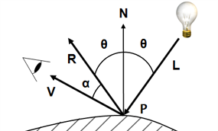
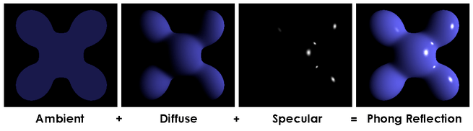
Review: Phong Lighting Model
$$I={K_{a}L}_{a}+K_{d}L_{d}(L∙N)+K_{s}L_{s}{(V∙R)}^{α}$$
Object color affects K_{a} and K_{d}, and light color affects K_{s}
Use ambient color as K_{a}
Use texture color/ diffuse color as K_{d}
α for shininess
α is bigger, the specular area gets smaller
The “dot values” must > 0

Slide 22
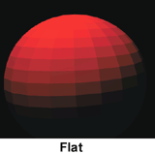
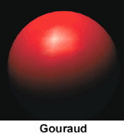
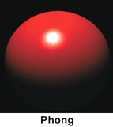
Phong Shading
Different interpolation strategy(over a facet/ among vertices)
$$No interpolation$$
$$Color interpolation$$
$$Normal interpolation$$
$$Image source:http://www.yourdictionary.com/flat−shading$$

Slide 23
Phong Shading
Why not Gouraud shading?
$$Image source:https://commons.wikimedia.org/wiki/File:Gouraud_low.gif$$

Slide 24
Phong Shading : Reminder
When transforming a vertex from local space to view space…
You multiply its position with modelview matrix (MV)
Position_view = vec3( MV * vec4(Position_local , 1.0));
But for transforming “normal”, using MV is not correct!
The matrix for transforming normal is called “Normal Matrix” in CG.
It’s also mentioned in class!
If you don’t know how to compute “Normal Matrix”, look for it in ppt or google!

Slide 25
Dissolving Effect

Slide 26
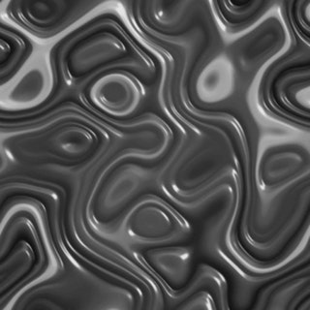
Dissolving Effect
Each fragment samples a value - v from noise texture
A noise texture is provided.
System maintains a threshold – t, which ranges from 0 to 1
When threshold is at its min(max), the whole object is either invisible or visible.
For thresholds in between, part of the object should be discarded.
In short :
If ( v < t ) { do not draw this fragment }
For discarding a fragment, look for a glsl-keyword, not a glsl-function

Slide 27
Dissolving Effect
Va = texture2D( noiseTexture, a.uv) = 0.33
Fragment a
Vb = texture2D( noiseTexture, b.uv) = 0.67
Fragment b
Fragment c
Vc = texture2D( noiseTexture, c.uv) = 0.15
When t = 0, none fragments are discarded
When t = 1, all fragments are discarded
When t = 0.2, c is discarded
When t = 0.4, a and c are discarded
As t increases, more fragments are discarded
$$Image source:http://www.yourdictionary.com/flat−shading$$

Slide 28
Dissolving Effect : Edge
Maintain a very small float - w, for representing the edge’s width.
Assume w = 0.1 and t = 0.3
Va = 0.2 , Va < t, a is discarded
Vb = 0.35, Vb < t + w, b isn’t discarded, but have edge color instead of texture color
Vc = 0.5, Vc > t + w, c isn’t discarded, and have regular texture color

Slide 29
Dissolving Effect
In this homework……
You don’t need to do lighting calculation in this mode.

Slide 30
Ramp Shading(Ramp Effect)

Slide 31
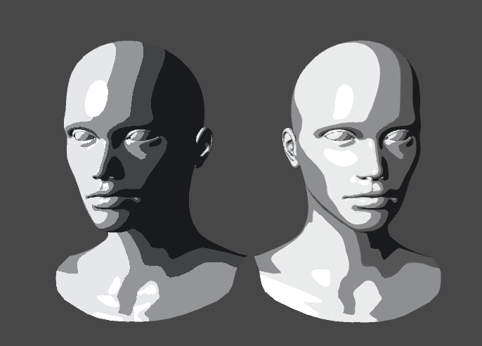
Ramp Shading
Lighting is discrete,
rather than continuous.
This effect is actually very simple…
$$Image source: http://www.artisticexperiments.com/cg−shaders/cg−shaders−ramp−shading$$

Slide 32

Ramp Shading
Have a “lighting intensity map”
Just like sampling any color textures, use a vec2 to get a vec3 value
But this time, not using texture coordinates, we use calculated lighting
Or, you can implement a normalized function yourself !
The point is to match continuous values to discrete values
1.36498, 1.3165, 1.98943 map to 1

Slide 33
GLMmodel

Slide 34
How to Get Data of Vertices from GLMmodel?
model->triangles[i] : i-th triangle structure of the mesh
model->triangles[i].vindice[j] : j-th vertex index of i-th triangle
model->vertices[3 * i + 0] : x value of i-th vertex position
model->vertices[3 * i + 1] : y value of i-th vertex position
model->vertices[3 * i + 2] : z value of i-th vertex position
model->groups[i] : i-th triangle group structure of the model
only 1 group in the .obj file of HW3
What you need : position, normal, texture coordinate, material of the group(K_{a}, K_{s}, Shininess)……
Please refer to glm.h for more information

Slide 35
More…
If you have questions, you can send emails to TA.
If you find any errors in template project, please contact TA asap.
The requirements for this homework is specified in spec.
Spec : hackmd.io/s7FWQNN5SzmOMDZRzi_3vw

