Slide 1
Raspberry Pi
Hints and Tips

Slide 2
Initial Setup
Obtain the Raspbian OS here:
https://www.raspberrypi.org/downloads/raspbian/
Install it with these instructions:
https://www.raspberrypi.org/documentation/installation/installing-images/README.md
Plug in HDMI Monitor, USB Keyboard & Mouse
Apply power
Choose your WiFi access point
Enjoy the Raspbian Linux GUI

Slide 3
Don’t have keyboard, monitor, & mouse?
Headless Setup
https://caffinc.github.io/2016/12/raspberry-pi-3-headless/
Use Internet sharing while travelling
Connect Pi to laptop with ethernet cable
MacOS: https://support.apple.com/kb/PH25327?locale=en_GB
Windows: http://www.andornot.com/blog/post/How-to-share-wired-internet-wirelessly-with-a-Windows-7-laptop.aspx
Or, use your cell phone hotspot
ssh to your device using it’s hostname.local (ie: ssh pi@raspberrypi.local)
Connect to multiple WiFi networks
https://www.mikestreety.co.uk/blog/use-a-raspberry-pi-with-multiple-wifi-networks

Slide 4
Node-Red
First thing, update the pre-installed NodeJS/Node-Red In a terminal enter:
update-nodejs-and-nodered
sudo npm update –g
Running node-red on a Raspberry Pi:
https://nodered.org/docs/hardware/raspberrypi.html

Slide 5
Occasional System updates - When the mood strikes you
In a terminal enter:
sudo apt update
sudo apt upgrade

Slide 6
What can I do with this thing?
https://www.raspberrypi.org/resources/
https://www.instructables.com/
https://www.adafruit.com/
https://www.ibm.com/developerworks/learn/iot/index.html
Sign up for the weekly Raspberry Pi newsletter for great projects:
https://www.raspberrypi.org/weekly/

Slide 7
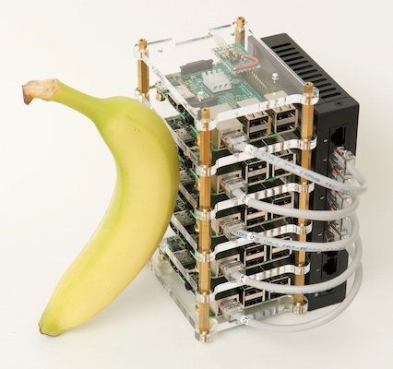
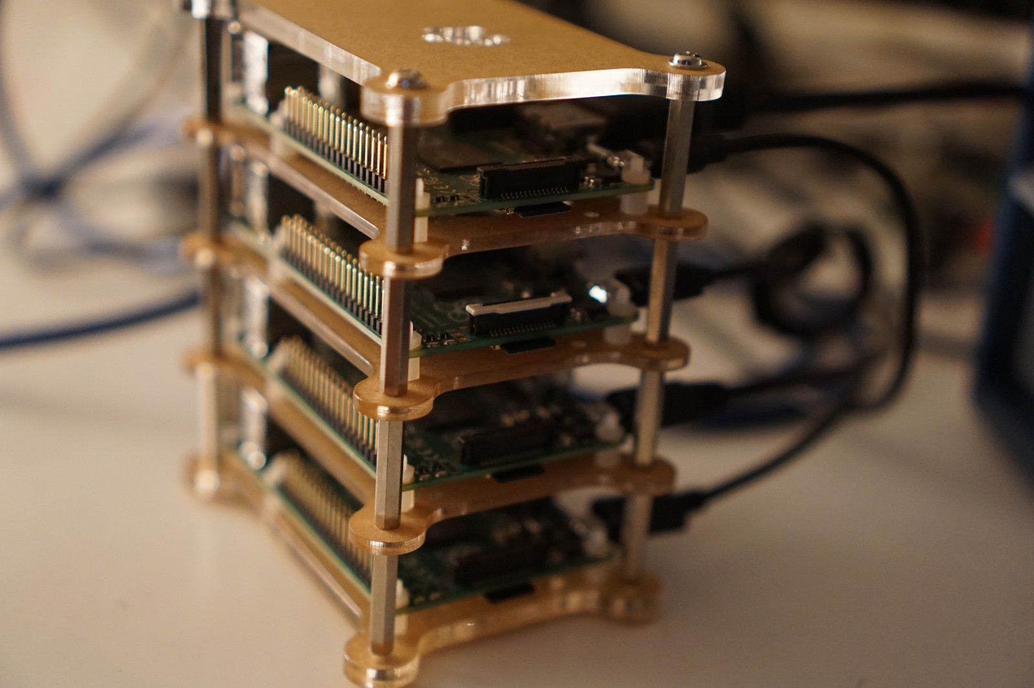
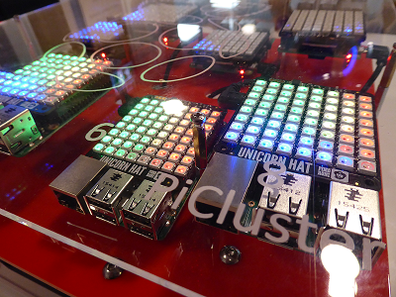
Wanna go a little crazy? Build a Raspberry Pi Cluster
https://projects.raspberrypi.org/en/projects/rpi-python-build-an-octapi
https://www.jeffgeerling.com/blog/2017/how-build-your-own-raspberry-pi-cluster

Slide 8
Shutdown your Pi
At terminal enter: node-red-stop
Then enter: sudo shutdown now
Green light next to red power light will flash a few times then stay off permanently as system shuts down (roughly 15-20 seconds)
Unplug the USB cable

