Slide 1
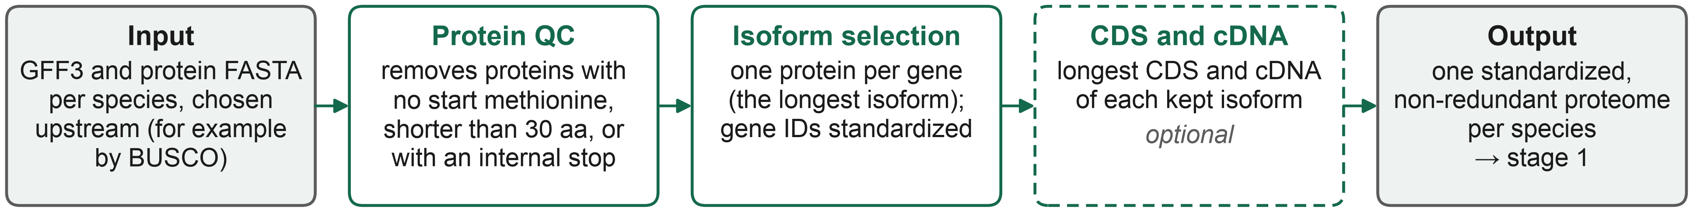
LINGUA stage 0 · Protein preprocessing
1

Slide 2
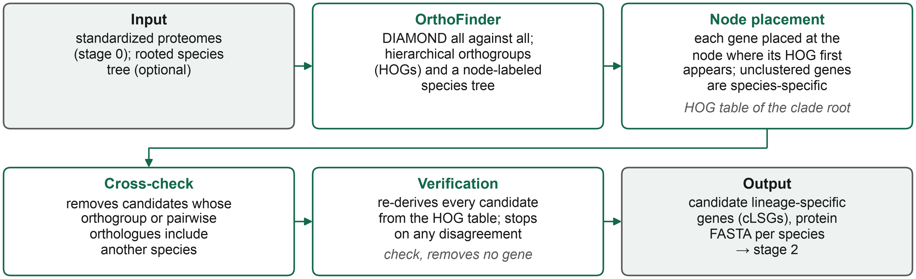
LINGUA stage 1 · Gene stratigraphy
2

Slide 3
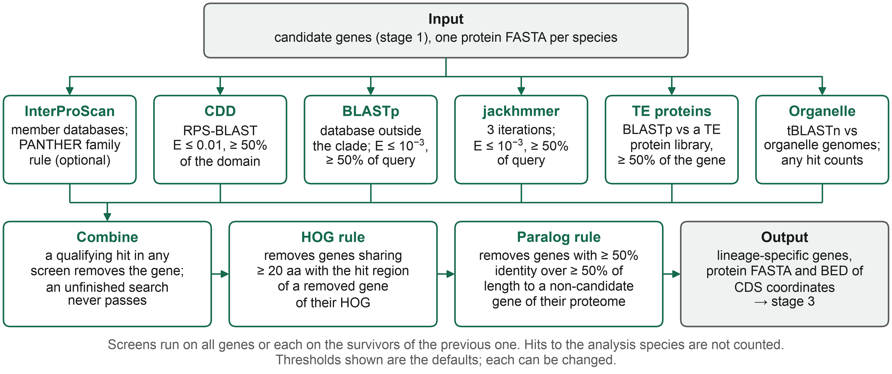
LINGUA stage 2 · Homolog exclusion
3

Slide 4
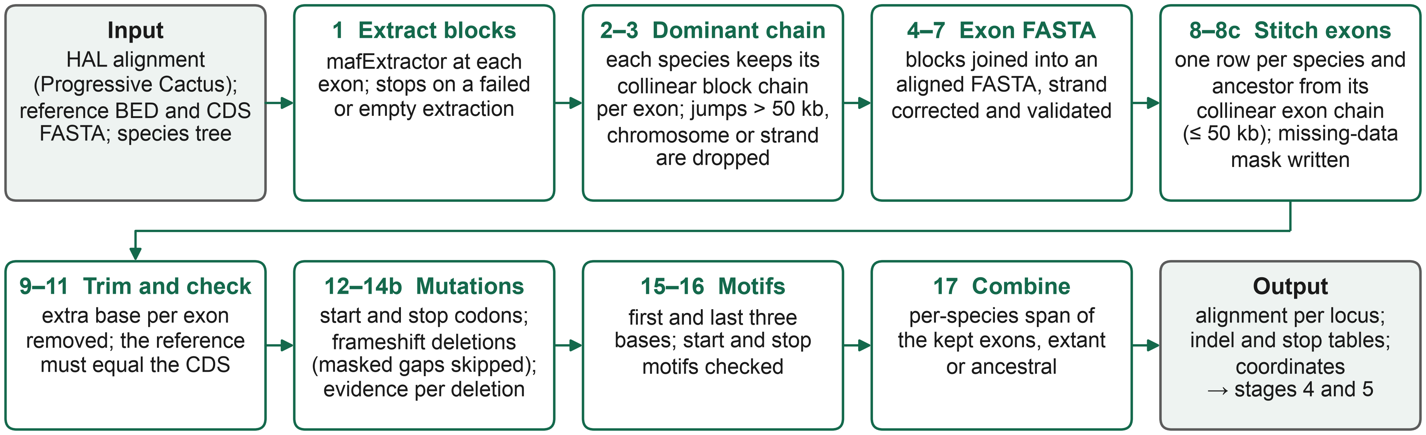
LINGUA stage 3 · Alignment extraction
4

Slide 5
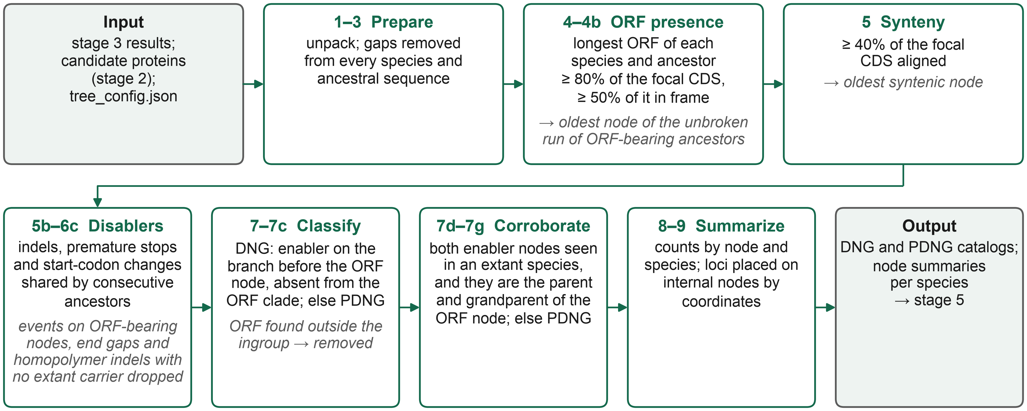
LINGUA stage 4 · Enablers
5

Slide 6
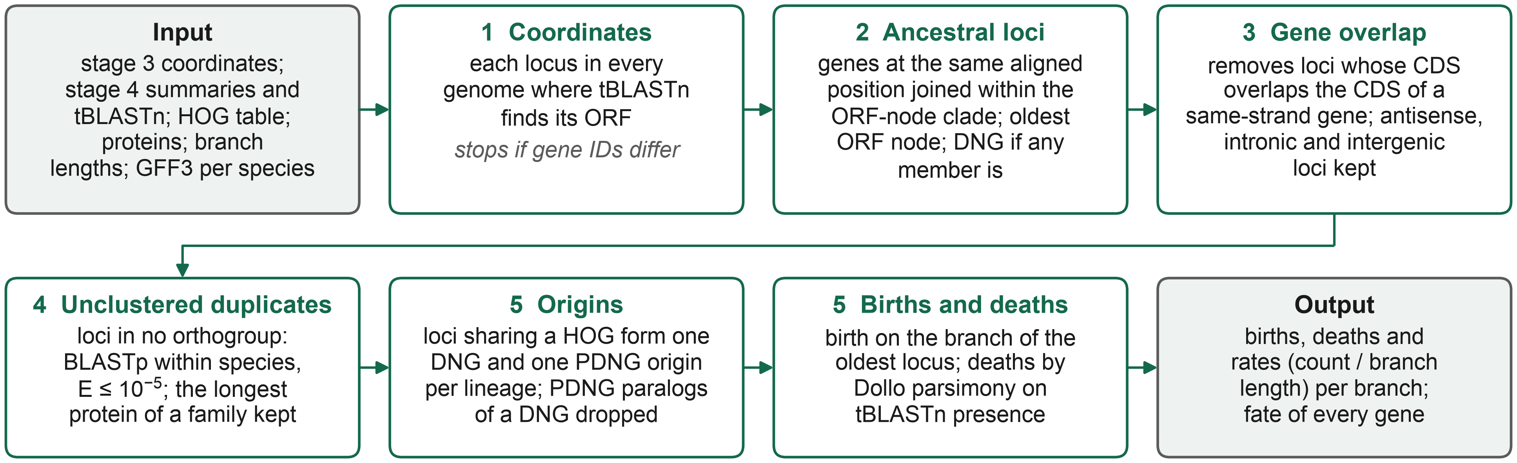
LINGUA stage 5 · Births, deaths and rates
6

