Slide 1

Self-driving Car
Radu Mariescu-Istodor & Seppo Nevalainen

Slide 2
Prerequisites
HTML, CSS, JavaScript
Math:
Interpolation https://youtu.be/J_puRs40GhM
Trigonometry https://youtu.be/xK3vKWMFVgw
Segment Intersection https://youtu.be/fHOLQJo0FjQ
Download Package
(Important!)

Slide 3
Schedule
Day 1 (Morning): Driving Mechanics + Artificial Sensors
Day 1 (Afternoon): Collision Handling + Traffic Simulation
Day 2: Neural Network + Genetic Algorithm

Slide 4
DAY 1 (Morning)

Slide 5

Car
0,0
width
height
x,y

Slide 6
Unit Circle
Rotated Unit Circle
+
-
π/2
0
π/2
+
+
α
Sin(α)
Cos(α)
Sin(α)
α
α
0
3π/2
0
-
π
-
π
π/2
Sin(α)
Cos(α)
Cos(α)
3π/2
3π/2
π

Slide 7
Unit Circle
Rotated Unit Circle
+1
+1
α
Sin(α)
Cos(α)
α
+1
-1
+1
Sin(α)
-1
Cos(α)
-1
-1

Slide 8
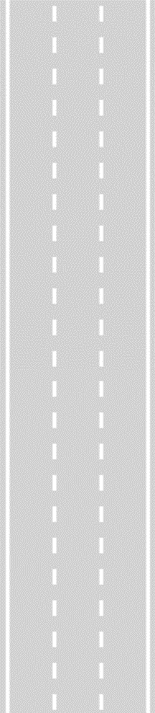
Road
top
-∞
topLeft
topRight
lane indices ➔ 0 1 2
x
left
right
width
bottomLeft
bottomRight
+∞
bottom

Slide 9
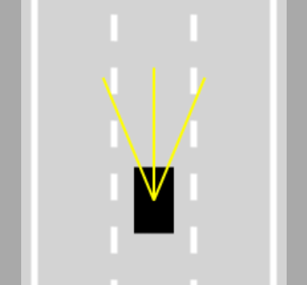
Sensors (Ray Casting)
+
-
spread
0
α
Cos(α)
3π/2
length
π/2
Sin(α)
count = 3
π

Slide 10
Sensor Readings
nearest
2 touches
offset
(0.2)

Slide 11
DAY 1 (Afternoon)

Slide 12
Collisions
+
-
0
width
?
α
α
Cos(α)
rad
?
?
3π/2
height
α
x,y
π/2
?
Sin(α)
?
π

Slide 13
Collisions
+
-
0
width
α
α
angle
Cos(α)
rad
3π/2
height
α
x,y
π/2
Sin(α)
π

Slide 14
END OF DAY 1
Self-study material:
Fine-tuning https://youtu.be/SL6PfDpSjao
Neural Networks https://youtu.be/Ve9TcAkpFgY
[0:00 ➔ 4:35 Important!]

Slide 15
DAY 2

Slide 16
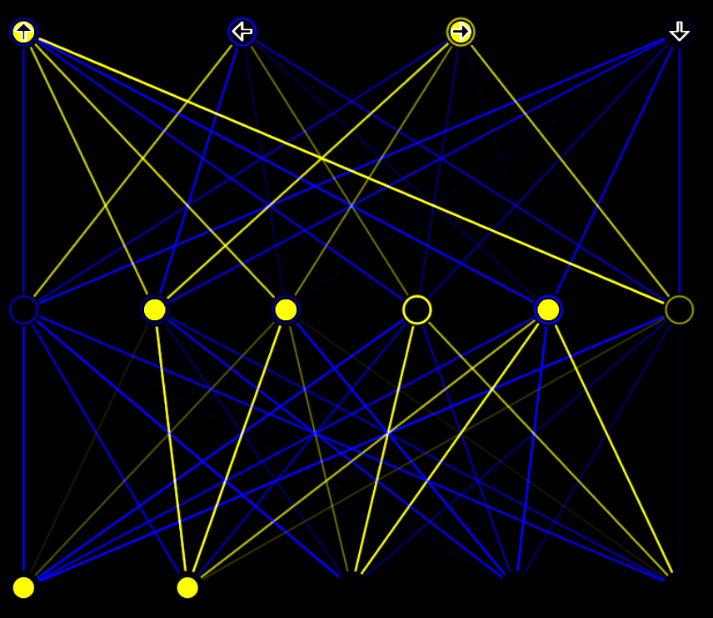

Neural Networks
outputCount
outputCount
inputs
-0.8 0.4 -0.4 0.2 0 0
0 0.5 0 0.2 0.5 0
0 0 0 0 0 0
0 0 0 0 0 0
0 0 0 0 0 0
-1 0.5 -0.5 0.2 0 0
0 0.7 0 0.3 0.7 0
0.3 0.7 -0.3 -0.7 -0.2 0.2
0.4 -0.2 0.8 -1 -0.4 0.2
-0.1 0.7 0.6 0.9 -0.3 1
×
×
×
×
×
0.8
0.7
0
0
0
inputCount
inputCount
-1
0
+1
0
sum
-0.8 0.9 -0.4 0.4 0.5 0
LEVEL 1
biases:[-0.7 -0.6 -0.7 1 -1 0.5 ]
outputs:[ 0 1 1 0 1 0 ] << Feed Forward Algorithm
outputCount=6
outputCount
-1 0.5 -0.5 0.2 0 0
0 0.7 0 0.3 0.7 0
0.3 0.7 -0.3 -0.7 -0.2 0.2
0.4 -0.2 0.8 -1 -0.4 0.2
-0.1 0.7 0.6 0.9 -0.3 1
weights:
LEVEL 0
inputCount
inputCount=5
inputs:[ 0.8 0.7 0 0 0 ]

Slide 17
Neural Networks
4
6
5
LEVEL 1
outputs
LEVEL 0
inputs
neuronCounts = [ 5, 6, 4 ]

Slide 18

END OF DAY 2
Self-study material:
Live Stream (curves) https://youtu.be/NUjN2Mln_Gg
Fine-tuning https://youtu.be/SL6PfDpSjao
NN Visualizer https://youtu.be/lok3RVBwSqE
Play With:
Mutation amount
Sensor count, length & spread
Number of neurons
[ REMEMBER TO discard(); ]

Slide 19
EXTRA

