Slide 1
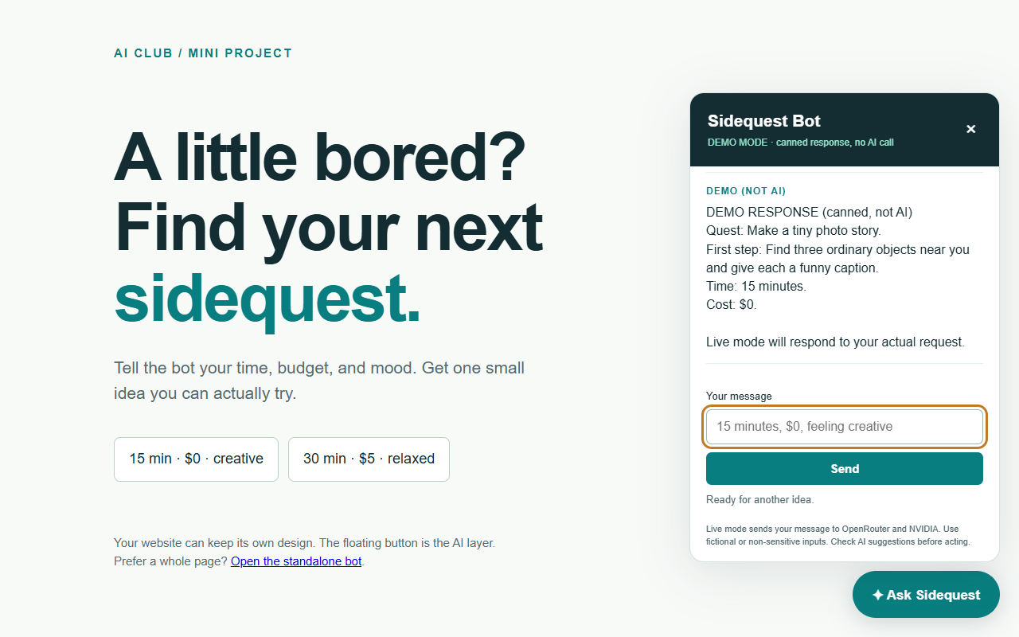
AI CLUB
AI LAB 02
A floating AI bot for your website
A 20-minute mini project with OpenRouter and one small backend
TODAY’S BUILD
01 Ask for a sidequest
02 Connect a real AI model
03 Give the bot a new job
Try: “15 minutes, $0, feeling creative”
01 Project
Resources
1-1
01 / 06
Notes:
TIME 0:00–2:00. Before the meeting: participants install Node.js LTS (22 or newer), verify node --version, sign in to OpenRouter, and download the repository. Installation and account recovery are outside the 20 minutes. Pair participants so one operates and one judges answers. Open the prepared app and click a sample prompt. Point out that the screenshot shows DEMO mode, which is a fixed response and does not call AI. In live mode the request path is browser index.html, local POST /api/chat, OpenRouter, NVIDIA model, then back through the server to the browser. An API route is a URL plus server code that receives a request and sends a response. Today is API integration, not model training. Deliverable: one working reply and one intentional customization. GitHub starter: https://github.com/Casper3211/Static-Page-Demo/tree/main/ai-sidequest. Sources: https://openrouter.ai/docs/quickstart and https://nodejs.org/en/download.

Slide 2
AI CLUB
AI LAB 02
1. Your key and project files
2:00–5:00 Open the downloaded ai-sidequest/project folder in your editor
01
Create a key
openrouter.ai/settings/keys, then Create Key
02
Copy the sample
Copy .env.example to .env in the same folder.
03
Paste privately
In .env: OPENROUTER_API_KEY=your_key
04
Keep live mode
DEMO_MODE=false, then save the file.
Model: nvidia/nemotron-3-ultra-550b-a55b:free
02 Setup
Resources
2-1
02 / 06
Notes:
TIME 2:00–5:00. Step 1: open https://github.com/Casper3211/Static-Page-Demo, choose Code then Download ZIP, extract it, and open ai-sidequest/project in VS Code. This download should ideally be done before the timer. Step 2: open https://openrouter.ai/settings/keys, sign in, click Create Key, name it AI Club workshop, and copy it privately. Do not ask participants to display keys on the projector. Step 3: in the editor file explorer, copy .env.example and rename the copy exactly .env, not .env.txt. Step 4: replace paste_your_key_here with the real key after OPENROUTER_API_KEY=. Keep DEMO_MODE=false. Save. .gitignore excludes .env, and our server does not serve it. The requested model ID is already in server.mjs including :free. Only that model is requested, with no paid-model fallback. The model page currently lists zero token pricing, subject to free-model limits and availability. It also discloses logging and asks users not to submit personal or confidential data. Use fictional inputs. If account setup stalls, DEMO_MODE=true allows the rest of the exercise without an AI call. Sources: https://openrouter.ai/developers, https://openrouter.ai/nvidia/nemotron-3-ultra-550b-a55b:free?view=api, https://openrouter.ai/docs/api_reference/limits.

Slide 3
AI CLUB
AI LAB 02
2. The private API route
Minutes 5 to 9: index.html calls /api/chat. server.mjs calls OpenRouter.
SERVER.MJS REQUEST EXCERPT
RUN IN THE PROJECT TERMINAL
fetch(ENDPOINT, {
method: 'POST',
headers: {
Authorization: `Bearer ${apiKey}`,
'Content-Type': 'application/json'
},
body: JSON.stringify({ model: MODEL,
messages, max_tokens: 2048 })
})
node --env-file=.env server.mjs
Open http://127.0.0.1:4320
Click Ask Sidequest and send.
Keep the terminal open.
The key stays on the server.
ENDPOINT = https://openrouter.ai/
api/v1/chat/completions
02 Connect
Resources
2-2
03 / 06
Notes:
TIME 5:00–9:00. Step 5: in the editor select Terminal > New Terminal. Ensure the terminal directory is ai-sidequest/project. Run node --version; version 22 or newer is required. Step 6: run node --env-file=.env server.mjs. No npm install or SDK is required. Step 7: open http://127.0.0.1:4320 in a browser, click Ask Sidequest, type the sample prompt, and Send. Wait for the answer. The startup message and badge should say LIVE. Step 8: open server.mjs and locate MODEL, SYSTEM_PROMPT, and the fetch call. The slide is an excerpt; the actual file builds messages inline. Authorization is a request header that proves which account can use the API. Bearer is the header's authentication scheme. The JSON body contains model and messages. System content sets the bot's role; user content holds the current question. The model content arrives at data.choices[0].message.content. Our server sends only {reply, demo} back to the browser. This local route accepts POST with JSON {message}; typing /api/chat into the address bar sends GET and returns 405. Public browser JavaScript is visible to visitors, so an owner key belongs in the backend environment. Sources: https://openrouter.ai/docs/quickstart and https://openrouter.ai/docs/api-reference/errors. Full implementation: project/server.mjs.

Slide 4
AI CLUB
AI LAB 02
3. The floating chat in index.html
9:00–13:00 The UI stays in one HTML file. The secret stays in the backend.
Copy three marked blocks
into your existing page
THE BROWSER’S REQUEST
fetch('/api/chat', {
method: 'POST',
headers: {'Content-Type':
'application/json'},
body: JSON.stringify({message})
})
BOT CSS into <head>
BOT HTML + BOT SCRIPT before </body>
Save as project/index.html and refresh.
Full-page option: /bot
Send once more. Both layouts use the same /api/chat route.
03 Integrate
Resources
3-1
04 / 06
Notes:
TIME 9:00–13:00. Step 9: work on a copy of your existing single-file site. If you do not have one, keep the supplied page. In project/index.html find BOT CSS START/END, BOT HTML START/END and BOT SCRIPT START/END. Copy the complete style block into your site's head. Copy the complete HTML block and script before the closing body tag, in that order. Save the combined page as project/index.html after backing up the supplied example elsewhere within your project folder. Keep your original site's content and styles. The widget uses sq- names to reduce style conflicts. Step 10: refresh the server URL. The button uses position: fixed with bottom and right offsets. It opens the panel; form submission sends a POST request to /api/chat. The script parses JSON and displays data.reply as text. It disables Send while waiting and shows errors. The server returns the reply field after reading OpenRouter's choices[0].message.content. This version sends only the current user message, not the visual chat history: each request starts fresh. Step 11: open http://127.0.0.1:4320/bot to see the same bot as a standalone tool. /bot is a page route, /api/chat is a data route. The example server serves only its built-in HTML routes, not arbitrary local files. For an existing site with external images/CSS/JS, add explicit public static-file serving or use the host's normal public directory as a later extension. GitHub Pages hosts static files only. Publishing the real AI version later needs a backend or serverless function, with server-side secret, authentication and rate limiting. Sources: https://openrouter.ai/docs/quickstart; https://docs.github.com/en/pages/getting-started-with-github-pages/what-is-github-pages.

Slide 5
AI CLUB
AI LAB 02
4. Your bot, your personality
13:00–18:00 One partner edits. One partner tests the result.
05
Sidequest Bot, study coach, or …
Edit SYSTEM_PROMPT in server.mjs.
Set a role, answer format, and one boundary.
Save, press Ctrl+C, then run the command again.
MINUTES
Change the button name. Try the same question again.
03 Customize
Resources
3-2
05 / 06
Notes:
TIME 13:00–18:00. Step 12: choose a job. Sidequest Bot finds a small activity; a study coach turns a topic and deadline into a short plan; a website guide answers from a short factual description you explicitly put in its prompt. Ask teams to predict what will change. Step 13: edit SYSTEM_PROMPT in server.mjs. Example: You are a friendly study coach. Give one 15-minute plan with three short steps and one self-check question. Ask which topic if it is missing. Do not invent assignment requirements. Save the file. Step 14: stop the server with Ctrl+C and rerun node --env-file=.env server.mjs. Changes to server code and .env require a restart. HTML changes need a browser refresh only. Step 15: change Sidequest Bot, Ask Sidequest, and the welcome message in index.html to match the new role. Refresh. Ask the same question before and after, then one vague question. The tester judges whether the format and boundary were followed. A role prompt is guidance, not guaranteed correctness. In DEMO mode answers stay fixed even if the prompt changes, so evaluate real behavior only in LIVE mode. No model training or fine-tuning happens. Stretch goal only if time remains: make /bot the main tool or put explicit website facts in SYSTEM_PROMPT. Completion: demonstrate one reply and explain one edit.

Slide 6
AI CLUB
AI LAB 02
5. The final check and next step
Minutes 18 to 20: show one reply and explain one change you made
Does it work?
Button opens. Send replies. Try a vague input.
If it fails
401: key 429: quota or busy Slow: demo mode
Take it further
README: setup, code map, and hosting notes
GitHub preview = fixed demo. Live AI = hosted backend + private key.
04 Check
Resources
4-1
06 / 06
Notes:
TIME 18:00–20:00. Step 16: check opening/closing the panel, a normal question, and a vague question. Confirm LIVE mode before claiming an AI answer. The UI should show a useful error instead of appearing frozen. 401: correct the key and restart. 402: inspect balance or key limits. 403: inspect access/privacy settings. 429: wait or inspect account quota; another key on the same account does not bypass shared limits. No answer after 60 seconds: retry later or switch to DEMO_MODE=true and restart. Blank content may require a larger completion budget because reasoning consumes output tokens. Step 17: each pair shares its role, one observed reply, and one improvement. Stop with Ctrl+C when finished. The public repository includes a static preview that sends no message to OpenRouter, local project files, this slide deck and README. Real public deployment is a follow-up: keep frontend and /api/chat on the same origin using a server or serverless function, set the key in host secrets, enforce user access and per-user rate limits, and retest. GitHub Pages cannot execute this Node server. Do not publish .env or your API key. Source links: https://github.com/Casper3211/Static-Page-Demo/tree/main/ai-sidequest; https://openrouter.ai/docs/quickstart; https://openrouter.ai/docs/api_reference/limits; https://openrouter.ai/docs/api-reference/errors; https://docs.github.com/en/pages/getting-started-with-github-pages/what-is-github-pages. Resource footers link to the repository workshop folder.

