Slide 1
DevOps at Scale:
Simplifying Service Architectures with Spinnaker
By: Casper Kristiansson & Nicole Wijkman
Notes:
Casper 30s

Slide 2
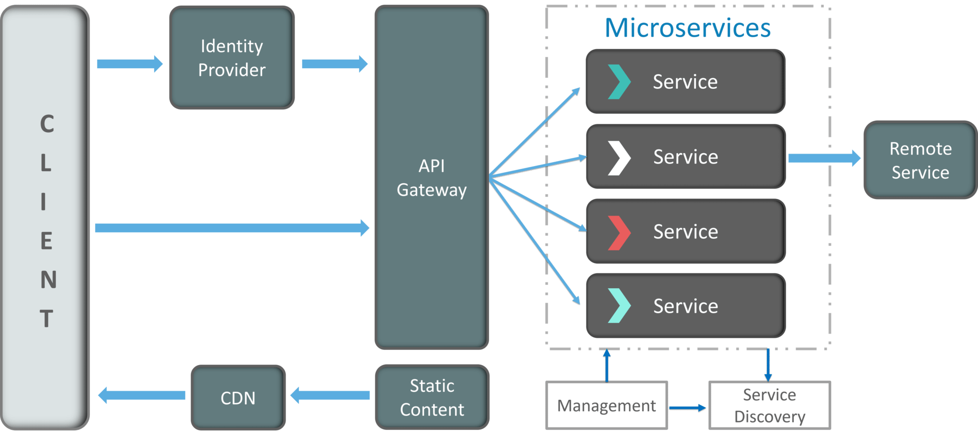
What is DevOps at Scale?
Definition
DevOps at scale manages practices for thousands of services
Scaling Increases Complexity
More services mean more complexity in CI/CD, dependencies, deploying and managing services
Focus
Managing services and teams: Ensuring smooth deployments and coordination across many microservices and development teams
Notes:
Casper 45s
Timestemp: 1:30

Slide 3
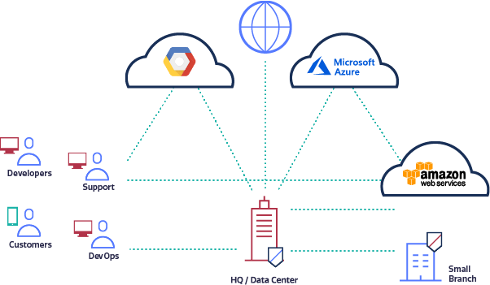
Challenges of Scaling DevOps
Managing Many Services
Updating versions
Consistent Deployments
Dependency Management
Orchestrating services
Avoiding downtime
Failed Releases
Coordinating Large teams
Code Conflicts
Longer Deployment Times
Coordination Challenges Across Teams
Notes:
Nicole 1min
Timestemp: 2:30

Slide 4
Spinnaker
Multi-Cloud Deployments
Advanced Deployment Strategies
Pipeline Automation
Deploy Across AWS, GCP, Azure while ensuring consistency in microservices with centralized control for environments
Blue/Green and Canary deployment strategies with automated rollbacks for safe releases ensuring zero-downtime updates
Coordinate complex release processes with automated testing and approvals scaled for large CI/CD pipelines
Notes:
Nicole 1m 30s
Timestemp: 3:45

Slide 5
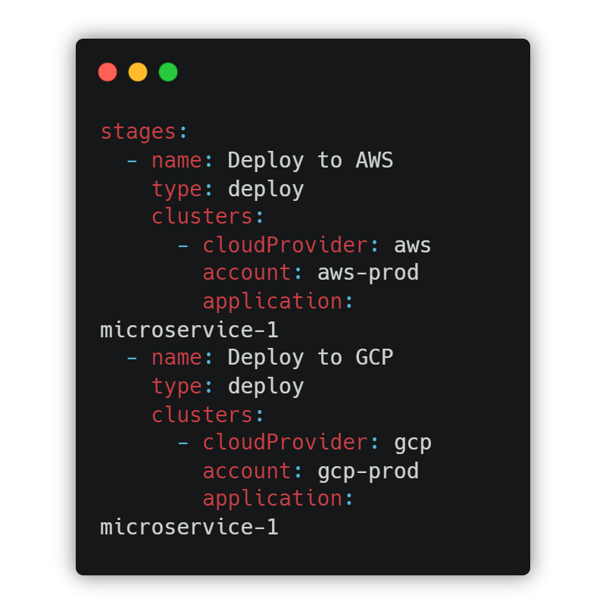
Key Features of Spinnaker
Multi-Cloud Deployments
Multi-Cloud Deployment
Seamlessly deploy across AWS, GCP, Azure, Kubernetes, etc.
Centralized control for managing cloud-specific configurations and environments.
Consistent Multi-Environment Management
Define once, deploy across dev, staging, and production environments in multiple clouds.
Simplifies managing diverse environments with unified pipelines.
Notes:
Casper 1min
Timestemp: 4:45

Slide 6
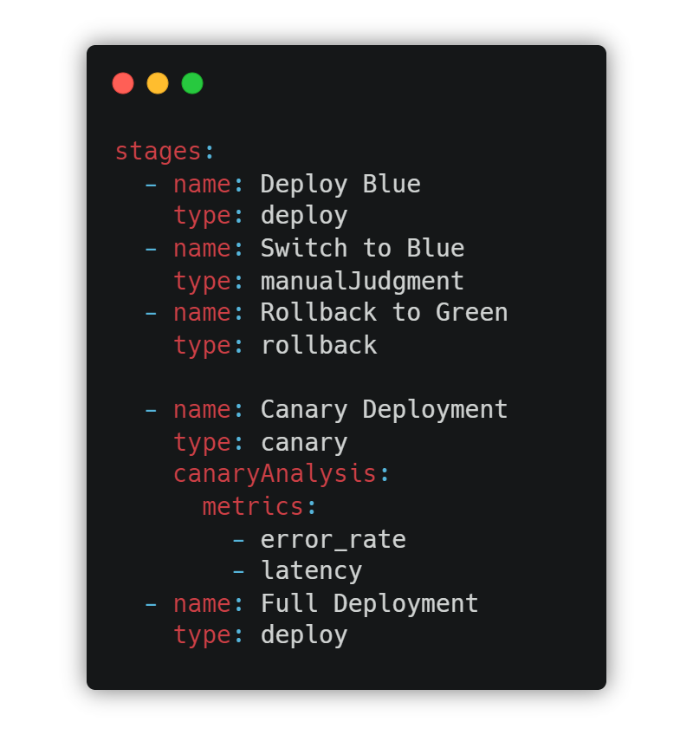
Key Features of Spinnaker
Advanced Deployment Strategies
Blue/Green Deployment
Deploy new versions (blue) alongside the current version (green) with zero downtime.
Switch traffic to the new version only after it’s validated, minimizing risk.
Canary Deployment
Gradually roll out updates to a small percentage of users before full deployment.
Monitor performance and user feedback during canary stages to ensure stability.
Notes:
Casper 1min
Timestemp: 5:45

Slide 7
Spinnaker Solving the Problems
Challenges Solved
Managing Many Services: Automates multi-cloud deployments without any downtime
Coordinating Large Teams: Standardized pipelines reduce conflicts and deployment times.
Spinnaker's Solutions
Multi-Cloud Support: Seamlessly deploys across AWS, GCP, etc.
Automated Rollbacks: Ensures safe, error-free releases.
Advanced Strategies: Blue/Green & Canary deployments for zero-downtime updates.
Notes:
Nicole 1min
Timestemp: 6:45

Slide 8
Reflection and Q&A
Key Takeaways
Questions?
Automated Multi-Cloud Deployments: Spinnaker streamlines deployments across multiple clouds for multiple services, reducing complexity and manual errors
Zero-Downtime & Safe Rollbacks: Advanced deployment strategies like Blue/Green and Canary ensure updates without downtime and allow fast rollbacks if needed
Notes:
Nicole 30s

Slide 9
Kubernetes: The Solution to Scaling DevOps
Automation & CI/CD Tools
Venus
Infrastructure as Code
Monitoring and Observability
Tools: Jenkins, GitLab CI, CircleCI
Description: These tools scale to support 1000+ services, enabling parallel testing, automated rollbacks, and fast deployments.
Tools: Terraform, AWS CloudFormation, Serverless
Description: IaC ensures scalable provisioning, compliance, and consistent infrastructure management at scale.
Tools: Prometheus, Grafana, New Relic
Description: Essential for tracking performance and uptime in large-scale systems, providing insights and proactive issue resolution.
Notes:
Nicole 1min 15s
Timestemp: 4:00

Slide 10
The DevOps Rabbit Hole: Designing for Scale from Day 1
Right foundation
Poor early design can lead to scaling challenges
Scaling issues
Poor CI/CD, monitoring, and automation cause inefficiencies and outages
Technical debt
Short-term fixes create complexities that slow future growth
Mitigation
Invest in good architecture, automation, and monitoring from the start to avoid firefighting later
Notes:
Casper 1min
Timestemp: 5:00
"Let’s talk about the DevOps rabbit hole—specifically, how crucial it is to design for scale from day one. If you don’t start with the right foundation, you’ll face scaling challenges later. For example, poor early design can lead to technical debt—those quick fixes that seem helpful now but will slow you down in the future. Scaling issues like inefficient CI/CD pipelines, inadequate monitoring, and insufficient automation can cause outages and performance problems. The key takeaway here is mitigation: by investing in good architecture, automation, and monitoring from the start, we can avoid the firefighting and inefficiencies that plague many companies down the road."

Slide 11
Case Study - Northvolt
Microservices (1000+):
Dedicated teams manage each microservice autonomously, with separate CI/CD pipelines.
GraphQL API:
GraphQL centralizes data queries from multiple sources, reducing over- and under-fetching.
Custom Pipelines:
Serverless, Terraform, and Grafana and other tools tailored to each microservice, optimizing workflows.
Centralized Component:
Centralization: GraphQL unified data access across independent microservices.
Notes:
Casper 45s
Timestemp: 5:45
"Here we have a case study of Northvolt, which operates over 1000 microservices. Each service is managed by dedicated teams with separate CI/CD pipelines, allowing for autonomy and flexibility. They use custom pipelines tailored to each service with tools like Serverless, Terraform, and Grafana, optimizing their workflows. One challenge they faced was centralizing data access, and this is where GraphQL comes in. By using GraphQL, they unified data access across these independent services, reducing over- and under-fetching while providing centralized control over data queries."

Slide 12
Northvolt - is it a Problem?
Monolithic GraphQL Repo
Deployment Delays
Concurrency Issue
The entire GraphQL API was centralized in a single repository, contradicting microservice modularity.
The size of the GraphQL schema led to deployment times exceeding 15 minutes, slowing development.
Only one developer could work on the API at a time, causing synchronization issues and inefficiencies.
Notes:
Casper 45s
Timestemp: 6:30
"While Northvolt’s use of GraphQL brought some initial benefits, they ran into significant challenges. First, their entire GraphQL API was centralized into a single monolithic repository, which contradicted the modularity that microservices are supposed to offer. This centralization caused deployment delays, with the large schema taking over 15 minutes to deploy, slowing down development. On top of that, only one developer could work on the API at a time, leading to concurrency issues and inefficiencies. These are the kinds of scaling problems we can encounter when implementing a monolithic approach within a microservice architecture."

Slide 13
Challenges of Scaling DevOps
Service Count
Managing 10 services is straightforward, but with 1000+ services, complexity increases exponentially.
Cross-team Collaboration
Coordinating distributed teams becomes harder at scale. What challenges arise as teams grow?
Managing Dependencies
Handling dependencies across 1000+ microservices can lead to conflicts. How do we ensure updates are seamless?
Notes:
Nicole 1min 15s
Timestemp: 2:45

