Slide 1
Business Problem
10 Million Americans are addicted to Sports Gambling. Statistically speaking based on Fanduel Sportsbook, 85% of users have a negative profit total. The problem at hand is that many users that put their accounts in financial debt, do not quit gambling. Most users choose to risk more money to bring their net total back to a positive rating!

Slide 2
Benefits of Analytics
From my own experiences, dealing with people that are addicted to anything is not an easy task. Telling an addict to stop will more than likely result in a heated argument and will cause dispatchment between yourself and the person you are trying to help. Giving an individual advice on what they should do, has always in my experience resulted in through one ear and out the other. This data set will provide sports bettors historical knowledge on sports betting in the World Cup which will provide them to make more responsible bets.

Slide 3
Problems
I thought of questions that would help me solve my problem, and what parts of my dataset was tangible for me to use. I used Plotly to find my data and I used two different excel sheets, one excel sheet had simple data which included the host country, year, placement from 1st to 4th and number of goals scored.The other excel sheet had a large array of data

Slide 4
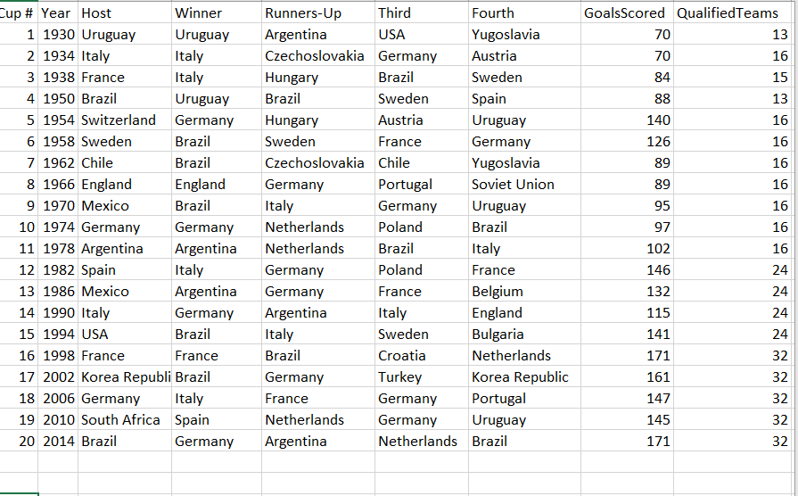
Snippet of Excel

Slide 5
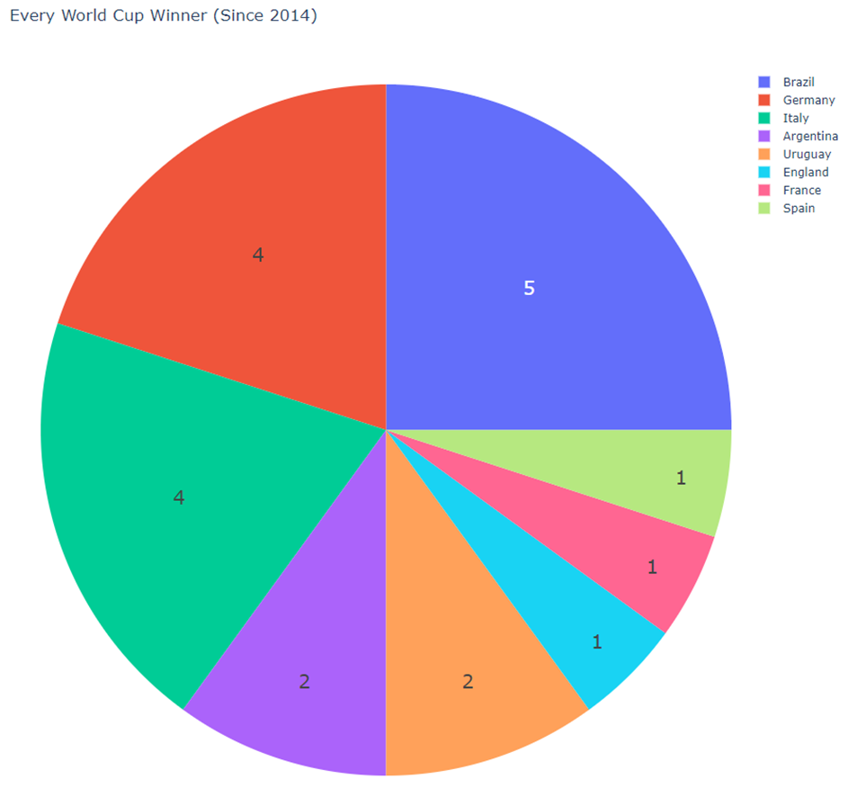
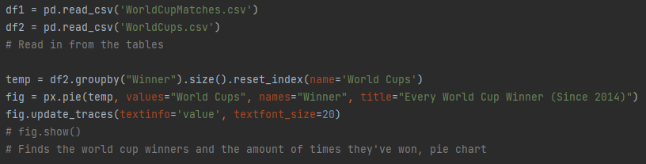
Every World Cup Winner

Slide 6
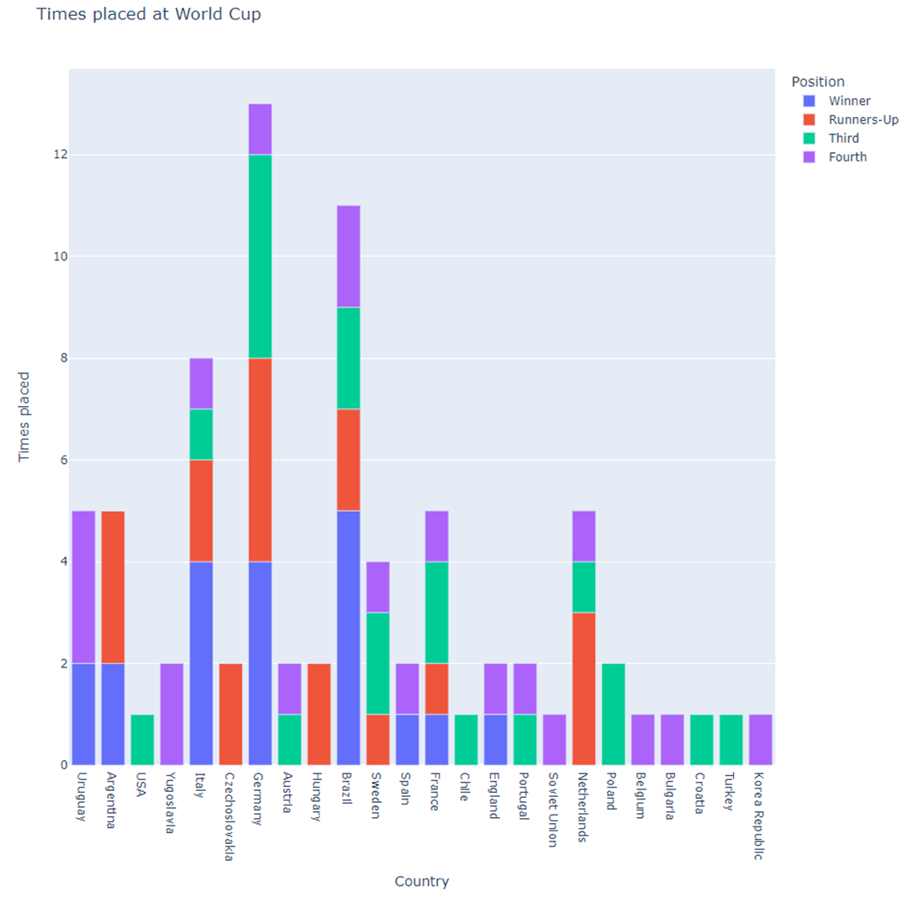
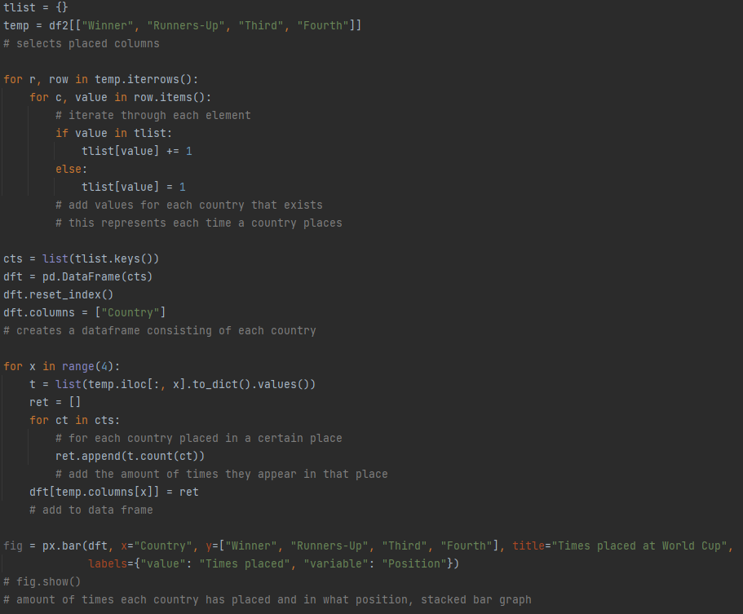
Times Placed in the World Cup

Slide 7
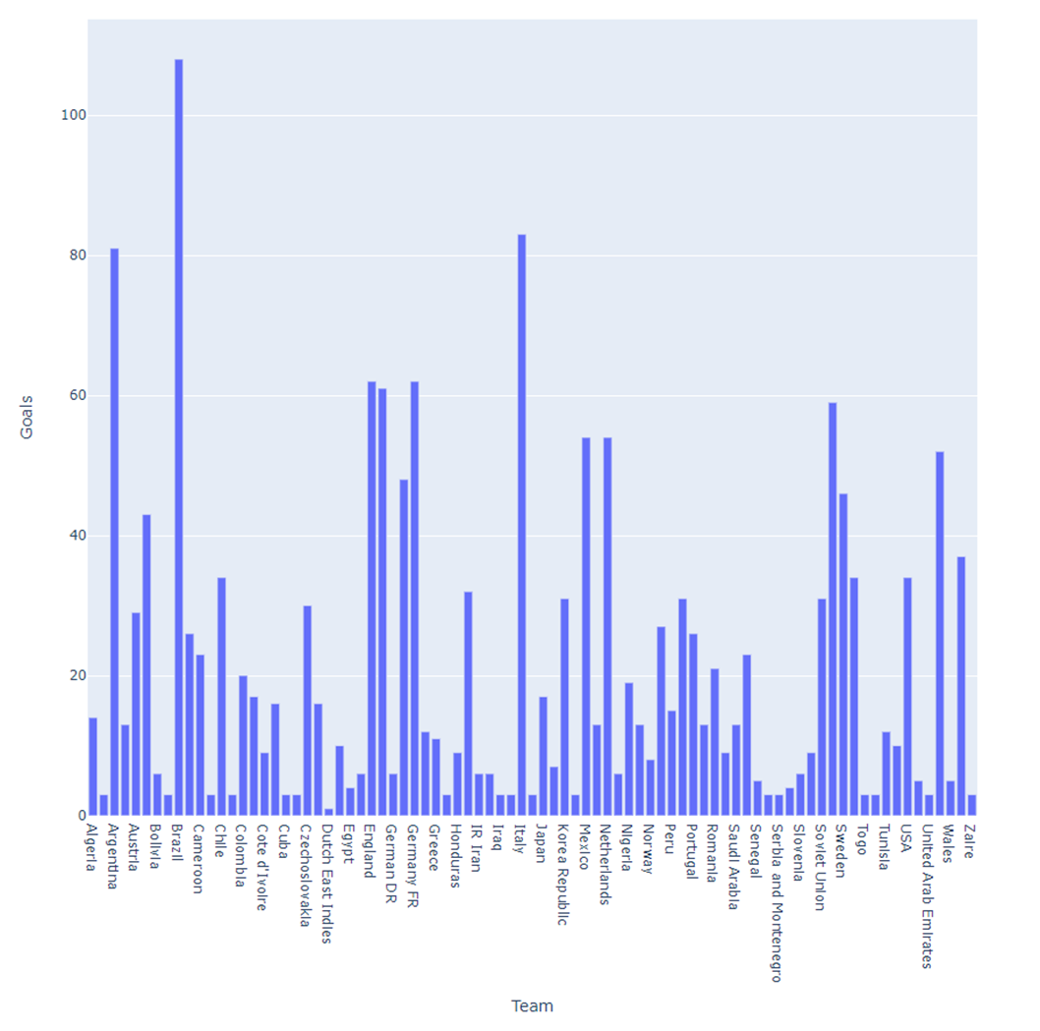
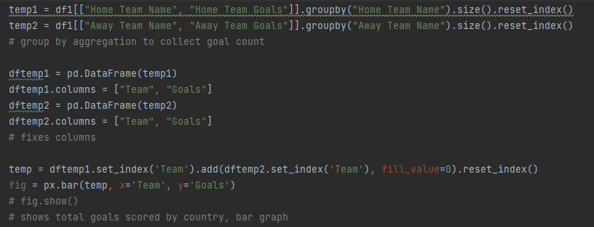
Most Goals scored per country

Slide 8
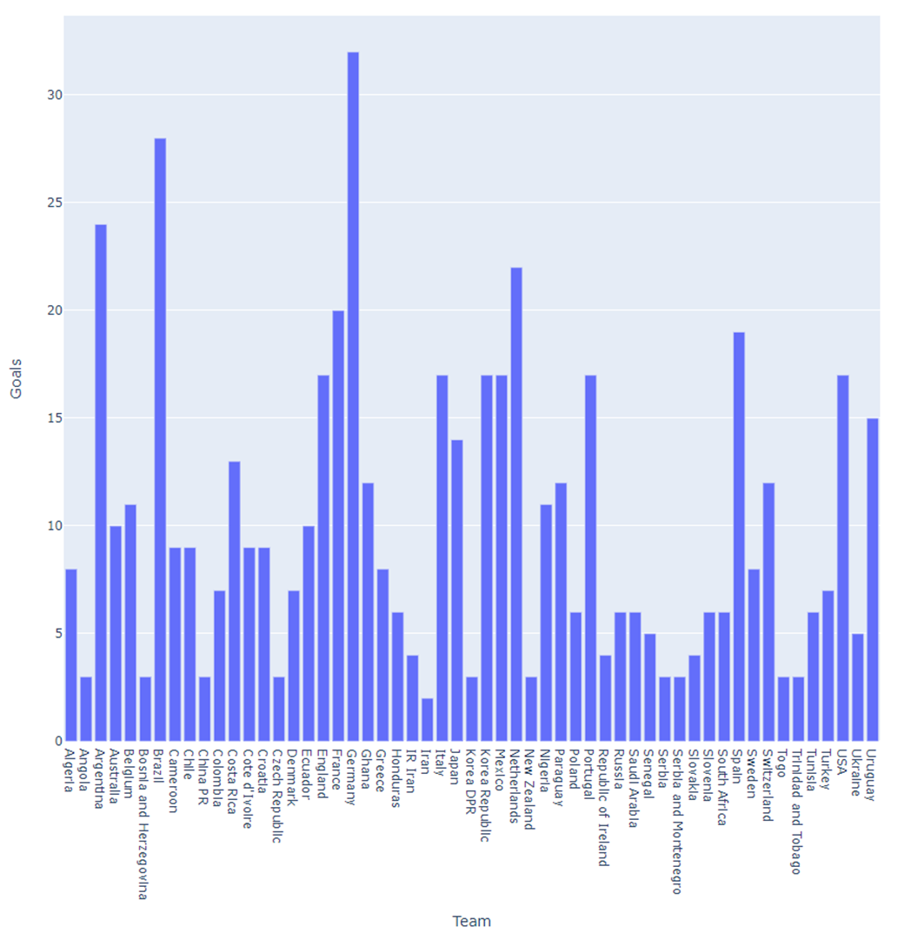
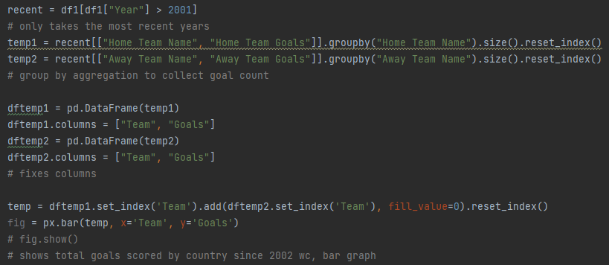
Most Goals Scored per Country since 2002

Slide 9
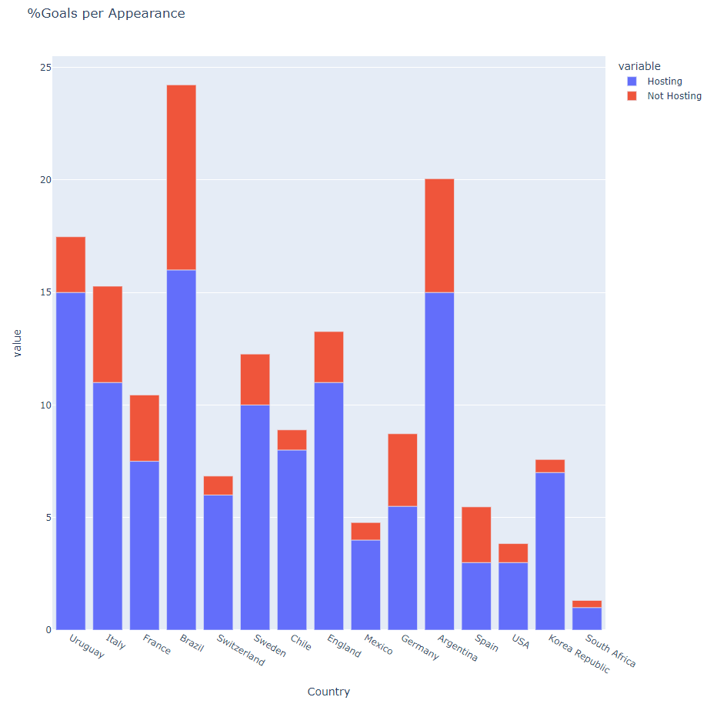
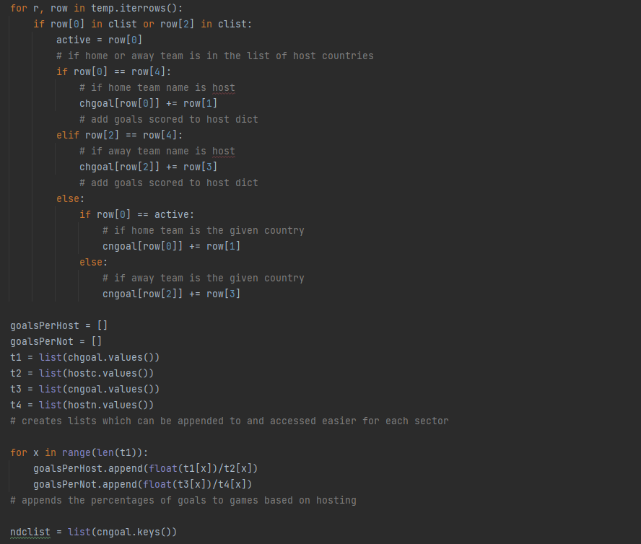
Percentage of Goals per appearance

Slide 10
Result/Future Outlook
Giving background knowledge on users provides sports betters a more accurate outlook on their betting decisions, although sports betting can involve a magnitude of different scenarios, having some background on previous results will provide sports bettors a higher chance in winning their bets! I would recommend possibly making a dataset on players playing for their country and making an average based on their performance to see which teams has the most elite players.

