Slide 1
Git 101
Introduction to Version Control &
Collaboration with Git & GitHub

Slide 2
This Session
Introduction to Version Control Systems
Introduction to Git and GitHub
A step-by-step example of collaborating on a data science project hosted on GitHub
Basic Git shell commands for managing your project
Pull requests for collaboration

Slide 3
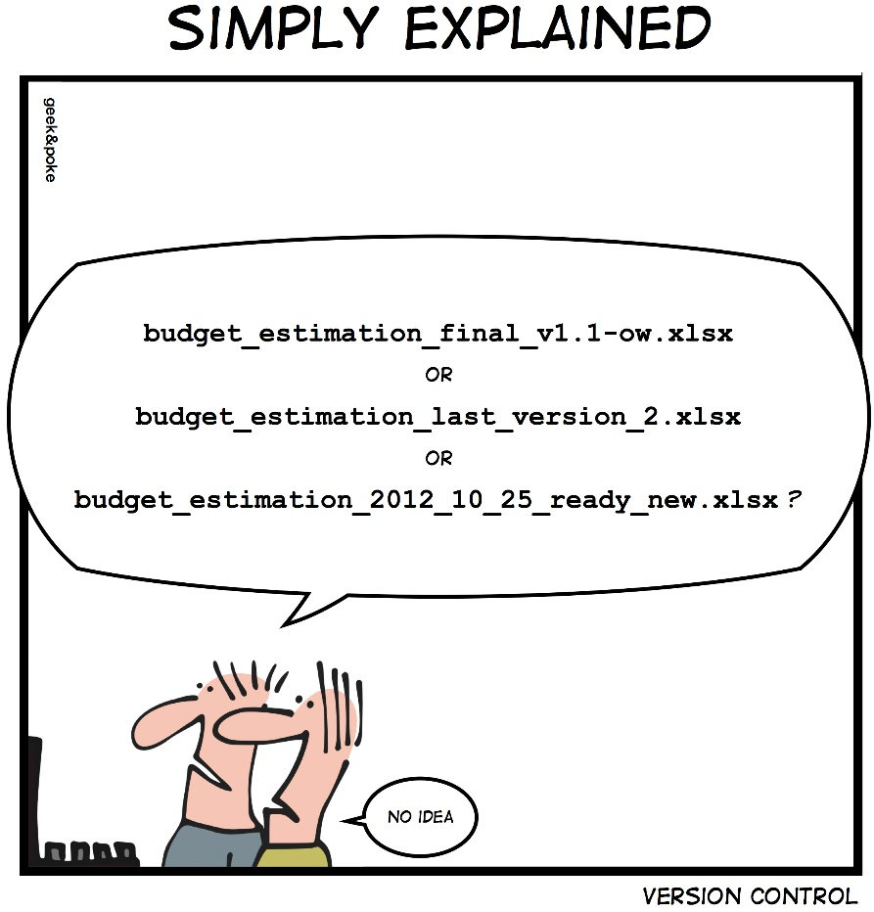
Version Control
Keep track of changes in your project
No more mile-long filenames
Makes collaboration easier and safer
Used as standard in software industry
Git is not the only one
There’s Mercurial, SVN and more

Slide 4
Git Version Control
Git exists as a hidden folder you put in your project that tracks all the changes and manages versions
A folder that is set up for Git is known as a repository, usually called a repo
Git != GitHub
GitHub is a place for hosting repos (as remotes) so that you can share them with your collaborators
There are alternatives, like BitBucket, Beanstalk, etc.
Think of GitHub as cloud storage
At SEAMS, we probably won’t use GitHub as the free version is not private
IT will set something up for us
You don’t need to use remotes to still get a lot of benefit from Git

Slide 5
To Git or not to Git?
Git is for controlling versions of things you and your team will change as you work
Don’t use it for data!
Data should be immutable
Git can track changes in any file, but it makes most sense with code and text documents
You can tell Git what you want it to track and what you would like it to ignore, using a text file called a .gitignore

Slide 6
Install Git on Windows
Go to: https://git-scm.com/
Hit Download X.XX.X for Windows
Open the executable, follow the installer
On Select Components, make sure Git Bash Here and Git GUI Here are selected
Allow Git to be run by 3rd-party software
This allows integration with, e.g., Rstudio
On Configuring the line ending conversions, select Checkout Windows-style,…

Slide 7
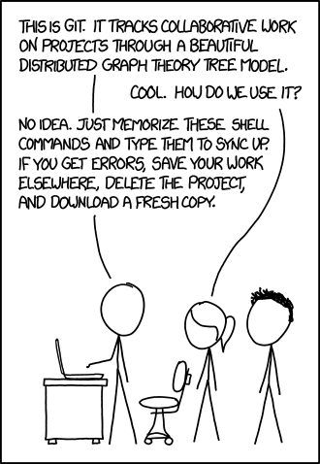
Questions
We have Git installed now, any questions before we start using it?

Slide 8
Clone a Public Repo
Go to: http://www.github.com/tomdakin/git_101
Click Fork to make a copy on your personal GitHub account.
Click Clone or Download and copy the link. This is the URL of your personal remote
Find a handy place to work on your hard drive in windows explorer and right-click there
Select Git Bash Here: A handy Git shell we’ll use for our git commands
Do: git clone shift+ins
Now you have a copy of the repo on your hard drive. It still has a connection to the remote, but it’s your copy and you can do what you like with it without affecting the remote
Head back to the explorer window and have a look at the folder you just cloned.
Tick View->Hidden items : This is where the .git folder is lurking

Slide 9
Change the Code and Commit
Add the movies.csv data file to the data folder
Open the .Rproj file and run the src/movies.R script.
The script loads the data, runs a little analysis and then prints some stuff
Add your own print statement to show your own favourite film (or anything you like)
In the Git shell, run
git status
git add src/movies.R – This adds the change to a staging area. It just tells Git that you want to include the updates to this file in the next commit.
git commit –m “adding favourite movie”
git status
Now your local copy has your changes but also has a complete history of what the code used to look like. We can reset or revert to this if we want to use an older version of the project
Do git push to publish your changes to your personal remote

Slide 10
Collaboration
Let’s send your changes back to the project lead for inclusion in the production version
This can be done using a pull request
Head back to github
Find your remote: www.github.com/<username>/git_101
Click Pull Requests -> New Pull Request -> Create Pull Request -> Create Pull Request
The project lead then can merge all the changes into the project
It’s their job to resolve any conflicts in the code
The final version will have everyone’s changes combined
Afterwards, you can refresh your local repo with
git remote add upstream https://www.github.com/tomdakin/git_101.git
git fetch upstream
git pull upstream master

Slide 11
Summary
Version Control – To manage versions and aid collaboration
Git & GitHub – Tools for VC (Git) and collaboration (GitHub)
git fork & git clone – Copying repos server-side (fork) and locally (clone)
git add & git commit – Tell Git which updates to look at (add) and save them when you’re done (commit)
git push & git request-pull – Save your changes to your own server (push) and request that they be added to the production project (request-pull)

Slide 12
Questions
Git can be confusing at first, but it becomes much easier with use
Data scientists and software developers around the world use it every day so there is lots of support on Google/Stack Overflow/GitHub Help
Any Git problem you may have will not be new!
Ask questions!

