Slide 1
User Feedback Machine Learning

Slide 2
User Feedback Machine Learning
Too Weak | Too Strong | Perfect
Make less coarse (smaller size) Colder temperature Add more water at a time | Make more coarse (larger size) Hotter temperature Add less water at a time | Does not adjust any settings

Slide 3
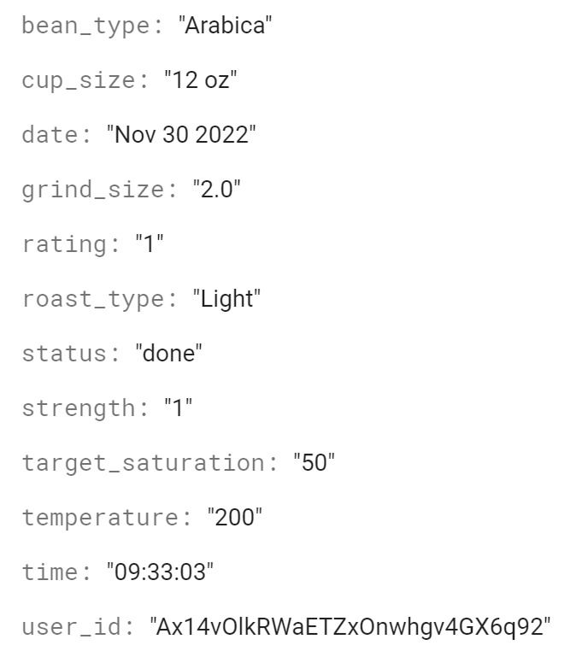
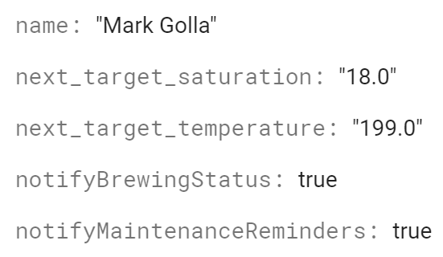
Too Weak -> three changes to increase strength
Less coarse
More Water
Colder

Slide 4
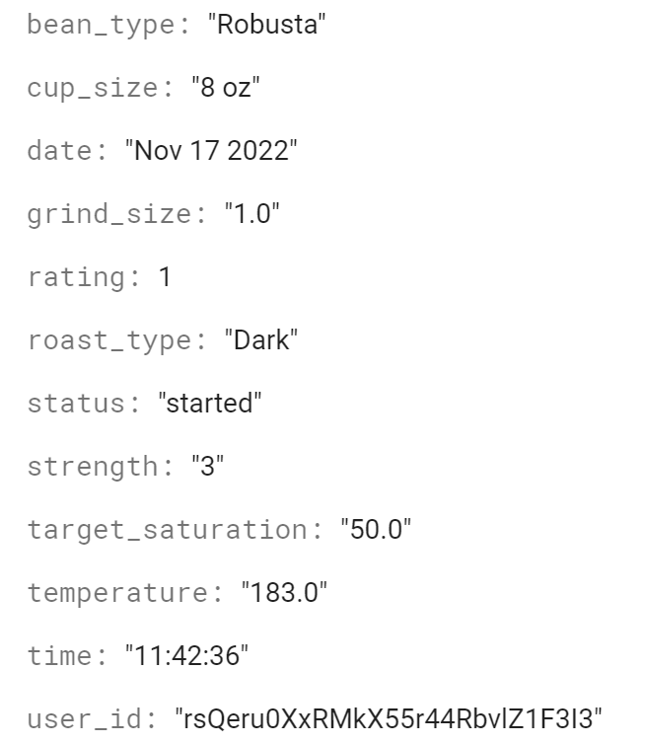
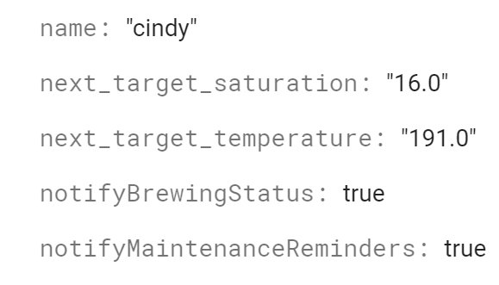
Too Strong -> three changes to decrease strength
Less Water
More coarse
Hotter

Slide 5
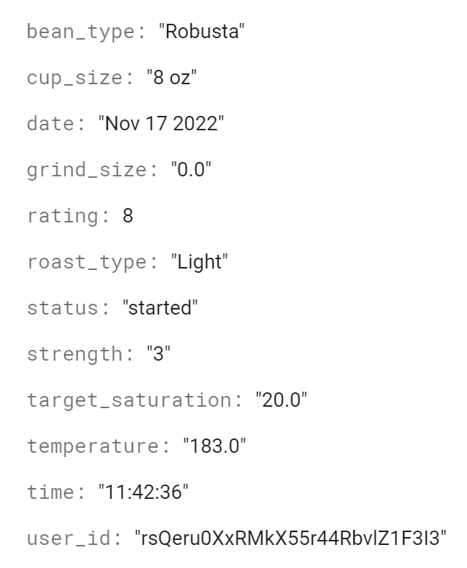
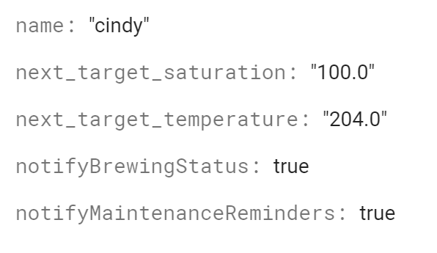
Middle Case - only two parameters change
More water
Keep same
Hotter

Slide 6
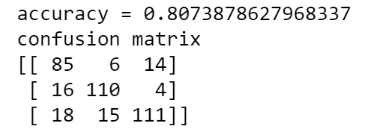
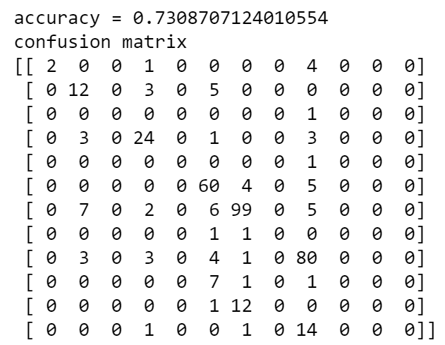
Accuracy of Dependent Variables
Grind Size
Water Saturation
Temperature

Slide 7
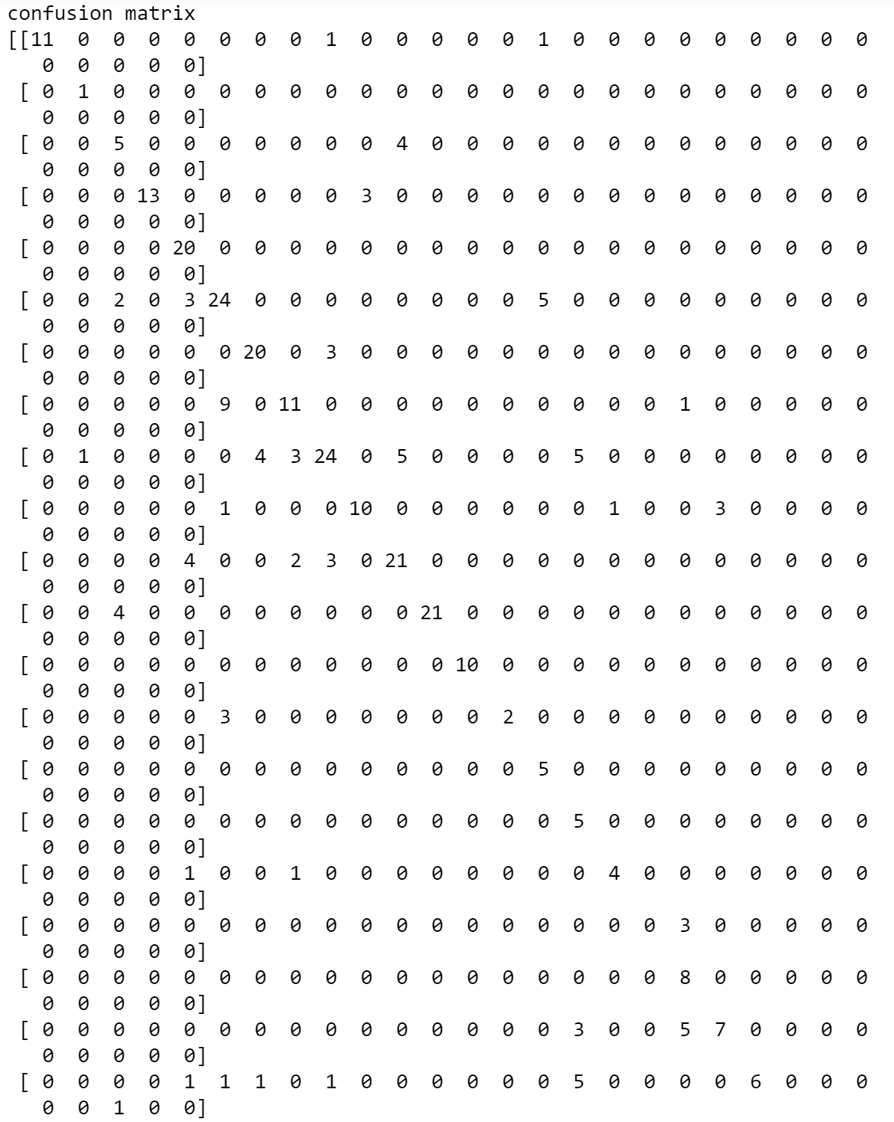
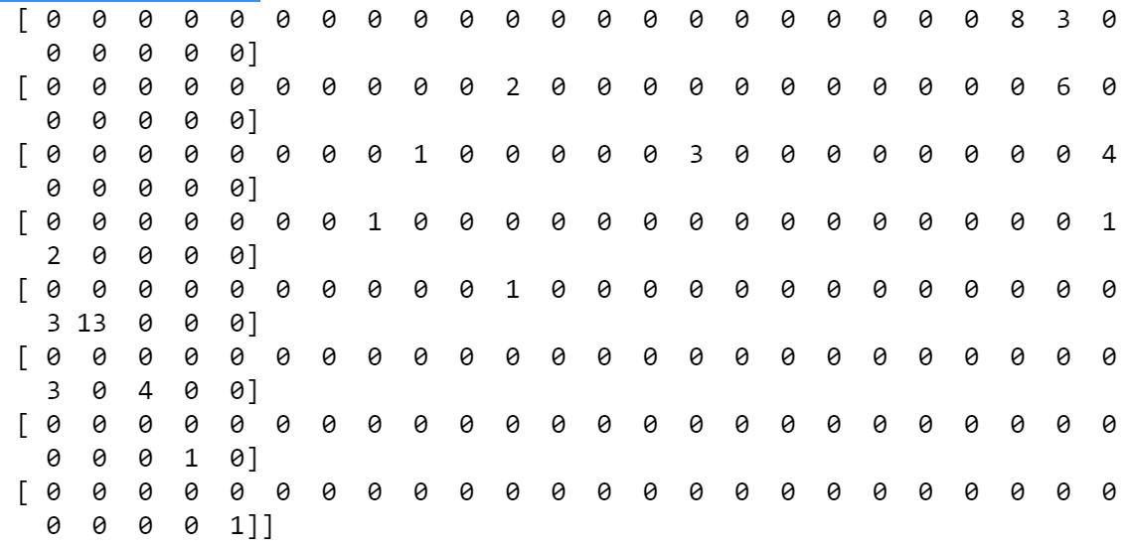
Target Water Saturation Confusion Matrix

Slide 8
Water Saturation Machine Learning

Slide 9
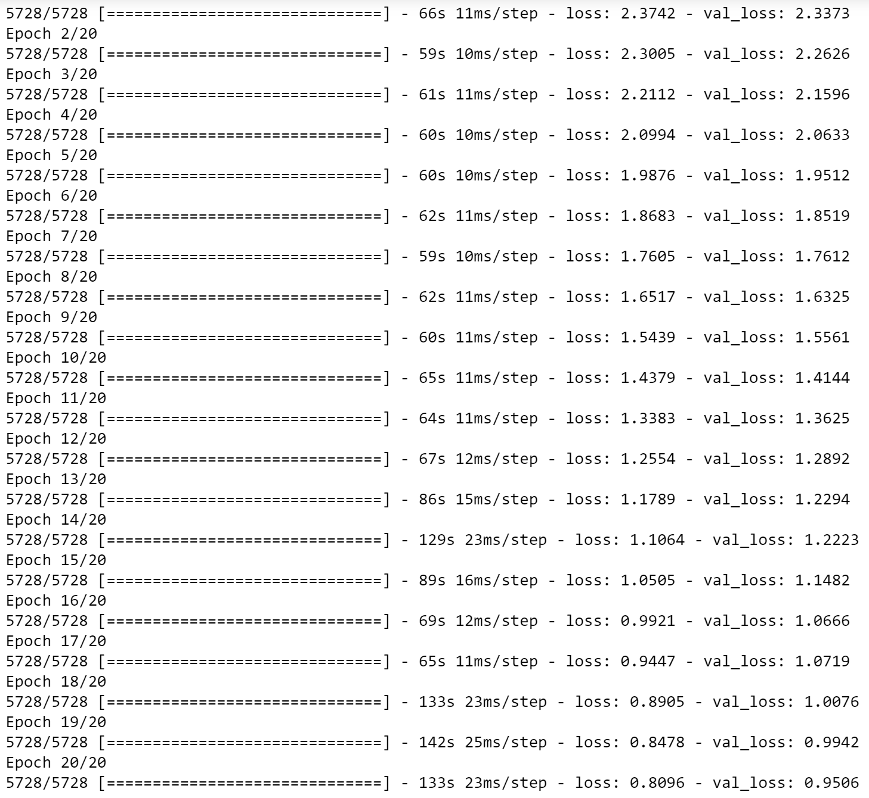
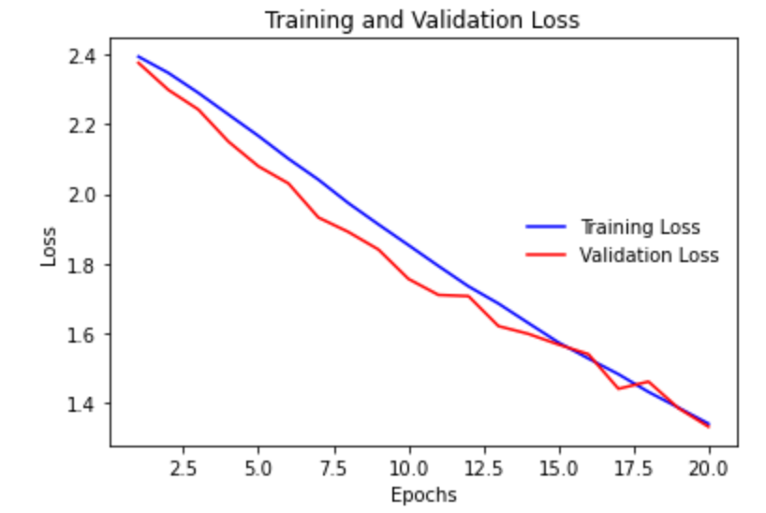
Water Saturation Data

Slide 10
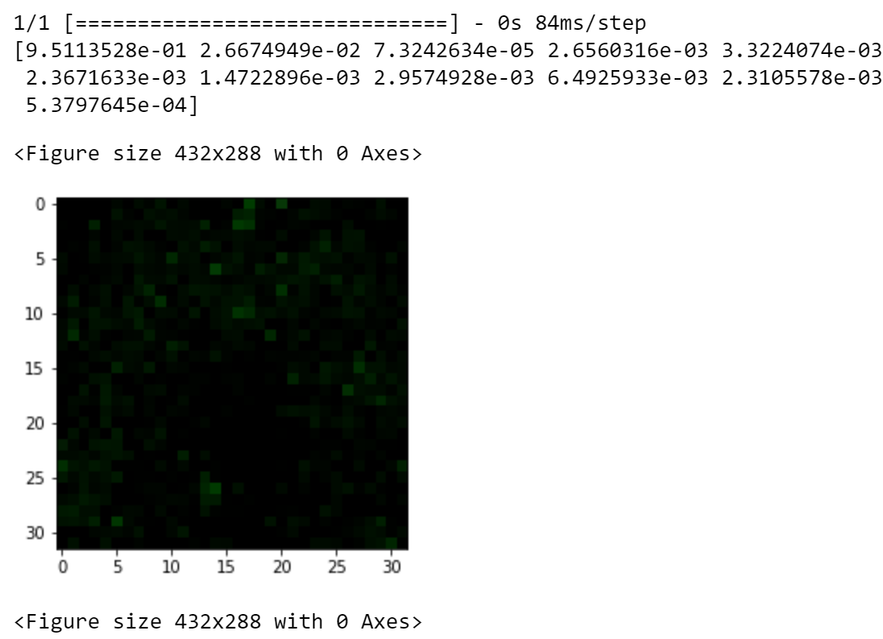
0% Saturation

Slide 11
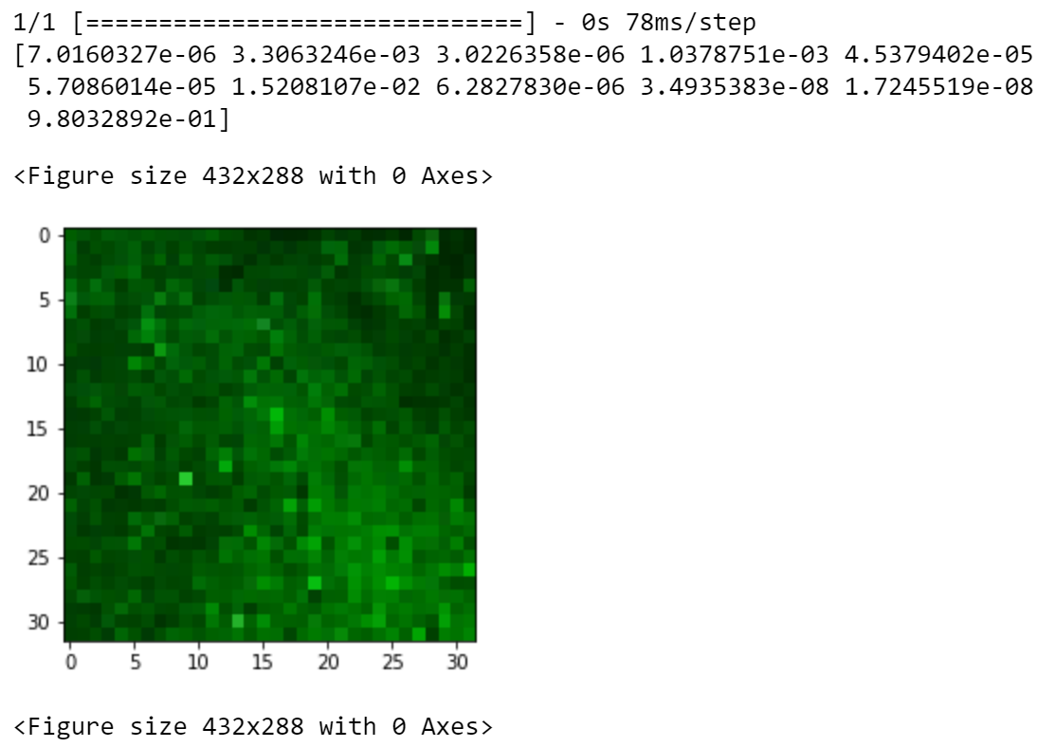
100% Saturation

Slide 12
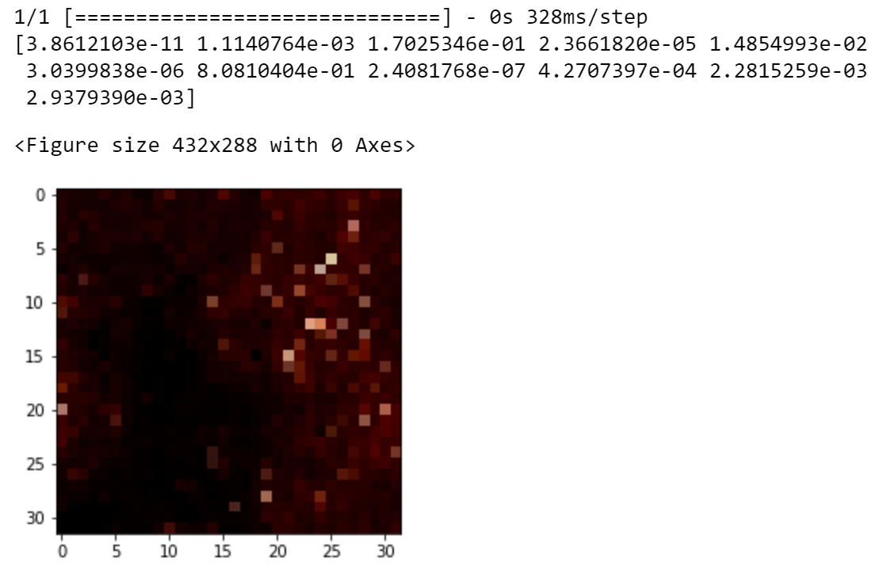
½ Full of Water

Slide 13
Validation Plan
Test Name | Success Criteria | Methodology | Status | Responsible Engineer(s)
Brew Prediction | The machine learning algorithm is able to receive feedback from the user and adjust temperature, grind size, and target saturation to increase positive rating. | If user has positive feedback, the temperature will stay constant. If user has negative feedback on too strong or too weak, it can adjust any of the three parameters down if too weak and up if too strong. | Passed | Cindy Ho
Database Storage Savings | The database is able to save user feedback ratings, temperature, water saturation requirements, and update every time a brew occurs. | Running the training data and checking if the database saves all of the data with no null responses with the exception of ratings. | Passed | Cindy Ho
Water Saturation Prediction Accuracy | The machine learning determines amount of ground bean saturation with a validation loss of about 95. | Run initial training data and two subsequent train data tests through (train/test splits). Have a confusion matrix to compare results. | Passed | Cindy Ho
Detect No Water | The machine learning can determine there’s no water within light, medium, medium dark, and dark grounds. | Input grounds at all types of roast and detect 0 as highest percentage. | Passed | Cindy Ho
Detect Full of Water | The machine learning can determine there’s full of water within light, medium, medium dark, and dark grounds. | Input grounds at all types of roast and detect top index as highest percentage. | Passed | Cindy Ho

Slide 14
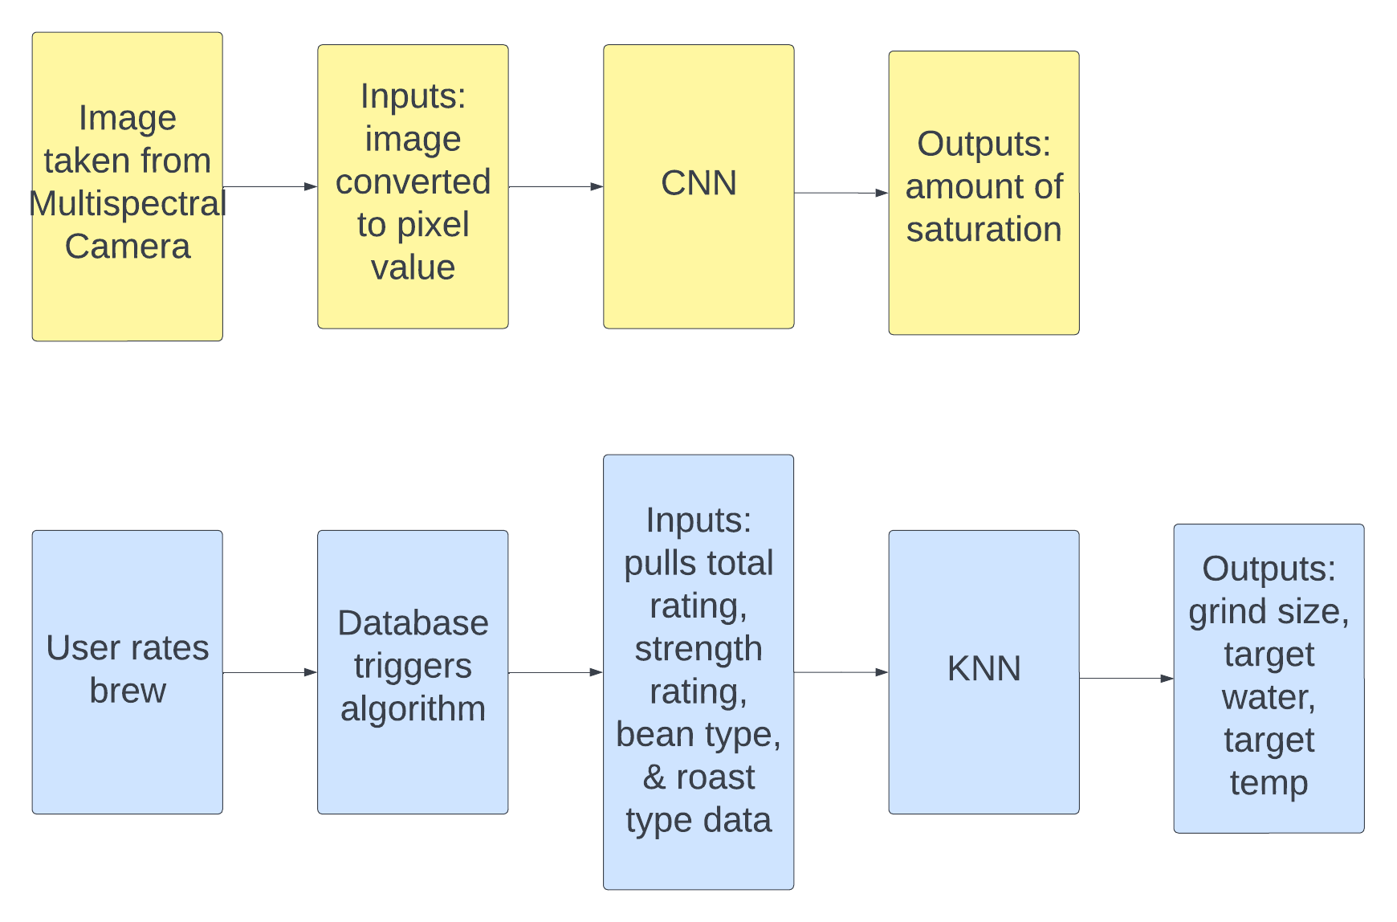
User Feedback Breakdown

Slide 15
User Feedback Algorithm
Uses K-Nearest Neighbors
Picked 9 neighbors due to best accuracies
Independent Variables: roast type, bean type, rating, strength
Dependent Variables: target water saturation, target temperature, grind size recommendation
Created 3 separate algorithms
New users
Default temperature depend on previous users: takes an average of temperatures from brews with ratings higher than 5
Default flow rate is 50%
Running on firebase database cloud

Slide 16
Water Saturation Prediction Algorithm

Slide 17
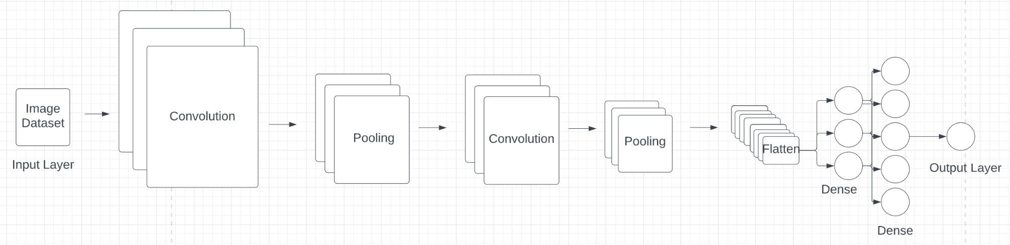
Model Breakdown
Trained & Validated CNN model
Layers: Input, Conv2D, MaxPool, Dropout, Flatten, 2 Dense layers, Output
7000 images to train and validate
Fully integrated onto raspberry pi

