Slide 1
Final Projects Overview
Machine Learning CSC 4850 / 6850
Dong Hye Ye
Georgia State University
March 7, 2023

Slide 2
Final Projects
Hands-on Applications of Machine Learning Algorithms to Image Processing
Automatic Target Recognition (ATR) for CT-based Airport Checkpoint Screening
Bring your own ideas/data (BYOI)

Slide 3
Final Projects: Grading
The final project is worth 30% of your final grade, which will be split amongst two deliverables:
Oral presentation on 4/6 and 4/18 10:00am~11:45am
15~20-minute presentation + 5~10-minute Q&A
Feedback from me
Conference-paper style final report by 5/2 (Tue)
Latex: Overleaf
4 page limit including title, abstract, and references
Supplementary files: Codes

Slide 4
Final Projects: Grading Criteria
Technical Depth: How technically challenging was what you did?
Scope: How broad was your project? How many aspects, angles, variations did you explore?
Presentation: How well did you explain what you did, your results, and interpret the outcomes? Did you use the good graphs and visualizations? How clear was the writing?

Slide 5
Final Projects: Final Reports
Overleaf: https://www.overleaf.com
IEEE Conference Template in D2L
2 Column + 4 pages including references
Guideline
Title + Author List + Institution
Abstract: max 250 words
Introduction: Literature Review + Highlight/Novelty
Methods: What you have done? (Equations)
Experimental Results: Tables + Figures/Illustration, Interpretation
Conclusion: One paragraph summary (+ Future work)

Slide 6

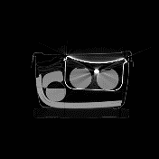




Final Projects: ATR
Automatic Target Recognition for CT-based Airport Screening System
Classification
Feature
Extraction
Target
Classifier
Training
Input CT image
Training
DB
Final ATR

Slide 7
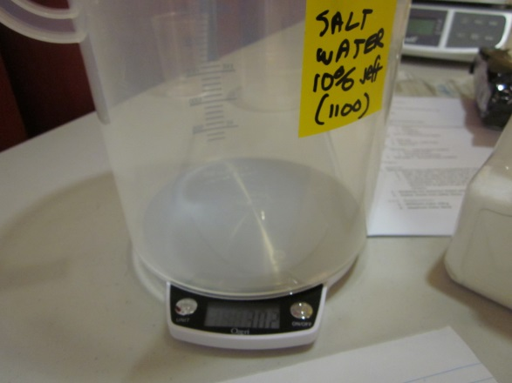
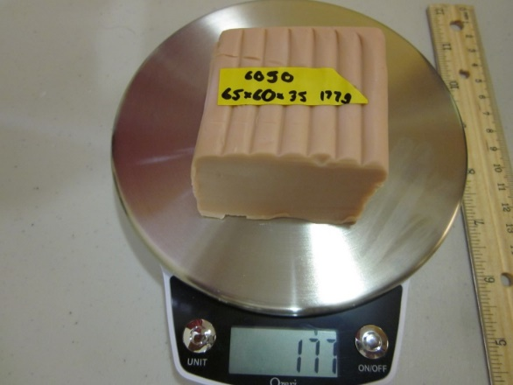
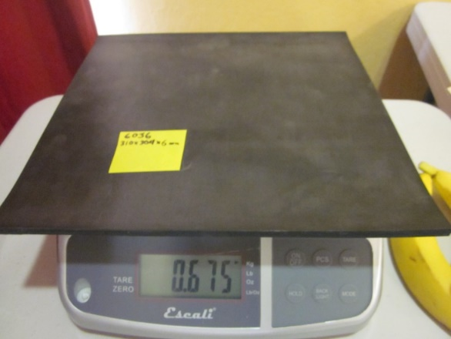
Final Projects: ATR-Targets
Saline
3.5%, 10%, 15% concentrations
Container not part of target; only the saline
Modeling (polymer) clay
Rubber sheets: ¼” thickness (minimum) + other rubber in bags

Slide 8
Final Projects: ATR-Non Targets
Stream of commerce items
Food
Drinks
Electronics
Magazines
Containers for liquid filled with saline and non-targets (e.g., water)

Slide 9
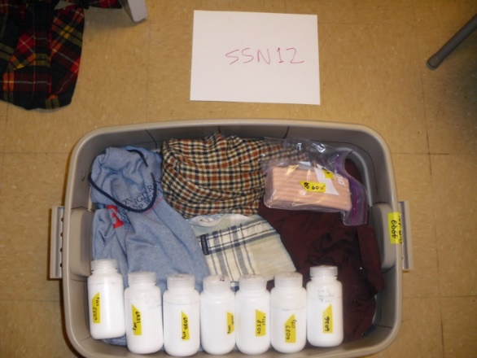
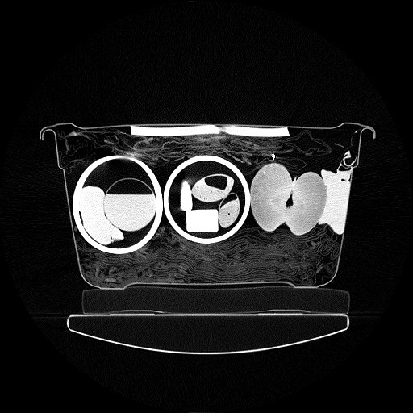

Final Projects: ATR-Resource
Packing: Targets packed with a plastic bin
Scanning: Scan on medical CT scanner
Ground-Truth: Only for targets

Slide 10



Final Projects: ATR-Your Dataset
CT image: Cropped CT images for each segmented object
Target Label: 0: Non-Target, 1: Saline, 2: Rubber, 3: Clay
Training: Target Labels are given
Testing: Target Labels are NOT given

Slide 11
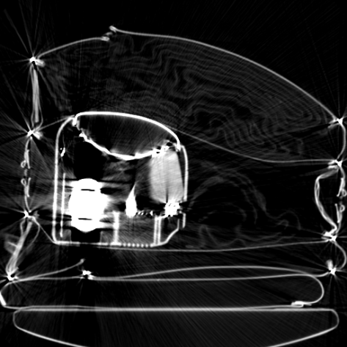
Final Projects: ATR-Typical Image Quality
Artifact types
Shading
Streaks
Noise
Blurring
Rings
Artifacts lead to
Imprecise density, volume, mass, shape
How are IQ issues handled in ATR in terms of robustness?

Slide 12
Final Projects: ATR-Features
Mass
Mean
Standard deviation
Histograms
Higher-order moments
Skew, kurtosis, entropy
Texture
Wavelets
Your responsibility to determine relevant features

Slide 13
Final Projects: ATR-Classifier
PCA
SVM
Decision Tree
Adaboost
Deep neural network
…
Your responsibility to develop the best classifier

Slide 14
Final Projects: ATR-Performance Metric
PD = # targets detected / # targets scanned
PFA = # false alarm objects / # non-targets scanned
PD > 90%, PFA < 10%
Cross-Validation on Training
Hold-out on Testing
Blind Evaluation: You provide the label and I give the number!

Slide 15
Final Projects: ATR-Visualization
Nifti file format: Standard Neuroimaging File Format
.nii.gz: gzipped image
Matlab tool for Nifti: load_nii.m https://www.mathworks.com/matlabcentral/fileexchange/8797-tools-for-nifti-and-analyze-image
MATLAB: readnifti.m
Python: PyNifti http://niftilib.sourceforge.net/pynifti/
Visualization: MIPAV https://mipav.cit.nih.gov/

Slide 16
Final Projects: BYOI
You must make sure you have the data available now and a nice roadmap, since time is too short to explore a brand-new concept.
You can discuss your ideas with me, but of course the final responsibility to define and execute an interesting piece of work is yours.
Submit 1-page Project Proposal by 3/9 (Thur)
Project title, Data set
Project idea description (2 paragraphs)
Teammate, Milestone
Software you will need to write.

