Slide 1
Automatic Target Recognition(ATR) for CT-based Airport Checkpoint Screening
Machine Learning CSC4850 - Team8:
Cassandra Lundberg and Nicholas Albano

Slide 2
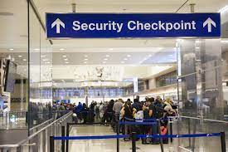
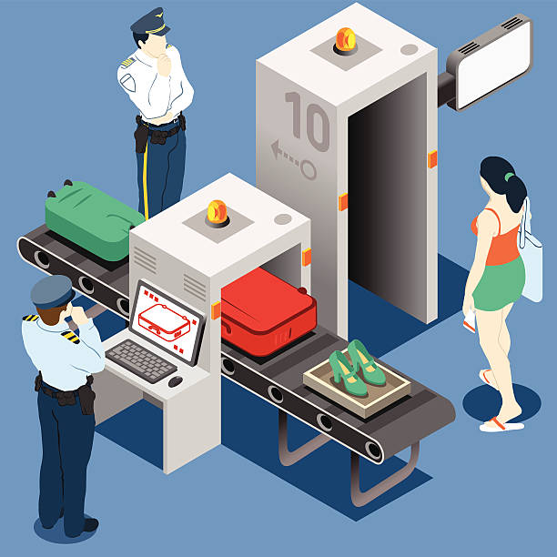
Basic Idea
With safety and security being the primary concern at airports, the issue arises with time constraints from long luggage checks, manually
Automatic Target Recognition helps in addressing these issues to examine the contents of baggage and detect substances of contraband

Slide 3
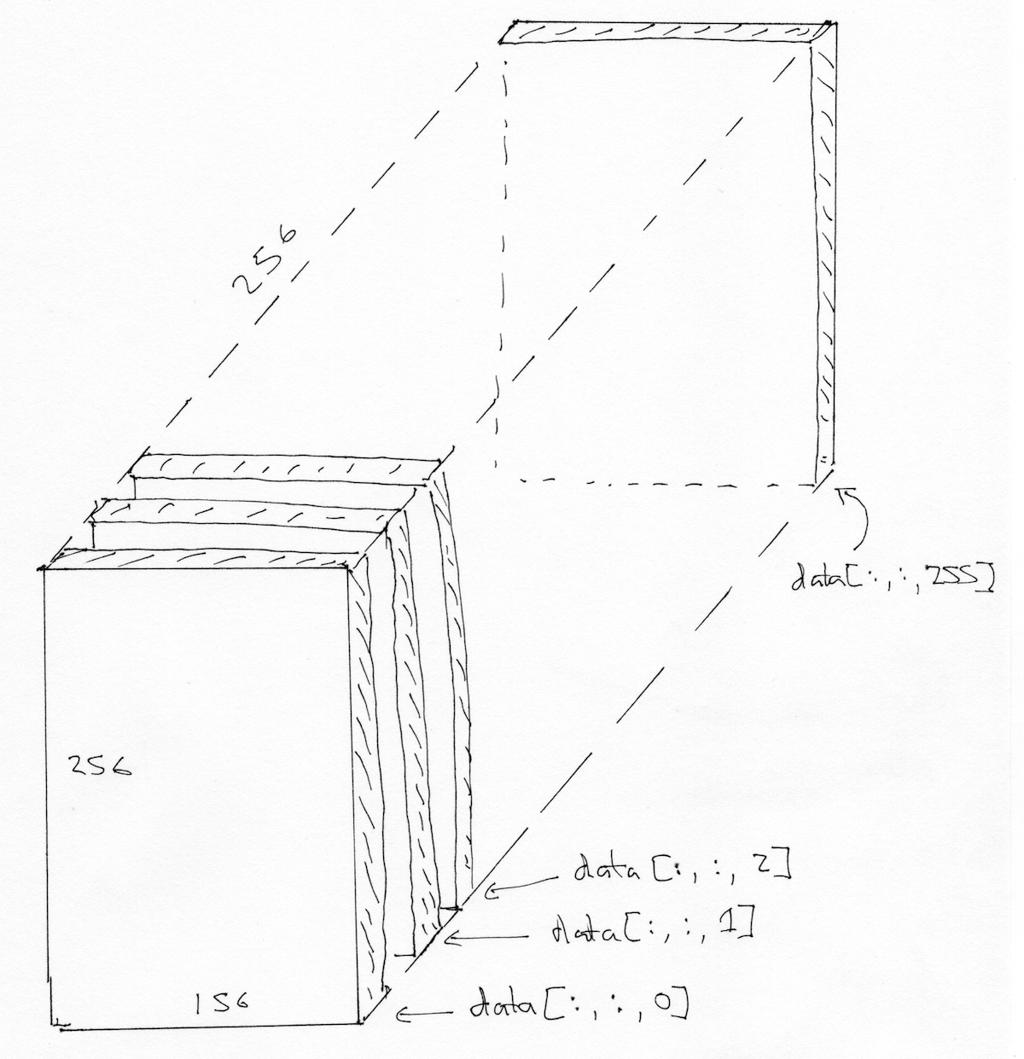
How it works
CT-scans of the luggage are taken as volumetric images, which consist a series of stacked two-dimensional images
This allows for a more accurate representation of the three-dimensional objects in the bags.
The ATR system will then locate the substances in the luggage and flag them as contraband

Slide 4
Dataset and Software
The dataset includes the provided ATR_data folder containing the three-dimensional CT-scanned images
There are 1005 images for training with their designated ground truth target labels and 467 testing images with no ground truth labels
Each image is in greyscale
Python
Libraries such as: pandas, numpy, sklearn, nilearn, nibabel, scipy, matplotlib, and os

Slide 5
Implementation
There are two important steps for CT automatic target recognition:
1. Feature Extraction of the CT images
2. Choosing the correct ATR classifier
During feature extraction of the images, basic characteristics of each image are taken as the statistical features:
Mean
Median
Maximum
Standard Deviation
Variance
Skew
Kurtosis

Slide 6
Implementation
Since the appearance and shape of each image can be clearly represented in the histograms of each image, we also extracted the histograms during feature extraction
This played an important role in results of a high accuracy
While choosing the best classifier for automatic target recognition
Calculated the accuracy and standard deviation of different classifiers such as: Support Vector Machine, Logistic Regression, AdaBoost, and K-Nearest Neighbor
Trained and tested each classifier on the training data
Observed the best classifier through the recall rate and precision rate

Slide 7
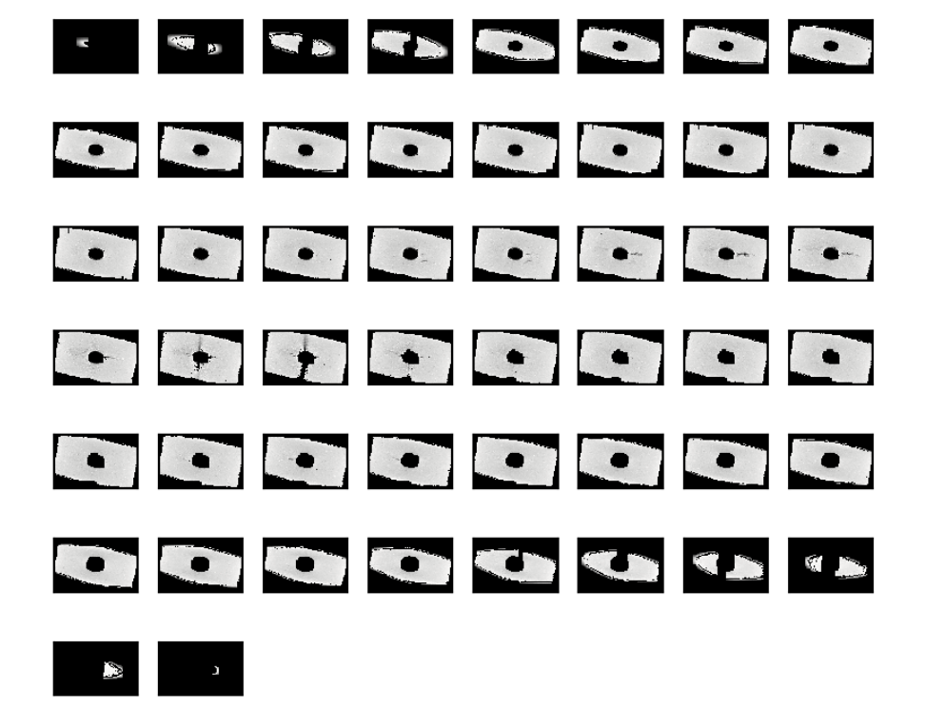
Image Visualization
We can observe each slice of an image
Here this image has dimensions of (89,140,50)
(89,140) are the dimensions of the image in x and y directions
The z dimension represents the number of slices
This image has a non-target value

Slide 8
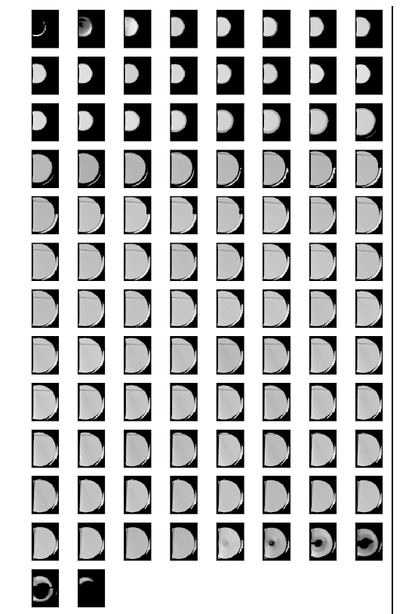
Image Visualization
These image slices have a target of 1(saline)
Since each image has different dimensions and a different number of slices, we can use histograms to find the same length descriptor

Slide 9
Image Preprocessing
Before extracting the image features, we first processed the images
Gaussian mixture models assume there is a certain number of Gaussian distributions where each distribution represents a cluster
By using a Gaussian mixture filter on the images, the pixel intensities can be grouped together to form a Gaussian distribution
Gaussian distributions help to eliminate the background and reduce artifacts found in the images
This helps in creating histograms of each image to extract the histogram features

Slide 10
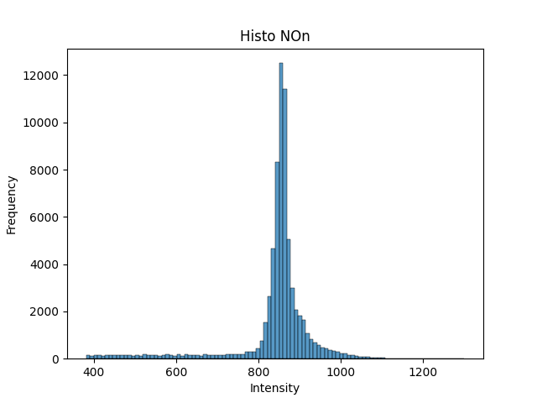
Histogram Feature Extraction
Histogram of an image representing a Gaussian curve

Slide 11
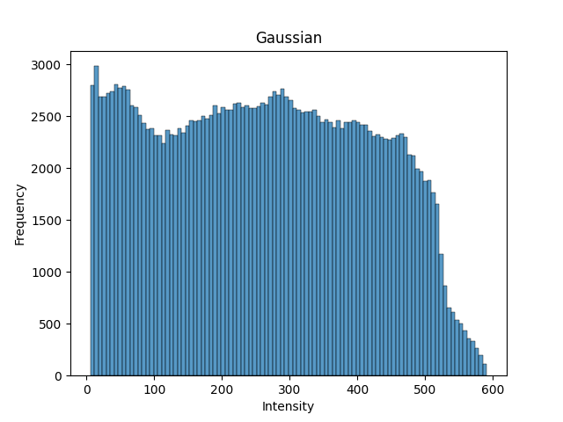
Histogram Feature Extraction
We normalize the histogram by dividing the mean of the histogram
The distribution of the pixel intensities are now more spread out to extract the features

Slide 12
Statistical Feature Extraction
Since each image is already in grey-scale, statistical information can be extracted of the grey-scale distribution
The statistical features extracted from the grey-scale distribution of an image are insensitive to size and orientation of an image and seem to already be very robust
Image preprocessing does not need to be done to extract these features
However, since the grey-scale of an image includes pixels ranging from 0 to 255 where 0 indicates darker pixels (background) and 255 indicates lighter pixels, we can set the range of pixels from 1-255
This eliminates the background noise

Slide 13
Statistical Features
The statistical values we calculated are:
The x ,y, and z dimensions of each image
The maximum, mid, and minimum dimensions of each image
Mean and the median
Standard Deviation
Variance
Skew
Kurtosis
These statistical features have helped in improving the accuracy across different classifier models

Slide 14
Choosing the Classifier
Cross Validation with 5 estimators of the training data to compare the cross validation score of each model
Performed train test split on the training data to evaluate the supervised models
80% for training and 20% for testing
Accuracy score, confusion matrix, precision score, recall rate, and f1-score
The models we trained the data on:
Support Vector Machine
Logistic Regression
AdaBoost Classifier
K-Nearest Neighbors

Slide 15
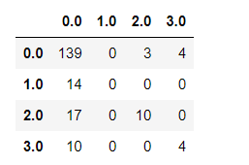
Support Vector Machine
Support Vector Machine (Linear Kernel and optimization parameter of 5)
When increasing c to 6 and decreasing to 4, the accuracy did not change
When c is decreased to 3 the accuracy decreases as misclassification rate increases
Having c at 5 helped the hyperplane margins correctly classify the data
Cross Validation
Accuracy Mean: 74%
Standard Deviation 0.01
Accuracy Score: 76%
Precision Score: 69.9%
Recall Score: 76.1%
F1-Score: 71.2%

Slide 16
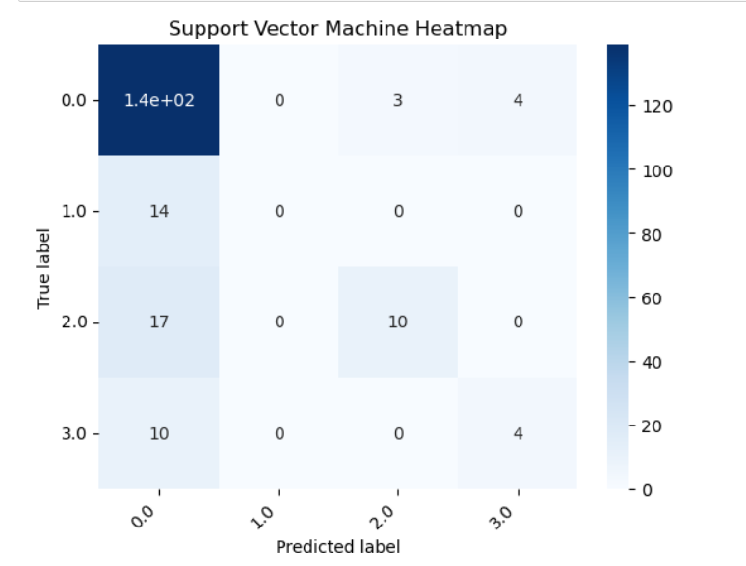
Support Vector Machine
Diagonal represents the number of true labels that were predicted correctly
Diagonal is not very prominent
SVM predicted mostly non-targets correctly but also incorrectly
SVM may be good in determining non-targets

Slide 17
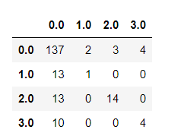
Logistic Regression
Logistic Regression (solver to help multinomial loss)
Cross Validation
Accuracy Mean: 72%
Standard Deviation: 0.02
Accuracy Score: 77.6%
Precision Score: 74.3%
Recall Score: 77.6%
F1-Score: 74.2%

Slide 18
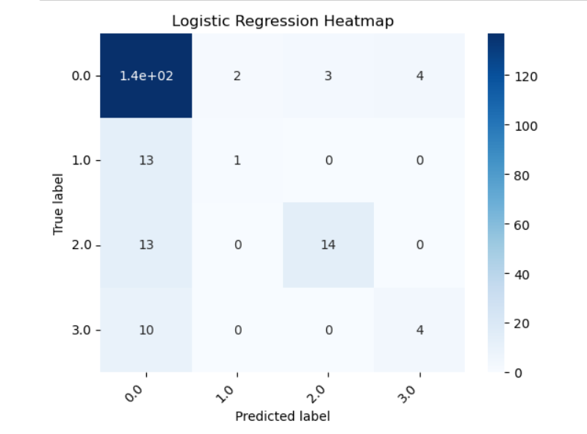
Logistic Regression
Diagonal is more prominent than SVM but still not very good
There are more non-targets than saline, rubber, or clay being predicted

Slide 19
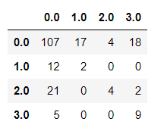
AdaBoost Classifier
AdaBoost Classifier (100 estimators)
Cross Validation:
Accuracy Mean: 64%
Standard Deviation: 0.03
Accuracy Score: 60.6%
Precision Score: 63.2%
Recall Score: 60.9%
F1-Score: 60.2%

Slide 20
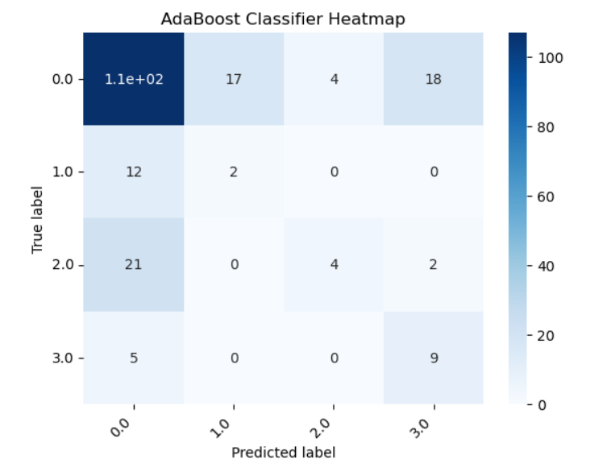
AdaBoost Classifier
Diagonal is less prominent than Logistic Regression but more prominent than SVM
Model makes incorrect classifications for non-targets, saline, rubber, and clay

Slide 21
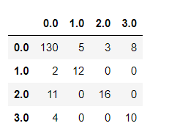
K-Nearest Neighbors Classifier
K-Nearest Neighbors( k = 3 nearest neighbors)
Having k at 4 decreased the accuracy rate and k at 2 also decreased the accuracy
When k is 4 or higher the model underfits more
When k is 2 the model overfits more
Cross Validation
Accuracy Mean: 79%
Standard Deviation: 0.02
Accuracy Score: 83.5%
Precision Score: 84.3%
Recall Score: 83.5%
F1-Score: 83.5%

Slide 22
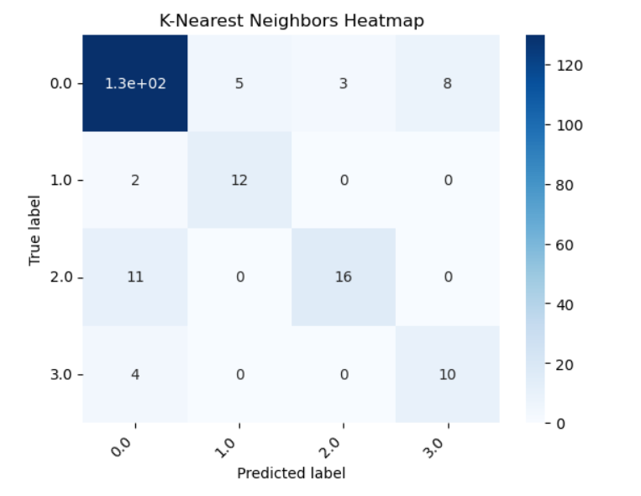
K-Nearest Neighbor
Diagonal is very prominent and is detecting most of the non-targets, saline, rubber, and clay correctly
Seems the best model to detect targets with lower misclassification than the rest

Slide 23
Best Model
The best model from the observed supervised classifiers for detecting targets seems to be the K-Nearest Neighbor model with the highest accuracy, precision rate, recall rate, and f1-score
To fully evaluate the performance of this model on the data, we used 5 folds and average to determine the overall accuracy, the percentage of false alarms, the total percent detected, and the percent detected for each target label
Overall Accuracy: 78.9%
Percent False Alarms: 21%
Percent Total Targets Detected: 63%
Percent Non-Targets(Target:0) Detected: 14%
Percent Saline(Target:1) Detected: 54.9%
Percent Rubber(Target:2) Detected: 56.6%
Percent Clay(Target: 3) Detected: 81.6%

Slide 24
Preliminary Results
When we calculated the predictions on the test dataset, we used the classifier k-nearest neighbors
These are the results from the testing data:
Recall Rate:0.28455 35/123 = 28.4%
Precision Rate:0.85465 294/344 = 85.5%
Saline Recall Rate:0.26829 11/41 = 26.8%
Rubber Recall Rate:0.29545 13/44 = 29.5%
Clay Recall Rate:0.28947 11/38 = 28.9%
Overall, the model evaluates very well on the non-targets with 85.4% and not so well on the saline, rubber, and clay targets with 28.4%

Slide 25
Improvements and Constraints
Constraints:
Small team
Not a lot of experience in image processing
Computer memory issues
Time constraints
Improvements:
Testing on other models
Add more visualizations
Combat the precision-recall tradeoff
Possibly explore SVM for non-target classification
Any suggestions are helpful

Slide 26
References
Gu, Chen & Dong, Zhen. (2020). Automatic Target Recognition for CT-based Airport Screening System. Journal of Physics: Conference Series. 1453. 012111.10.1088/1742-6596/1453/1/012111.(https://www.researchgate.net/publication/339680820_Automatic_Target_Recognition_for_CT-based_Airport_Screening_System)
Wenling Xue, Ting Jiang,An adaptive algorithm for target recognition using Gaussian mixture models,Measurement,Volume 124,2018,Pages 233-240,ISSN 0263-2241,https://doi.org/10.1016/j.measurement.2018.04.019.(https://www.sciencedirect.com/science/article/pii/S0263224118302951)

Slide 27
Thank You!
Questions?
Suggestions?

