Slide 1
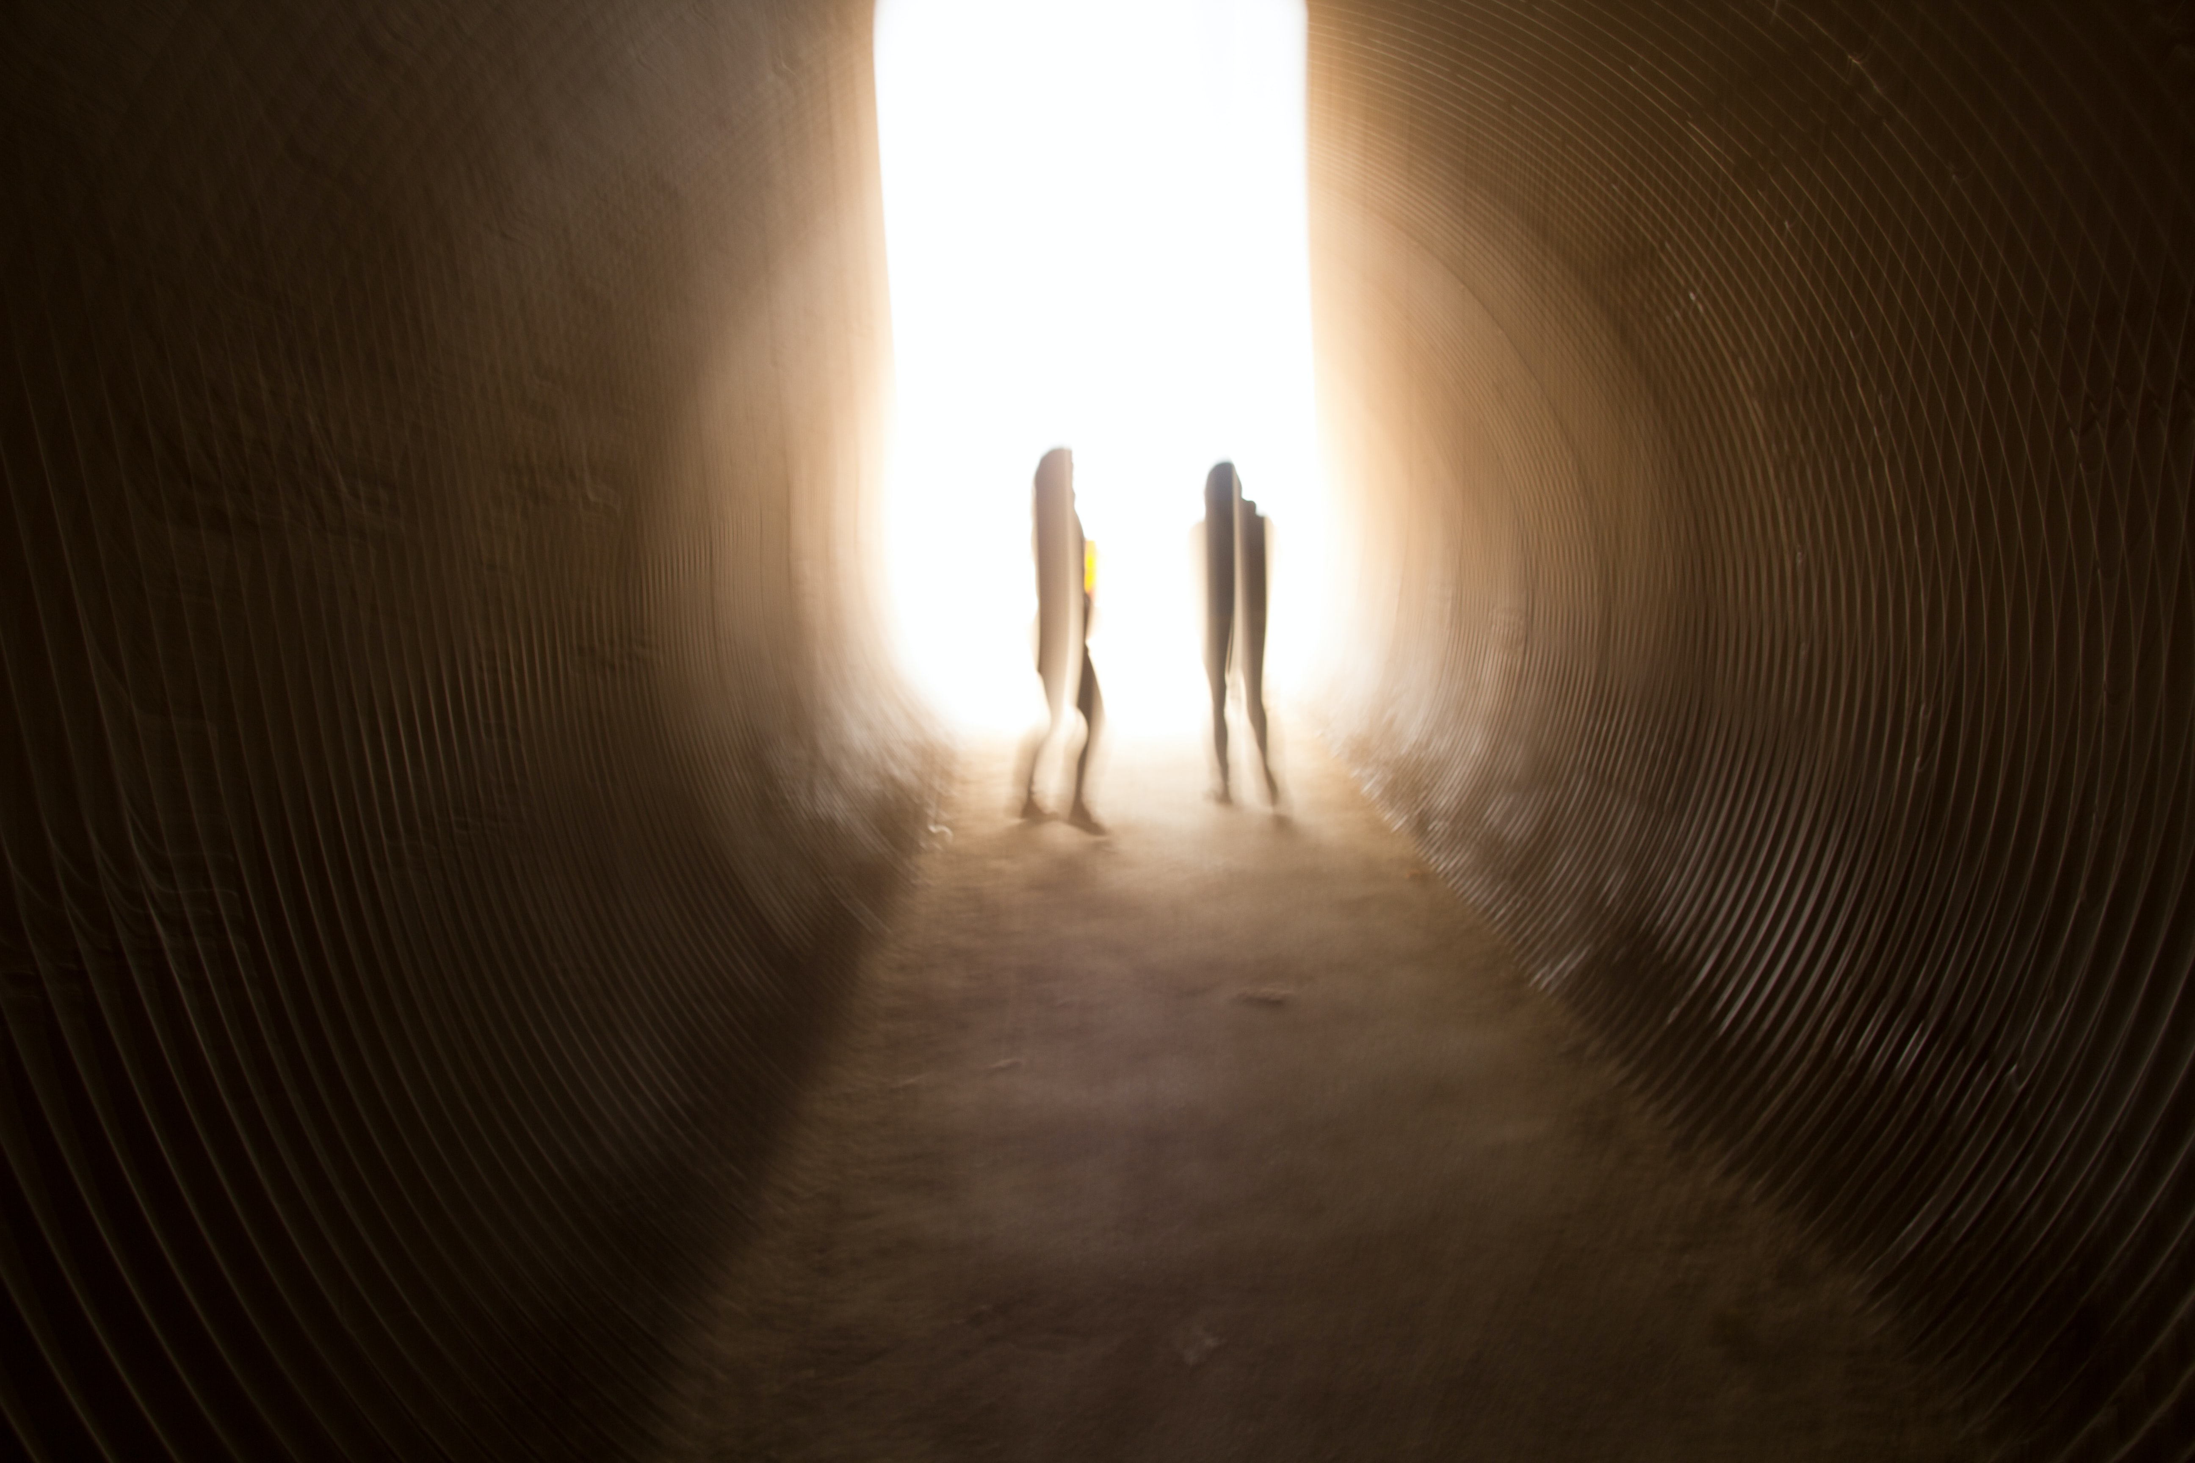
Forces to Be Reckoned With
By Cassandra Sherwin

