Slide 1
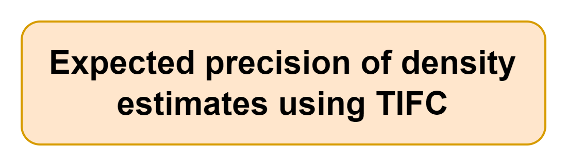




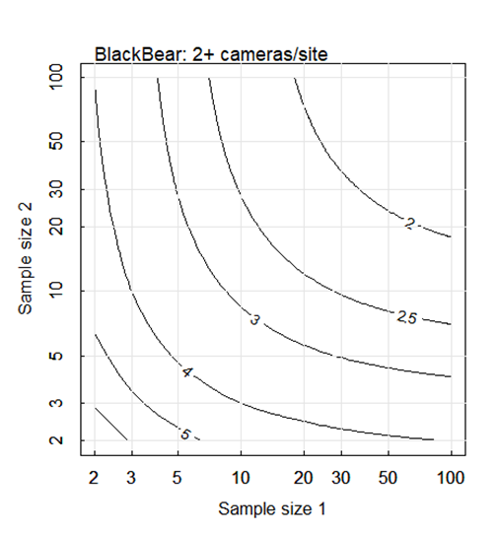
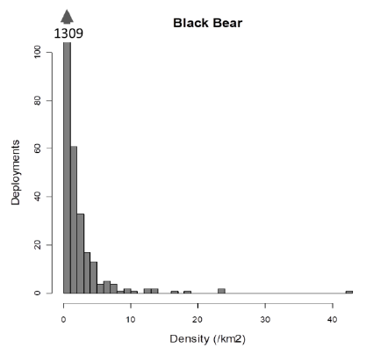

Monte Carlo simulation (10,000 runs) to evaluate expected precision of density estimates
Shiny app outputs
Shiny app user-inputs
Number of cameras
Length of deployment (days)
Lure (yes/no)
Rare/medium/common (with examples) species of interest
Number of treatments of interest
Game trail vs random deployment
Figure of distribution of simulated animal densities (bar chart)
Expected precision of design based on inputs
Figures of expected precision given the number of treatments and cameras

