Slide 1

Apache Cassandra
Big Data Programming – With Cassandra Architecture
Group Member: Tung Doan, Ibrahim Dawha, Dakota Hermandez, Shuxiao Xie

Slide 2
Big Data Programming – With Cassandra Architecture
Four Parts of Cassandra Tutorial
History and Background
Installation (Cassandra Cloud Setup)
Generate A Speed Layer
Speed Contest Vs MongoDB

Slide 3
Big Data Programming – With Cassandra Architecture
About Cassandra
Apache Cassandra -- An open source, distributed /decentralized database, provides highly available service with no single point of failure.
Notable Features:
Elastic scalability - Cassandra is highly scalable; it allows to add more hardware to accommodate more customers and more data as per requirement.
Always on architecture - Cassandra has no single point of failure and it is continuously available for business-critical applications that cannot afford a failure.
Fast linear-scale performance - Cassandra is linearly scalable. Therefore, it maintains a quick response time.
Flexible data storage - Dynamically accommodate structured, semi-structured, and unstructured according to need.
Easy data distribution - Cassandra provides the flexibility to distribute data where you need by replicating data across multiple data centers.
Fast writes - run on cheap commodity hardware. It performs blazingly fast writes and can store hundreds of terabytes of data, without sacrificing the read efficiency. (Arunkumar U, June 2017)
Notes:
gfdgfshfsh

Slide 4
Big Data Programming – With Cassandra Architecture
Pros & Background:
It is scalable, fault-tolerant (data is automatically replicated to multiple nodes, failed nodes will be replaced with no downtime), and consistent.
It is a column-oriented database.
Its distribution design is based on Amazon’s Dynamo and its data model on Google’s Bigtable.
Created at Facebook, it differs sharply from relational database management systems.
Cassandra implements a Dynamo-style replication model with no single point of failure, but adds a more powerful “column family” data model.
Cassandra is being used by some of the biggest companies such as Facebook, Twitter, Cisco, Rackspace, ebay, Twitter, Netflix, and more.

Slide 5
Big Data Programming – With Cassandra Architecture
Cassandra Cloud Set Up Steps
Create google account
Open https://cloud.google.com
Sign up for free trial
Create a project on the google cloud console
Open “https://google.bitnami.com” and sign in with Google
Create a virtual machine

Slide 6
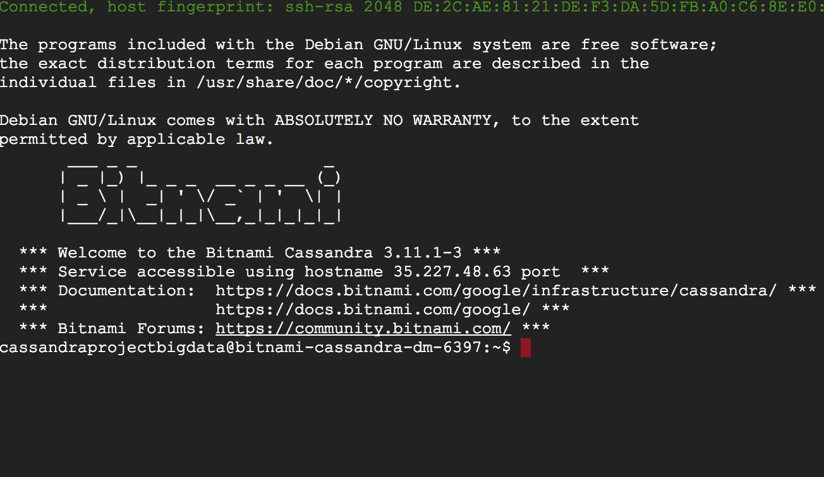
Big Data Programming – With Cassandra Architecture
Using Google Cloud Platform
Acclaim a google account (assume everybody got one)
Open up bitnami.com and log in with your google account, click virtue machine
Launch console.

Slide 7
Big Data Programming – With Cassandra Architecture
Create a Cassandra Cluster with Multiple Seeds Nodes
Launch the Bitnami Cassandra Stack first to generate a single node.
Log in to each node, stop Cassandra: $ sudo /opt/bitnami/ctlscript.sh stop cassandra
Restart Cassandra, on each node of the cassandra.yaml file update the following:
-seeds: 35.227.48.63; 35.227.96.7 (Public IP Address)
Listen_address: 10.142.0.2 (Private IP Address)
Broadcast_address: 35.227.48.63; (Current nodes public IP)
Endpoint_snitch: GoogleCloudSnitch
Repeat above configuration for all the nodes in the cluster.
For all the other nodes beside the seed node, delete the default data: $ sudo rm -rf /opt/bitnami/cassandra/data/*
Start Cassandra on the seed node, followed by other nodes, make the following change: $ sudo /opt/bitnami/ctlscript.sh start cassandra
Finally, to test all the clusters are operating with a single seed node: $ /opt/bitnami/cassandra/bin/nodetool status

Slide 8
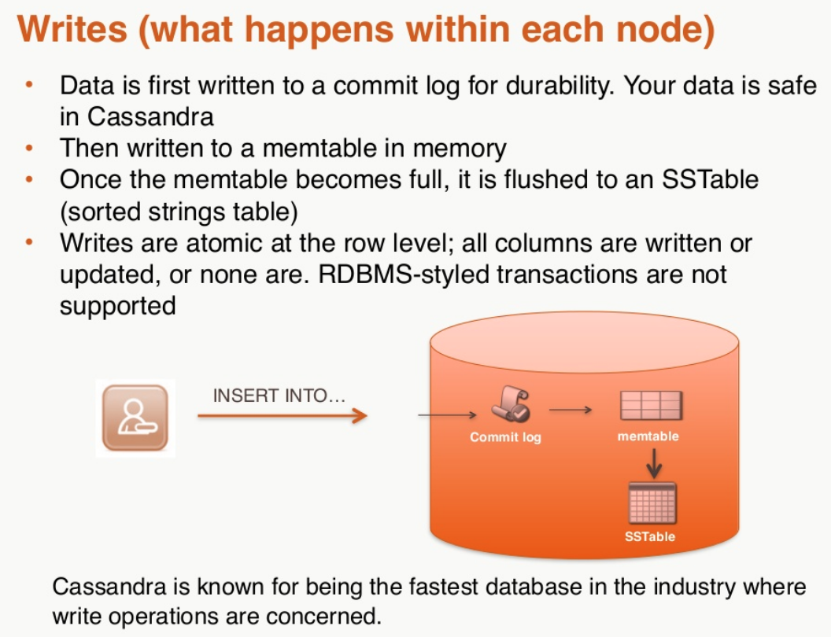
Big Data Programming – With Cassandra Architecture
Nodes and Cluster
Every node is a peer
Ring structure (not master/slave)
Tokens and hashing
Elastic scaling (remove or add node
from (to) runnung cluster,
upgrade when it’s running, …)

Slide 9
Big Data Programming – With Cassandra Architecture
Consistency
Every node acts as a coordinator
Tunable consistency levels
Strong consistence (R + W > N)
Eventually consistence (R + W < N)

Slide 10
Big Data Programming – With Cassandra Architecture
Cassandra Data Model
Query language (CQL) looks like SQL
Data model is tabular (like relational database)
Tall, but narrow (6-10 columns)
Scalable → can keep millions or billions of rows
Differences:
Cassandra do not do JOIN tables
Denormalize a lot (at scale we do not JOIN, it slows the read down)
Keyspace is namespace (container) for tables

Slide 11
Big Data Programming – With Cassandra Architecture
Cassandra Keys
Record ID:
Primary key:
Uuid:
surrogate primary key
why not just integer?
Keys:
Primary keys uniquely identify rows (like RB)
Each key has 2 parts:
Partition key: group of rows in the table is guaranteed is located in the same node
Clustering key: provide ordering to the rows in the table
You have to put a column in a key so that it can participate in the query

Slide 12
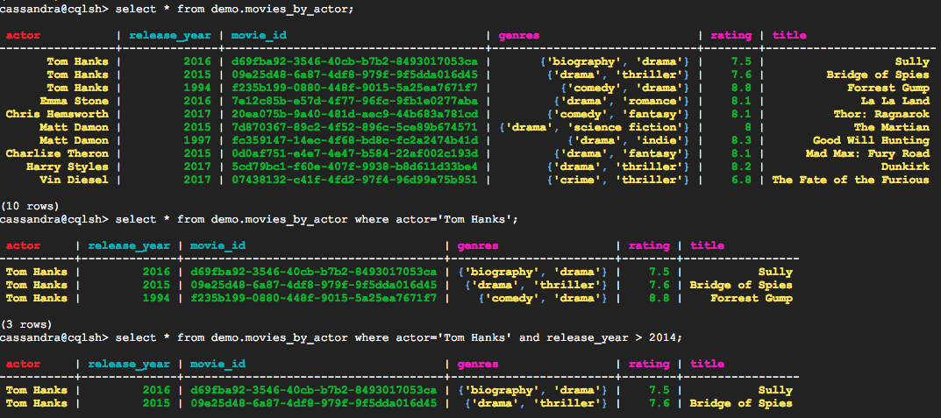
cQL queries
Big Data Programming – With Cassandra Architecture
Notes:
You can not query:
Select * from demo.movies_by_actor where actor=‘Tom Hanks’ and rating > 7
Because it’s not like relational database, rating is not in the key, so you cannot query with rating.
For performance queries, field have to be in the key to query quickly.

Slide 13

Big Data Programming – With Cassandra Architecture
Secondary Indexes
SASI (SSTable Attached Secondary Index): attached to SSTable
CREATE CUSTOM INDEX title ON demo.movies_by_actor (title) USING 'org.apache.cassandra.index.sasi.SASIIndex' WITH OPTIONS = { 'mode' : 'CONTAINS'};
It’s very he.lpful and powerful inside a partition.
Notes:
How do we make it work?
Make that not second lagacy index ‘org…..SASIIndex’
Title is not in the primary key, but we can use it by query by using SASSIndex.

Slide 14
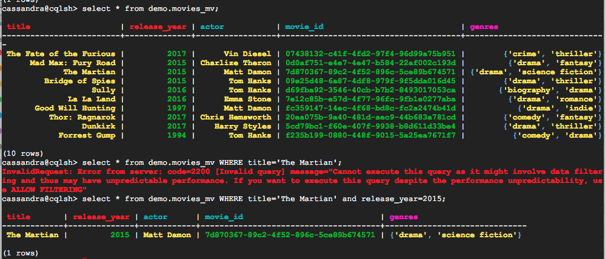
Materialized views
Big Data Programming – With Cassandra Architecture
Create new table with new primary key
It supports different queries
Notes:
for performance-critical queries the recommended approach has been to denormalize into another table
SOME tables must be kept in sync with OTHER tables
Materialized views give you the performance benefits of denormalization, but are automatically updated by Cassandra

Slide 15
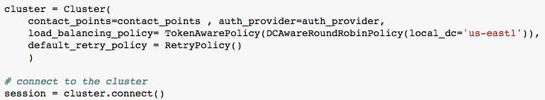
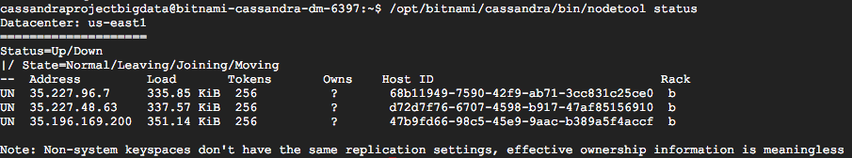
Big Data Programming – With Cassandra Architecture
Connected to Cluster

Slide 16
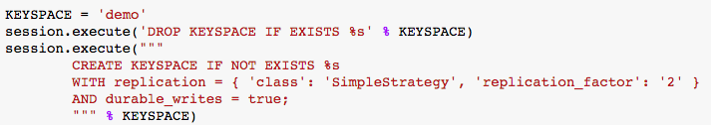
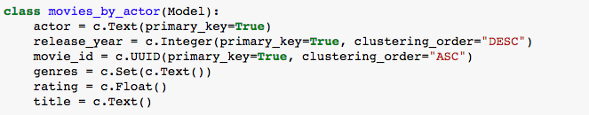
Big Data Programming – With Cassandra Architecture
Create Table

Slide 17
Big Data Programming – With Cassandra Architecture
Speed Test: Cassandra vs MongoDB
According to the Cassandra website (Apache, 2016): “Cassandra consistently outperforms popular NoSQL alternatives in benchmarks and real applications”
Datastax (Datastax, 2017): “For mixed operational and analytic workloads typical to modern Web, Mobile and IOT applications, Cassandra performed six times faster than HBase and 195 times faster than MongoDB.”

Slide 18
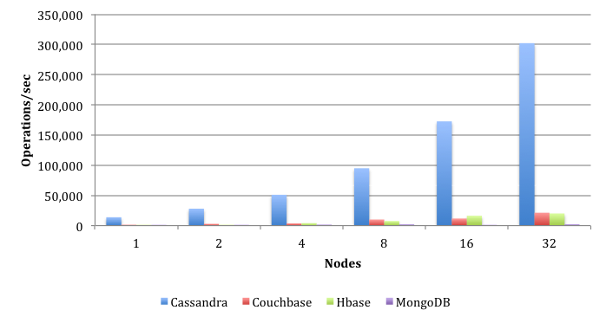
Big Data Programming – With Cassandra Architecture
Datastax, 2017: Operations Per Second Per Node Cluster

Slide 19
Big Data Programming – With Cassandra Architecture
Speed Test: Cassandra vs MongoDB - Procedure
Cassandra and MongoDB node (one each) set up on Google Cloud Platform
Three trials: In each, create 1000 pretend movies (fictitious films that have the same fields as that from the movie database) and insert them into the respective database.
Trials differ in the amount of times we repeat the process (1, 100, 1000).
Statistics collected displaying the time (in seconds)
Total time for # of inserts
Average time for # of inserts

Slide 20
Big Data Programming – With Cassandra Architecture
Speed Test: Cassandra vs MongoDB - Procedure
Cassandra and MongoDB node (one each) set up on Google Cloud Platform
Two trials: Create and insert 100 or 1000 movies.
Statistics collected displaying the time (in seconds)
Each also had some specific tests (1 movie insert for MongoDB, adding movies by actor for Cassandra; see GitHub for full results)

Slide 21
Big Data Programming – With Cassandra Architecture
Speed Test: Cassandra vs MongoDB - Results
Cassandra:
100 writes duration: 0.293 seconds
1000 writes duration: 2.716 seconds
Mongo:
Best case 100 writes: 0.0764 seconds
Worst case 100 writes: 0.107 seconds
Best case 1000 writes: 0.742 seconds
Worst case 1000 writes: 3.59 seconds (outlier; other highest is 1.102 seconds)
Full information plus extra trials available on GitHub

Slide 22
Big Data Programming – With Cassandra Architecture
Speed Test: Cassandra vs MongoDB - Limitations
Only one node per service used
Relatively small amounts of data used
Performance not tested over time
Focused on random writes but not on reads (a practical speed layer database would use itself to make a new speed layer)
Different databases have their own pros and cons: this only views the situation from one angle - factors such as cost not taken into account.

Slide 23
Big Data Programming – With Cassandra Architecture
References:
Apache, 2016. http://cassandra.apache.org/
Datastax, 2017. https://www.datastax.com/apache-cassandra-leads-nosql-benchmark
Arunkumar U, June 2017. https://medium.com/@arun_74827/what-is-apache-cassandra-what-are-the-features-of-it-a4b26b860d07
Bitnami Docs, https://docs.bitnami.com/google/infrastructure/cassandra/#description

Slide 24
Big Data Programming – With Cassandra Architecture

