Slide 1
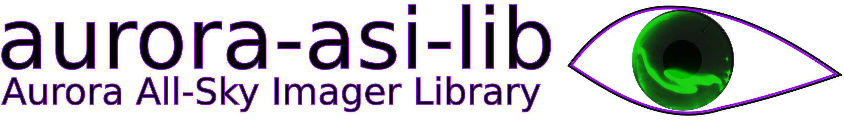
Easily download, plot, animate, and analyze auroral all sky imager (ASI) data
Mykhaylo (Mike) Shumko, Bea Gallardo-Lacourt, Isaac Thompson, Alexa Halford, and Kyle Murphy

Slide 2
Follow along! Install with:
python3 –m pip install aurora-asi-lib

Slide 3
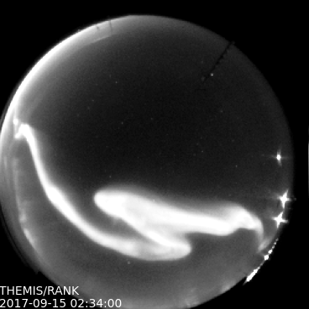
aurora-asi-lib overview
What?
A python package that enables seamless and painless handling and analysis of auroral images
Why?
Auroral researchers do similar analysis steps---our goal with asilib is to enable researchers to focus their time and energy on what matters: studying the aurora!

Slide 4
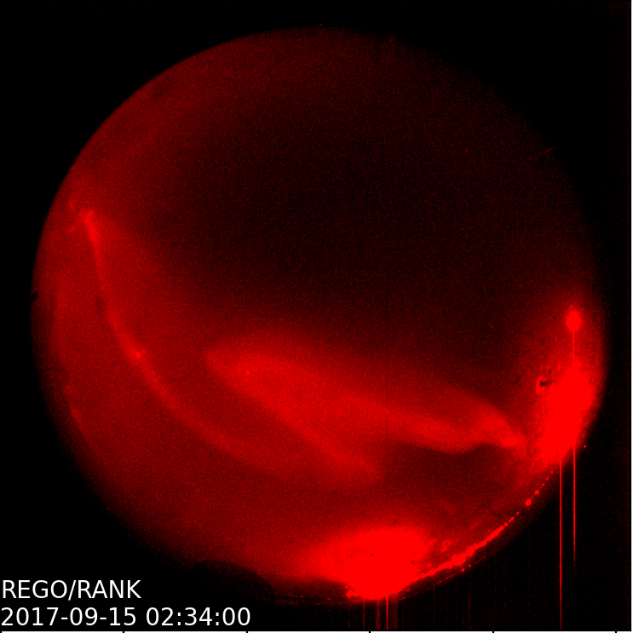
aurora-asi-lib overview
Supported camera arrays:
THEMIS
REGO
Once these two arrays are fully supported, we plan to add other camera arrays to asilib.
TREX
ASI-derived models

Slide 5
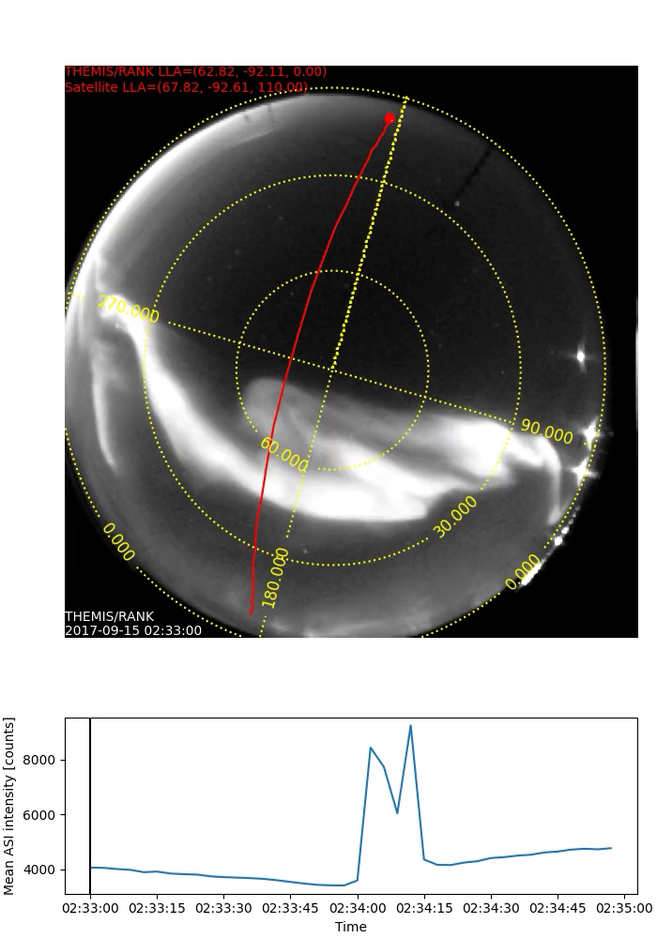
What can it do?
Plot one fisheye lens frame:
asilib.plot_frame()
Make a movie:
asilib.plot_movie()*
asilib.plot_movie_generator()*
* Requires ffmpeg

Slide 6
What can it do?
Map a satellite’s location:
asilib.lla2azel()
asilib.lla2footprint()*
Calculate equal areas in the image:
asilib.equal_area()
* Requires IRBEM

Slide 7
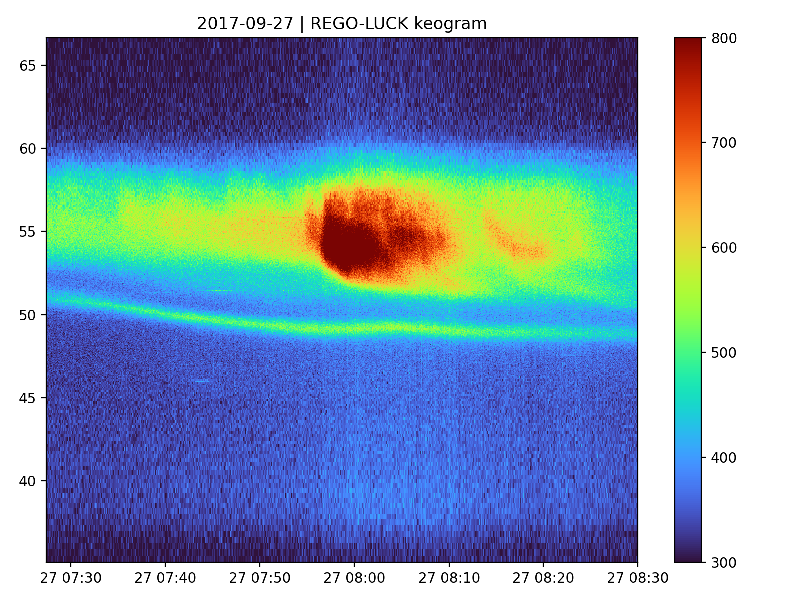
What can it do?
Plot a keogram:
asilib.plot_keogram()
Load data
asilib.load_img()
asilib.load_cal()
If a file is not found, one will be automatically downloaded!
Bulk download data
asilib.download_themis_cal()
asilib.download_themis_img()

Slide 8
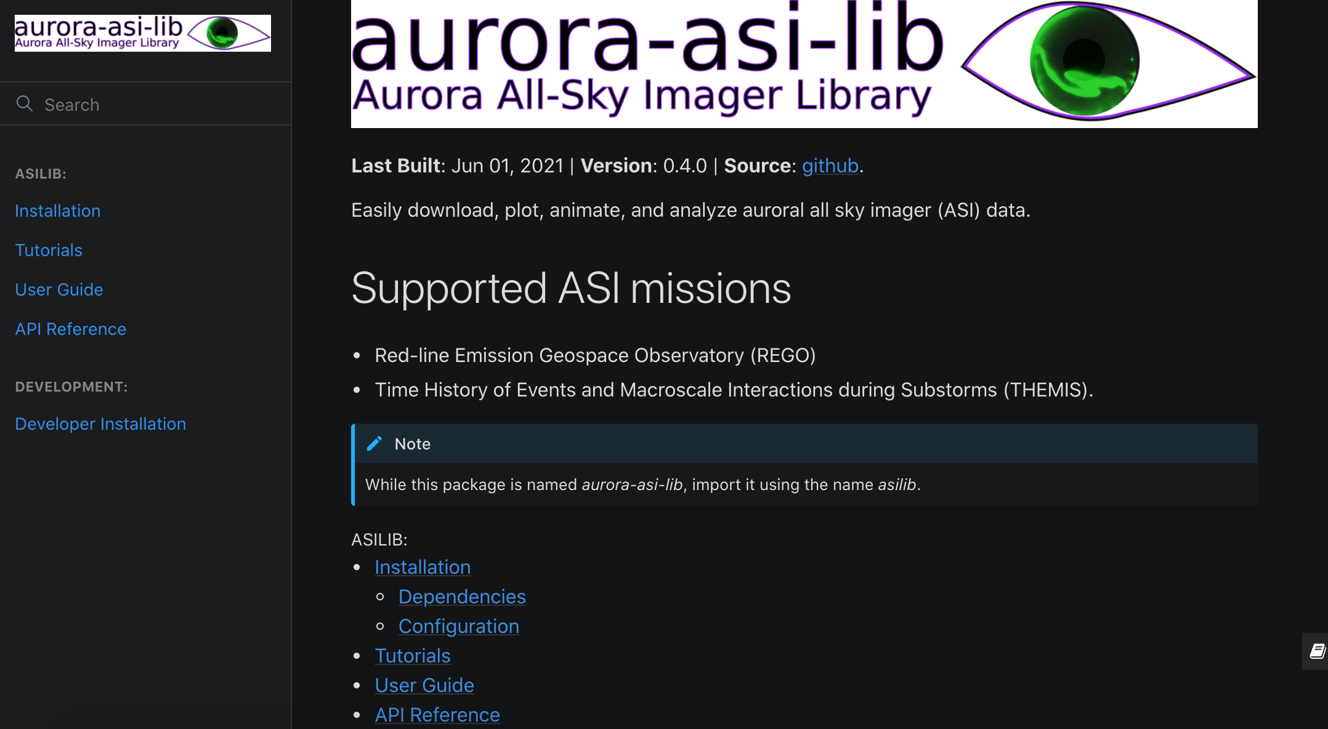
Didn’t memorize the commands? Documentation: aurora-asi-lib.readthedocs.io

Slide 9
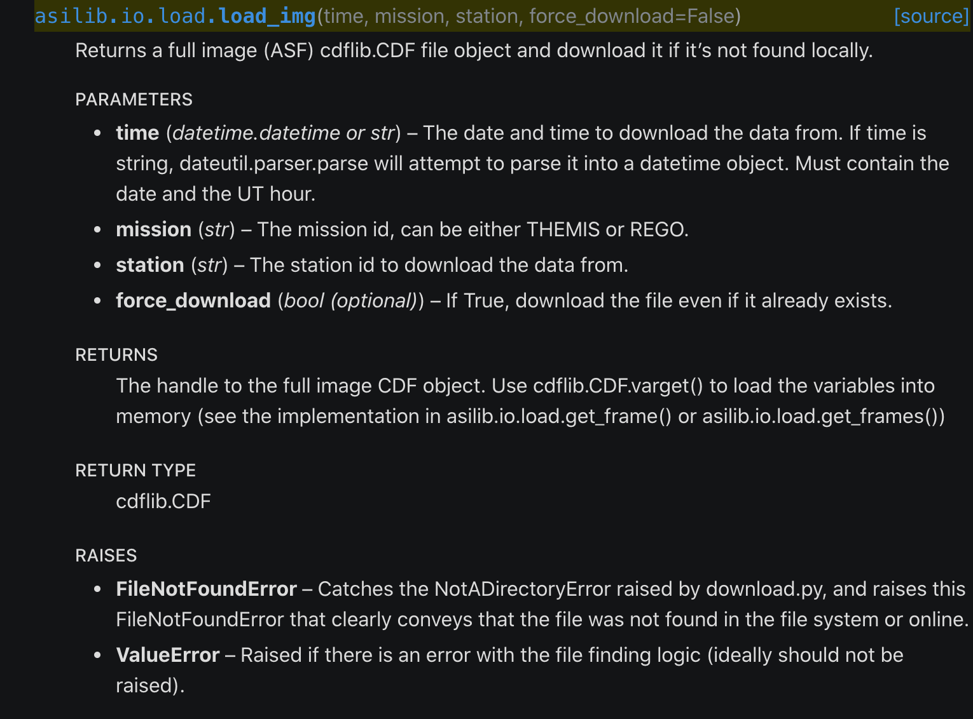
Didn’t memorize the commands? Documentation: aurora-asi-lib.readthedocs.io

Slide 10
One class to rule them all
The most usable (and fun!?) python libraries have a central class:
numpy.array
pandas.DataFrame
xarray.DataArray
pysat.Instrument
bs4.BeautifulSoup
…

Slide 11
One class to rule them all
The most usable (and fun!?) python libraries have a central class:
numpy.array
pandas.DataFrame
xarray.DataArray
pysat.Instrument
bs4.BeautifulSoup
…
And now:
asilib.Imager

Slide 12
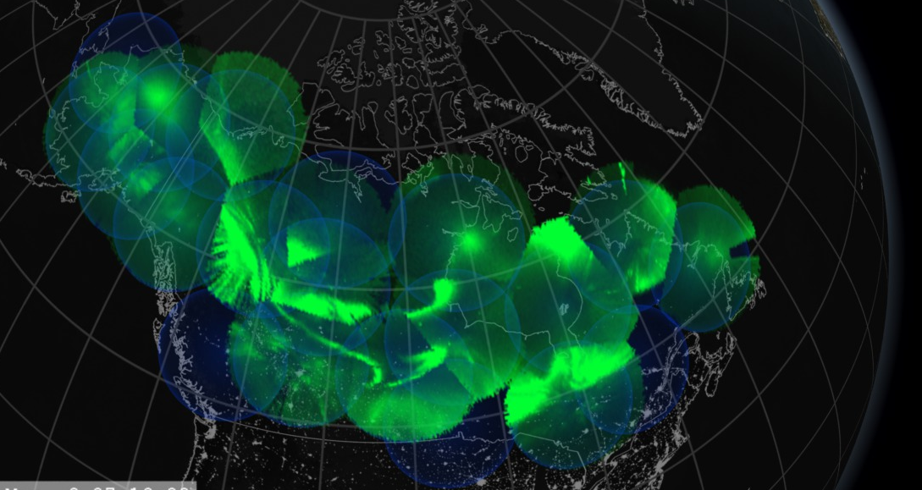
Ongoing Development Topics
Handle computer resources effectively
Project the fisheye images to a map
Unify the asilib functionality into an asilib.Imager() class
Integrate with Aurora X
Update the documentation with examples and tutorials
And add other imager arrays as plugins.
We need your help! Please contact me, mykhaylo.shumko@nasa.gov if you’d like to contribute or have ideas (I am always interested in ways to improve this code)

Slide 13
How to get started
python3 –m pip install aurora-asi-lib (import as asilib)
Documentation: https://aurora-asi-lib.readthedocs.io
Source code: https://github.com/mshumko/aurora-asi-lib
Thank you for listening!

