Slide 1
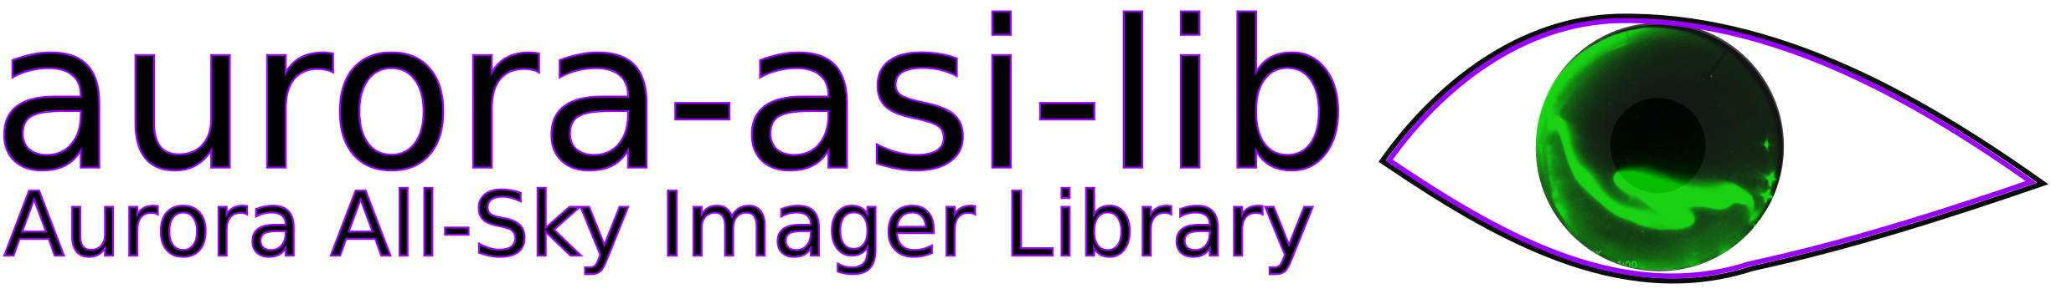
Easily download, plot, animate, and analyze auroral all sky imager (ASI) data.
Mykhaylo Shumko, Bea Gallardo-Lacourt, Isaac Thompson, Alexa Halford, and Kyle Murphy

Slide 2
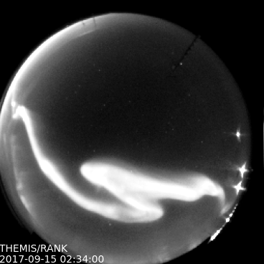
What is aurora-asi-lib?
A python package that enables seamless and painless handling and analysis of aurora images
Who has the time to write programs to process aurora data? Aurora researchers follow the same steps, and asilib helps by focusing their time time on what matters: studying the aurora!

Slide 3
What is aurora-asi-lib?
Supported camera arrays:
THEMIS
REGO
Once these two missions are fully supported, we plan to add other camera arrays to asilib.

Slide 4
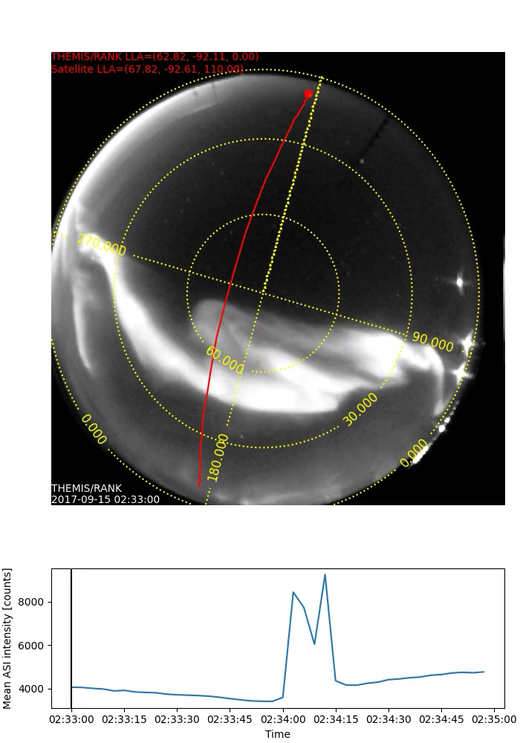
What can it do?

Slide 6
Motivation---we want to make this as easy as possible.
The most usable (and fun!?) python libraries have one central class:
Numpy -> array
Pandas -> dataframe
Pysat -> Instrument
Beautiful Soup -> BeautifulSoup
And NOW:
aurora-asi-lib -> Imager

Slide 7
How can I use it?
Documentation is hosted at: https://aurora-asi-lib.readthedocs.io
And on github: https://github.com/mshumko/aurora-asi-lib

