Slide 1
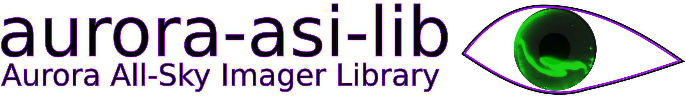
Easily download, plot, animate, and analyze auroral all sky imager (ASI) data
Mykhaylo (Mike) Shumko, Bea Gallardo-Lacourt, Isaac Thompson, Alexa Halford, and Kyle Murphy

Slide 2
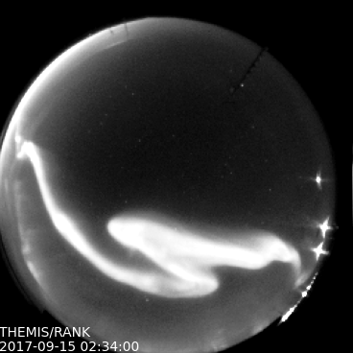
aurora-asi-lib overview
What?
A python package that enables seamless and painless handling and analysis of auroral images
Why?
Who has the time to write programs to process aurora data? All auroral researchers do similar analysis steps---asilib helps by focusing their time and energy on what matters: studying the aurora!

Slide 3
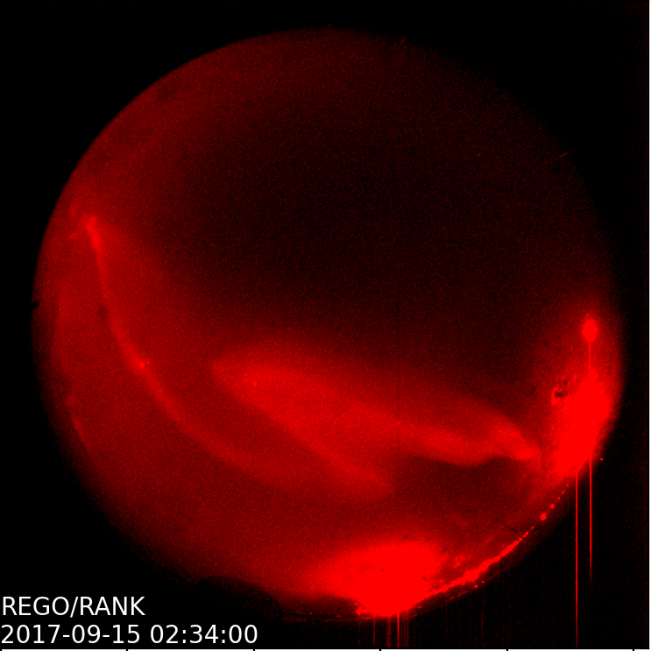
aurora-asi-lib overview
Supported camera arrays:
THEMIS
REGO
Once these two missions are fully supported, we plan to add other camera arrays to asilib.

Slide 4
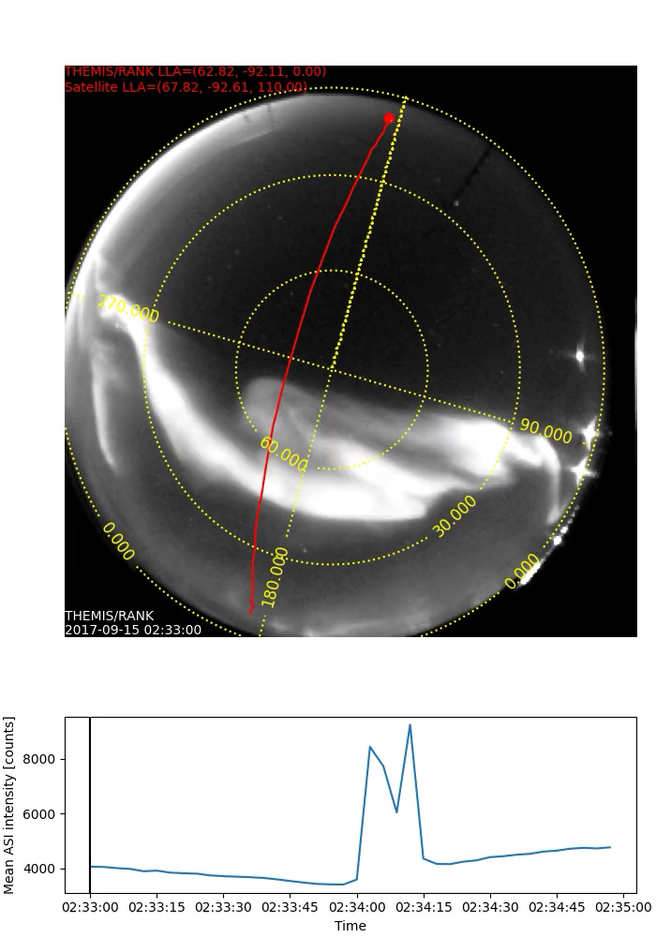
What can it do?
Plot one fisheye lens frame:
asilib.plot_frame()
Make a movie:
asilib.plot_movie()*
asilib.plot_movie_generator()*
Plot a keogram:
asilib.plot_keogram()
* Requires ffmpeg

Slide 5
What can it do?
Map a satellite’s location:
asilib.lla2azel()
asilib.lla2footprint()*
Calculate equal areas in the image:
asilib.equal_area()
* Requires IRBEM

Slide 6
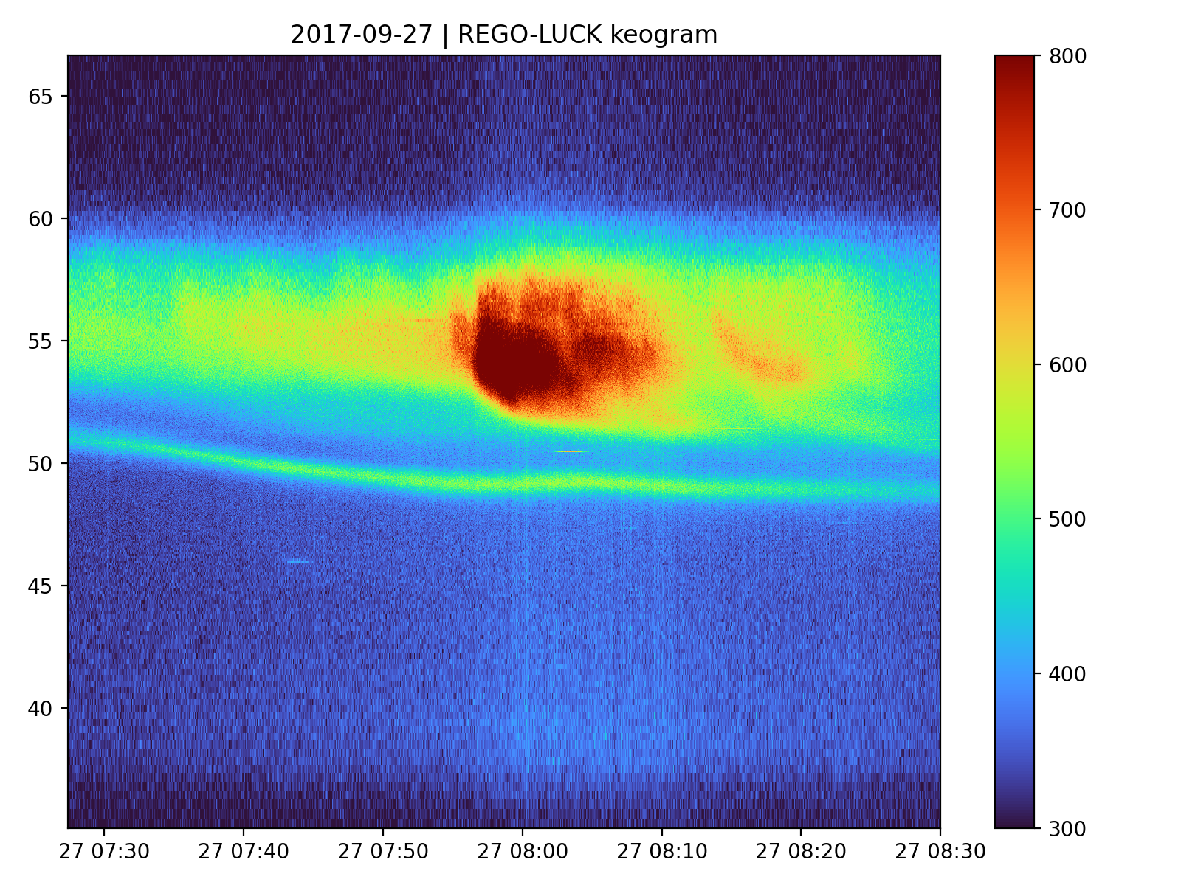
What can it do?
Load data
asilib.load_img()
asilib.load_cal()
If a file is not found, one will be automatically downloaded!
Bulk download data
asilib.download_themis_cal()
asilib.download_themis_img()
asilib.download_rego_cal()
asilib.download_rego_img()

Slide 7
One class to rule them all
The most usable (and fun!?) python libraries have a central class:
numpy.array
pandas.DataFrame
xarray.DataArray
pysat.Instrument
bs4.BeautifulSoup
…

Slide 8
One class to rule them all
The most usable (and fun!?) python libraries have a central class:
numpy.array
pandas.DataFrame
xarray.DataArray
pysat.Instrument
bs4.BeautifulSoup
…
And now:
aurora-asi-lib -> Imager

Slide 9
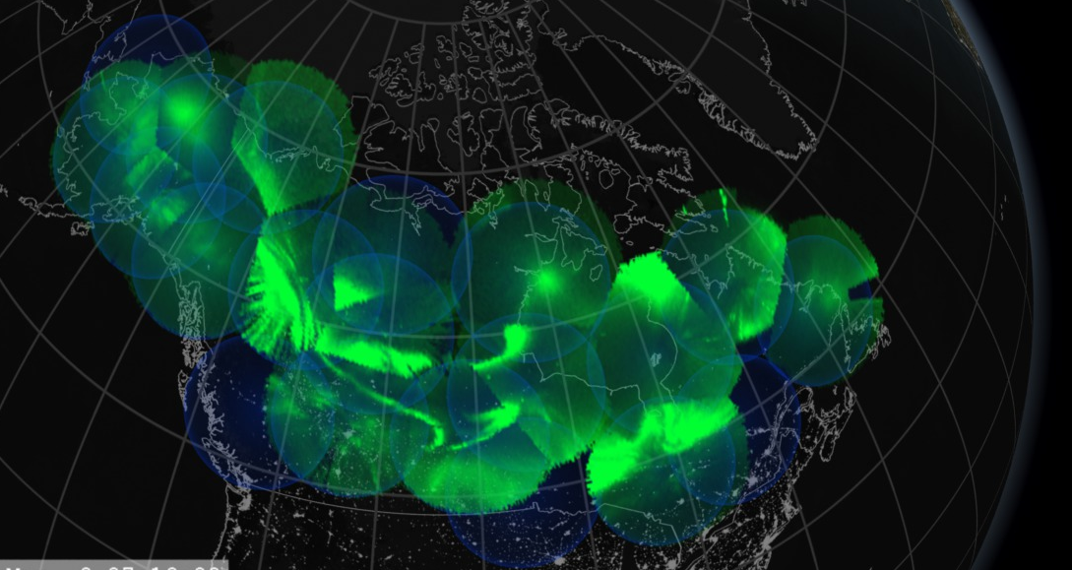
Ongoing Development Topics
Handle computer resources effectively
Project the fisheye images to maps (e.g. plot on the right)
Unify the asilib functionality into an asilib.Imager() class
Integrate with Aurora X
Update the documentation with more examples
And add other imager arrays as plugins
We need your help! Please contact me, mykhaylo.shumko@nasa.gov if you’d like to contribute or have ideas (I am always interested in ways to improve asilib)

Slide 10
How to get started
python3 –m pip install aurora-asi-lib (import as asilib)
Documentation: https://aurora-asi-lib.readthedocs.io
Code: https://github.com/mshumko/aurora-asi-lib
Thank you for listening!

