Slide 1
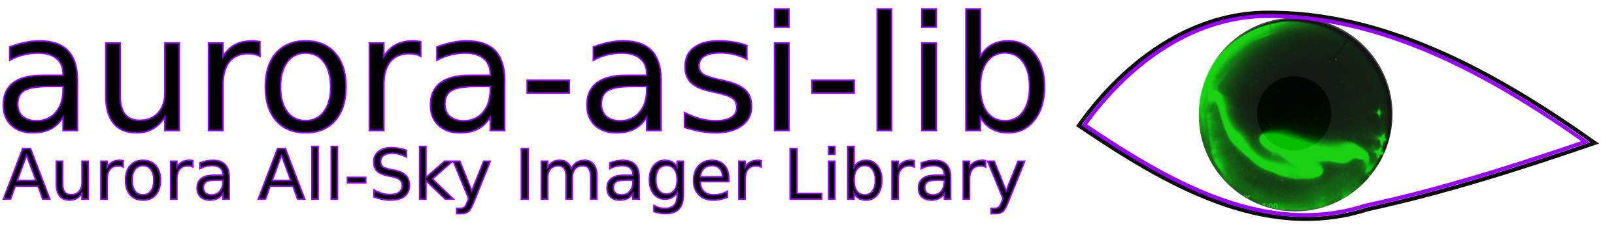
Easily download, plot, animate, and analyze auroral all sky imager (ASI) data

Slide 2
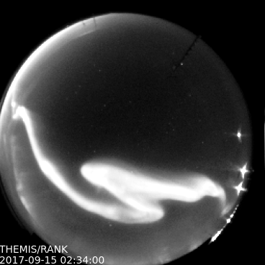
aurora-asi-lib overview
What is it?
A python package that enables seamless handling and analysis of auroral images
The downloading, loading, plotting, and analysis functionality is fully automated.
Currently Supported camera arrays
THEMIS
REGO

Slide 3
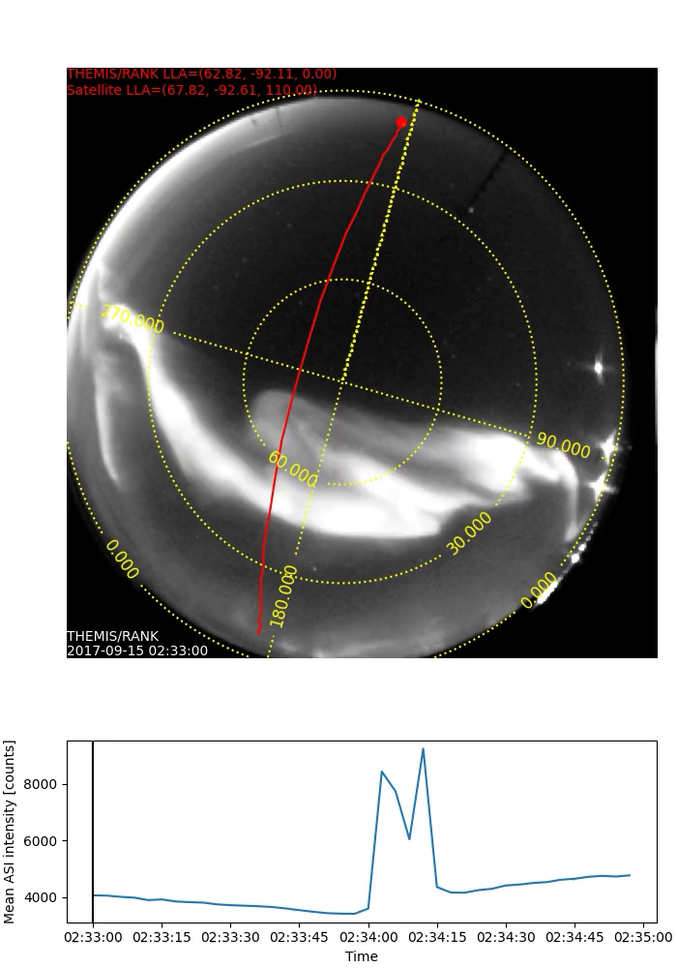
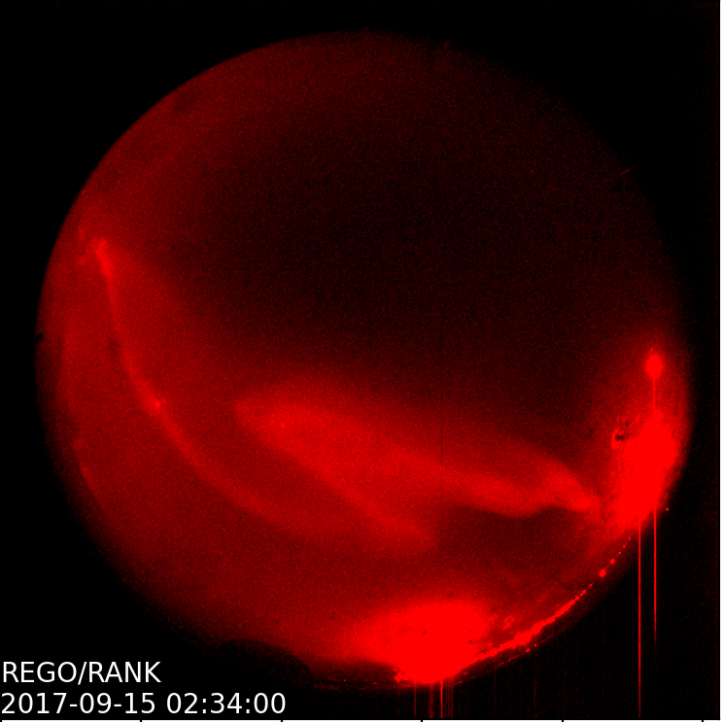
What can it do?
Make a conjunction movie
Plot one fisheye lens frame

Slide 4
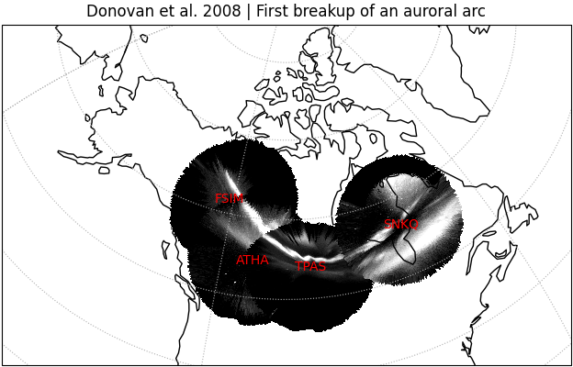
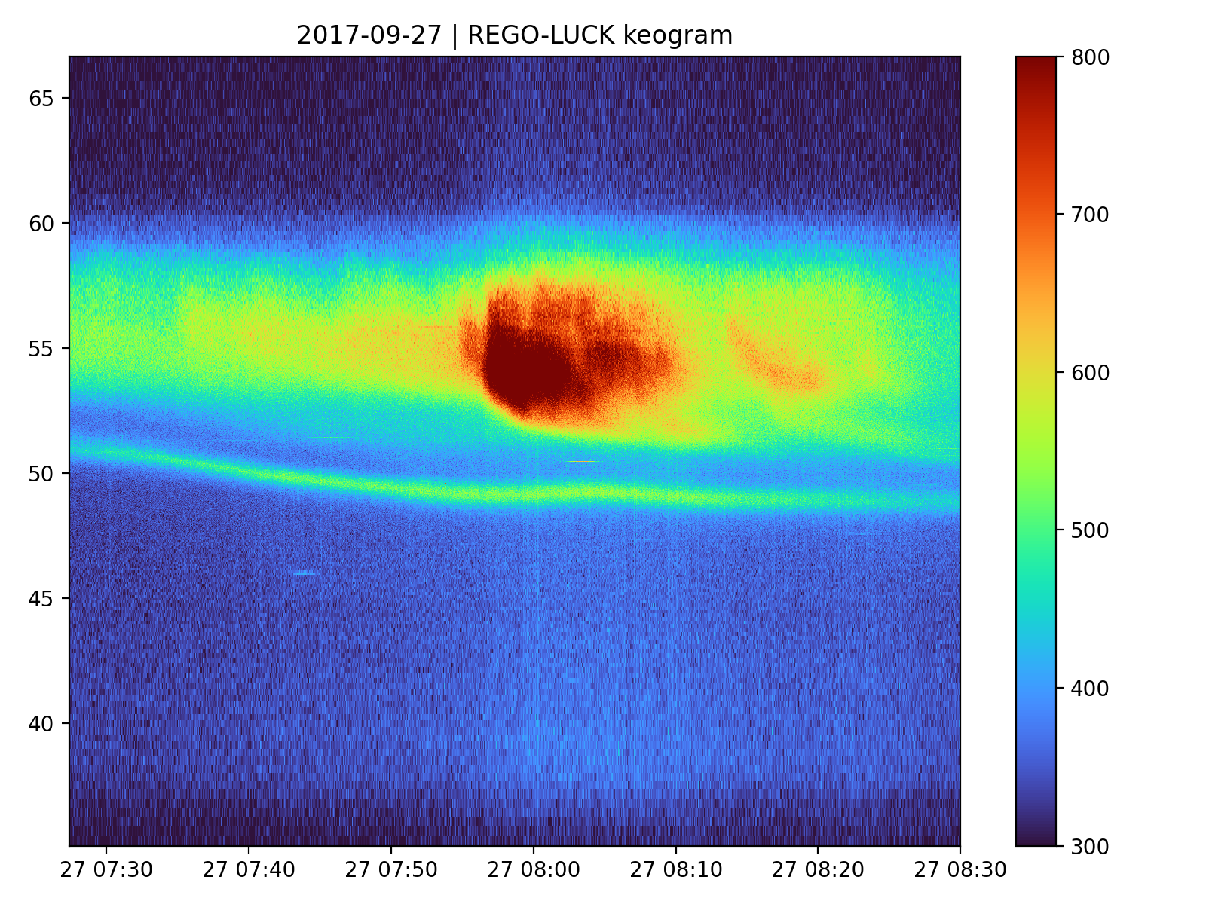
What can it do?
Project fisheye images onto a map
Plot a keogram

Slide 5
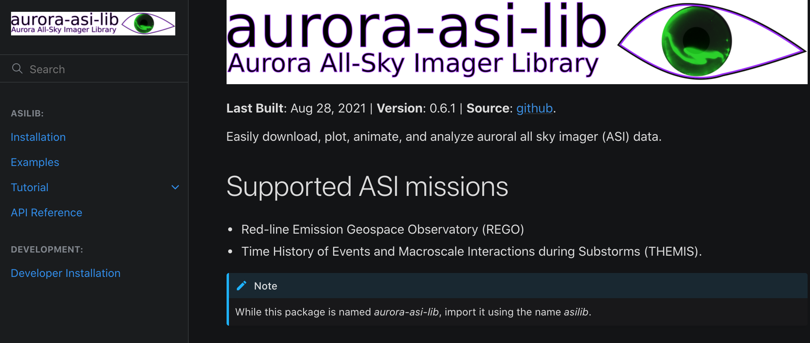
Documentation
Our goal: Focus on a good user experience and remove barriers to entry

Slide 6
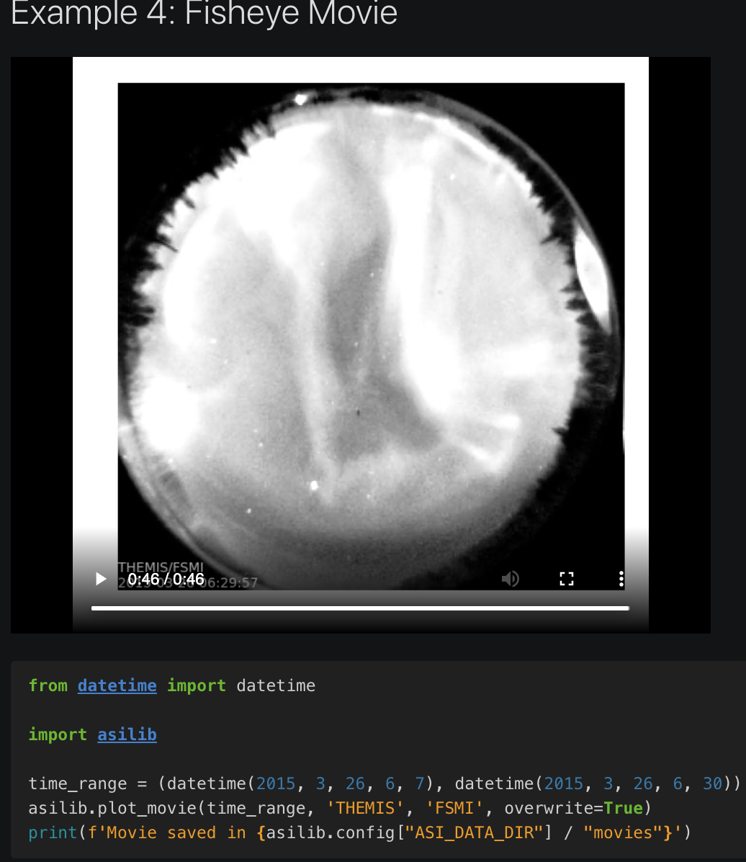
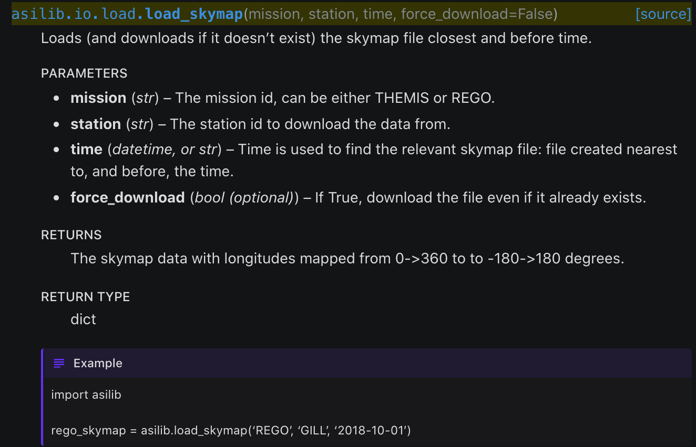
Documentation (cont.)

Slide 7
How to get started
python3 –m pip install aurora-asi-lib (import as asilib)
Documentation: https://aurora-asi-lib.readthedocs.io
Source code: https://github.com/mshumko/aurora-asi-lib

