Slide 1
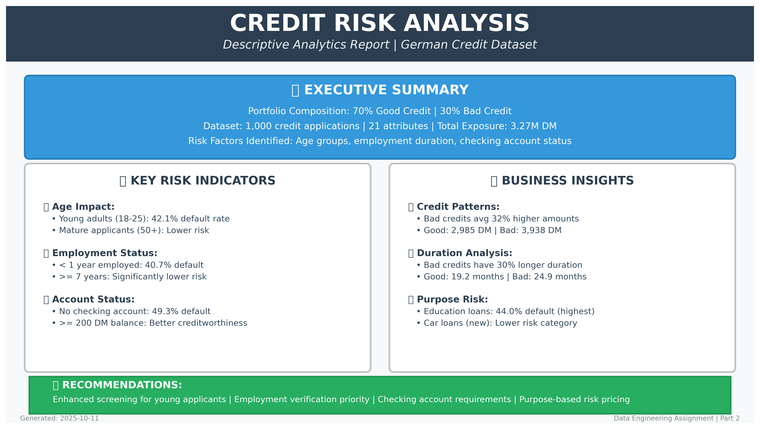

Slide 2
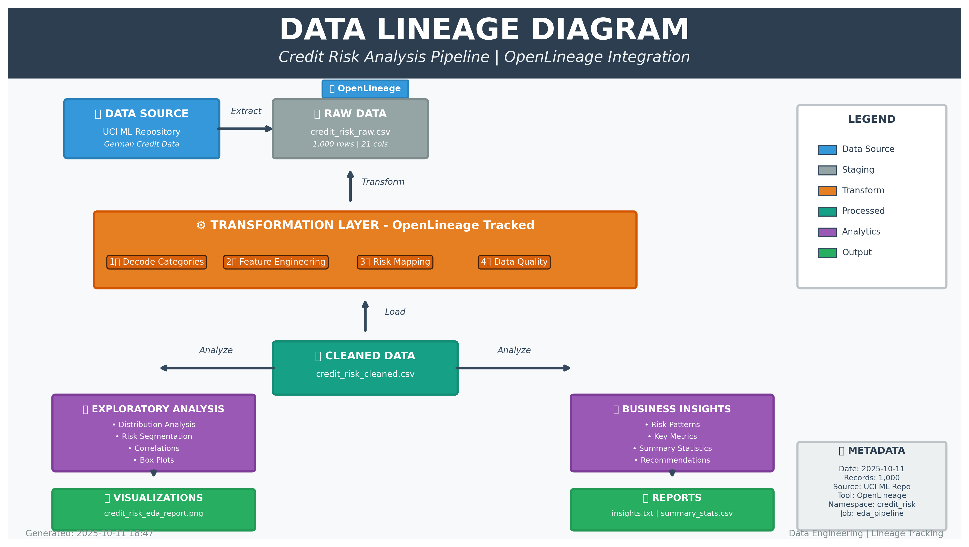
METADATA
Date: 2025-10-11
Records: 1,000
Source: UCI ML Repo
Tool: OpenLineage
Namespace: credit-risk
credit_risk_insights.txt | credit_risk_summary_stats.csv

