Slide 1
AI Investment Advisor
Tell it how much money you have. It tells you where to put it.
Atharva
Project Based Learning, 2026
atharva.funl.bio

Slide 2
The problem
Most people leave their savings in a bank account, where inflation eats the value year after year.
Advice from banks and apps is generic, or it points you at the products they earn from.
A normal person cannot read the market every day and act on it.
2

Slide 3
What we built
A web app that takes three answers from you and returns a plan for your money, backed by live market data.
Risk score
A number from 0 to 100 that says how much risk suits you.
Where to invest
Your money split across five options, in rupees and in percent.
Live market and news
Five stock picks with today's price, and today's headlines.
Growth projection
What the amount could become over the period you chose.
3

Slide 4
How it works
1
2
3
4
5
You enter amount, time, and comfort with risk.
The model scores your risk.
Money is split across five options based on that score.
Live prices and news are pulled in.
Growth is projected with a best and worst case.
4

Slide 5
The AI part
Risk model
A logistic regression model, one of the simplest there is.
Trained on 2,000 investor profiles: amount, time horizon, and stated risk preference.
It returns one number, a risk score from 0 to 100.
News reading
Every headline we pull is scored as positive, neutral or negative.
Those scores are combined into one market mood for the day.
Positive
Neutral
Negative
Both models are small enough to explain on one slide, and both run live on every request.
5

Slide 6
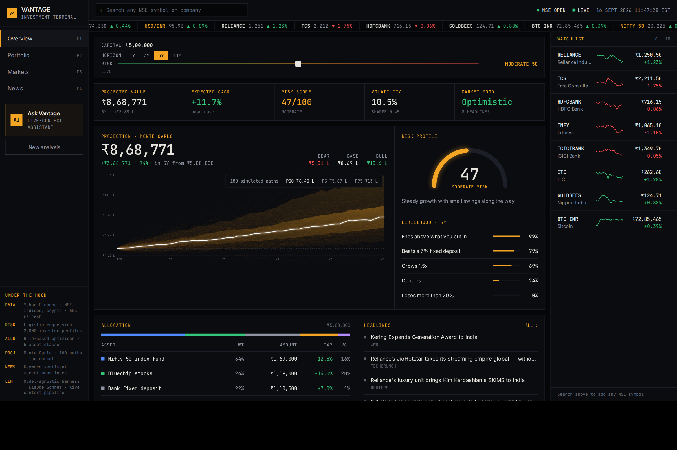
Live demo
atharva.funl.bio
Example: 5 lakh, 5 years, moderate risk.
Live now. React and FastAPI, with a built-in assistant on Claude Sonnet. Code on GitHub.
6

Slide 7
Data sources
Prices and news
Yahoo Finance, live. NSE tickers for Reliance, TCS and HDFC Bank, plus a Gold ETF and Bitcoin priced in rupees.
Expected returns
Published long-run averages for each of the five asset classes.
Risk model training data
2,000 investor profiles generated from investor profile rules.
7

Slide 8
What next
SIP mode
Invest a fixed amount every month instead of once.
Broker connection
Link a broker account so the app can place the order for you.
Hindi and regional languages
The same advice in the language the user thinks in.
Alerts
A message when the news turns negative on something you hold.
Thank you.
8

