Slide 1
Phase II: Optimizing AdStreams Two-Stage Allocation System
Optimus Prime Consulting
Hunter Delaney, Steven Edwards, Melani Louie, Eugene Tu
Notes:
Melani

Slide 2
Agenda
1. Executive Deployment Recommendation
High-level summary of revenue, utilization, and risk reduction
2. Problem Overview & Business Context
What AdStream is trying to optimize and why it matters
3. Stage 1 – Allocation Performance
Heuristic vs. optimized: utilization, feasibility, gross revenue
4. Stage 2 – Ordering Performance
Heuristic vs. optimized: competitor adjacency, violation rates
5. System-Level Comparison
End-to-end net revenue, fines, runtime, and advertiser coverage
6. Snowflake Validation & Benchmarking
How we validated the model against production-like data and current system behavior
7. Modeling Approach
Two-stage system: allocation (MILP) + ordering (heuristic/local search)
8. Future Improvements & Open Questions
Brand-safety modeling, penalty design, and runtime / latency trade-offs
Notes:
Melani

Slide 3
Recommendations
Improvements
Validation
Approaches
Using our optimization model, AdStream can achieve substantial improvements in allocation efficiency and revenue performance while still respecting all contractual and capacity constraints.
Executive Deployment Recommendation: Snowflake data
-Deploy the optimized two-stage model as the default engine: it uses 100% of available impressions (1933.7K / 1933.7K) and lifts gross revenue from $96.4K to $110.6K and net revenue from $78.5K to $90.0K (+14.6%).
-Runtime increases from ~1.59s to ~27.50s per full run, so we recommend keeping the heuristic as a lightweight fallback path if needed.
Notes:
Melani

Slide 4




Problem Overview and Business Impact
Problems:
AdStream's ad serving system is losing advertisers due to poor performance
The system allocates impression inventory inefficiently using greedy heuristics (only simple and fast)
Business Impact:
Revenue is below potential
Significant revenue loss from brand safety violations that trigger automatic 20% discounts
Complaints by advertisers about poor topic matching and appearing alongside competitors
Multiple advertisers have threatened to cancel
Need optimization to retain clients and demonstrate profitability to investors
Notes:
Melani

Slide 5
Recommendations
Improvements
Validation
Approaches
Stage 1 Performance: Allocation Component
=== Allocation Evaluation: Heuristic ===
Total impressions : 1374000
Total revenue : 77,097.21
Feasible : False
- Capacity violations : 0
- Advertiser MIN violations : 2
- Advertiser MAX violations : 0
- Min-websites violations : 8
- Min-placement violations : 0
- Topic-mismatch violations : 0
- Unserved advertisers (min>0, 0impr): 439
=== Allocation Evaluation: Optimized ===
Total impressions : 1422998
Total revenue : 79,672.34
Feasible : True
- Capacity violations : 0
- Advertiser MIN violations : 0
- Advertiser MAX violations : 0
- Min-websites violations : 0
- Min-placement violations : 0
- Topic-mismatch violations : 0
- Unserved advertisers (min>0, 0impr): 438
The heuristic allocation uses 1.374M impressions and earns $77.1K, but it is infeasible: 2 advertisers miss their minimum impressions and 8 miss the minimum number of websites, with 439 advertisers completely unserved
The optimized allocation uses 1.423M impressions, reaches $79.7K in revenue, and is fully feasible: 0 capacity, min/max, website, placement, or topic-match violations, and slightly fewer unserved advertisers (438).
In short, Stage 1 now squeezes more value out of the same inventory without breaking any business rules.
Notes:
Hunter
Decides how many impressions each advertiser gets on each site.
The old heuristic leaves some advertiser contracts unmet and only uses about 96% of our capacity.
The optimized model uses 100% of inventory, meets all min/max and website requirements, and increases gross revenue from about $67K to almost $80K

Slide 6
Recommendations
Improvements
Validation
Approaches
Stage 2 Performance: Ordering Component
=== Ordering Evaluation: Heuristic ordering ===
Impression mismatch pairs : 0
Total mismatch impressions : 0
Competitor adjacency violations : 680
Websites with ≥1 violation : 73
Base revenue (no penalties) : 79,672.34
Revenue after 20% penalties : 65,936.70
Heuristic violations : 680
=== Ordering Evaluation: Optimized ordering ===
Impression mismatch pairs : 0
Total mismatch impressions : 0
Competitor adjacency violations : 466
Websites with ≥1 violation : 73
Base revenue (no penalties) : 79,672.34
Revenue after 20% penalties : 65,936.70
Optimized violations : 466
Both orderings preserve the allocation exactly (0 impression mismatches), so Stage 2 never changes how many impressions each advertiser gets, only the sequence they appear in. The optimized ordering cuts competitor adjacency violations from 680 to 466, a reduction of roughly 31%.
However, since penalties are all-or-nothing per website, the number of penalized sites and net revenue remain unchanged under the current penalty rule
Notes:
Hunter
Both approaches start from the same allocation – how many impressions each advertiser gets on each site – and just change the sequence of ads.”
the impression mismatch is zero for both heuristic and optimized ordering. That means ordering never changes how many impressions we deliver; it just rearranges them in time, which is exactly what we want.
Where the optimized approach helps is competitor adjacency. The heuristic ordering has 680 competitor adjacency violations; our optimized ordering brings that down to 466, about a 31% reduction in direct back-to-back competitor exposures.
However, the number of websites with at least one violation stays at 73 in both cases. So we’ve reduced the severity of conflicts on many sites, but most of the same sites are still ‘dirty’ under the current allocation
Because AdStream’s penalty is all-or-nothing per website—any violation triggers a 20% discount on that whole site—this means penalized revenue is basically identical for the heuristic and optimized orderings, even though we’ve made the sequences cleaner.”
So the takeaway for Stage 2 is: ordering clearly improves brand-safety quality by cutting conflict points, but to materially reduce fines we’d need to either (1) change how we allocate ads across sites in Stage 1, or (2) make the penalty model more sensitive to the number of violations rather than just ‘any vs none’ on a site.”

Slide 7
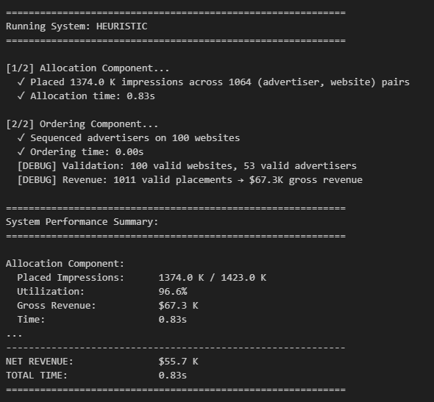
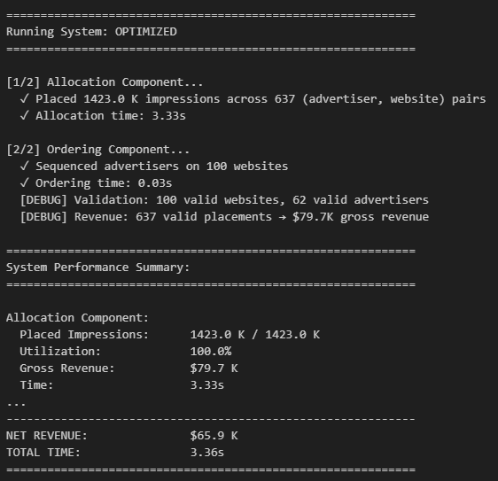
Recommendations
Improvements
Validation
Approaches
Comparison

Slide 8
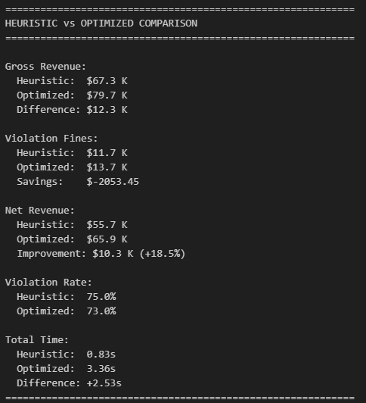
Recommendations
Improvements
Validation
Approaches
Comparison Results
End-to-end, the optimized system serves 1.423M / 1.423M impressions for 100% utilization, versus 1.374M / 1.423M (96.6%) for the heuristic. Gross revenue improves from $67.3K to $79.7K, and net revenue (after brand-safety fines) improves from $55.7K to $65.9K, an 18.5% lift in profit. The optimized configuration also activates more advertisers (62 vs 53 valid advertisers in validation) while keeping total runtime reasonable: 3.4s vs 0.8s for the heuristic.

Slide 9
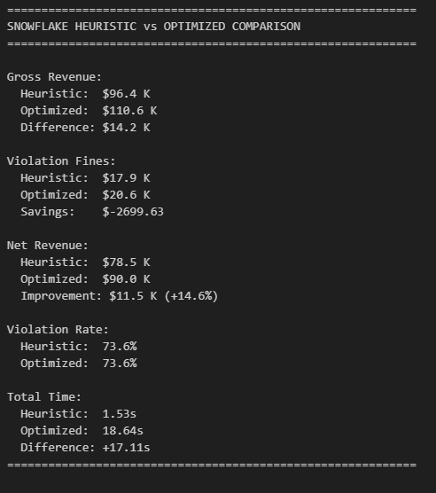
Improvements
Recommendations
Validation
Approaches
Snowflake Optimized Results
Placement Ratio 1933.7k/1933.7k
Placement Proportion 100%
Gross Revenue $110.6k
Sites with Violations 103/140
Violation Fines $20.6k
Net Revenue $90k
Execution Time 18.64s
Key Takeaways
There were 1933.7k impressions, while having a 100% utilization rate.
Gross Revenue increased by $14.2k
Violation Fines increased by $2699.53
Net Revenue increased by $11.5k (+14.6%)
Violation Rate stayed the same at ~73.6% (73.57%)
Total run time increased by 17.11s

Slide 10
Approaches
Recommendations
Improvements
Validation
Stage 1 Approach: Allocation
Implemented a MILP allocation model that maximizes revenue while respecting all constraints, preventing over-allocation to early advertisers that could block potential later advertisers
Key areas of improvement to target:
Impression Placement
Impression placement was incomplete
Only hit 96.6% of available impressions on the websites initially
Increased to 100% with optimized solution
Gross Revenue
With better impression allocation, gross revenue improved

Slide 11
Approaches
Recommendations
Improvements
Validation
Stage 2 Approach: Order
Implemented a search model model that generated valid advertiser sequences however because Adstreams penalties are applied on an “all or nothing” basis, we still have a substantial number of sites with violations despite reducing competitor adjacencies.
Overall, the increase in gross revenue offsets the remaining fines, resulting in a substantial improvement in net revenue
Key business requirements:
Competitors must be ≥2 positions apart in the sequence
Find any valid ordering that satisfies spacing constraints
If no valid ordering exists for a website, use fallback approach
Each website is solved independently

Slide 12
Possible Improvements / Next Steps
Deeper brand-safety optimization:
Further reduction of brand-safety fines would be hypothetically possible through adding stronger constraints into the MILP but they would greatly increase model complexity and runtime for likely negligible benefit in revenue.
Clarify latency requirements:
Right now the model has a runtime of a few seconds so we would like to ask a member of the Adstream Engineering team what kind of speed they are expecting the program to run with (seconds, minutes… ?)
Revenue vs. speed trade-off:
If longer runtimes are acceptable, we can experiment with richer models (more brand-safety rules, multi-objective optimization) to squeeze out slightly more revenue at the cost of slower solves.
Notes:
Hunter Refine penalty model (future work): A more nuanced penalty scheme (e.g., proportional to number of conflicts rather than all-or-nothing per website) could better reward our improved ordering and give clearer business control over the revenue–risk trade-off.

Slide 13
Q&A
Optimus Prime

