Slide 1
147 Phase II
Client Health Analytics Initiative LTV & Churn Risk Models
Yanelli Gloria Evan Padiyil Vanessa Birrueta-Hernandez Hunter Delaney

Slide 2
Problem Alignment
Vantage has two urgent questions. We built models to answer both.
ALAN FUJIMOTO • CFO
What are our clients actually worth?
Pricing, sales targeting, and resource allocation decisions lack a clear picture of lifetime value. Some clients look expensive but drive substantial long-term revenue.
Our answer: LTV Regression Model using realized invoice revenue across 558 accounts.
NATE KOWALSKI • VP CLIENT SUCCESS
Which clients are about to leave?
The team reacts to red flags after they appear. Vantage lost several clients last year that earlier intervention could have saved.
Our answer: Churn Classification Model scoring all 430 active accounts by risk level.

Slide 3
LTV Executive Summary
The goal of this analysis is to better understand how much revenue each customer generates over the full course of their relationship with the company.
Even though contract values show what customers are supposed to pay, they don’t always match what the company actually collects over time. So instead of relying on projections, we built a model that estimates Lifetime Value using actual invoiced revenue and customer behavior data.
Topics that will be addressed:
How Lifetime Value was defined
What data was used to model it
How the model was built and evaluated
What we learned about revenue patterns across customer segments
This analysis gives leadership a clearer understanding of what customers are actually worth over time so future decisions are based on real revenue patterns.

Slide 4
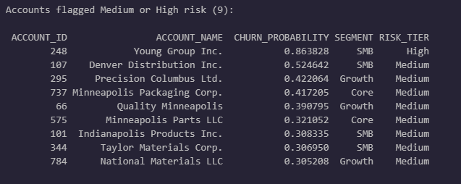
Churn Executive Summary
We identified 9 active accounts at elevated churn risk.
Our model scored all 430 active accounts and these are the 9 that need outreach now
The #1 Predictor of Churn: How long since we last contacted the account.
The fix is proactive outreach.
*Full ranked list of all 430 accounts in churn_risk_list.csv
Notes:
Bottom line: We built a model that scores every active account
by how likely they are to churn. Out of 430 active clients, 9 came back as medium
or high risk.
Young Group Inc. is the most urgent — the model gives them an 86% chance of
churning. They're a small SMB account. The next eight range from about 30% to 53%.
Well go into more detail regarding segments later but note that a majority of churned accounts are SMB
The biggest thing the model flagged: accounts that haven't had a recent CS (Client Success team DAYS_SINCE_LAST_ACTIVITY)
touchpoint are far more likely to churn. That's actually good news — it means
the fix is something we can control. More proactive outreach, especially to
these 9 accounts.
The full scored list of all 430 accounts is in a CSV file Q: 'Why only 9? That seems low.'
A: That's actually a positive sign. It means the vast majority of our active
accounts (421 out of 430) are in good shape. The model isn't over-alarming —
it's focused on the accounts with a real, measurable risk.
Q: 'What should we actually DO with this list?'
A: Start with Young Group Inc. — schedule an outreach call this week. For the
other 8, I'd recommend your team review their recent activity and set up
check-ins within the next 2 weeks. The CSV has the probability scores so
you can prioritize top-down.
Q: 'How reliable is this list?'
A: The model is 97% accurate on historical data and catches 96% of actual
churners. I'll get into the details on the next slides, but the short version
is: we're very confident in these flags."

Slide 5
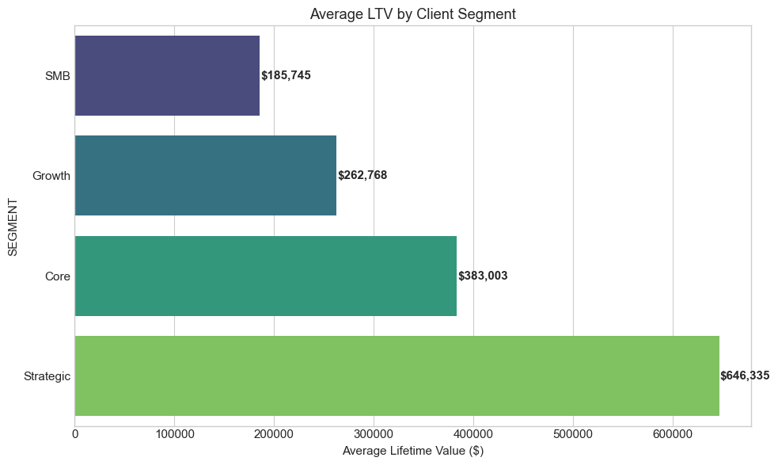
LTV: How We Built The Model (Pt. 1)
Target Value: TOTAL_VALUE vs INVOICES
Features were chosen to target 4 different sections of an account:
Usage (e.g. UTILIZATION)
Commitment (e.g. TENURE_DAYS)
Engagement (e.g. TICKET_COUNT)
Account Profile (e.g. EMPLOYEE_COUNT)
Models Used
Linear Regression - Baseline Model
Ridge Regression - Similar to Linear
Random Forest - Show Multicollinearity
Notes:
Vanessa
Target value - why we went to aggregated invoices (realized value - early churned clients) - we did see some clients who’s full contract was not realized

Slide 6
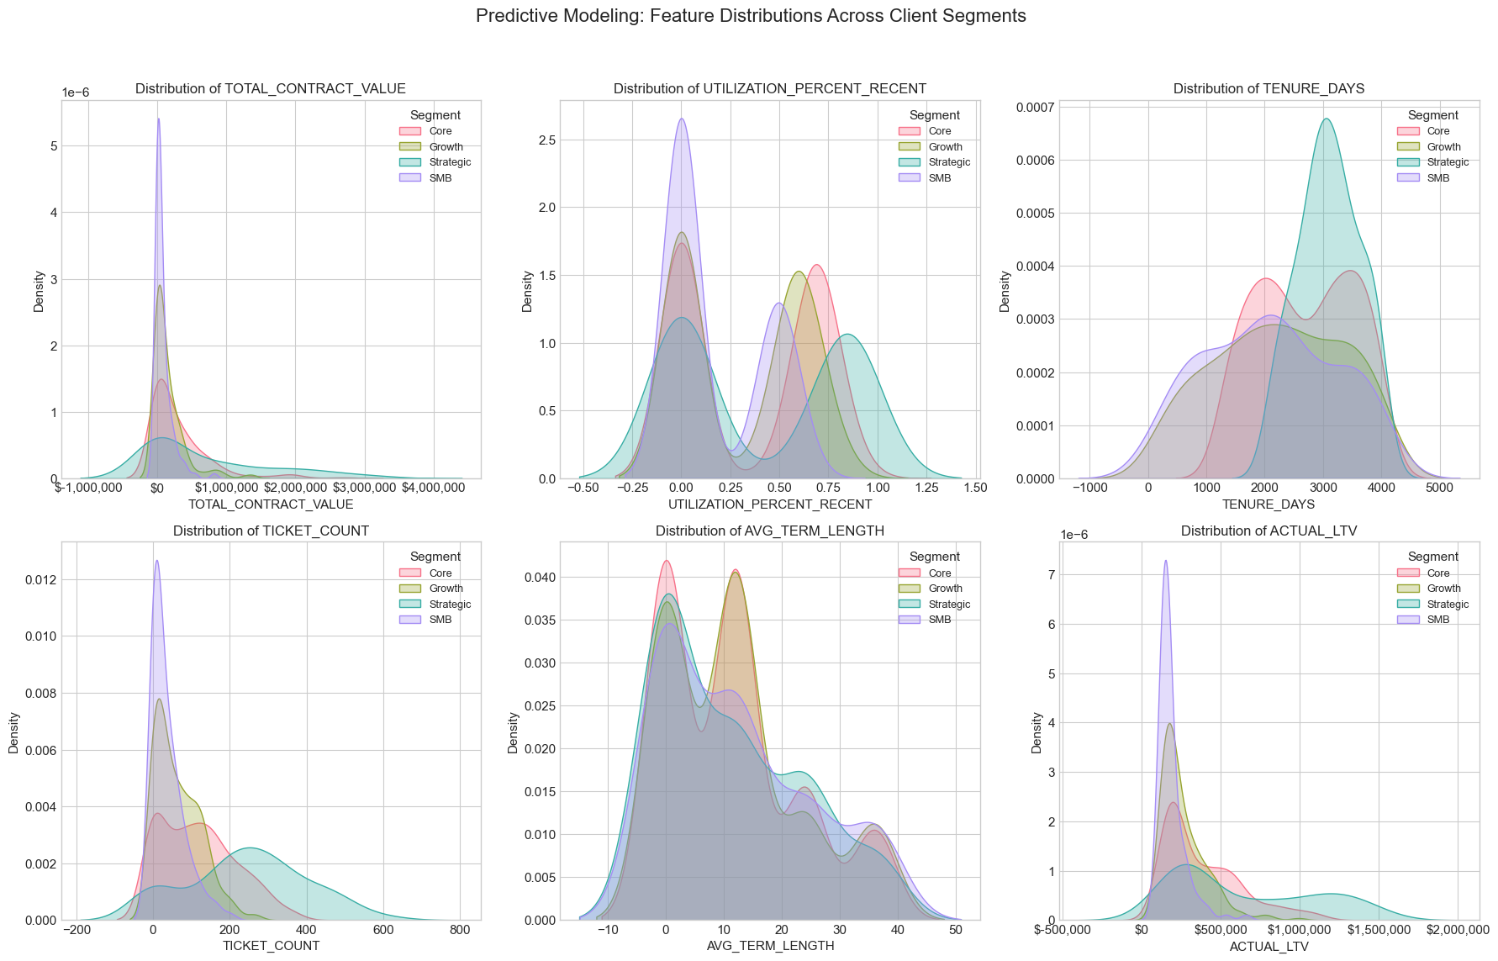
LTV: How We Built The Model (pt. 2)
Notes:
Vanessa - different features affect different segments differently (i.e. the relationship between each feature and each segment is different (complex)) - supports the use of Random Forest (multicollinearity) and why it is more accurate

Slide 7
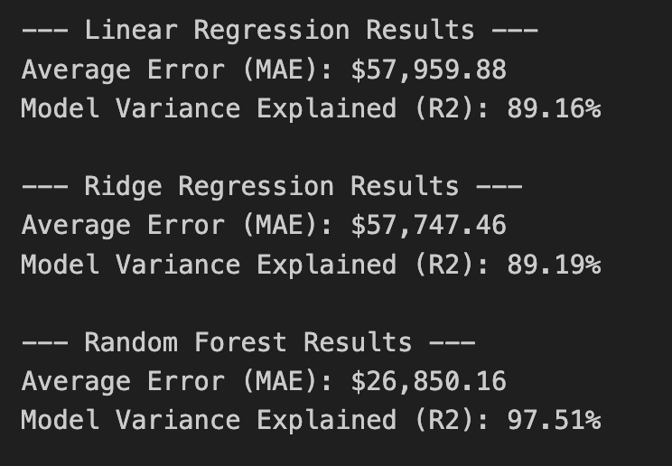
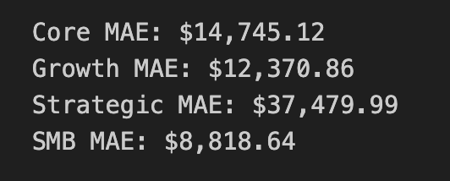
LTV: Evaluation (Pt. 1)
All Accounts
By Segment
Despite the MAE in strategic accounts being the highest, it was less than 6% of the average LTV.
Notes:
Vanessa - baseline established with Linear and Ridge did not change much in terms of Multicollinearity. However, we can see that the model was much better and more accurate with the test and training data for the Random Forest Model. When looking more closely at the model in different segments, we can see the model is decently accurate with Strategic accounts.

Slide 8
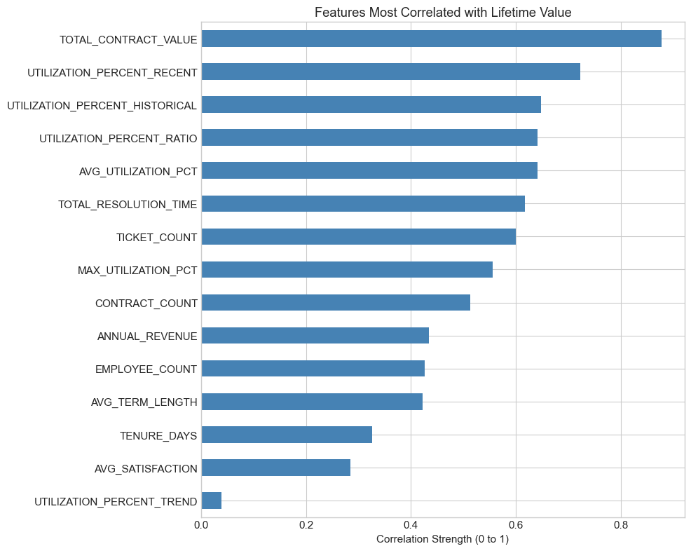
LTV: Evaluation (Pt. 2)
Notes:
Vanessa - Contract Value - obviously a lifetime drive, but usage is also strongly correlated. This can be an area of exploration (long term goal) and seeing when/why it is a trigger for certain accounts (like SMB accounts) - long term-ish goal

Slide 9
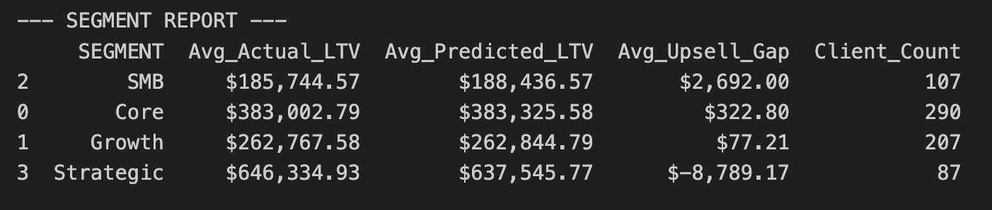
LTV: Recommendations
Immediate Target the “Upsell Gap” in the SMB segment
Short Term Focus on retaining Strategic Accounts
Long Term Creating a Usage-Based Trigger System
Notes:
Vanessa
Immediate - we could find ways to enforce different tiers or reevaluate the pricing model used for SMB accounts.
Short term - We profit the most from strategic accounts despite the high usage, so avoiding upselling to them and prioritizing their engagement
Long term - after total_value, we saw that ticket usage was the next highly correlated (but a *potential* point for friction for SMB accounts - we can take a look at that next and see when usage gets too high, are we likely to lose someone or retain. For further exploration

Slide 10
LTV Summary
What does the model tell us?
The model predicts revenue very accurately, with an average error of about $27K.
Strategic customers are the most valuable, averaging about $646K in lifetime revenue.
SMB customers generate much less on average, about $186K.
Contract size and how much a customer uses the product are the strongest drivers of long-term revenue.
Some SMB accounts are using more than their current contract level suggests, which creates upsell opportunities.

Slide 11
Churn - How We Built The Model
We pulled data from 8 tables across the Vantage data warehouse and condensed it into ~40 features per account.
- Accounts (segment, size, age)
- Contracts (count, value, auto-renew, cancellations)
- Support Tickets (volume, priority, resolution time, satisfaction)
- Service Utilization (usage %, trends over time)
- Engagement Scores (logins, feature adoption, training)
- NPS Surveys (scores, detractor %, response rate)
- CS Activities (meetings, outcomes, recency of contact)
- Invoices (payment health, overdue rate)
Population: 558 accounts (430 active, 128 churned) Overall historical churn rate: 22.9% Train/test split: 80% train, 20% held-out test
Two Algorithms Compared
Logistic Regression:
Draws a straight line between churned and active accounts.
Interpretable and tells us exactly which factors push toward churn.
Random Forest:
Builds hundreds of decision trees and takes a majority vote.
Catches complex patterns that a simple line might miss.
We use two models to validate our results and to ensure the results are not a fluke of one particular model
Notes:
We pulled data from 8 different tables in the warehouse — everything from
contract details to support tickets to how often clients actually use the
product. We combined all of that into about 40 measurable features per account.
Our modeling population was 558 accounts — 430 active and 128 that have churned.
So historically, about 23% of accounts have churned. That's our baseline.
We tested two different algorithms. Logistic Regression is the simpler one —
think of it as drawing a line that separates churned accounts from active ones.
It's useful because it tells you exactly which features matter and by how much.
Random Forest is more complex — it builds 200 decision trees, each looking at
the data from a slightly different angle, and combines their votes. It's better
at catching patterns that aren't straightforward.
The reason we used both is validation. If a simple model and a complex model
both point to the same conclusions, that's a strong signal that we're finding
something real in the data, not just overfitting noise.
We held out 20% of accounts as a test set — accounts the model never trained on —
so the accuracy numbers I'm about to show you are on 'unseen' data.
Q: 'What is the target variable? How do you define churn?'
A: We used the IS_CHURNED flag from the Accounts table. If status = 'churned',
that's a 1. If status = 'active', that's a 0. We excluded prospects and
implementation-only accounts since they were never fully onboarded.

Slide 12
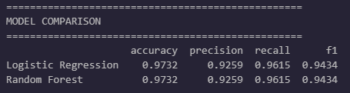
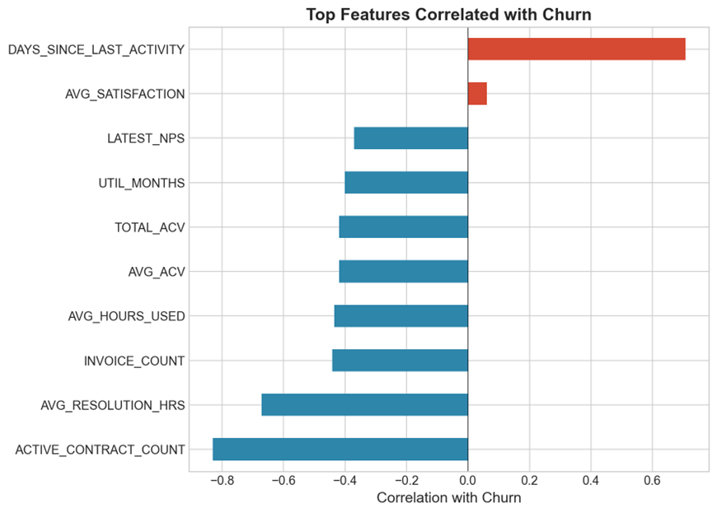
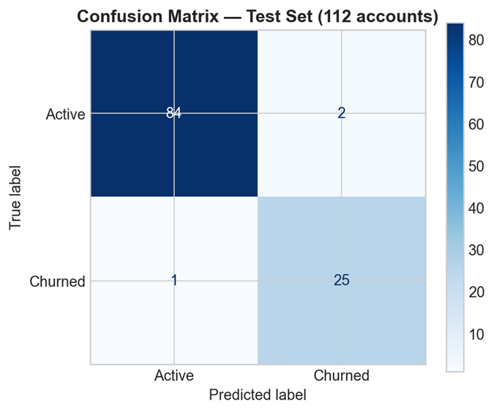
Churn - Model Performance & What Drives Churn?
• Precision 93% → When we flag an account, we're right 93% of the time • Recall 96% → We catch 96 out of every 100 actual churners • Only 3 misclassifications out of 112 test accounts
#1 Days Since Last Activity — accounts that go quiet churn #2 Active Contract Count — fewer contracts = higher risk #3 Avg Resolution Hours — slow support = churn driver
Notes:
Both models hit 97.3% accuracy on accounts they'd never seen before. Out of 112 test accounts, only 3 were wrong — 2 active accounts incorrectly flagged as churn risks, and 1 churned account was missed.
Recall is 96.2% — the model catches 96 out of every 100 accounts that actually churn. Very few slip through.
Precision is 92.6% — when the model says an account is at risk, it's right 93% of the time. Your team won't waste effort chasing false alarms.
Now the most important part: feature importance. This tells us WHAT the model is using to make predictions.
Number one by a wide margin: days since last CS activity. The longer an account goes without a touchpoint, the more likely they churn. This was #1 in BOTH models.
Number two: active contract count. Fewer active contracts = higher risk. Less commitment, easier to walk away.
Number three: average support resolution hours. Slow ticket resolution = higher churn. Support responsiveness directly impacts retention.
The good news: two of these three — outreach frequency and support resolution — are things we can directly improve. Q: 'What does precision vs recall mean?'
A: Precision = 'when we flag someone, how often are we right?' 93%. Recall = 'of all actual churners, how many did we catch?' 96%.
Q: 'Why did both models get identical scores?'
A: The signal in the data is very strong and clear. Both approaches converge because the patterns are unambiguous.
Q: 'Can we reuse this model?'
A: Yes — re-score active accounts monthly or quarterly.

Slide 13
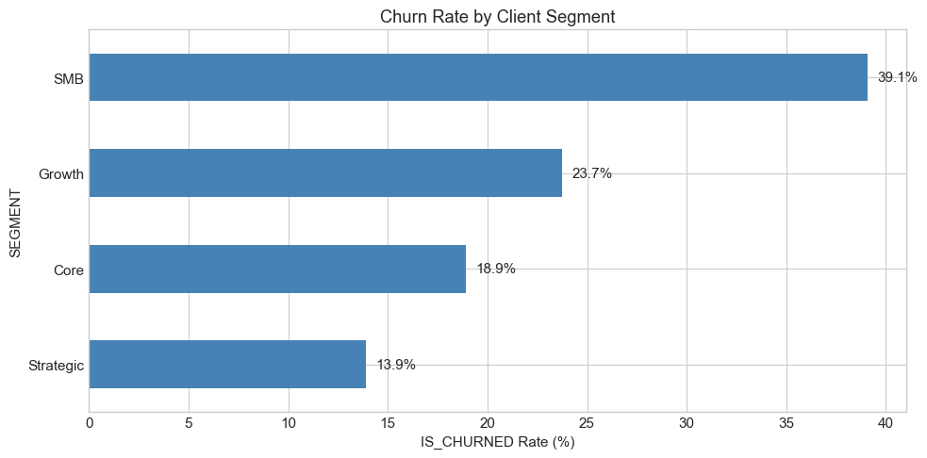
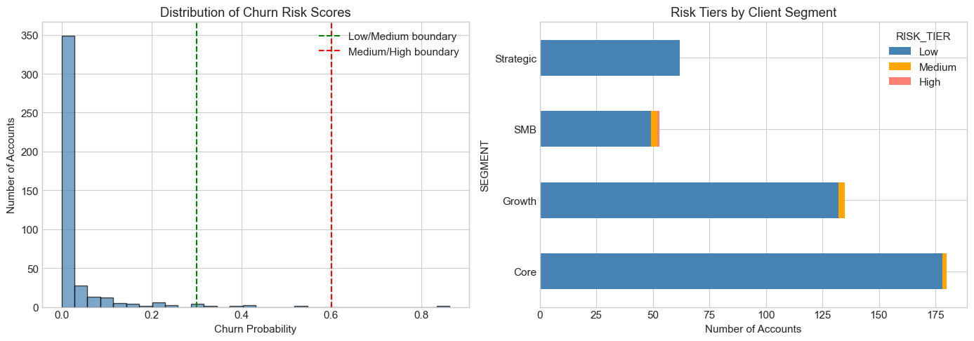
Churn- Segment Risk Breakdown & Recommendations
SMB accounts have a 39% historical churn rate, nearly 3 times higher than Strategic at 14%. Growth is in the middle at 24%, and Core is at 19%.
Recommendations:
1. Immediate
Schedule outreach to the 9 flagged accounts this month, starting with Young Group Inc. (86% churn probability).
2. Structural
Increase CS touchpoint frequency for SMB accounts. Days since last activity is the #1 churn predictor so regular check-ins are the most direct intervention.
3. Support
Prioritize reducing average ticket resolution time. It's the #3 churn driver and can be controlled operationally
Notes:
From individual accounts to the segment level:
SMB accounts have a 39% historical churn rate — nearly 3 times higher than Strategic at 14%. Growth is in the middle at 24%, Core at 19%.
The right chart shows where medium and high-risk accounts land by segment. The risk concentrates in SMB and Growth. Strategic has zero flagged accounts.
Three concrete recommendations:
First — immediate action: reach out to the 9 flagged accounts. Young Group Inc. at 86% is most urgent. Get someone on the phone this week. The other 8 should have check-ins within 2 weeks.
Second — structural change: the data says the single biggest churn preventer is regular contact. SMB accounts seem to be falling through the cracks. Even a brief quarterly check-in could make a measurable difference.
Third — support: ticket resolution time is the #3 churn driver. Bringing down average resolution hours, especially for at-risk accounts, directly reduces churn risk.
The full scored list is in a CSV your team can start using today. We can also set this up to re-score monthly.
Q: 'How often should we re-run this?'
A: Monthly or quarterly. Re-score against current data so the list stays fresh.
Q: 'Should we treat all Medium-risk accounts the same?'
A: No — Denver Distribution at 53% is very different from National Materials at 31%. Use the probability to prioritize.
Q: 'What about the 421 low-risk accounts?'
A: Low risk NOW, but re-scoring regularly catches any that start trending down.
Q: 'Could we have predicted the clients we lost last year?'
A: With 96% recall, the model very likely would have flagged most of them.

Slide 14
Next Steps
Improving the Models
Predict churn within a 60–90 day window
Add deeper engagement and usage signals
Re-evaluate performance over time
What LTV + Churn Model Tell Us
Strategic accounts drive most long-term revenue and have the lowest churn risk
SMB accounts have the highest churn risk
Usage and engagement matter for both value and retention
What do we recommend overall
Protect high-value accounts
Stay ahead of SMB churn
Build simple trigger systems based on inactivity and usage

