Slide 1
Optimus Prime Consulting
Project Phase 1
Notes:
Melani: Hello, we’re Optimus Prime Consulting…

Slide 2
Agenda
Problem Overview (01)
Impact on Production (02)
Methodology and Key Assumptions (03)
Recommended Solution with Financial Impact (04)
Notes:
Melani: …and we are going to explain our production solutions for the following issue.

Slide 3
Problem Overview
Two Critical Delivery Windows:
Week 45, November 10, 2025
Week 46, November 17, 2025
October 3rd Flood: In Taiwan, which severely impacted the Kaohsiung facility
The Kaohsiung facility produces 40% of our global output → Now operates at 35% capacity
Key Problem:
Need to reallocate production across the 3 facilities to fulfill both delivery weeks on time
Within a $15 million emergency budget
Need to minimizing total cost
Chennai, and Guadalajara facilities remain fully operational
Notes:
Melani: The problem we’re faced with is that the facility in Taiwan was severely damaged in a flood and can only operate at 35% capacity. This facility usually produces 40% of Orange Electronics global output, which is especially an issue with Black Friday deliveries coming up. Luckily, the facilities in India and Mexico still remain fully operational, so the task was to reallocate production across the three facilities to fulfill both the week 45 and week 46 delivery windows. Since this situation could lead to a critical loss in revenue and jeopardize customer relationships, we were provided a $15 million dollar emergency budget to cover the costs of overtime and express shipping. Another main goal was to minimize the total cost of production which includes base production costs, standard shipping costs, and any penalties incurred from late deliveries to customers.

Slide 4
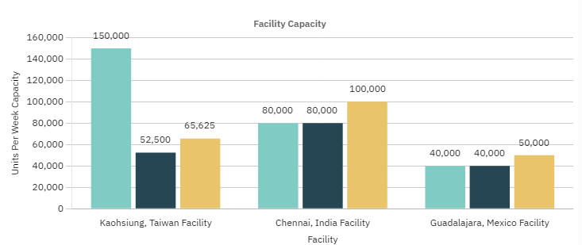
Impact on Production
Facility | Normal Capacity After the Flooding | Max Capacity With Overtime | Current Status
Kaohsiung, Taiwan | 52,500 units | 65,625 units | Operating at 35% capacity due to the flood
Chennai, India | 80,000 units | 100,000 units | Fully Operational
Guadalajara, Mexico | 40,000 units | 50,000 units | Fully Operational
Notes:
Melani: A closer look at the impact of the October 3rd flood in Taiwan reveals the options for production going forward. For the Taiwan facility, it normally handles 150,000 units per week, but due to the flood, it’s currently operating at 35% capacity and can produce 52,500 units a week without overtime and 65,625 units with. The facility in India is fully operational being able to produce 80,000 units a week normally, and 100,000 units at max capacity. Similarly, the Mexico facility can produce 40,000 units at normal capacity and 50,000 units a week with overtime. In the facility capacity chart, you can see how much of a loss in production was taken at the Taiwan facility due to the flooding.

Slide 5
Methodology and Key Assumptions
1.
2.
Setting up the Excel workbook in preparation for implementing formulas and solving
Configuring the solver and executing it on the completed workbook
3.
4.
Iterating on the solver configuration and workbook formulas to reach a possible optimal solution
Validating the found solution against expected results and taking into account possible error sources
Key assumptions:
Cameras would be our main limiting factor
Target on time delivery for all business partners, possibly at the cost of overtime and express shipping expenditure
Major cost increases for a carrier was unacceptable and limited shipment sizes.

Slide 6
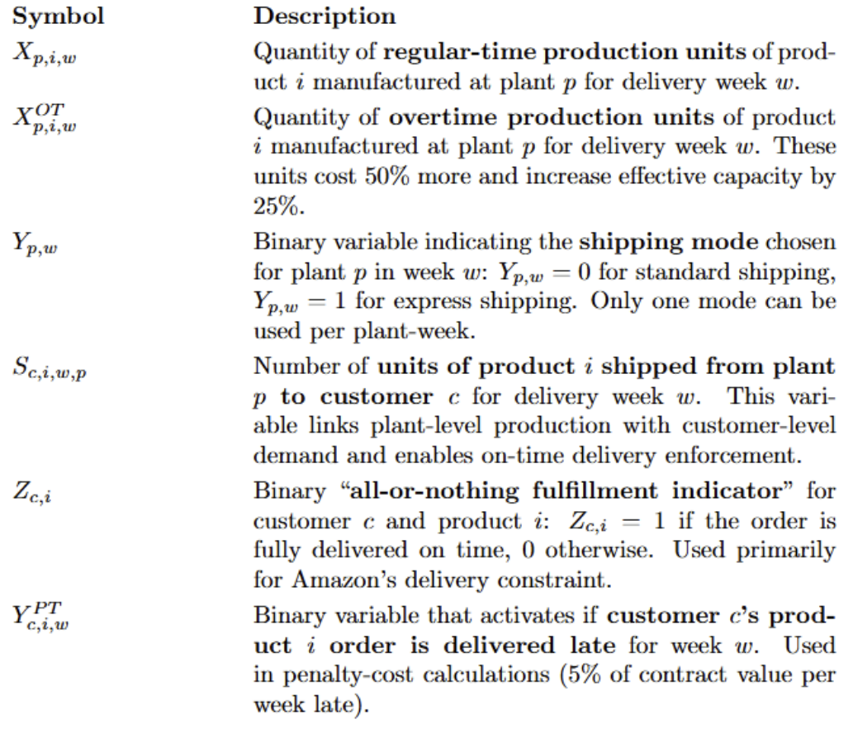
Core Decision variables

Slide 7
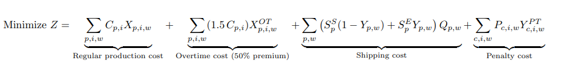
Objective Function

Slide 8
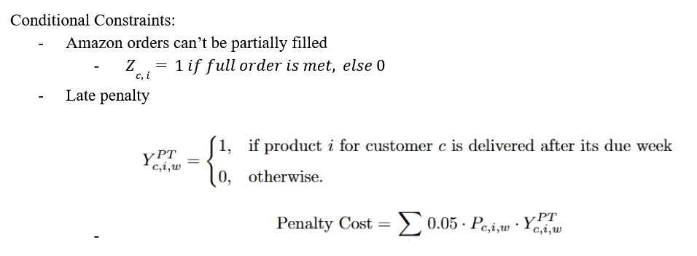
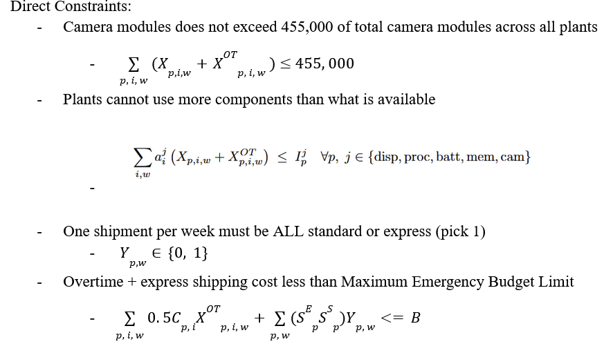
Select Constraints

Slide 9
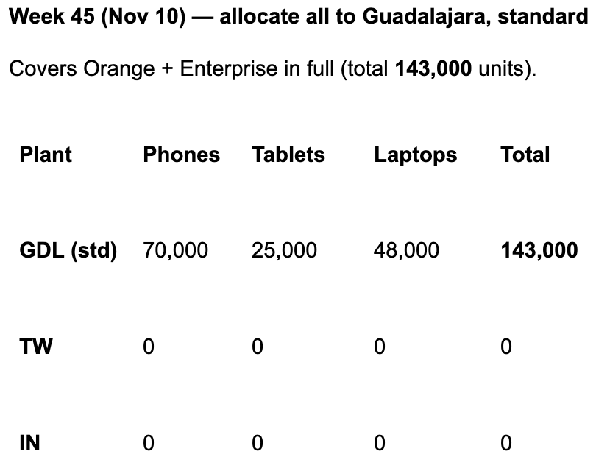
Recommended Solution Pt. 1
Delivery Week:
Week 45:
Produce only from the
Guadalajara facility
~3.7 weeks of production time
Only use standard shipping
No overtime
Emergency budget usage: $0

Slide 10
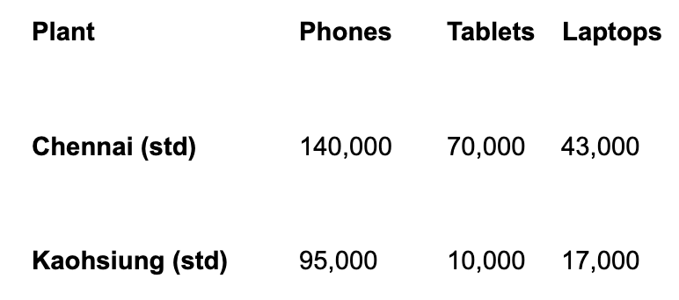
Recommended Solution Pt. 2
Delivery Week:
Week 46:
Produce only from the
Chennai and Kaohsiung facilities
~5.1 weeks of production time
Only use standard shipping
No overtime
Emergency budget usage: $0
Total Cost = $289.96 M

Slide 11
Questions?
?
!

