Slide 1
Tracer Analytics Layer
Phase 2 Data Layer
TIM 175, Spring 2026
June 2026
Notes:
SPEAKER: Hunter
Our team built the analytical data layer for Tracer's Rollouts feature. We will walk through why we built it, how we designed it, the three numbers Erin needs for the CPO review, and our recommendation. 10 minutes, then we will take questions.

Slide 2
Problem Overview: Without a Data Layer, Tracer Cannot Defend Its Own Pricing Story
Manual CSV pulls taking two days each produced no number Erin could walk into the CPO review with.
The Problem
What We Built
No analytics layer across 4 source systems
Star schema on dbt over the existing warehouse
Each manual pull took 2 days and results did not reconcile
Three defensible numbers produced in one build command
Pro+ pricing premium had no measurable proof
Same model answers follow-up questions live at the CPO review
Erin can now walk into the CPO review with reproducible numbers and answer follow-up questions without a 2-day wait.
48.3%
29
15
Rollouts adoption vs 60% target
Pro+ orgs at April month-end, flat since Feb
Non-adopting Pro+ orgs at renewal risk
Notes:
SPEAKER: Hunter
Before we built this, Erin's team had no easy way to answer basic questions about the business. Every time someone needed a number -- like how many customers are on the premium plan, or how much revenue is coming in -- an analyst had to go into four completely separate systems, pull data by hand, and try to piece it together. That process took about two days every single time, and the numbers would often not match up between passes. So Erin had nothing she could confidently bring into a meeting and defend.
What we did was build a system that connects all of those data sources automatically. Now instead of two days of manual work, the same numbers are produced in one command, and they come out the same every time. The rest of this presentation shows you exactly what those numbers are.

Slide 3
Recommendation: Activate the 15 Non-Adopting Pro+ Orgs Before Their Renewals
Flipping 4 orgs from non-adopter to adopter closes the gap from 48% to 60%.
The Signal
The Gap
The Action
What the data shows
Where we are vs target
What to do
Pro+ count flat at 29 since February. Pro MRR flat at $50,955. Starter down 21% with no upgrade conversion. Rollouts launched four months ago and revenue has not moved.
48.3% adoption. 15 of 29 Pro+ orgs have never used the feature their tier is priced around. At renewal, they have no demonstrated reason to stay on Pro+.
Use the Q2 adoption data to identify the 15 non-adopters. Prioritize by contract age. Run direct activation outreach, not self-serve. Closing 4 orgs hits the 60% target.
The same model that produced these numbers can be queried weekly to track progress.
Notes:
SPEAKER: Hunter
Our recommendation is this: reach out personally to the 15 customers who are paying for the premium plan but have never actually used the Rollouts feature. Walk them through the feature and get them using it.
Why 15? Our data shows that out of the 29 customers on the premium plan, only 14 have ever touched Rollouts. That means just under half of the people paying extra for this feature have never tried it. That is a problem because if they go to renew their contract and they have never used the thing they are paying a premium for, they have no reason to keep paying that premium.
The good news is we do not need to reach all 15. We only need to get 4 of them using Rollouts to hit the 60 percent target. That is a very achievable number if we start outreach now, before any of those contracts come up for renewal. The next slides show you the data behind these numbers.

Slide 4
Business Case: Why an In-House Analytical Layer, and Why Now
Tracer considered four options. Three of them still would not have produced a number in time.
What We Rejected
Why In-House dbt
Status quo: 2-day manual pulls that did not reconcile pull to pull
Fast: weeks, not months
Direct DB queries: spans four services, no shared model, operational risk to production
Tracer owns the model and answers follow-up questions live
BI vendor: 6 to 9 months to deploy, Tracer does not own the model, misses the CPO review
Commodity capability; extends to future questions on the same schema
Overbuilt system: future-proofed integration adds months; CPO needs numbers in 30 days
No vendor contract, no external deployment dependency
Success criteria: Erin treats the numbers as defensible, her analyst stops manual pulls, and the layer remains in use after the CPO review.
Notes:
SPEAKER: Max
Tracer had four options. The status quo -- manual CSV pulls -- was already failing: two days per pass, results that didn't reconcile, and nothing Erin could defend at a CPO review. Direct queries against production databases carried operational risk. A BI vendor would have taken 6-9 months and Tracer wouldn't own the model. We chose in-house dbt because it's fast, Tracer owns the output, and the same model supports follow-up questions beyond the three on the table today. The analytical layer itself is a commodity -- standard questions any SaaS company needs answered. The value is in owning it and having it ready in time.

Slide 5
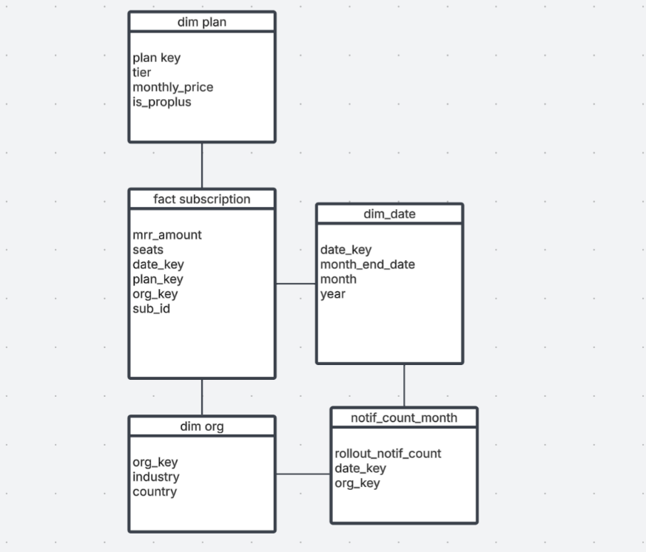
The Star Schema: Three Design Decisions
Monthly snapshot grain. Two facts. Three dimensions. dim_date shipped pre-built.
Grain: Monthly Snapshot
One row per active subscription per month-end. Rejected event grain: cannot produce month-end counts without re-deriving on every query.
Measures
mrr_amount (semi-additive: sums within a month, not across months), seats (semi-additive), rollout_notif_count (additive). Rejected aggregate MRR by tier: computable as a query.
Dimensions
dim_plan (tier, monthly_price, is_proplus), dim_org (industry, country), dim_date (pre-built). Rejected dim_user (answers none of the three questions).
Notes:
SPEAKER: Max
Here is the schema we designed. The central fact table is a monthly subscription snapshot -- one row per active subscription per month-end. We chose monthly snapshot grain over event grain because questions 1 and 3 both ask for month-end state directly; event grain would require re-deriving that on every query. For measures, MRR and seats are semi-additive -- you can sum them across subscriptions within a month but not across months, which would introduce double counting. The notification count is fully additive. We kept only three dimensions: dim_plan for pricing and tier, dim_org for segmenting by industry and country, and dim_date which shipped pre-built. We rejected dim_user because it doesn't answer any of the three questions Erin needs.

Slide 6
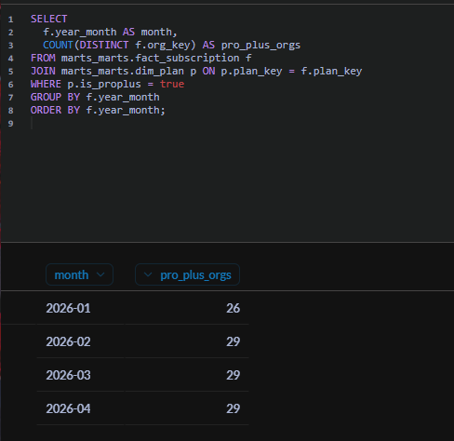
Q1: Pro+ Grew in January, Then Stopped
Month-end count of orgs on Pro or Enterprise, reconstructed from the subscription change log.
Growth of 3 orgs happened between January and February, immediately after Rollouts launched on January 1. Nothing has moved since.
April's count of 29 is the denominator for the 60% adoption target in Q2.
The number is reproducible: one dbt build command gives the same result every time, unlike the prior manual CSV process.
Metabase: marts_marts.fact_subscription + dim_plan
Notes:
SPEAKER: Juan
The first number: how many Pro+ orgs does Tracer have each month? The key design decision here was not to use the current billing_subscriptions table, which only shows today's state. Instead the model reconstructs month-end plan state by reading the subscription change log and asking: was this subscription created by month-end, not yet cancelled, and what was the most recent plan on record? The result: 26 Pro+ orgs in January, 29 in February, and flat for the three months since. The growth happened immediately after Rollouts launched and stopped. That April figure of 29 is the denominator for Q2's adoption rate -- hand off to Josh.

Slide 7
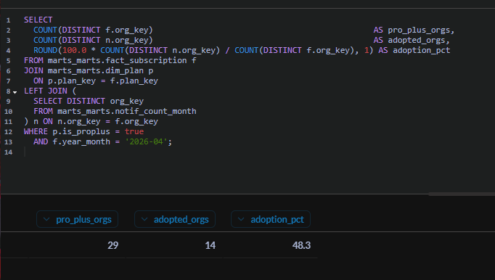
Q2: Adoption at 48.3% -- 12 Points Below the 60% Target
Share of April 2026 Pro+ orgs that fired at least one rollout_, rollback_, or threshold_ notification since January 2026.
14 of 29 Pro+ orgs adopted Rollouts | 48.3%, below the 60% target
Event filter uses ESCAPE clause on rollout_, rollback_, threshold_ prefixes -- not a wildcard -- so only true Rollouts events count.
15 orgs have never fired a rollout notification | These are the renewal risk orgs
48.3%
60%
Current adoption (April 2026)
CPO review target
Target gap: 4 more orgs need to adopt Rollouts to reach 60%.
Metabase: fact_subscription + notif_count_month
Notes:
SPEAKER: Josh
This is the headline number for the review. Out of the 29 orgs on Pro or Enterprise at the end of April, 14 have fired at least one rollout-related notification since the January launch which is about 48.3% adoption, 12 points under Erin's 60% target. The way we did this: an org is counted as "adopted" if it fired any event starting with rollout_, rollback_, or threshold_. We matched that prefix exactly, with an escaped underscore, so we're only counting genuine Rollouts activity.
The part that matters for Erinn is the other 15 orgs. They're paying the Pro+ premium but have never touched the feature that premium is supposed to buy. Those are the renewal-risk accounts, and they line up with the flat Pro MRR you'll see on the revenue slide. This means the orgs that didn't adopt are the same ones that didn't upgrade.

Slide 8
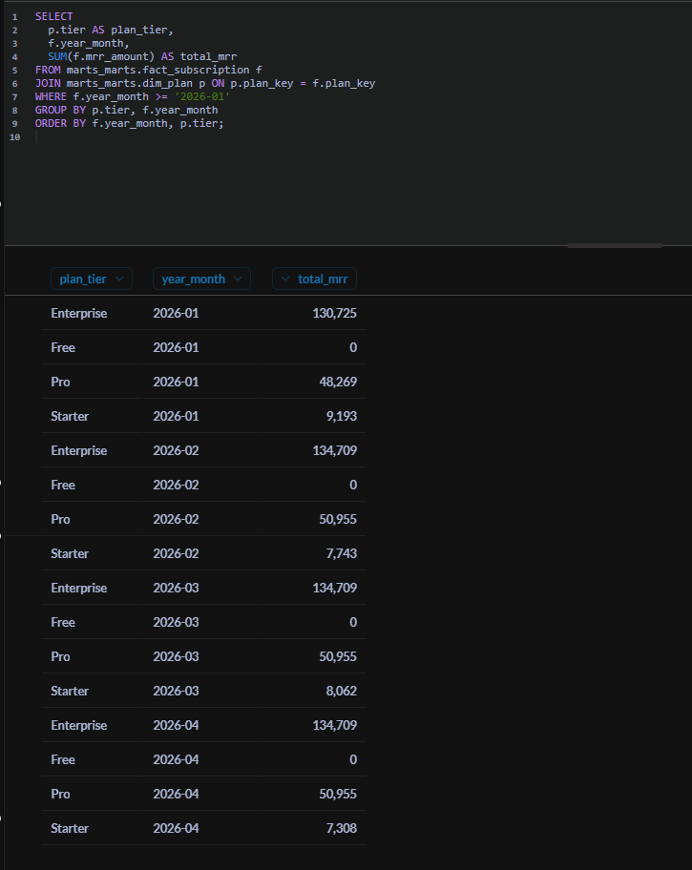
Q3: MRR Is Flat. Enterprise Carries 70%. Pro Has Not Grown.
Monthly MRR = monthly_price x seats, summed by tier. Semi-additive: do not sum across months.
Pro MRR flat at $50,955 since February. Rollouts was supposed to drive Starter-to-Pro upgrades. It has not.
Starter MRR down 21% over four months with no corresponding Pro growth. Those customers are leaving, not upgrading.
Notes:
SPEAKER: Arushi
The third number: revenue by tier. MRR is monthly_price times seats, summed within each month -- it is semi-additive, meaning you can sum across orgs and tiers within a month but not across months. Total MRR has been essentially flat since February at around $193,000. Enterprise is the dominant tier at roughly 70% of revenue and has been stable. Pro MRR plateaued at $50,955 in February and has not moved -- this is the most important signal because Rollouts was supposed to pull Starter customers up into Pro. Instead Starter MRR has declined 21% over four months with no corresponding Pro increase, which means those customers are churning out, not upgrading. The Rollouts launch has not moved the revenue needle. Hand off to Hunter for the recommendation.

Slide 9
Questions?
Notes:
Open the floor for questions. Any team member should jump in for questions in their area:
- Max for business case or schema design questions
- Juan for Q1 methodology or the month-end reconstruction logic
- Josh for Q2 adoption definition or the notification filter
- Arushi for Q3 MRR calculation or the semi-additive measure explanation
- Hunter for the recommendation or the overall strategy
Metabase is available at localhost:3000 -- can pull up any query live if asked.

