Slide 1

GAIA
Group 1
COMP2125 - 002

Slide 2
Meet our team
Cassandra Courchesne Evans
200398437
Roshan R Padmanabhan
200509164
Mic Riewe
20027066

Slide 3


Agenda
A
Introduction
System design
Technologies used
Problems Faced
Future Directions
Conclusion

Slide 4
Introduction
GAIA is an iOS application that helps user care for their plants. The app will store users' data about their plants which sets reminders for watering or feeding and has helpful hints about plant care. The motive of the project is to
Provide information about the user’s plants on how to grow them.
Use this as a medium to spread awareness about the environment.
Take plant care to next level.

Slide 5
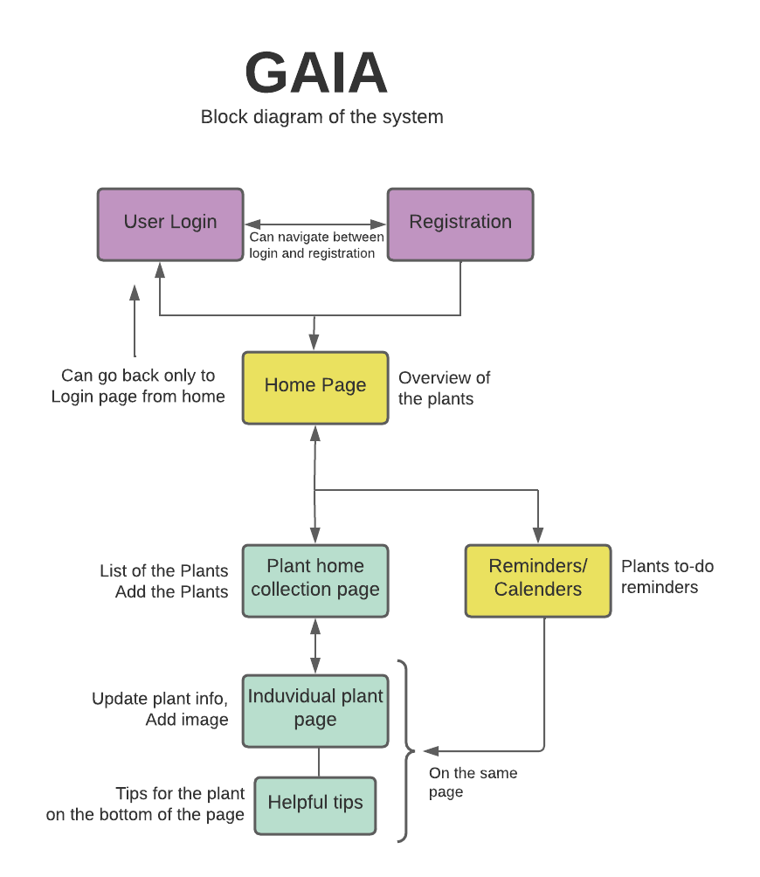

Slide 6
Technologies Used
Mapkit
Firebase
Core Data

Slide 7
Problems Encountered – How we solved it?

Slide 8
Future Directions
If we had 6 more months to further develop our App:
Add in more user settings functions.
More App themes. (Light/dark)
Create an extensive plant and plant tips database
Add in plant identification based on image and name.
Add an Image gallery
GAIA

Slide 9
Conclusion
The motive of the project is to provide information about the user’s plants on how to grow them.
This Project is a start-up and can be enhanced in many ways.
With enough time and resources, we could reach new heights in plant care.

