Slide 1
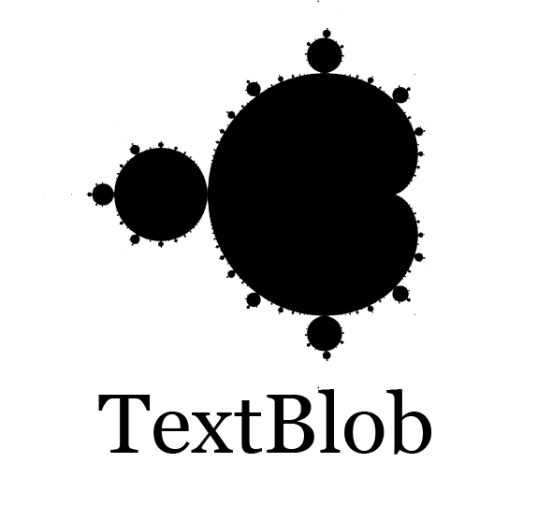
Investigation 1
Janice Lee
Metis Data Science Bootcamp
12 July 2018

Slide 2
Lightweight NLP Tool
Python Library
Easy to install and implement
Integrates well with NLTK:
Natural Language Toolkit
      (https://www.nltk.org/)

Slide 3
Features
Simplified Text Processing:
  POS Tagging
  NP Extraction
  Word frequencies
  Classification
  Translation
  Sentiment Analysis

Slide 4
Demo

