Slide 1
Visibly Connected
Visualizing Your Connection Network
Using Graph Data From Crunchbase
Casson Stallings

Slide 2
A Graph Database to Explore Connections and Relationships
Crunchbase
Edge Attributes
Title
Relationship Type
Funding Date & Amount
Mongo
Neo4j
Gephi
NetworkX
Matplotlib

Slide 3
“Said tongue in cheek but: I'm often not the most talented in any given topic but often my value is that I know who is & how to get help.”
--Mark Suster

Slide 4
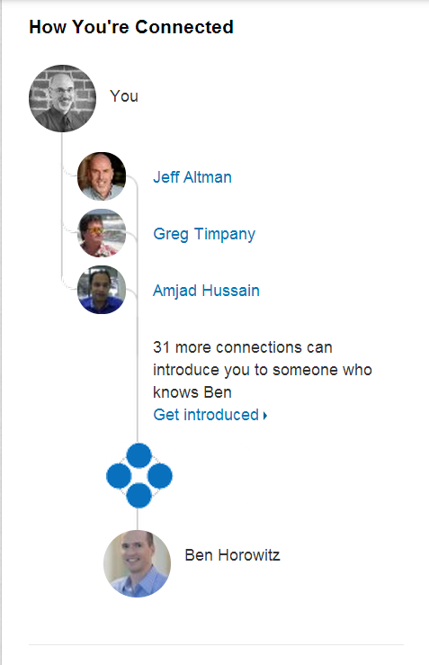

The Network View LinkedIn Gives You

Slide 5
Identify and Expose the Shortest Path

Slide 6
Identify and Expose the Shortest Path Identify Alternative Paths
6

Slide 7
Identify and Expose the Shortest Path Identify Alternative Paths Identify Relative Strengths of Relationships
7

Slide 8
Identify and Expose the Shortest Path Identify Alternative Paths Identify Relative Strengths of Relationships Interactive Investigation of Network
8

Slide 9
“venture capitalists who are better networked in the VC industry generate better outcomes”
Alexander LjungqVist
“In the non-profit world, connection is everything.”
Kathy Landau

Slide 10
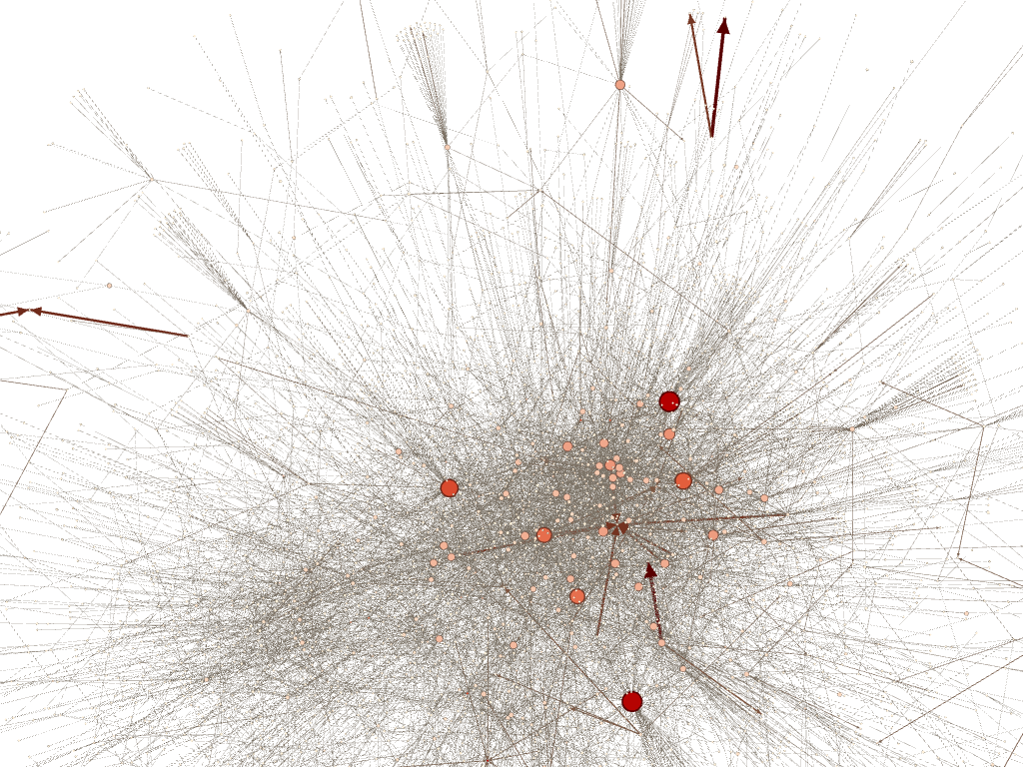
Connections within the Startup Community from Crunchbase

Slide 11
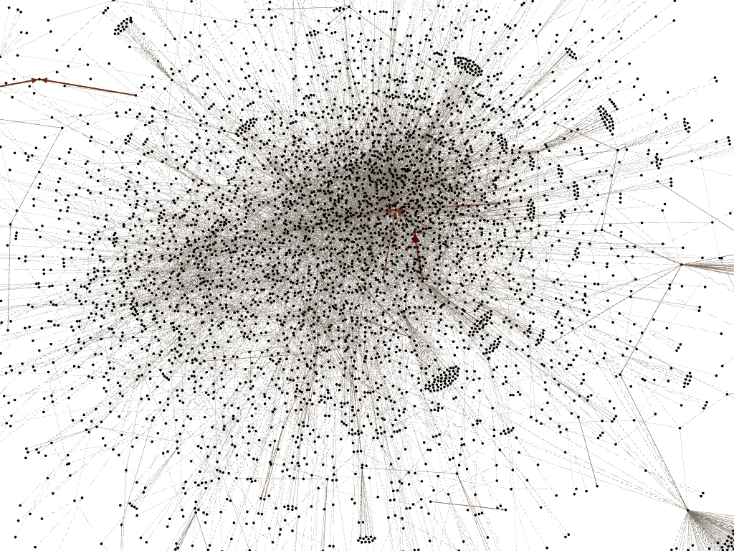

Slide 12
Unused Slides

Slide 13
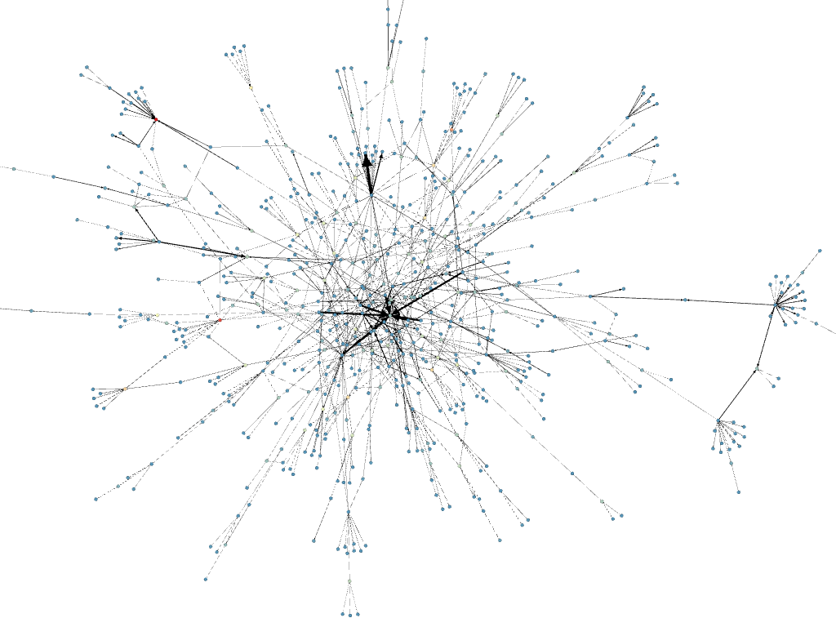

Slide 14
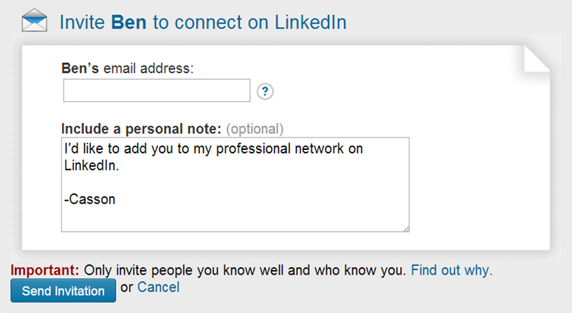

Slide 15
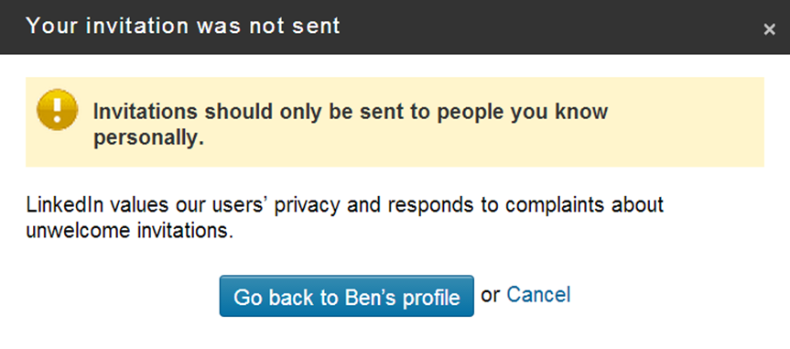
15

Slide 16
16

Slide 17
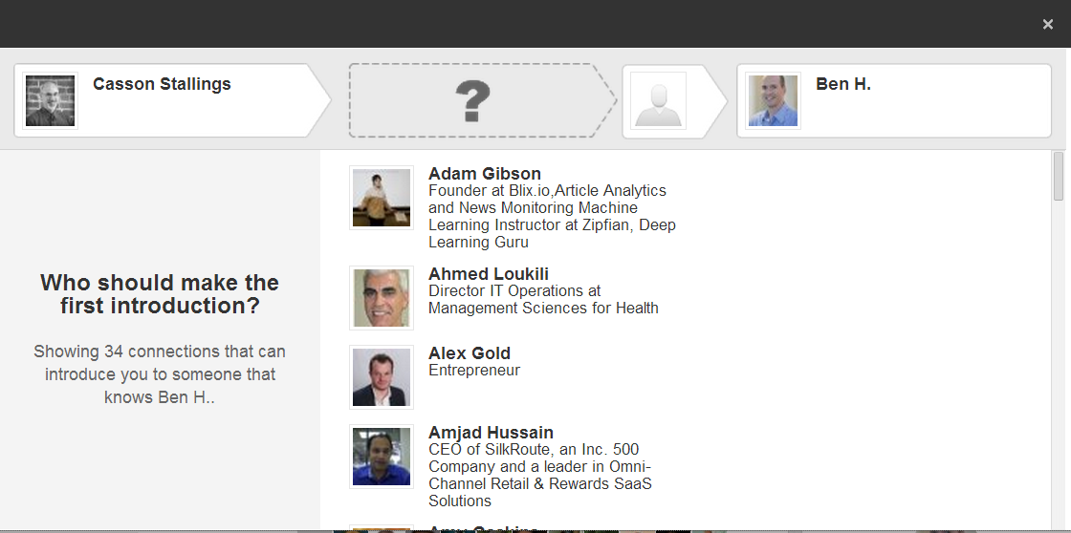
17

