Slide 1
Advanced Programming
Lab 9, Class(1)
廖琪梅，王大兴, 于仕琪，王薇

Slide 2
Topic
Class in C++
Class constructor and destructor
Static member variables and static member functions
Const member variables and const member functions
this pointer
Class, object, member variable, member function, static variable & memory Management
Class in Python vs Class in C++(1)
constructor and destructor
static
const
self
Practice

Slide 3
Class Constructors
A class constructor is a special member function:
1. Has exact same name as the class
2. No return value
3. It is a public member function of the class
4. Invoked whenever you create objects of that class
Constructors can be very useful for setting initial values for certain member variables.
If you do not provide a constructor, C++ compiler generates a default constructor (has no parameters and an empty body) for you.
Note:The constructor can be overloaded, be careful the constructor with default arguments.

Slide 4
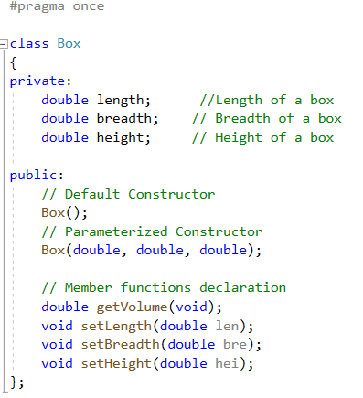
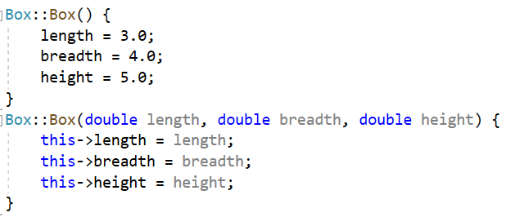
Implementation of functions using the scope resolution operator(::)
“this” is a pointer points to the object itself

Slide 5
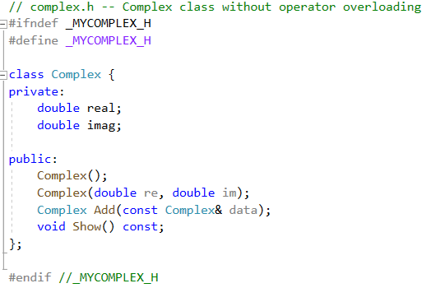
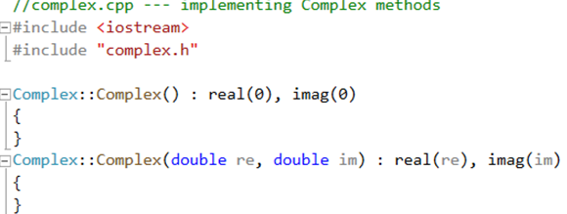
initialization list
The member initialization list is set off from the parameter list by a colon. It is a comma-separated list in which the value to be assigned the member is placed in parentheses following the member's name.
The member initialization list is used primarily to pass arguments to member class object constructors.

Slide 6
Default constructor
A default constructor is a constructor that is used to create an object when you don’t provide
explicit initialization values. If you do not provide any constructors, the compiler will automatically
supplies a default constructor. It’s an implicit version of a default constructor, and it does nothing.
There is only one default constructor in a class.
If you define any constructor for a class, the compiler will not provide default constructor. You must define your own default constructor that takes no arguments.
You can define a default constructor two ways. One is to provide default values for all the arguments to the existing constructor:
Box(double len = 1.0, double bre = 1.0, double hei = 1.0);
The second is to use function overloading to define a second constructor that has no arguments:
Box( );
NOTE: You can have only one default constructor, so be sure that you don’t do both.

Slide 7


Creating objects
When you create an object, the constructor will be invoked automatically. If you define default constructor, you can declare object variables without initializing them explicitly.
You shouldn’t be misled by implicit form of the non-default constructor.
second() is a function that returns a Box object.
When you implicitly call the default constructor, do not use parentheses.

Slide 8
Class Destructors
A class destructor is also a special member function:
1.A destructor name is the same as the classname but begins with tilde(~) sign.
2. Destructor has no return value.
3. A destructor has no arguments.
4. There can be only one destructor in a class.
5. The compiler always creates a default destructor if you fail to provide one for a class.
6. Invoke when an object goes out of scope or the delete is applied to a pointer to the object.
Destructor can be very useful for releasing resource before coming out of the program like closing files, releasing memories etc.
Note:The destructor can not be overloaded.

Slide 9
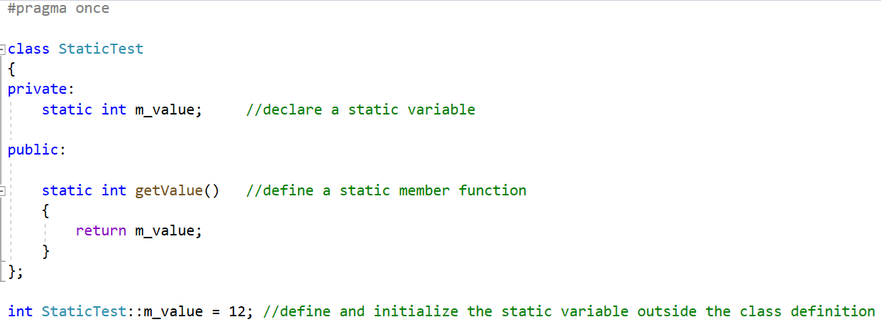
Static member variables
The static member variables in a class are shared by all the class objects as there is only one copy of them in the memory, regardless of the number of objects of the class.You must provide an explicit definition of that instance within a program text file. The definition looks like the global definition of an object except that its name is qualified with the class scope operator ::
static member variable can not be initialized when it is defined
static member variable must be initialized outside the class definition

Slide 10
Static member functions
A static member function can be invoked independently of a class object in exactly this way. A member function can be declared as static only if it does not access any non-static class members. We make it static by prefacing its declaration within the class definition with the keyword static
Define a static member function

Slide 11
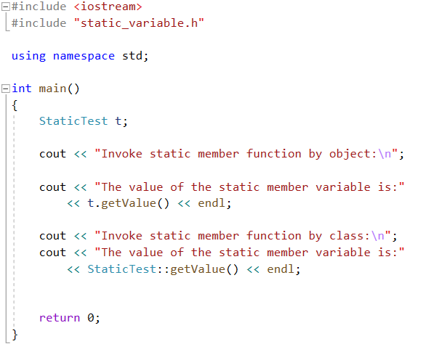
You can use object or class to access the static members.

Slide 12
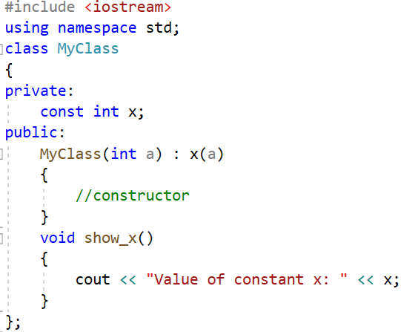
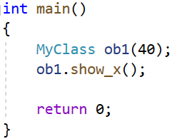
Const member variables
The const keyword specifies that a variable’s value is constant and tells the compiler to prevent the programmer from modifying it. If some member variables need not be modified, these variables can be defined as const. These const member variables can be initialized by initialization list in the constructor.
const member variable
Initialize the const member variable by initialization list
Create an object of MyClass, initialize the
value of x 40.

Slide 13
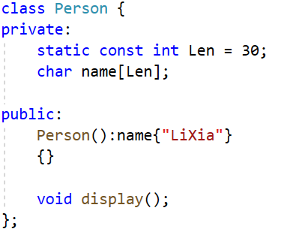
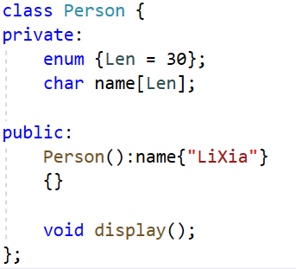
Const member variables
static const member variable can be initialized when it is defined
Define an enumeration

Slide 14
Const member functions
The const modifier follows the parameter list of the function, such function is called const member function. const indicates that the data of the class would not be modified by the function.
A const member function defined outside the class body must specify the const modifier in both its declaration and definition.

Slide 15

Const member functions

Slide 16
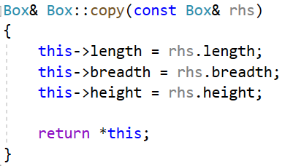
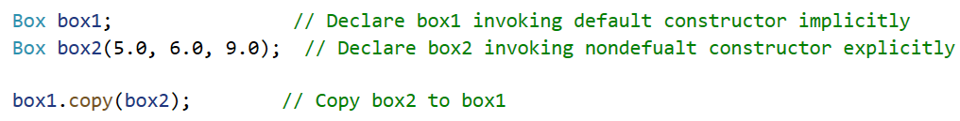
this pointer
There’s only one copy of each class’s functionality, but there can be many objects
of a class. Every object has access to its own address through a pointer called this.
The this pointer is passed(by the compiler) as an implicit argument to each of the
object’s non-static member functions.
Within a member function, the this pointer addresses the class object that invokes the member function. In our example, box1 is addressed by the this pointer.
Inside a class member function, the this pointer provides access to the class object through which the member function is invoked. To return box1 from within copy(), we simply dereference the this pointer.

Slide 17
Class in C++ vs Class in Python(1)
Similarities:
Support for classes and objects: Both can define classes and create object instances.
Encapsulation: Binding data (properties) and methods (functions) through classes.
Inheritance and polymorphism: Supports single inheritance, multiple inheritance, and method override.
Difference:
features | C++ | Python
Access Control, Encapsulation | Control member access through public, private, and protected | Without strict access control, privacy is simulated through naming conventions such as _ or __.
Constructors, Destructor | Explicitly define the constructor (with the same name as the class) and destructor (~ClassName), with controllable memory release. | Use the __init__ constructor and __del__ destructor, but the __del__ call is determined by garbage collection.
Method invocation ,self/this | Implicit use of ‘this’ pointer without explicit declaration | The method needs to explicitly declare the self parameter to represent the object itself
Static methods, class methods | Directly declare static member functions | Use @ staticmmethod or @ classmethod decorators
Dynamics, Metaprogramming | The class structure is fixed at compile time and cannot be dynamically modified | Classes and objects can be dynamically modified (such as adding methods at runtime)

Slide 18
Demo(1)
#include <iostream> //C++ Code
#include <cstring>
using namespace std;
class vsdemo{
private:
const int length;
char *name;
static int classId;
public:
vsdemo(int len,char* nm):length(len){
name=new char[length];
if(NULL!=name){
strncpy(name,nm,length-1);
name[length-1]='\0';
}
}
~vsdemo(){
if(NULL!=name){
delete[](name);
cout<<"~vsdemo"<<endl;
}
}
void disObj(){
cout<<"Ojb address: "<<this
<<", length:"<<length<<", name: "<<name<<endl;
}
static void displayClassId(){
cout<<"classId: "<<classId<<endl;
}
};
int vsdemo::classId=2025;
int main(){
char tdata[14]="SUSTECH_CS219";
vsdemo vsd1(sizeof(tdata),tdata);
vsdemo::displayClassId();
vsd1.disObj();
return 0;
}
class VSDemo: """Python code"""
class_id=2025
def __init__(self, length: int, nm: str):
self._length=length
self.name= (nm[:length-1] +'\0').ljust(length, '\0')[:length]
@property
def length(self):
return self._length
def __del__(self):
print("~vsdemo")
def dis_obj(self):
print(f"Obj address: {hex(id(self))}, length: {self.length}, name: {self.name.split(chr(0))!r}")
@classmethod
def display_class_id(cls):
print(f"classId: {cls.class_id}")
if__name__=="__main__":
tdata = "SUSTECH_CS219"
vsd1 = VSDemo(len(tdata) +1, tdata)
VSDemo.display_class_id()
vsd1.dis_obj()
Python代码有部分待修改

Slide 19
Demo(2)
class variables here worked as static member variables in C++
class VSDemo: """Python code"""
class_id=2025
def __init__(self, length: int, nm: str):
self._length=length
self.name= (nm[:length-1] +'\0').ljust(length, '\0')[:length]
@property
def length(self):
return self._length
def __del__(self):
print("~vsdemo")
def dis_obj(self):
print(f"Obj address: {hex(id(self))}, length: {self.length}, name: {self.name.split(chr(0))!r}")
@classmethod
def display_class_id(cls):
print(f"classId: {cls.class_id}")
Constructor, Member variable
Read only property here work as const members in C++
Deconstructor
member function
Class methods here work as static methods in C++

Slide 20
#include<iostream>
using namespace std;
class Demo
{
private:
int id;
void display(){
cout<<"this is: "<<this<<", id is:"<<this->id<<endl;
}
public :
Demo(int cid){
this->id=cid;
}
static int num;
void display()
{
cout<<"The value of the static num is: "<<num<<endl;
}
};
int main()
{
Demo obj;
Demo obj1(1);
obj.display();
obj1.display();
Demo::display();
return 0;
}
Exercises1
1. Can the program below be run successfully?
Why?
2. Modify the program to： 2-1) fix the grammer error.
2-2) make the function invoked by object to display the value of “this” pointer and variable “id”.
2-3) make the function invoked by class to display the value of static variable “num”.
You need to explain the reason to a SA to pass the test.
int main()
{
Demo obj;
obj.display();
return 0;
}

Slide 21
Exercises2
What is the result of the program below? What happens if you uncomment the commented line in function main()? Why? You need to explain the reason to a SA to pass the test. 考虑下是否可以加入析构函数（+涉及到内存）
#include <iostream>
using namespace std;
class ConstMember
{
private:
const int m_a;
public:
ConstMember(int a) : m_a(a) {}
void display() const
{
cout << "The value of the const member variable m_a is: " << m_a << endl;
} };
int main()
{
ConstMember o1{666};
ConstMember o2{42};
o1.display();
o2.display();
// o1 = o2;
return 0;
}

Slide 22
Exercises3
Define a class called Complex for performing arithmetic with complex numbers. Write a program to test your class. Complex numbers have the form
realPart + imaginaryPart * i
Use two member variables to represent the private data of the class. Provide a constructor that enables an object of this class to be initialized when it’s declared. The constructor should contain default values in case no initializers are provided. Provide public member functions that perform the following tasks:

Slide 23
a) add—Adds two Complex numbers: The real parts are added together and the imaginary parts are added together.
b) subtract—Subtracts two Complex numbers: The real part of the right operand is subtracted from the real part of the left operand, and the imaginary part of the right operand is subtracted from the imaginary part of the left operand.
c) display—Displays a Complex number in the form of a + bi or a - bi, where a is the real part and b is the imaginary part.
Tip: If a member function does not modify the member variables, define it as const member function.

