Slide 1
Advanced Programming
Lab 12, class inheritance & polymorphism
廖琪梅，王大兴，于仕琪，王薇

Slide 2
Topic
class inheritance & polymorphism in C++
Class inheritance
Polymorphism (virtual function)
Inheritance and dynamic memory allocation
class inheritance & polymorphism in Python
Public inheritance, explicit call, dynamic resource management
Duck Type

Slide 3
Class inheritance
Inheritance syntax:
class derived_class_name : access_mode base_class_name
{
// body of subclass
};
Subclass,Derived class, Child class
public, protected, private
Base class, Super class, Parent class
Public inheritance represents an is-a relationship, it means every derived-class object is an object of its base class.
If you do not provide a copy constructor or an assignment operator for the base class and the
derived class, the compiler will generate a copy constructor and assignment operator for both
of them respectively.

Slide 4
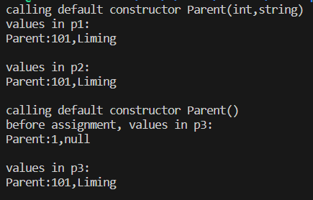
Default copy constructor and assignment operator
If no copy constructor or an assignment operator are designed for the class, the compiler will generate a copy constructor and assignment operator for the class.
class Parent{
private:
int id;
string name;
public:
Parent():id(1),name("null"){
cout<<"calling default constructor Parent()\n";
}
Parent(int i, string n):id(i),name(n){
cout<<"calling default constructor Parent(int,string)\n";
}
friend ostream& operator<<(ostream& os, const Parent& p){
return os<<"Parent:"<<p.id<<","<<p.name<<endl;
}
};
int main(){
Parent p1(101,"Liming");
cout<<"values in p1:\n"<<p1<<endl;
Parent p2(p1);
cout<<"values in p2:\n"<<p2<<endl;
Parent p3;
cout<<"before assignment, values in p3:\n"<<p3<<endl;
p3=p2;
cout<<"values in p3:\n"<<p3<<endl;
return 0;
}
The behavior of the default copy constructor and overloaded assignment operator generated by the compiler is:
No extra information printed, assign the attribute values in the rhs object to the target object's attributes.

Slide 5
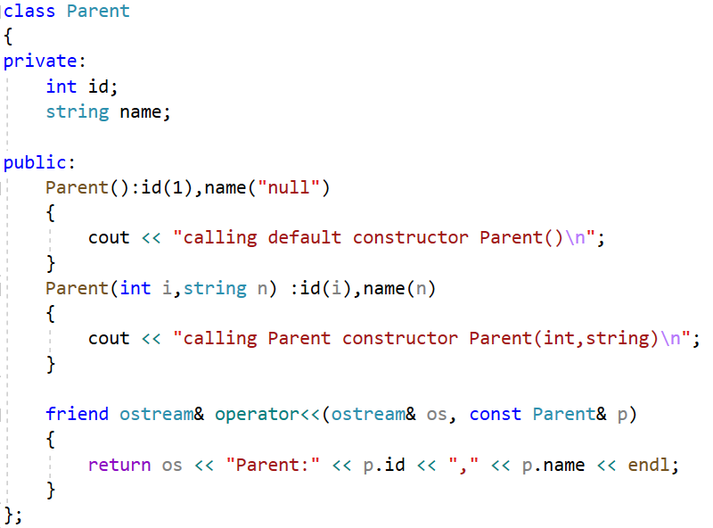
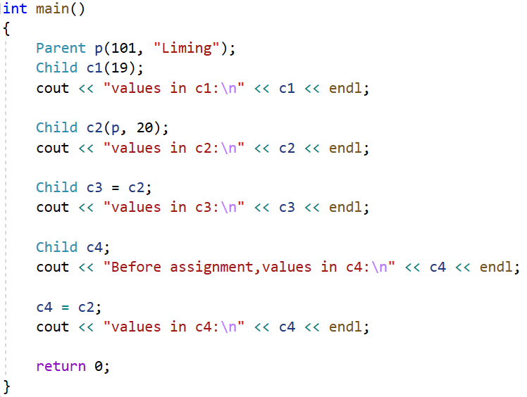
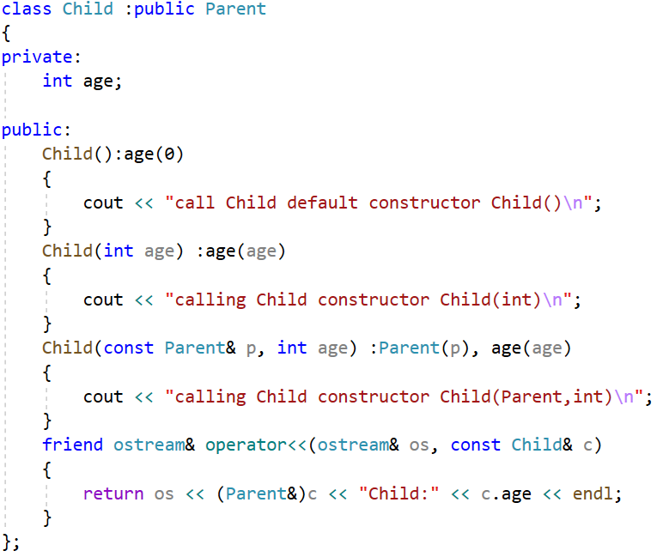
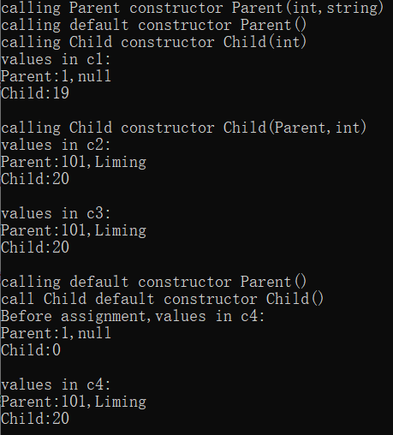
Call Child copy constructor
If no copy constructor or assignment operator provided for the base class and the
derived class,
the compiler will generate a copy constructor and assignment operator for both
of them respectively.
Call Child assignment operator
The derived class will call the default constructor of the base class
to initialize the data members.
Call Parent copy constructor

Slide 6
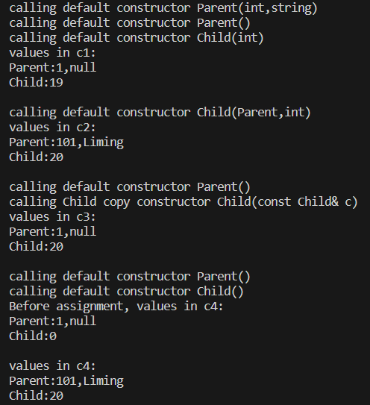
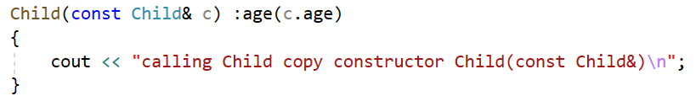
Copy Constructor of Child(1): without initializing the base class component.
Define copy constructor of Child without initializing the base class component.
int main(){
Parent p(101,"Liming");
Child c1(19);
cout<<"values in c1:\n"<<c1<<endl;
Child c2(p,20);
cout<<"values in c2:\n"<<c2<<endl;
Child c3(c2);
cout<<"values in c3:\n"<<c3<<endl;
Child c4;
cout<<"Before assignment, values in c4:\n"<<c4<<endl;
c4=c2;
cout<<"values in c4:\n"<<c4<<endl;
return 0;
}
without initializing the base class component

Slide 7
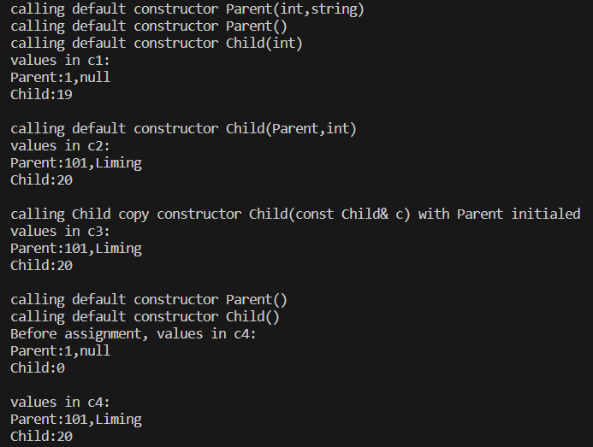
Copy Constructor of Child(2) : with initializing the base class component.
Define copy constructor of Child with initializing the base class component.
Child(const Child& c):Parent(c),age(c.age){
cout<<"calling Child copy constructor Child(const Child& c) with Parent initialed\n";
}
int main(){
Parent p(101,"Liming");
Child c1(19);
cout<<"values in c1:\n"<<c1<<endl;
Child c2(p,20);
cout<<"values in c2:\n"<<c2<<endl;
Child c3(c2);
cout<<"values in c3:\n"<<c3<<endl;
Child c4;
cout<<"Before assignment, values in c4:\n"<<c4<<endl;
c4=c2;
cout<<"values in c4:\n"<<c4<<endl;
return 0;
}
initializing the base class component

Slide 8
Note:
When creating an object of a derived class, a program first calls the base-class constructor and then calls the derived-class constructor. The base-class constructor is responsible for initializing the inherited data member. The derived-class constructor is responsible for initializing any added data members. A derived-class constructor always calls a base-class constructor.
To destroy an derived class object, the program first calls the derived-class destructor and then calls the base-class destructor. That is, destroying an object occurs in the opposite order used to constructor an object.

Slide 9
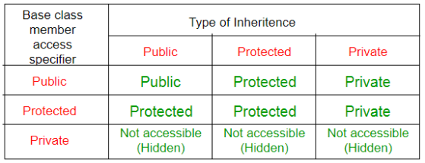
The table below shows the access specifier of the members of base class in the sub class when derived in public, protected and private modes:
In a base class definition, if a member declared as protected can be directly accessed by the derived classes but cannot be directly accessed by the general program.

Slide 10
Polymorphism
Polymorphism is one of the most important feature of object-oriented programming. Polymorphism works on object pointers and references using so-called dynamic binding at run-time. It does not work on regular objects, which uses static binding during the compile-time.
There are two key mechanisms for implementing polymorphic public inheritance:
1. Redefining base-class methods in a derived class
2. Using virtual methods

Slide 11
Polymorphism - demo
derived class
base class
#include<iostream>
#include<string>
using namespace std;
class Employee{
private:
string name;
string ssn;
public:
Employee(const string& n, const string& s): name(n),ssn(s){
cout<<"The base class constructor is invoked."<<endl;
}
~Employee(){
cout<<"The base class destructor is invoked."<<endl;
}
string getName() const { return name;}
string getSSN() const { return ssn; }
void setName(const string& n){ name=n; }
void setSSN(const string& s) { ssn=s; }
double earning(){ return 0; }
virtual void show(){
cout<<"Name is:"<<name<<", SSN number is: "<<ssn<<endl;
}
};
class SalariedEmployee : public Employee{
private:
double salary;
public:
SalariedEmployee(const string& name, const string& ssn, double s):
Employee(name,ssn),salary(s){
cout<<"The derived calss constructor is invoked."<<endl;
}
~SalariedEmployee(){
cout<<"The derived class destructor is invoked."<<endl;
}
SalariedEmployee(const Employee& e, double s):Employee(e), salary(s){ }
double getSalary()const { return salary; }
void setSalary(doubles) { salary=s; }
double earning(){ return getSalary();}
void show(){
cout<<"Name is:"<<getName()<<", SSN number is: "
<<getSSN()<<", salary is:"<<salary<<endl;
}
};
base class
base class
If the access specifier is protected,
the derived class can access the data
If the access specifier is protected,
the derived class can access the data
If the keyword virtual used, the program choose a method based on the type of object the reference or pointer refers to rather than based on the reference type or
pointer type.
invoke base class method in derived class to get the name and snn
override the function show() in SalariedEmployee

Slide 12
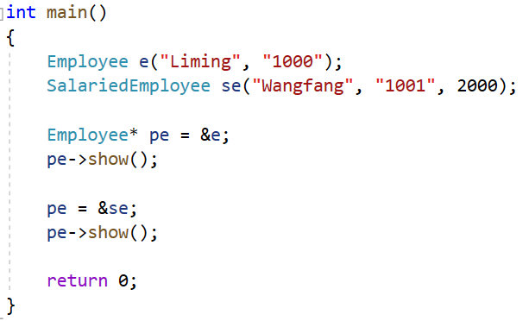
The pointer type of pe is Employee, it points to a different object respectively,
and invokes different objects’ show() functions. This is polymorphism.

Slide 13
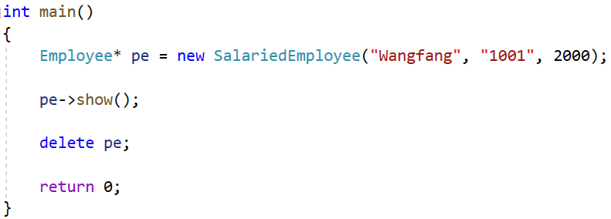

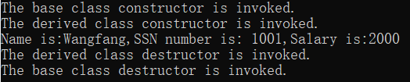
Destructors: not virtual vs virtual
class Employee{
private:
string name;
string ssn;
public:
~Employee(){
cout<<"The base class destructor is invoked."<<endl;
//
}
If the destructors is not virtual, the delete statement invokes the ~Employee() destructor.
This frees memory pointed to by the Employee component of the SalariedEmployee object not memory pointed to by SalariedEmployee component.
If the destructor is virtual, the same code invokes the ~SalariedEmployee() destructor, which frees memory pointed to by the SalariedEmployee component, and then calls the ~Employee() destructor to free memory pointed to by the Employee component.
class Employee{
private:
string name;
string ssn;
public:
virtual ~Employee(){
cout<<"The base class destructor is invoked."<<endl;
//
}

Slide 14
Inheritance and Dynamic Memory Allocation
If a base class uses dynamic memory allocation and redefines assignment operator and a copy constructor, how does that affect the implementation of the derived class? The answer depends on the nature of the derived class.
If the derived class does not itself use dynamic memory allocation, you needn’t
take any special steps.
If the derived class does use new to allocate memory, you do have to define an explicit destructor, copy constructor, and assignment operator for the derived class.

Slide 15
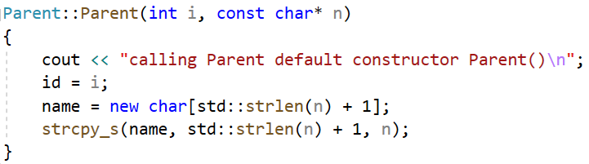
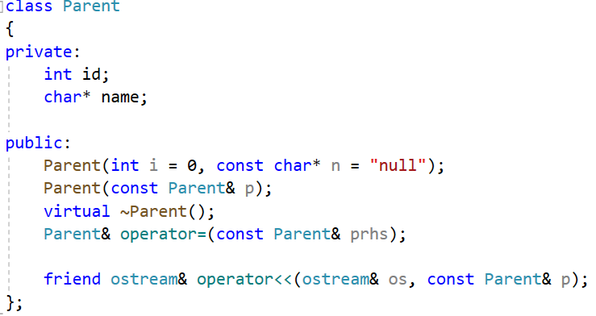
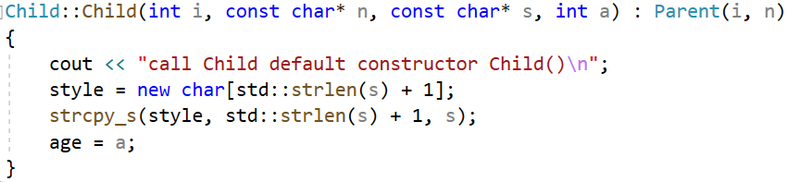
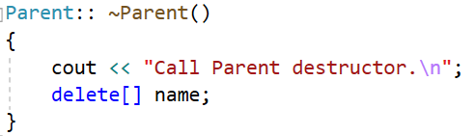
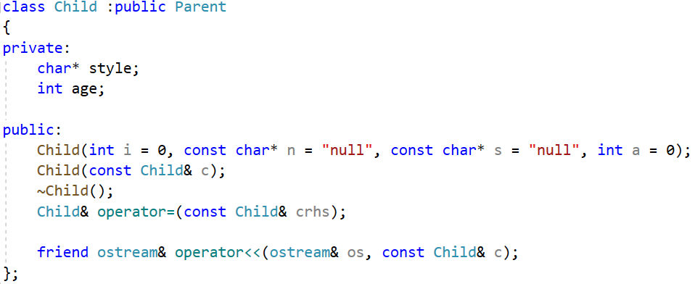
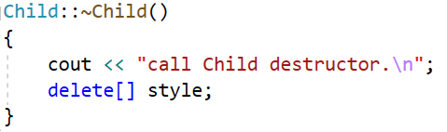
base class constructor
base class
derived class constructor
derived class
The data fields both in the base class
and the derived class hold pointers,
which indicate they would use dynamic
memory allocation.
A derived class destructor automatically calls the base-class destructor, so its own responsibility is to clean up after what the derived-class destructors do.

Slide 16
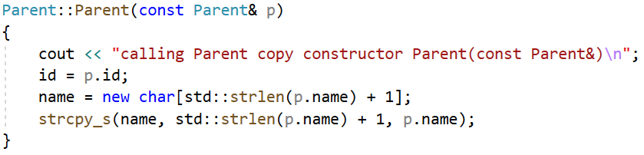
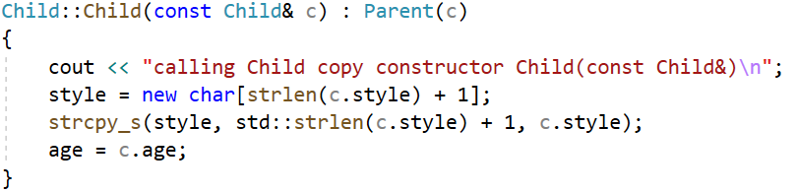
Consider copy constructor:
the base-class copy constructor
The derived class copy constructor can only accesses to its own
data, so it must invoke the base-class copy constructor to handle
the base-class share of the data.
The member initialization list passes a Child reference to a Parent constructor.
The Parent copy constructor has a Parent reference parameter, and a base class reference
can refer to a derived type. Thus, the Parent copy constructor uses the Parent portion of the
Child argument to constructor the Parent portion of the new object.

Slide 17
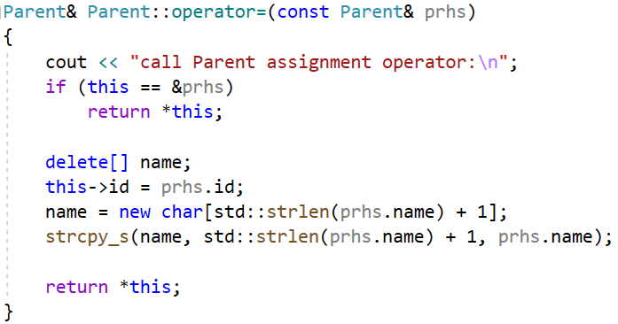
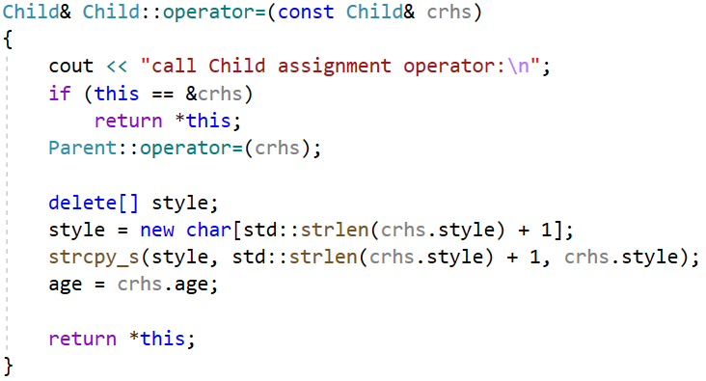
Consider assignment operators:
the Parent assignment operator
Because Child uses dynamic memory allocation,
it needs an explicit assignment operator. Being a
Child method, it only has direct access to its own
data.
An explicit assignment operator for a derived class also has to take care of assignment for the
inherited base class Parent object. You can accomplish this by explicitly calling the base class
assignment operator.

Slide 18
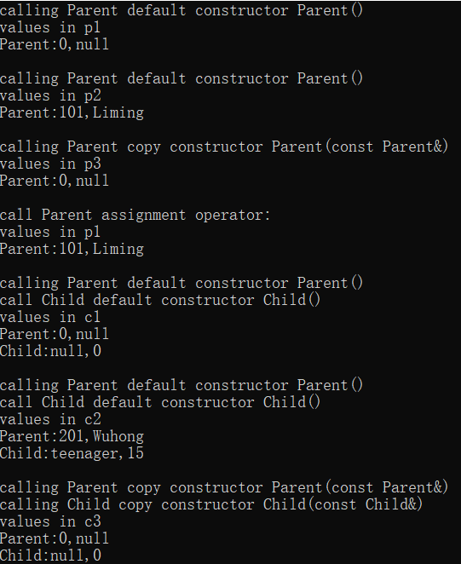
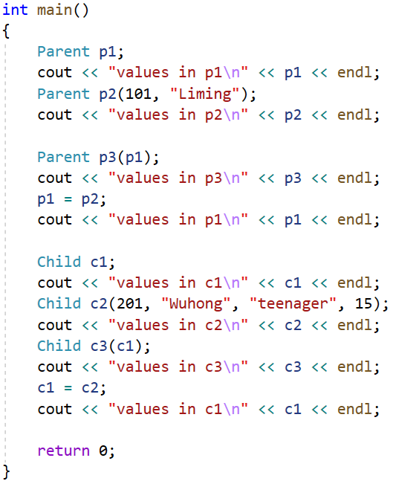
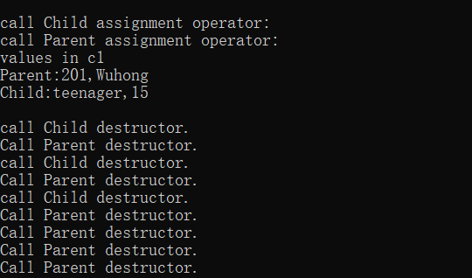
Three child objects
Three parent objects

Slide 19
class inheritance in Python(1)
1. Inheritance in Python is public inheritance, providing flexible data access
2. The inheritance mechanism in Python is explicit and requires calling the constructor of the parent class during initialization, which can be implemented through super()
3. Assignment in Python is usually a reference, and deep copy requires the deepcopy method of the copy module
4. Python does not allow overloading operator, using method instead( assign, __str__ here)
class Child(Parent):
def __init__(self, i=0, n="null", s="null", a=0):
super().__init__(i, n)
print("call Child default constructor Child()")
self.style=s
self.age=a
def __deepcopy__(self, memo):
print("calling Child copy constructor Child(const Child&)")
new_obj=self.__class__(self.id, self.name, self.style, self.age)
memo[id(self)] =new_obj
return new_obj
def assign(self, other):
print("call Child assignment operator:")
if self is other:
return self
super().assign(other)
self.style=other.style
self.age=other.age
return self
def __del__(self):
super().__del__()
print("call Child destructor.")
def __str__(self):
parent_str=super().__str__()
return f"{parent_str}Child:{self.style}, {self.age}\n"
import copy
class Parent:
def __init__(self, i=0, n="null"):
print("calling Parent default constructor Parent()")
self.id=i
self.name=n
def __deepcopy__ (self, memo):
print("calling Parent copy constructor Parent(const Parent&)")
new_obj=self.__class__(self.id, self.name)
memo[id(self)] =new_obj
return new_obj
def assign(self, other):
print("call Parent assignment operator:")
if self is other:
return self
self.id=other.id
self.name=other.name
return self
def __del__(self):
print("call Parent destructor.")
def __str__(self):
return f"Parent:{self.id}, {self.name}\n"

Slide 20
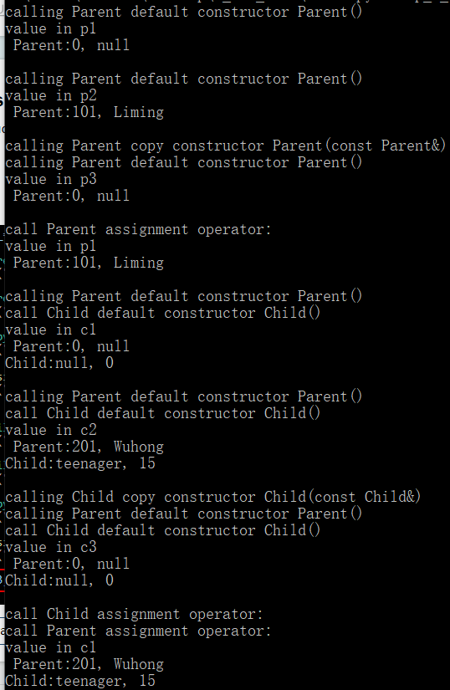
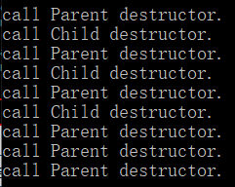
class inheritance in Python(2)
5. Destructors in Python rely on garbage collection mechanisms.
6. Rewriting __del__ requires caution and attention to potential memory risks.
if__name__=="__main__":
p1=Parent()
print("value in p1\n", p1)
p2=Parent(101, "Liming")
print("value in p2\n", p2)
p3=copy.deepcopy(p1)
print("value in p3\n", p3)
p1.assign(p2)
print("value in p1\n", p1)
c1=Child()
print("value in c1\n", c1)
c2=Child(201, "Wuhong", "teenager", 15)
print("value in c2\n", c2)
c3=copy.deepcopy(c1)
print("value in c3\n", c3)
c1.assign(c2)
print("value in c1\n", c1)
del c3, c2, c1, p3, p2, p1
Three child objects
Three parent objects
Python garbage collection timing uncertain, manually triggering decomposition here.

Slide 21

Duck type in Python
Polymorphism: allowing different objects of the same class to exhibit different behaviors towards the same method name.
Duck type in Python: focuses on the behavior of objects (whether methods or properties exist), rather than their specific types or inheritance relationships.
For example, as long as an object has a speak() method, it can be called uniformly, regardless of whether it inherits from the same parent class or not.
class Animal:
def __init__(self, name):
self.name=name
class Duck(Animal):
def __init__(self, name):
super(Duck, self).__init__(name)
def Speak(self):
print(self.name, ' Quack')
class Dog(Animal):
def __init__(self, name):
super(Dog, self).__init__(name)
def Speak(self):
print(self.name, ' Quack')
class Robot:
def __init__(self, name):
self.name=name
def Speak(self):
print(self.name, 'Beep')
def testSpeak(duck):
duck.Speak()
if __name__ == "__main__":
duck=Duck('Tommy')
dog=Dog('Fox')
robot=Robot('Wall-E')
testSpeak(duck)
testSpeak(dog)
testSpeak(robot)

Slide 22
Exercise:
1. Please find the errors of the following code and explain why to SA.
class Base
{
private:
int x;
protected:
int y;
public:
int z;
void funBase (Base& b)
{
++x;
++y;
++z;
++b.x;
++b.y;
++b.z;
}
};
class Derived:public Base
{
public:
void funDerived (Base& b, Derived& d)
{
++x;
++y;
++z;
++b.x;
++b.y;
++b.z;
++d.x;
++d.y;
++d.z;
}
};
void fun(Base& b, Derived& d)
{
++x;
++y;
++z;
++b.x;
++b.y;
++b.z;
++d.x;
++d.y;
++d.z;
}

Slide 23
Exercise:
2. Run the following program, and explain the result to SA.
int main ()
{
Rectangle rect;
Triangle trgl;
Polygon * ppoly1 = &rect;
Polygon * ppoly2 = &trgl;
ppoly1->set_values (4,5);
ppoly2->set_values (2,5);
cout << rect.area() << endl;
cout << trgl.area() << endl;
cout << ppoly1->area() << endl;
cout << ppoly2->area() << endl;
return 0;
}
#include <iostream>
using namespace std;
class Polygon
{
protected:
int width, height;
public:
void set_values (int a, int b)
{ width=a; height=b; }
int area()
{ return 0;}
};
class Rectangle: public Polygon
{
public:
int area()
{ return width * height; }
};
class Triangle: public Polygon
{
public:
int area()
{ return width*height/2; }
};

Slide 24
Exercise:
3. Run the following program, and explain the result to SA. Is there any problem in the program?
class Rectangle: public Polygon
{
public:
Rectangle(int a,int b) : Polygon(a,b) {}
int area()
{ return width*height; }
};
class Triangle: public Polygon
{
public:
Triangle(int a,int b) : Polygon(a,b) {}
int area()
{ return width*height/2; }
};
// dynamic allocation and polymorphism
#include <iostream>
using namespace std;
class Polygon
{
protected:
int width, height;
public:
Polygon (int a, int b) : width(a), height(b) {}
virtual int area (void) =0;
void printarea()
{ cout << this->area() << '\n'; }
};
int main ()
{
Polygon * ppoly = new Rectangle (4,5);
ppoly->printarea();
ppoly = new Triangle (2,5);
ppoly->printarea();
return 0;
}

Slide 25
Exercise:
4. Write a simple “Hello world” program, compile and run it.

