Slide 1
Advanced Programming
Lab 4, CMake, Inputs, Data Storage
廖琪梅, 王大兴, 于仕琪, 王薇

Slide 2
topics
1. CMake
2. Inputs
Command-Line Arguments
Standard Input
3. data storage
array, string, struct, union
big-endian vs little-endian
4. pracitce

Slide 3

What is CMake?
CMake is an open-source, cross-platform family of tools designed to build, test and package software. CMake is used to control the software compilation process using simple platform and compiler independent configuration files, and generate native makefiles and workspaces that can be used in the compiler environment of your choice.
For more information https://cmake.org/

Slide 4
CMake needs CMakeLists.txt to run properly.
A CMakeLists.txt consists of commands , comments and spaces.
The commands include command name, brackets and parameters ,
the parameters are separated by spaces. Commands are not case sensitive.
Comments begins with ‘#’.
Steps for generating a makefile and compiling on Linux using CMake:
Step1: Writes the CMake configuration file CMakeLists.txt.
Step2: Executes the command cmake PATH to generate the Makefile.
(PATH is the directory where the CMakeLists.txt resides.)
Step3: Compiles using the make command.

Slide 5
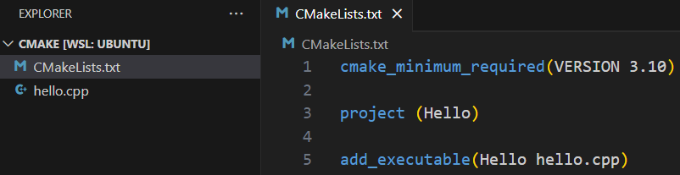
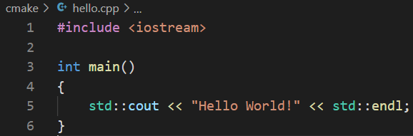
1. A single source file in a project
The most basic project is an executable built from source code files. For simple projects, a three-line CMakeLists.txt file is all that is required.
Specifies the minimum
required version of CMake.
Use cmake --version in Vscode terminal window to check the cmake version in your computer.
Defines the project
name.
Adds the Hello executable
target which will be built
from hello.cpp.
The first parameter indicates the filename of executable file.
The second parameter indicates the source file.
Suppose there is a hello.cpp
Stores the CMakeLists.txt file in the same directory as the hello.cpp.

Slide 6

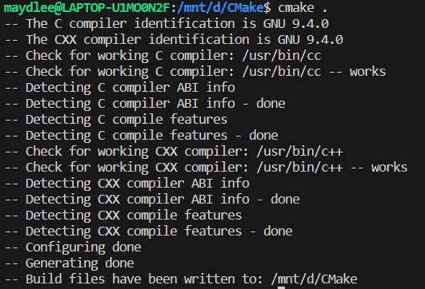
In current directory, type cmake . to generate makefile. If cmake does not be installed, follow the instruction to install cmake.
Install cmake first by instruction
Run cmake to generate makefle, . indicates the CMakeList.txt is in the current directory.
Makefile file is created automatically after running cmake in the current directory. Except Makefile, there are other new files and folders.

Slide 7
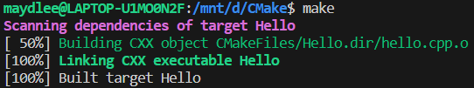
Execute make to compile the program.
Run the program

Slide 8
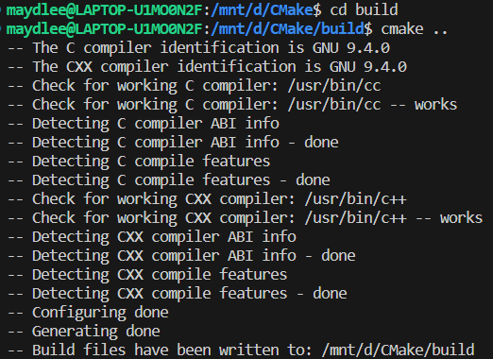
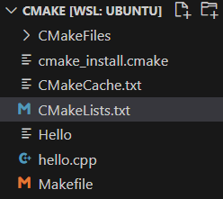
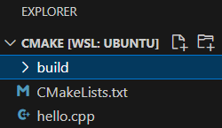
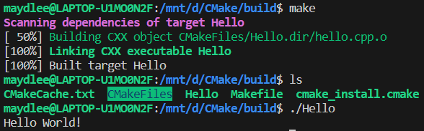
Deletes all the building files and directory by CMake.
Creates an empty folder to store the building files and directory by CMake.

Slide 9
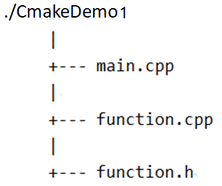
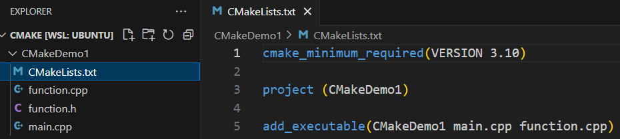
2. Multi-source files in a project
There are three files in the same directory.
List all the source files using space as the separator.

Slide 10
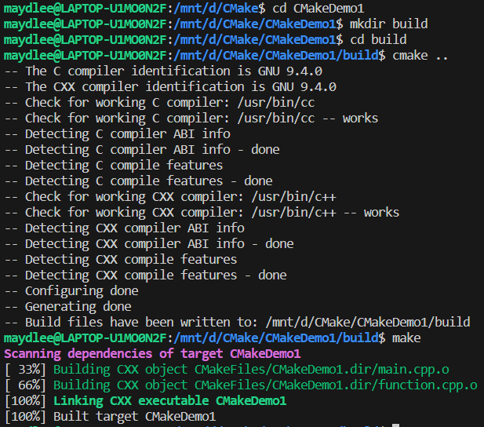
Creates a folder

Slide 11
2. Multi-source files in a project-1
If there are several files in directory, put each file into the add_executable command is not recommended. The better way is using aux_source_directory command.
aux_source_directory (<dir> <variable>)
The command finds all the source files in the specified directory indicated by <dir> and stores the results in the specified variable indicated by <variable>.

Slide 12
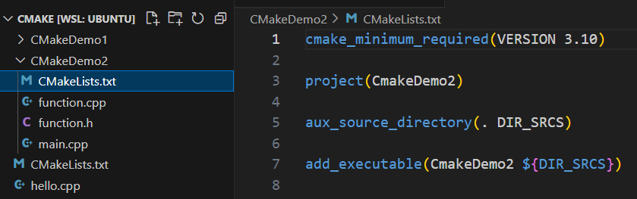
2. Multi-source files in a project-2
Stores all files in the current directory
into DIR_SRCS variable.
Compiles the source files in the variable by ${ } into an executable file named CmakeDemo2

Slide 13


Slide 14
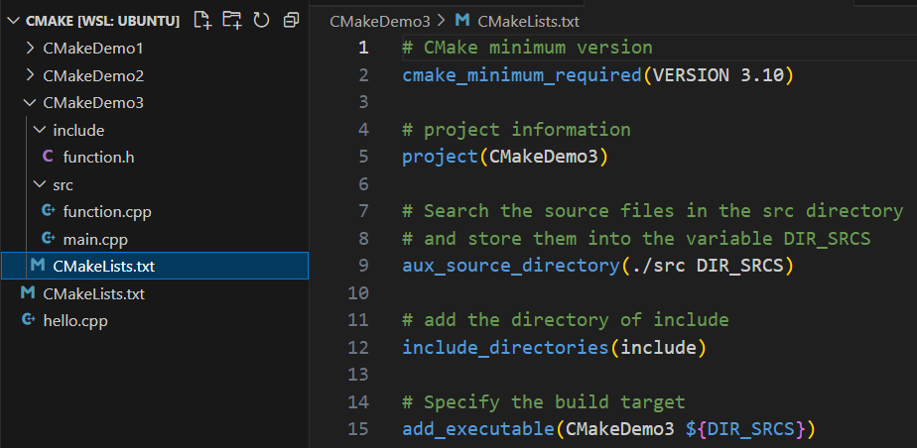
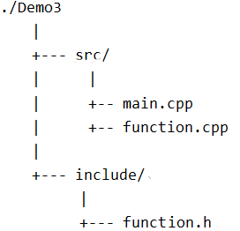
3. Multi-source files in a project in different directories
We write CMakeLists.txt in CmakeDemo3 folder.
./CMakeDemo3
All .cpp files are in the src directory
Include the header file which is stored in
include directory.

Slide 15
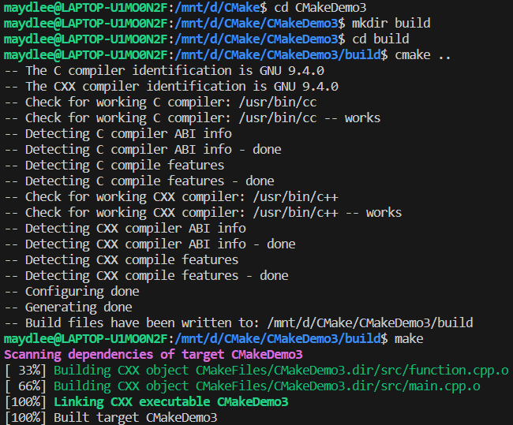
For more cmake tutorial:
https://cmake.org/cmake/help/latest/guide/tutorial/index.html
https://riptutorial.com/cmake

Slide 16
2. Inputs
2. Inputs
2.1 Command-Line Arguments
int main(int argc, char*argv[])
2.2 Standard Input
2.2.1 C style：scanf, gets vs fgets
2.2.2 C++ style: cin, cin.gets vs cin.getline, getline()
others inputs
file, network, GUI, database, sensor

Slide 17
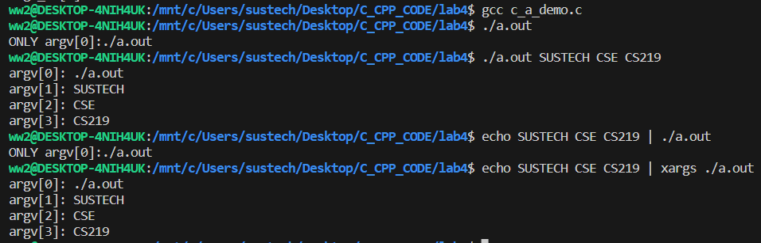
2.1 Command-Line Arguments
#include <stdio.h> // c_a_demo.c
int main(int argc, char*argv[]){
if(argc ==1)
printf("ONLY argv[0]:%s\n",argv[0]);
else
for(int i=0;i<argc;i++)
printf("argv[%d]: %s\n",i, argv[i]);
return 0;
}
At the beginning of program execution, arguments are read.
All the arguments here are treated as string.
Suitable for scenarios involving scripts and tools, but lacks interactivity.

Slide 18
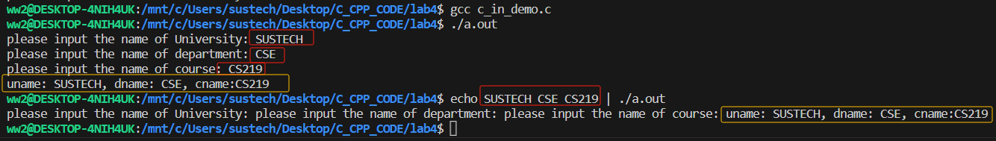
2.2 Standard Input
#include <stdio.h>
int main(int argc, char*argv[]){
char uname[10]={""};
char dname[10]={""};
char cname[10]={""};
printf("please input the name of University: ");
scanf("%s", uname);
printf("please input the name of department: ");
scanf("%s", dname);
printf("please input the name of course: ");
scanf("%s", cname);
printf("uname: %s, dname: %s, cname:%s\n",uname,dname,cname);
return 0;
}
During program execution, read input data from standard input devices.
Support different types of input data.
Suitable for interacting with users.

Slide 19
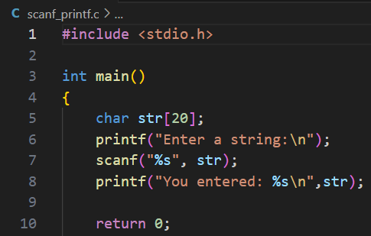
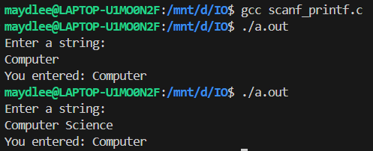
2.2.1 C style function about Standard Input processing
1-1. C: scanf
%d ----int
%f ----float
%c -----char
%s -----string
There is no &
Why only
Computer?
scanf uses whitespace—spaces, tabs, and newlines to delineate a string.

Slide 20
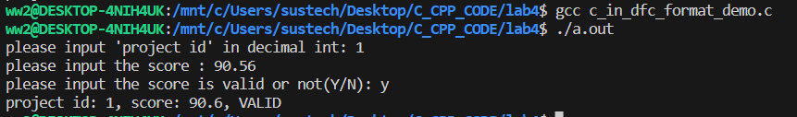
2.2.1 C style function about Standard Input processing
1-2. C: scanf
%d ----int
%f ----float
%c -----char
%s -----string
#include <stdio.h>
int main(){
int prj_id=0;
float prj_sc=0.0f;
char valid=0;
printf("please input 'project id' in decimal int: ");
scanf("%d", &prj_id);
printf("please input the score : ");
scanf("%f", &prj_sc);
printf("please input the score is valid or not(Y/N): ");
while (getchar() != '\n');
scanf("%c", &valid);
printf("project id: %d, score: %.1f, %s\n",
prj_id, prj_sc, (valid=='y'||valid=='Y')?"VALID":"NOT VALIDE" );
return 0;
}
There is &
Tips:
When using scanf ("% d") or scanf ("% f") to read values, scanf skips leading whitespace characters (spaces, line breaks, etc.), but does not consume line breaks in the input stream (i.e., those generated by pressing enter).

Slide 21
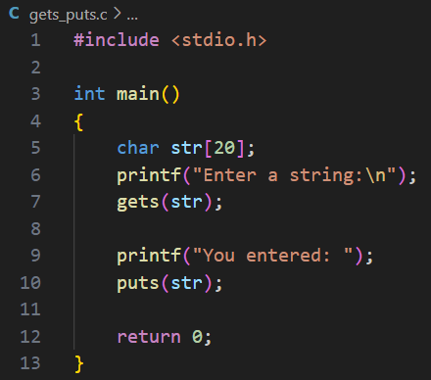
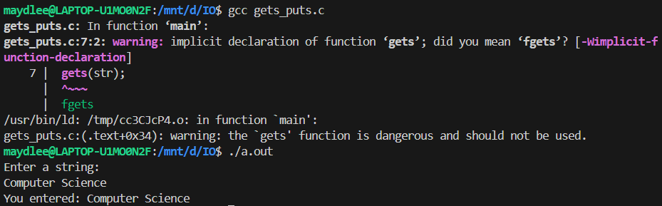
2.2.1 C style function about Standard Input processing
2. C: gets
There is a warning due to using gets().
You can use fgets() function instead.
Use gets to gain a sentence with a space. gets() stops reading input when it encounters a newline or end of file.

Slide 22
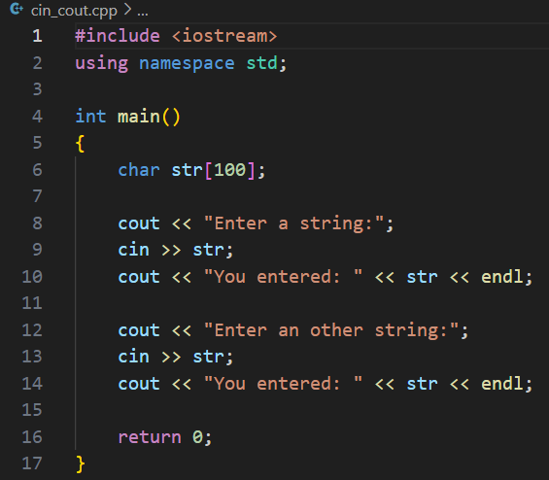


2.2.2 C++ style method about Standard Input processing
1. C++: cin
The cin is to use whitespace-- spaces, tabs, and newlines to separate a string.

Slide 23
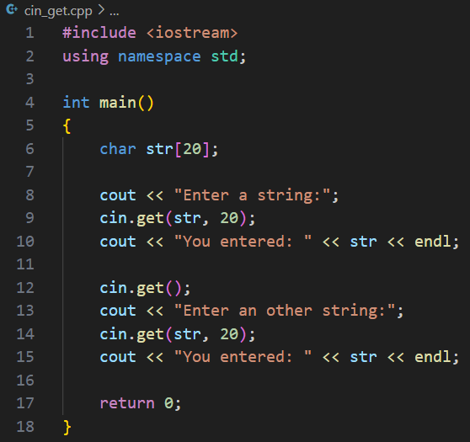


2.2.2 C++ style method about Standard Input processing
2. C++: cin.get( )
Input a single character:
istream& get(char&);
int get(void);
Input a string:
istream& get(char*,int);
If the statement is omitted, what will be the output?
If the length of input string is greater than 20,
it can only store first 19 characters in it.

Slide 24
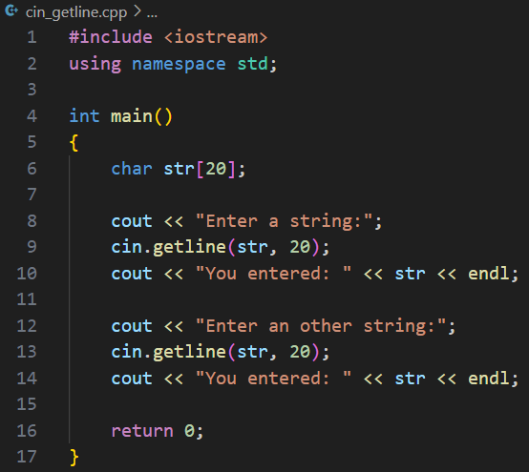

2.2.2 C++ style method about Standard Input processing
3. C++: cin.getline( )
Input a string:
istream& getline(char*,int);
If the length of input string is greater than 20,
it can only store first 19 characters in it.

Slide 25
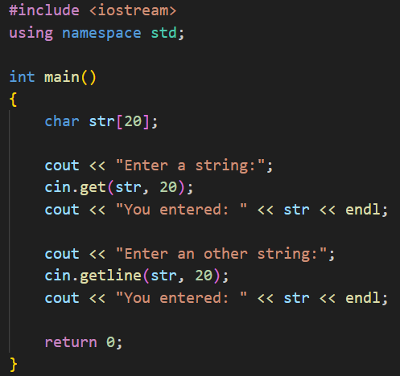

2.2.2 C++ style method about Standard Input processing
4. C++:
cin.get( ) vs cin.getline( )
getline() and get() both read an entire input line—that is, up until a newline character.
However, getline() discard the newline character, whereas get() leave it in the input queue.
Program runs
without entering
another string

Slide 26
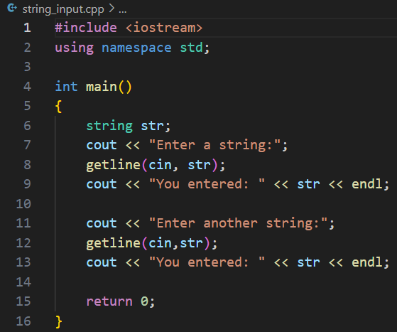

2.2.2 C++ style method about Standard Input processing
5. C++: string class I/O
getline() function takes the input
stream as the first parameter which
is cin and str as the location of the
line to be stored.

Slide 27
2. Data storage
2.1.Data storage on construction type
array:
One dimensional array and two-dimensional array
string:
char array vs string
struct:
align
union:
share
2.2. Data storage details
big-endian vs small-endian
Network byte order, system byte order

Slide 28
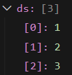
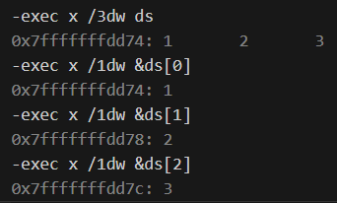
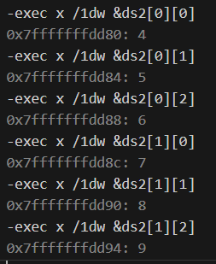
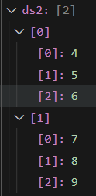
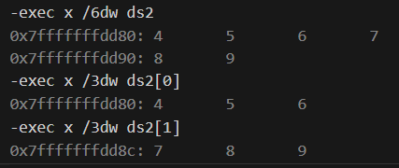
2.1 Data storage-array
command executed in gdb
int main(){
int ds[ ]={1,2,3 };
int ds2 [2] [3]= {
{4,5,6}, {7,8,9}
};
return 0;
}
staring address: data(s)
starting address
data(s)
using ‘x’ command in gdb to examine the data storage details
1)address: starting from the position specified by the subsequent parameters
2) datas: for example, option “/3dw” here means show the data stored in the space of 3 consecutive words starting from the address in decimal.

Slide 29
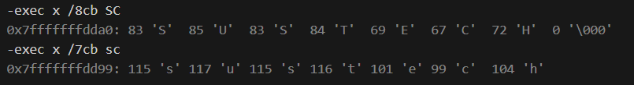
2.1 Data storage: char-array vs string
int main(){
char SC[ ]="SUSTECH";
char sc[ ]= {'s','u','s','t','e','c','h'};
printf("size of SC: %ld bytes, sc: %ld\n",sizeof(SC), sizeof(sc));
return 0;
}
The string terminator character(\000, value 0) is automatically included at the end of the string, but there is no such automatic operation in character arrays

Slide 30

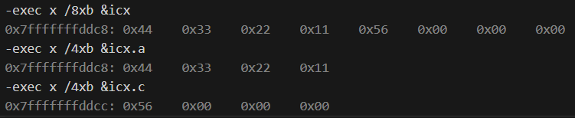
2.1 Data storage: struct
#include<stdio.h>
struct data{
int a;
char c;
};
int main(){
struct data icx;
icx.a = 0x11223344;
icx.c = 0x56;
printf("size of icx: %ld\n",sizeof(icx));
printf("size of icx.a: %ld, icx.a=0x%x\n",sizeof(icx.a),icx.a);
printf("size of icx.c: %ld, icx.c=0x%x\n",sizeof(icx.c),icx.c);
return 0;
}
Each member in the struct occupies exclusive space and is filled with necessary padding to achieve alignment.

Slide 31

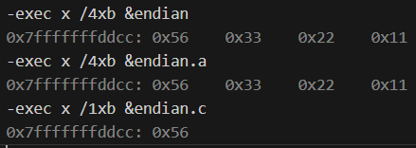
2.2 Data storage: union
#include<stdio.h>
union data
{
int a;
char c;
};
int main()
{
union data endian;
endian.a = 0x11223344;
endian.c = 0x56;
printf("size of endian: %ld\n",sizeof(endian));
printf("size of endian.a: %ld,endian.a=0x%x\n",sizeof(endian.a),endian.a);
printf("size of endian.c: %ld,endian.c=0x%x\n",sizeof(endian.c),endian.c);
return 0;
}
All members in the union share the same space.

Slide 32
2.2 Data storage details ： Big-Endian and Little-Endian(1)
BE stores the big-end first, the lowest memory address is the biggest.
LE stores the little-end first, the lowest memory address is the littlest.
#include<stdio.h>
union data
{
int a;
char c;
};
int main()
{
union data endian;
endian.a = 0x11223344;
if(endian.c == 0x11)
printf("Big-Endian\n");
else if(endian.c == 0x44)
printf("Little-Endian\n");
return 0;
}
Big-Endian
2003
44
2002
33
Q: Run the demo on your system, is your system Big-Endian or Little-Endian?
2001
22
2000
11
Little-Endian
2003
11
2002
22
2001
33
2000
44

Slide 33
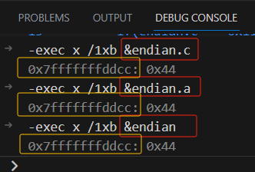
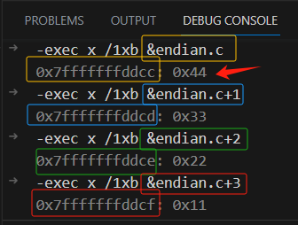
2.2 Data storage details ： Big-Endian and Little-Endian(1)
#include<stdio.h>
union data
{
int a;
char c;
};
int main()
{
union data endian;
endian.a = 0x11223344;
if(endian.c == 0x11)
printf("Big-Endian\n");
else if(endian.c == 0x44)
printf("Little-Endian\n");
return 0;
}
Q: Using the command x (for “examine”) to examine memory while debug the executable file(generated by gcc -g option) , if the address of the memory unit and the data stored in the memory unit are as shown in the following figure, is this system Big-Endian or Little-Endian?
address data
https://sourceware.org/gdb/current/onlinedocs/gdb.html/Memory.html#Memory

Slide 34
Please refer to the content of courseware p14-p15 to generate a makefile using cmake tool and CMakeLists.txt, run the makefile to generate an executable file, and then run the executable file. NOTES: all the source files are in ./src , all the head files are in ./inc, all the build files are in ./build.
Exercise 1

Slide 35
Exercise 2
First, complete the code, then run the program, explain the result and answer the following question to SA. If it has bugs, fix them.
Q. It is asked to get the the number of characters in ‘dirction’(which should be 4) by using strlen without changing the size of the ‘dirction’ array, one option is to add a piece of code between the definitions on “dirction” and “title”:
A. char x = ‘ ’; //a spce in ‘’
B. char x= 0;
C. char x=’\0’
D. char xs[]=“ ” // a space in “”
E. other method
#include <iostream>
#include <string.h>
using namespace std;
int main()
{
int cards[4]{};
int hands[4];
int price[] = {2.8,3.7,5,9,’C’, “D”};
char direction[4] {'L',82,'U',68};
char title[] = "DeepSeek is an awesome tool.";
cout << "sizeof(cards) = " << sizeof(cards) << ",sizeof of cards[0] = " << sizeof(cards[0]) << endl;
cout << "sizeof(price) = " << sizeof(price) << ",sizeof of price[0] = " << sizeof(price[0]) << endl;
cout << "sizeof(direction) = " << sizeof(direction) << ",length of direction = " << strlen(direction) << endl;
cout << "sizeof(title) = " << sizeof(title) << ",length of title = " << strlen(title) << endl;
return 0;
}

Slide 36
Exercise 3
#include <stdio.h> //p2_1.c
union data{
int n;
char ch;
short m;
};
int main()
{
union data a;
printf("%d, %d\n", sizeof(a), sizeof(union data) );
a.n = 0x40;
printf("%X, %c, %hX\n", a.n, a.ch, a.m);
a.ch = '9';
printf("%X, %c, %hX\n", a.n, a.ch, a.m);
a.m = 0x2059;
printf("%X, %c, %hX\n", a.n, a.ch, a.m);
a.n = 0x3E25AD54;
printf("%X, %c, %hX\n", a.n, a.ch, a.m);
return 0;
}
1. Run the program and explain the result to SA.
2. You can write a program to check whether you system is little-endian or big-endian or answer the following question:
Q. which demo(s)(p2_1.c or p2_2.c or both of them) is(are) suitable to judge the big-endian or little-endian?
#include <stdio.h> //p2_2.c
struct data{
int n;
char ch;
short m;
};
int main()
{
struct data a;
printf("%d, %d\n", sizeof(a), sizeof(struct data) );
a.n = 0x40;
printf("%X, %c, %hX\n", a.n, a.ch, a.m);
a.ch = '9';
printf("%X, %c, %hX\n", a.n, a.ch, a.m);
a.m = 0x2059;
printf("%X, %c, %hX\n", a.n, a.ch, a.m);
a.n = 0x3E25AD54;
printf("%X, %c, %hX\n", a.n, a.ch, a.m);
return 0;
}

Slide 37
Exercise 4
#include <iostream>
using namespace std;
enum Day{/*complete code here if needed*/};
enum Weather{/*complete code here if needed*/};
int main( /*complete code here if needed*/ ){
int d=0;
int w=0;
cout<<"input the Day value:
Monday(1), Tuesday(2), Wednesday(3), Thursday(4),
Friday(5), Saturday(6), Sunday(7)\n";
/*complete code here if needed*/
cout<<"This is"<</*complete code here if needed*/<<endl;
cout<<"input the Weather value: SUNNY(0), RAINY(1), CLOUDY(2), SNOWNY(3)\n";
/*complete code here if needed*/
cout<<"The weather is: "<< /*complete code here if needed*/;
if(/*complete code here if needed*/) cout<<"can Travel\n";
else cout<<"not suitable for travelling\n";
return 0;
}
Complete the code on the right hand:
1) Design two enumeration types. The first is an enum “Day” for (Monday, Tuesday, Wednesday, Thursday, Friday, Saturday, Sunday), and the second is an enum “Weather” for (SUNNY, RAINY, CLOUDY, SNOWNY).
2) Complete the main function, which ask user to input the day value and the weather value accoding to the notice information, if the day is at weekend and the weather is SUNNY, pring out “can Travel”, else print out “not suitable for travelling”.
The testing result is as shown on the next page.

Slide 38
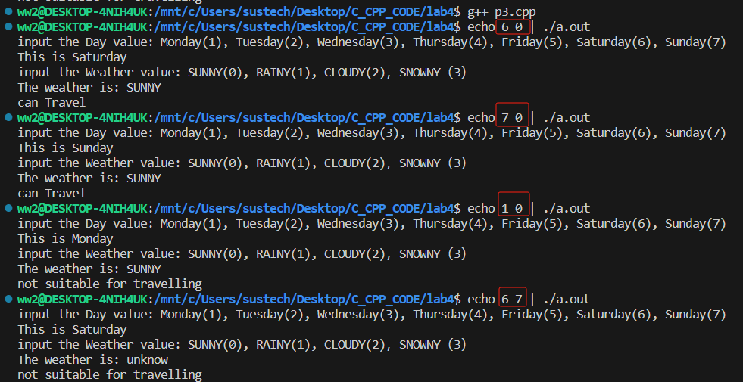
Exercise 4
#include <iostream>
using namespace std;
enum Day{/*complete code here if needed*/};
enum Weather{/*complete code here if needed*/};
int main( /*complete code here if needed*/ ){
int d=0;
int w=0;
cout<<"input the Day value:
Monday(1), Tuesday(2), Wednesday(3), Thursday(4),
Friday(5), Saturday(6), Sunday(7)\n";
/*complete code here if needed*/
cout<<"This is"<</*complete code here if needed*/<<endl;
cout<<"input the Weather value: SUNNY(0), RAINY(1), CLOUDY(2), SNOWNY(3)\n";
/*complete code here if needed*/
cout<<"The weather is: "<< /*complete code here if needed*/;
if(/*complete code here if needed*/)
cout<<"can Travel\n";
else cout<<"not suitable for travelling\n";
return 0;
}

