Slide 1
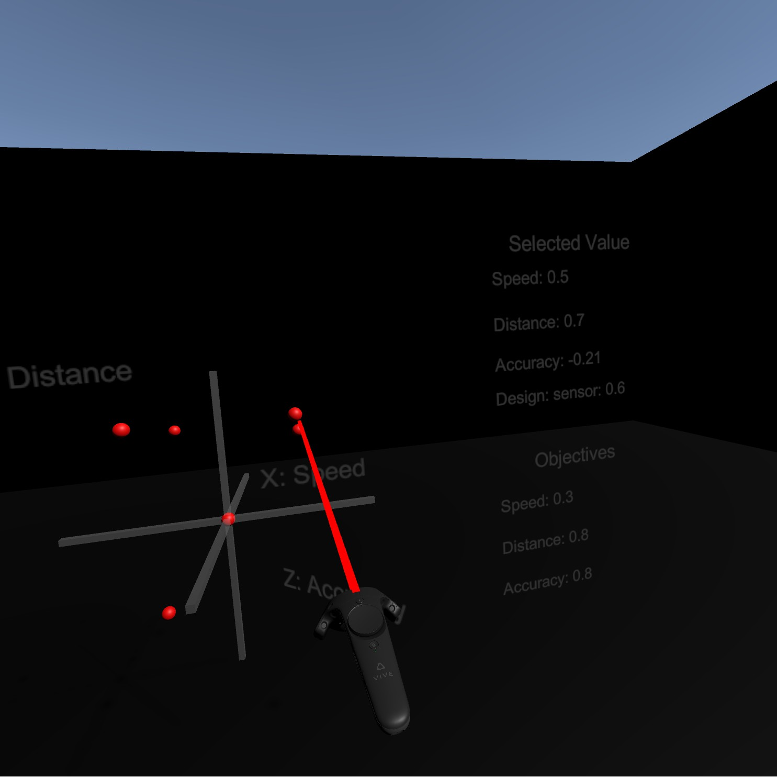
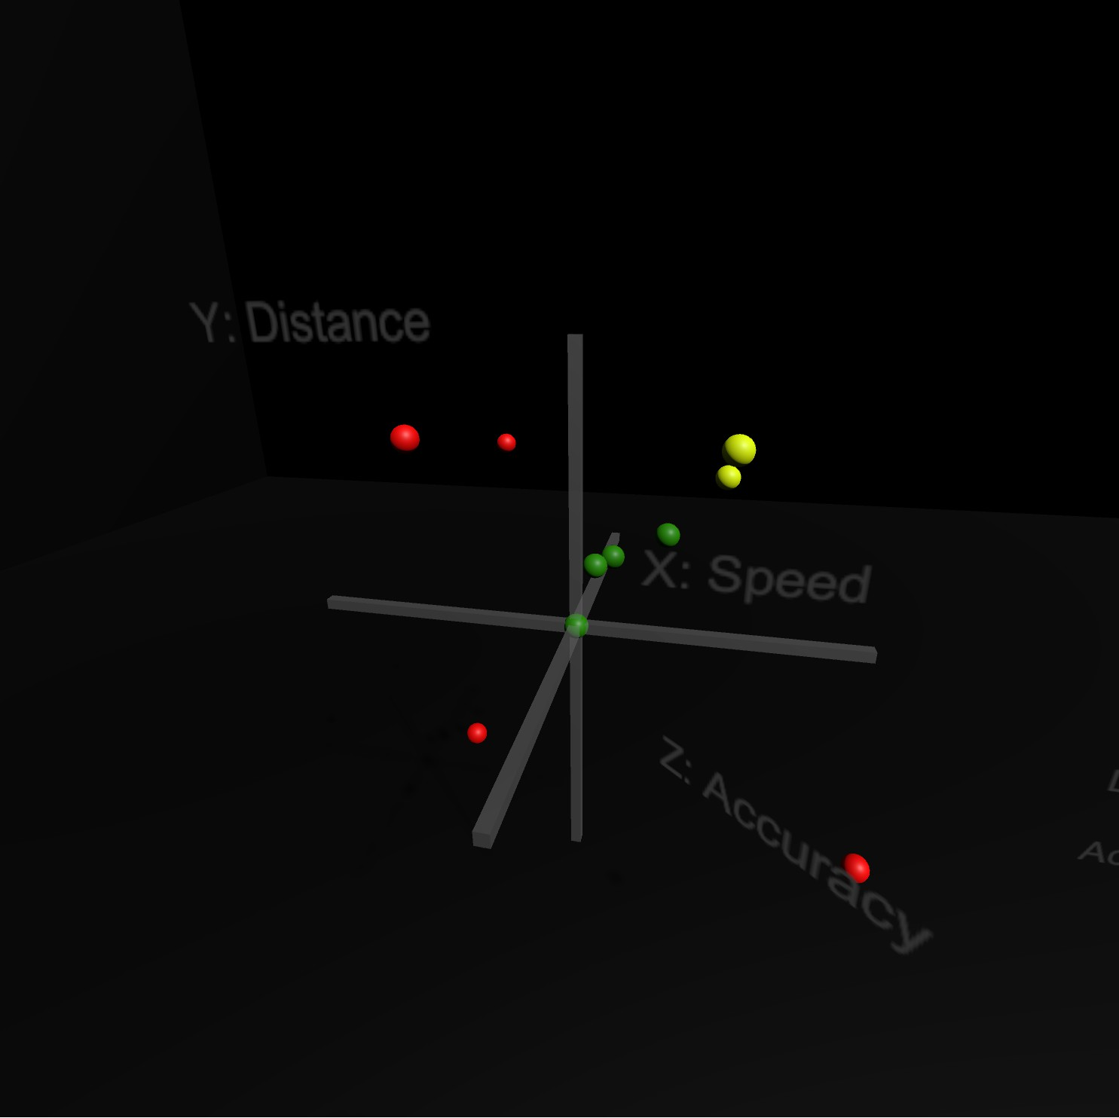
Using Virtual Reality to Visualise Design Space Exploration (DSE) of Cyber Physical Systems’ (CPS) Co-Models
Aims & Objectives
Aim Illustrate the results of DSE of CPS through visualisations using VR equipment.
Objectives:
Review and work around the risks and limitations of data representation with VR equipment
Illustrate the multidimensional Cyber Physical DSE in 3D graphs using VR hardware
Illustrate the effects of changing Cyber Physical DSE objectives using motion controls in a VR environment on three-dimensional graphs.
Allow the user to switch to different sets of dimensions in the design space dimensions through VR motion controls
Motivation
Research and Analysis
DSE is a technique that is used to analyse complex and models like Co-Models. DSE systematically explores potential designs to see which design meet objectives. However, this exploration cancan make interpreting its results difficult by individuals that study CPS due to sheer number of designs.
An interview conducted with a INTO-CPS user (A co-simulation tool with DSE) to collect data. The interview has shown that INTO-CPS users find selection and 3D axis important. Moreover, research conducted on 3D VR data representation has shown that VR can help make understanding data easier times (Ware & Franck, 1994, p. 183).
Purposed Solution
Implementation and Tools
Since VR has shown that it helps user understand data more easily and that DSE tools users prefer 3D representation, a 3D VR environment was purposed. A 3D environment with be constructed and to be interacted with using VR hardware for selection and interaction.
To implement the solution, the Unity engine was chosen for its popularity in VR (Unity, 2018). A Unity Scene was constructed to be the VR environment. Moreover, SteamVR assets were added to allow the Unity C# scripts to communicate with HTC Vive VR hardware. Results would be read from .json and .csv files from INTO-CPS.
Core Features
3D VR Environment with Motion Controlled Selection: The user is presented with a 3D environment with a motion interactable graphical display of the designs. A 3D graph is presented to the user based on provided data and can be selected to be read via the controller (as seen in Fig 1).
INTO-CPS Compatibility: Results are read directly from output produced from the INTO-CPS toolset, taking the various parameters, rankings and variables into account. This allow objectives (Fig 1) to be read and Pareto analysis to be done.
Pareto Display: Results can be presented with their Pareto ranking for analysis purposes of best designs. As shown in figure 2, the solutions are coloured from best (green) to worst (red) based on how well the achieve the objectives.
Other Additions: More DSE controls (backtracking) and axis controls (inversion). Moreover, Objective manipulation and its effects on the data. Lastly, additional forms of data representation (bar charts) were considered.
Future work: Addition of 3D simulations to the VR Environment and Interactive DSE pruning of designs. Lastly, more integration with the physical (e.g. 20-sim) and cyber (e.g. Overture) models.
Fig 1
Fig 2
References: 1-Unity (2018) Unity for VR and AR. 2018. Available at: https://unity3d.com/unity/features/multiplatform/vr-ar. (Accessed: 30 March 2018).
2- Ware, C., & Franck, G. (1994). Viewing a graph in a virtual reality display is three times as good as a 2D diagram. IEEE Symposium on Visual Languages, Proceedings, 182-183.
a

